Slide 1
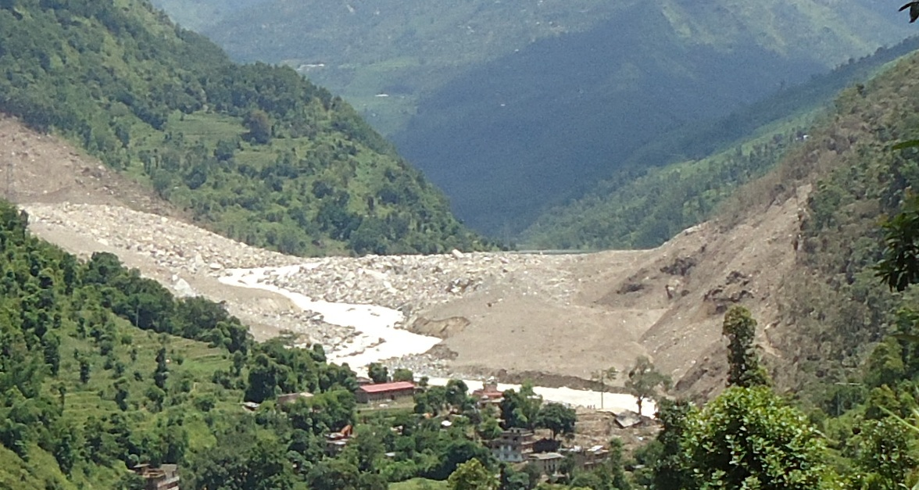
Valley Blocking Sunkoshi Landslide in Mankha, Tekanpur VDCs and its implications
Er. Shital Babu Regmee

Slide 2
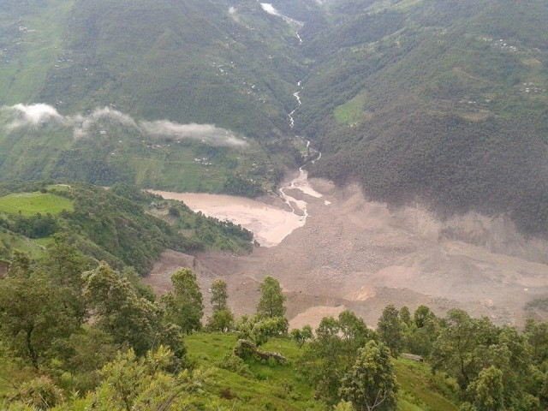
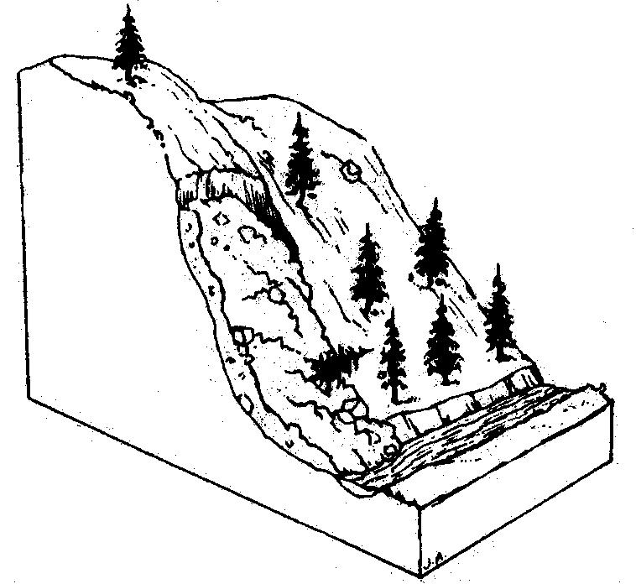
Introduction
A very large landslide blocked the Sunkoshi River near Jure village in Mankha VDC in Sindhupalchowk district of Nepal
swept away settlements
blocked Sunkoshi river.
Massive Kanlay hill crumbled to the ground on August 2 killing more than 156 people.

Slide 3
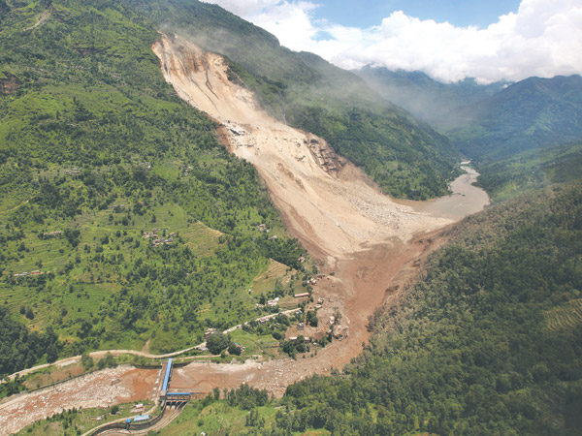
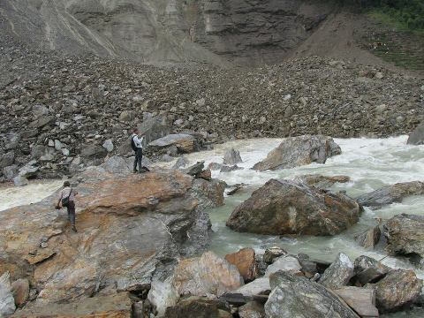
…..Introduction
Dam geometry
Crest height :52.5m
Lake volume: of 7.4 million cubic meter.
Displaced volume:1.5 million cubic meter
Dam base width: 350m
length: 400m
Volume: 1.1 MCM
Location of the slide: 83km to 84 km along Araniko highway.

Slide 4
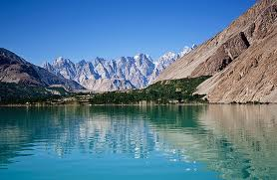
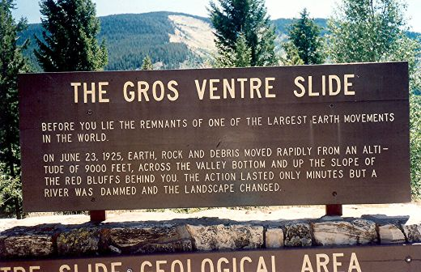
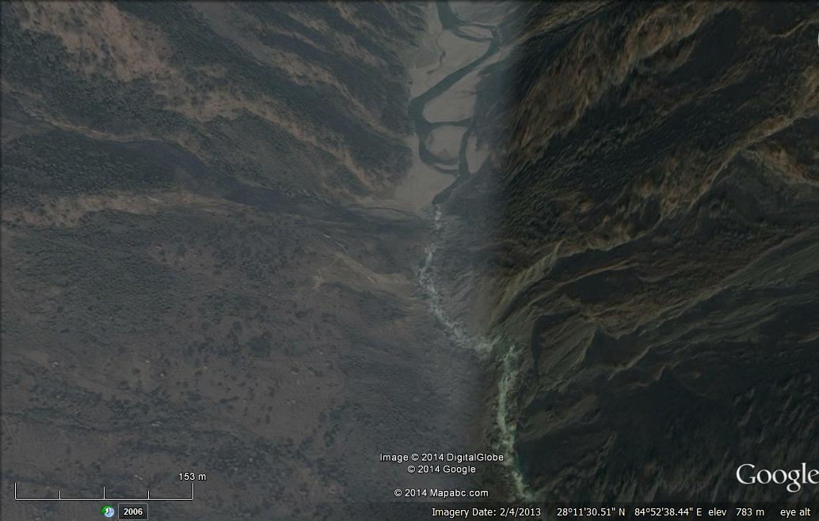
History
Six decades ago same hill had toppled down
Other Dams
Usoi Dam in Tajikastan
Lake Waikaremoana in New Zealand
Attabad Lake in Pakistan
Budhi Gandaki in Nepal

Slide 5
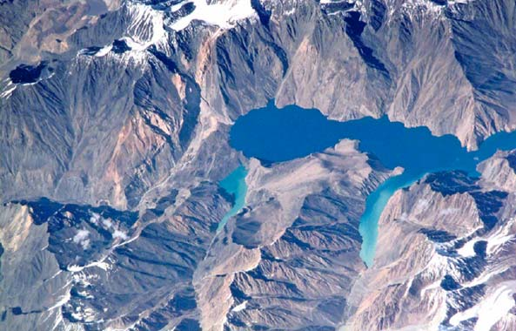
Usoi Dam in Tajikastan Lake Sarez

Slide 6
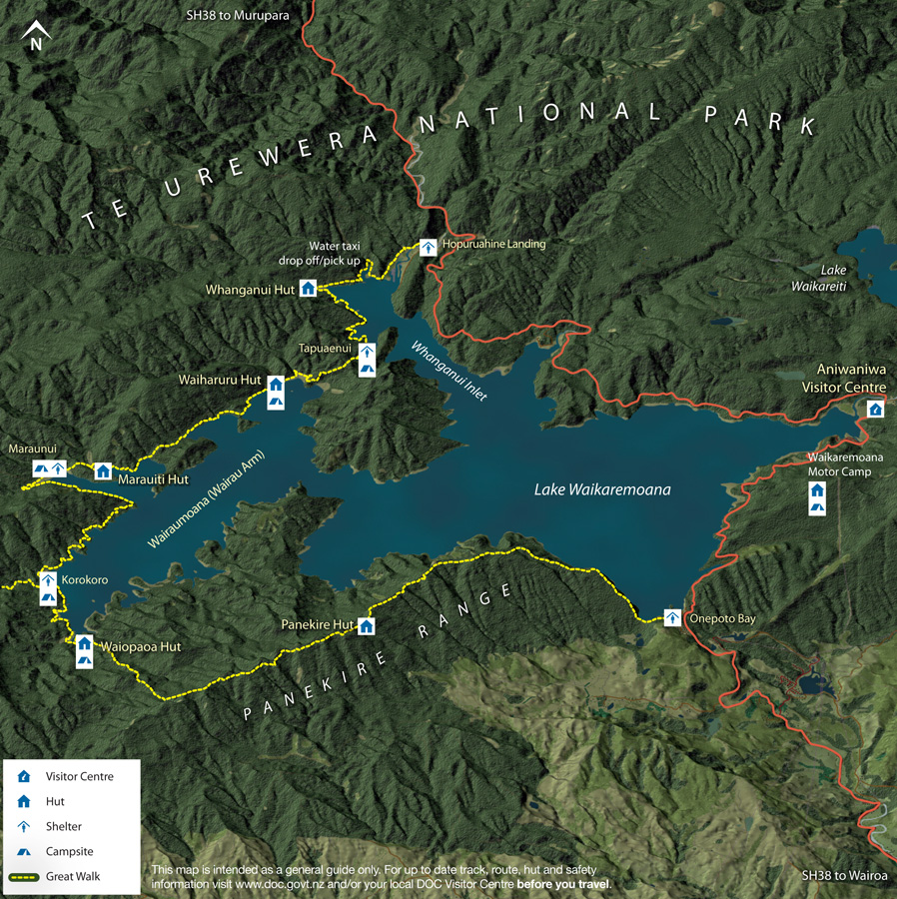
Lake Waikaremoana in New Zealand

Slide 7
Life of Landslide Dams

Slide 8
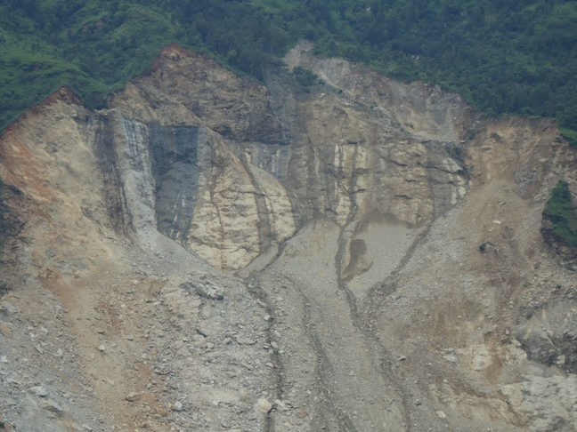
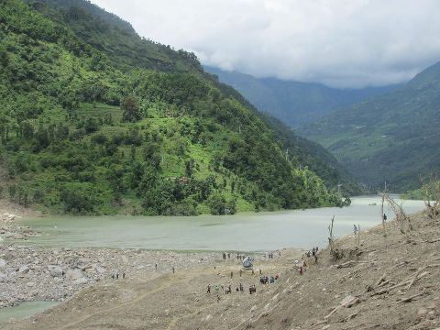
Circumstances of collapse
Complex Phenomenon
Old landslide area
Wet, saturated
creeping
undercutting by river
Land mass from as high as half kilometer fell on the riverbed
moved up to 200 meter above the river on the left side.
Mud slurry leaf about 500m above the river bed

Slide 9
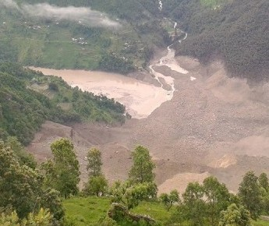
Will the dam break?
The dam at present looks sturdy
conclusive judgment only after:
Detailed study of the vulnerability of the area,
Probability of extreme floods,
Behavior of river downstream of the dam,
Composition of dam and river bed material,
Upstream and downstream slopes of the dam,
Probability of further landslide,
Urgency of opening road,
Concern of the affected people etc

Slide 10
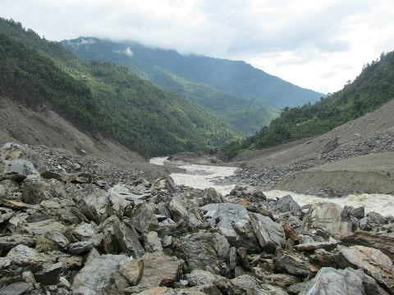
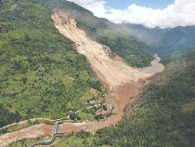
Future course of action
Normal
Outflow of about 300 cms should be maintained.
High runoff
If only one outlet is maintained and the discharge is within 500 cms it can pass safely through Sunkoshi Dam and downstream areas.
Extreme condition
Extreme case may occur, but most unlikely
flood fighting, rescue and relief activities and information dissemination

Slide 11
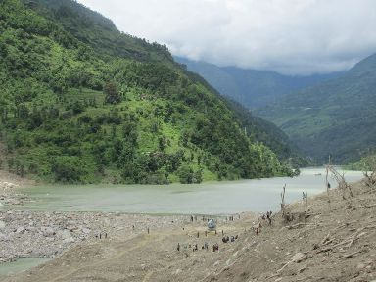
Consequences
Very difficult to drain all accumulated water upstream of the dam.
Downstream of the dam: normal situation will, most likely, prevail.

Slide 12
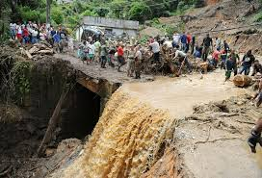
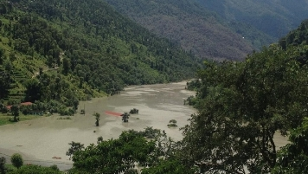
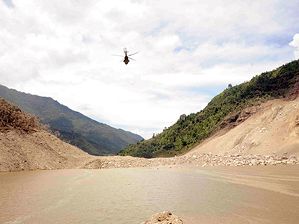
Recommendations
Drain out water from the spillway safely. Increase the capacity of spillway to outflow 300 cms. Deepen it as and when necessary by blasting or using heavy equipments.
Maintain only one spillway on the right side of the river.
Be prepared for rescue and relief in case of extreme events.
Maintain information flow along the river course.

Slide 13
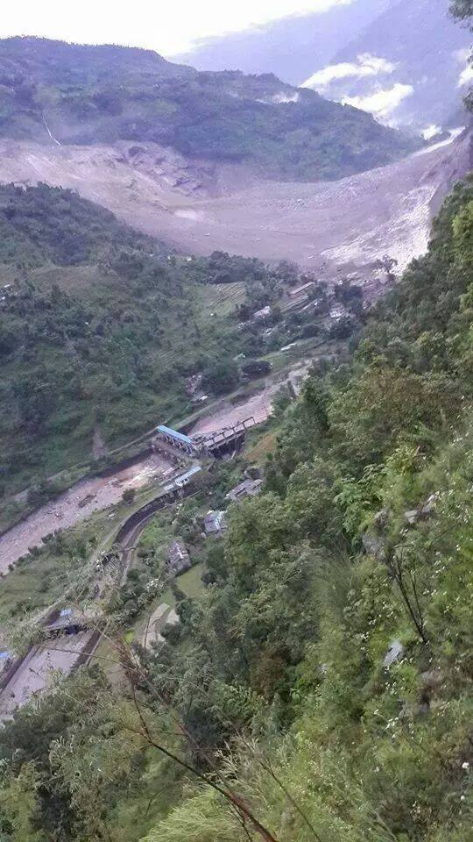
… recommendations
The effect d/s of Chatara will be minimal even for extreme case. Panic need not be created on behalf of Sunkoshi landslide dam.
A consultative decision should be taken for the lowering of water level in the upstream pond.
Take necessary help from China or India and share expertise.

Slide 14
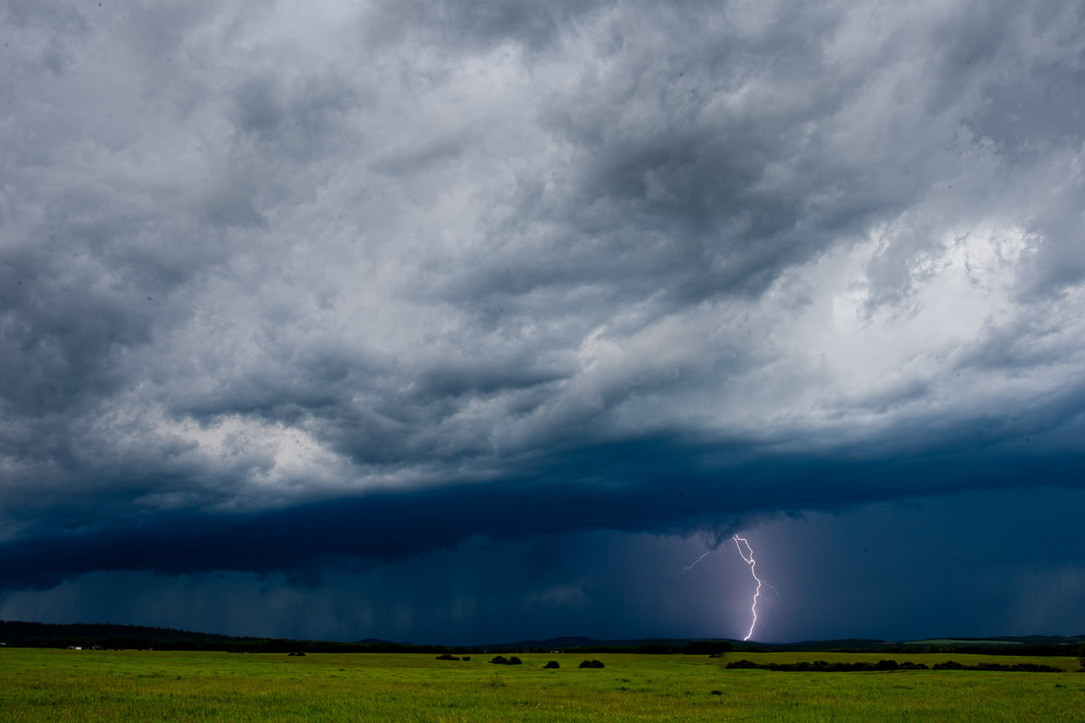
THANK YOU

