Slide 1
United Nations
Development Program
Debris Management Project in partnership with MoFALD

Slide 2
Project Objectives
1. Immediate Disaster Recovery
a. Supporting communities through Cash for Work and Debris Management
2. Capacity Building
a. International experts training UNV Engineers through Debris Management
b. Empowerment of local communities
3. Debris Management and Demolition
Public and private safety through demolition of hazardous structures
4. Facilitation of Reconstruction
Reconstruction can begin only after demolition
5. M&E Innovation - Cross Sector Coordination
Enhancing Monitoring and Evaluation through the Microsoft application
UNDP Debris Project

Slide 3
PHASE 1
1. Private and public buildings
2. Stone masonry buildings
3. Labor intensive demolition
PHASE 2
Public/Community buildings
RCC/Masonry buildings
Labor cum Mechanical demolition
UNDP Debris Project

Slide 4
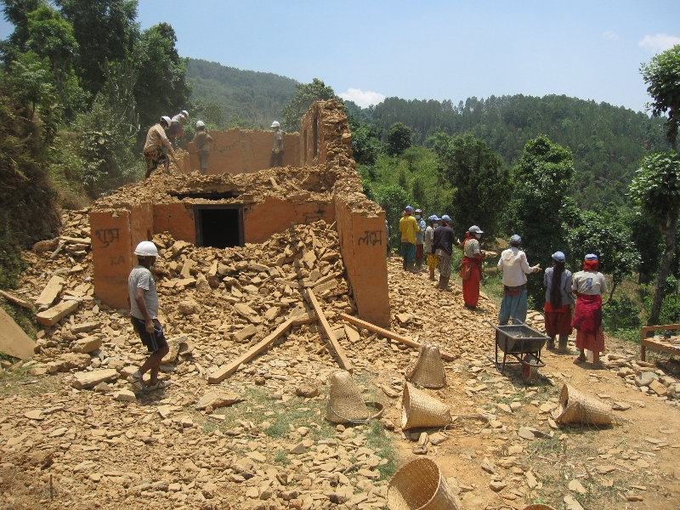
UNDP Cash for work brigade working in Irkhu
UNDP Debris Project

Slide 5
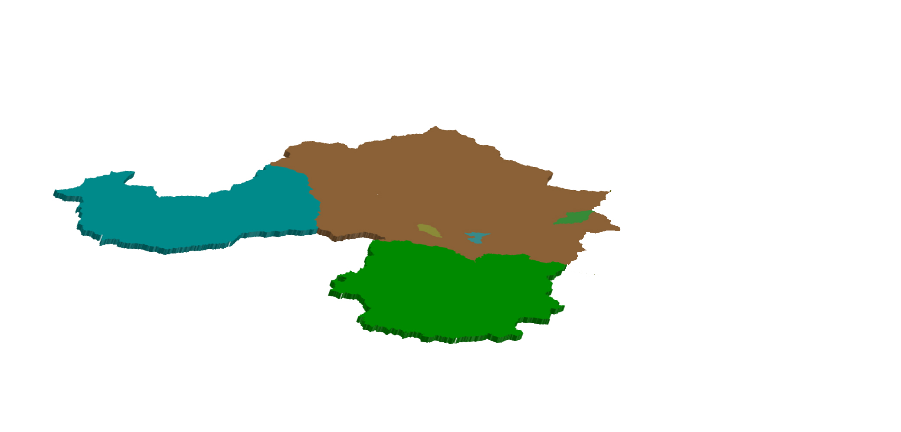
Program results to date
Phase - I
901 CFW Participants
1050 CFW Participants
952 CFW Participants
45% Female Participation
45% Female Participation
37% Female Participation
1148 Rural Homes Assessed
1152 Rural Homes Assessed
1066 Rural Homes Assessed
674 Demolition Completed
1152 Demolition Completed
562 Demolition Completed
32,517 m³ of Debris
71,361 m³ of Debris
37,510 m³ of Debris
Kunchowk
Irkhu
Karthali
Phase - II
192 CFW Participants
83 Buildings Assessed
151 CFW Participants
65 Female Participant
86 Female Participant
245 Buildings Assessed
119 Buildings Assessed
32 Completed
13 Completed
m³ of Debris
2466.69 m³ of Debris
Sindhupalchowk
Kavrepalnchowk
Nuwakot
UNDP Debris Project

Slide 6
`
Immediate disaster recovery
People
Results
`
`
2961
Local people employed
2,300,000USD
Total Payments
2433
Total demolitions
45%
Female participation
445,523USD
Payments to Women
1246
Women empowered
`
Livelihoods
UNDP Debris Project

Slide 7
`cv
Capacity building
People
Results
`
`
80
Nepalese UNV Engineers
328,000USD
Total Payments
2433
Total demolitions
100%
UNV Engineers trained
80
Nepalese Engineers
Empowered
18,500
Invested in training
`cv
Livelihoods
UNDP Debris Project

Slide 8
Engineers orientation and training program
UNDP Debris Project

Slide 9
`cv
Debris Management and Demolition
Houses
Debris
`
`
2,300,000USDProject cost to date
2433
Structures Demolished
3730
Structures Assessed
65%
Complete
141,000
Cubic Meters of Debris
From demolition
18USD /m3
`cv
DRR
UNDP Debris Project

Slide 10
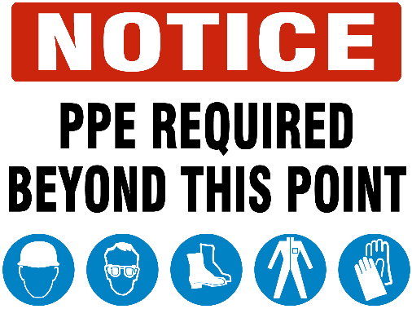
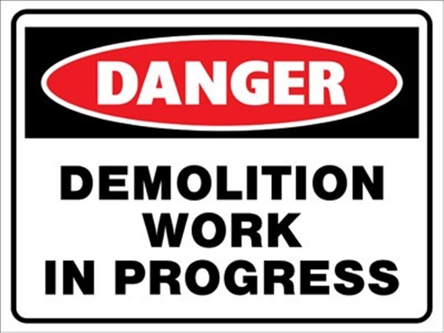
Approach
UNDP Debris Project

Slide 11
District Forest office Before and after

Slide 12
Managed debris stacked on site
`cv
UNDP Debris Project

Slide 13
Facilitation of Reconstruction
UNDP Debris Project

Slide 14
`cv
Supporting sustainable reconstruction
54,000m² of open land area ready for reconstruction
Recycled Materials
10.2m USD
in construction
Material recovered
Sorted, stacked
And ready to be
Recycled and
Used to begin
Rebuilding homes
For those who
Lost theirs
27k m² CGI
81kUSD
77k m³ Stone
1.5mUSD
2433
Demolitions
23k m³ Timber
8.6mUSD
UNDP Debris Project

Slide 15
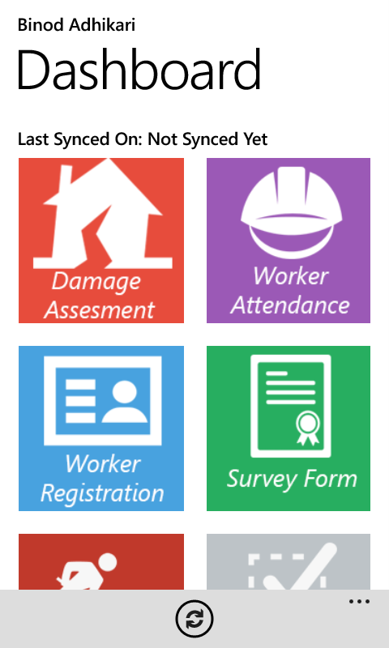
Innovations in Monitoring and Evaluation
Debris Management Program App
UNDP Debris Project

Slide 16
Why UNDP for Debris & Reconstruction?
Cash for work:
Invested funds stay in local communities
Immediate disaster relief in the Health sector
Support of likelihoods in local communities
Experience:
International Experts with years of combined experience in debris management, construction and disaster recovery
Capacity building:
UNV Engineer training and experience
UNDP Debris Project

Slide 17
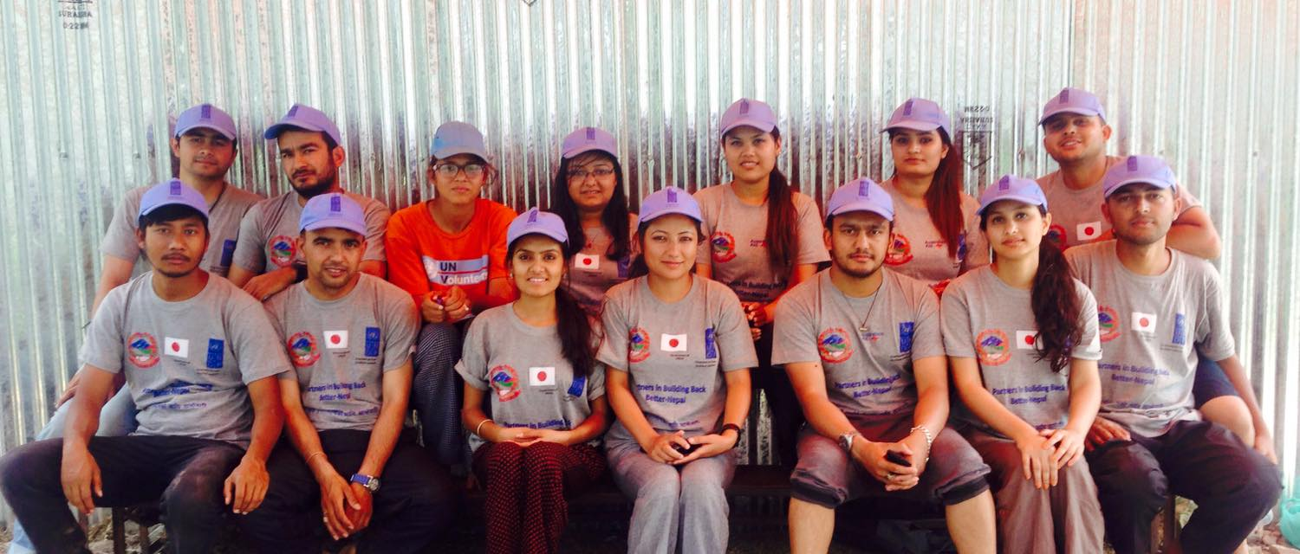
Significance of Debris Project
“Safe, proper and timely management of debris is a priority in the post disaster phase. It is important that disaster debris be managed so as to protect human health, reduce injuries and minimize or prevent adverse environmental impacts.”
~ Sunil Rai (UNV Engineer)
‘As a Civil Engineer, I think this is the most essential post-earthquake work which is a gateway to reconstruction.”
~ Suman Tiwari (UNV Engineer)
"I forget about scorching heat when I see those piled up stones and wood at end of the day. I feel so much happy and proud when I see whole village working like celebrating a new beginning.“
~ Luna Thapa(UNV Engineer)
“The wounds of earthquake, mental fear and psyche are not removed as long as they see the damaged house and rubbles around them. This is the main importance of demolition and debris management program.“
~AyushKuinkel(UNV Engineer)

Slide 18
Thank you
UNDP Debris Project

