Slide 1
earthquake song.mp4

Slide 2
Seismic Vulnerability Assessment of Existing Buildings and its Importance
Rekha Shrestha, PhD
Structural Engineer
Presentation in NEA-Nepal
7th April 2017
R
ReRekha Shrestha
National Engineer
UNDSS- Nepal
Presentation in SSAFE Training
8th March 2017

Slide 3
Seismic Vulnerability Assessment
Seismic Vulnerability is a measure of the seismic strength or capacity of the structure.

Slide 4
SOURCES OF DEFICIENCIES
1. Defects arising from the original design, such as under estimation of loads as per old standard/inadequate detailing
2. Defects arising from original construction, such as under strength concrete, poor compaction, poor construction joint, improper placing of reinforcement and honeycombing
3. Deterioration due to reinforcement corrosion, alkali-aggregate reaction etc

Slide 5
Level of Seismic Vulnerability Assessment
Nepal and Earthquake
Level-1
Rapid Visual Seismic Assessment (RVSA)
Level-2
Simplified Vulnerability Assessment (SVA)
Level-3
Detailed Vulnerability Assessment (DVA)

Slide 6
Rapid Visual Seismic Assessment (RVSA)
Nepal and Earthquake
For mass scale screening of existing buildings in the city
Limited to visual inspection and identification of potential seismic defects/deficiencies
Use of checklists

Slide 7
Simplified Vulnerability Assessment (SVA)
Site Inspection
Study of available drawings
As built drawing preparation (if not provided)
Simplified Calculations

Slide 8
Detailed Vulnerability Assessment
Visual inspection and study of available documents
Preparation of as built drawings
Detailed in-situ investigation of material strength, defects and deterioration
Modelling and analysis
Retrofitting design if required

Slide 9
Case studies

Slide 10
RSVA.docx

Slide 11
Pal1.docx

Slide 12
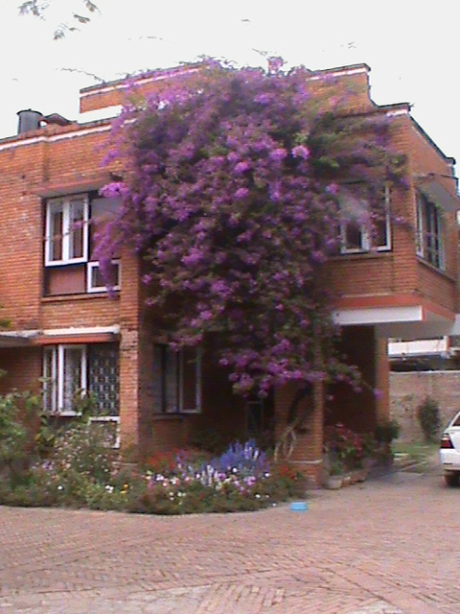
Rapid Seismic Vulnerability assessment of Residence of Load Bearing Wall System Building
Source: Rekha Shrestha

Slide 13
Kopundole bld.doc

Slide 14
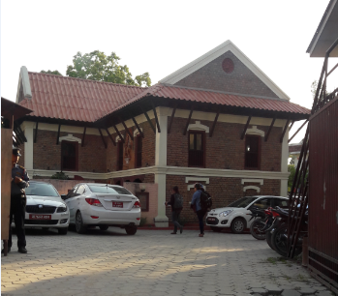

Slide 15
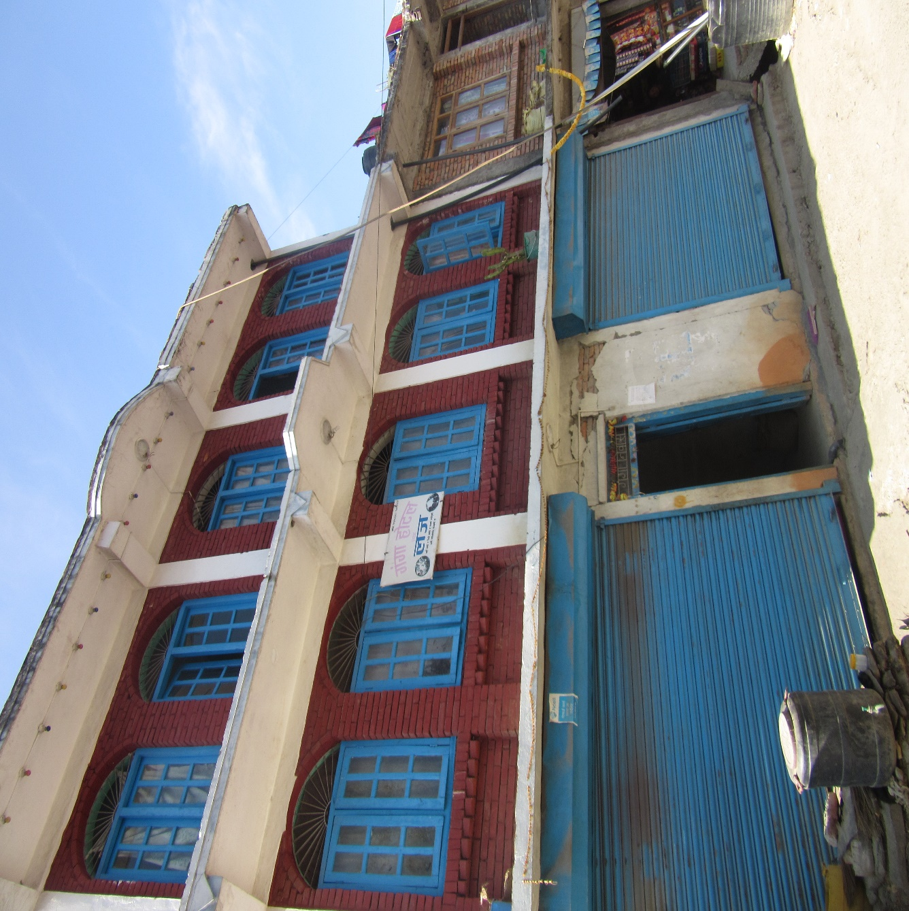
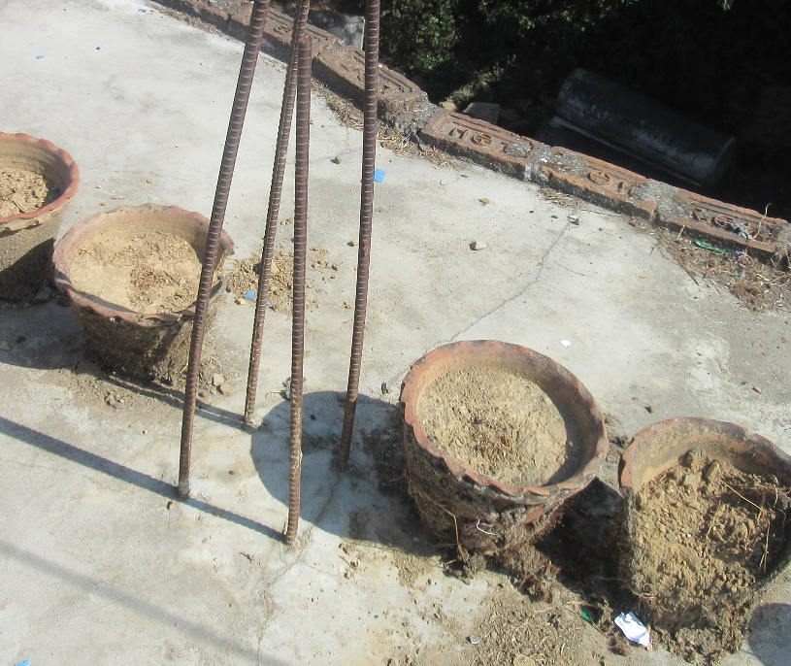
Source: Rekha Shrestha
8 Feb 2017

Slide 16
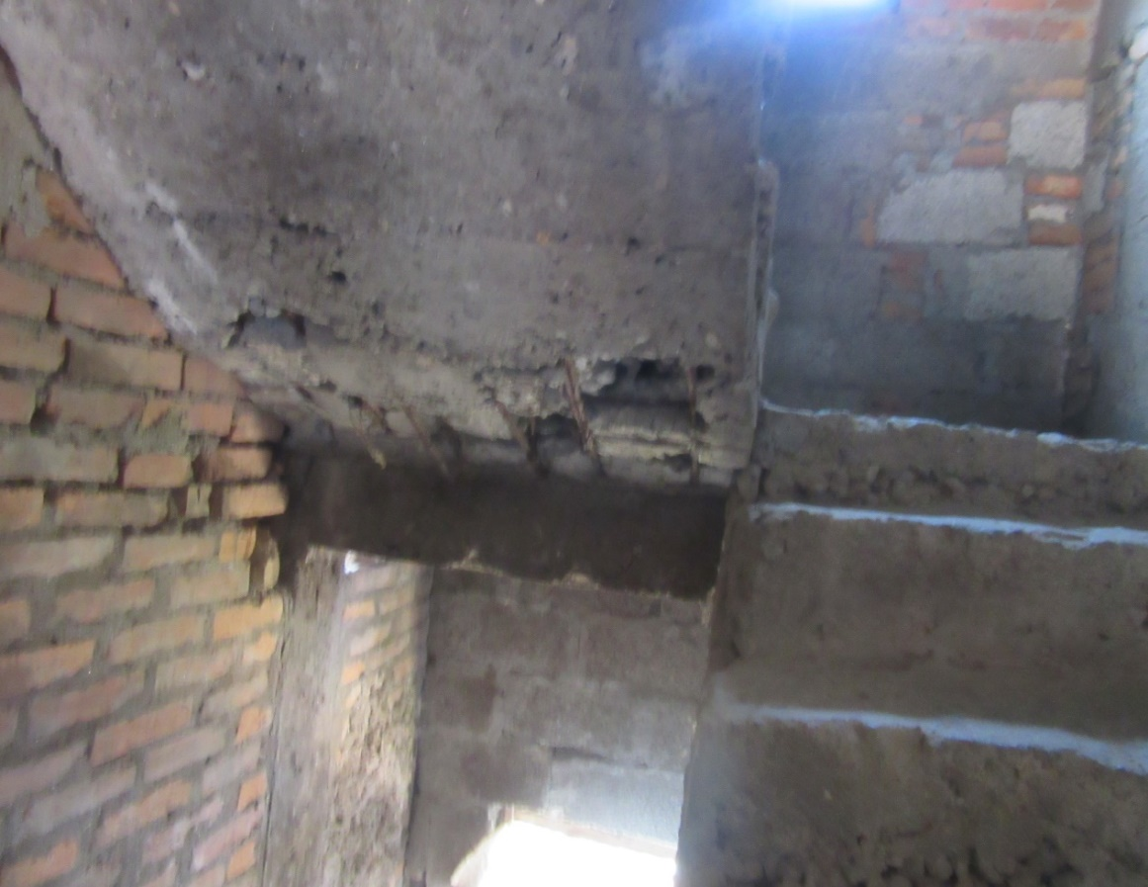
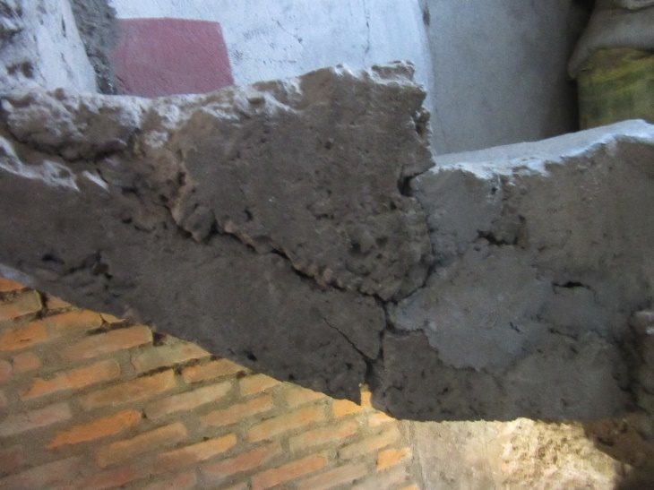
Source: Rekha Shrestha
8 Feb 2017

Slide 17
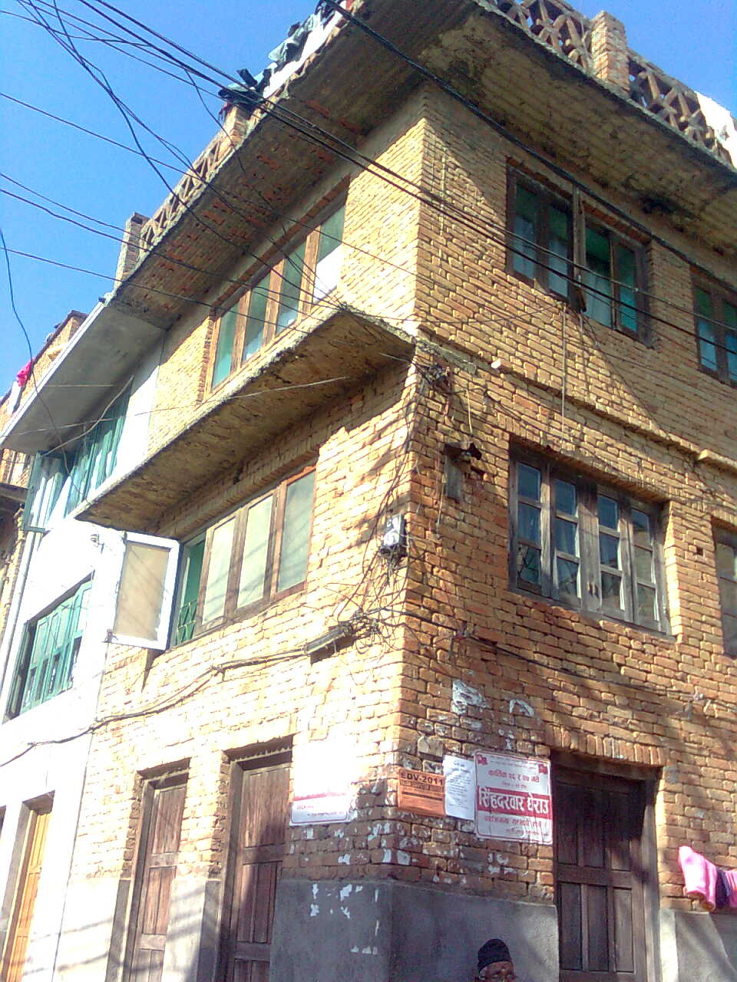
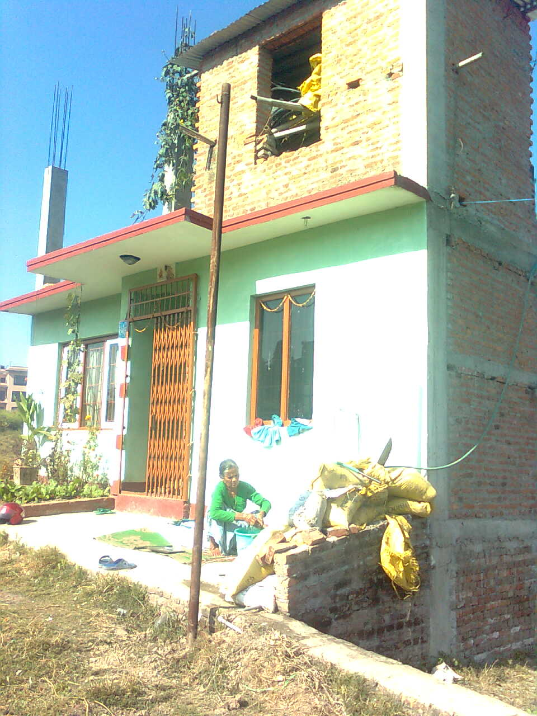
Source: Rekha Shrestha
8 Feb 2017

Slide 18
RSVA-99.doc

Slide 19
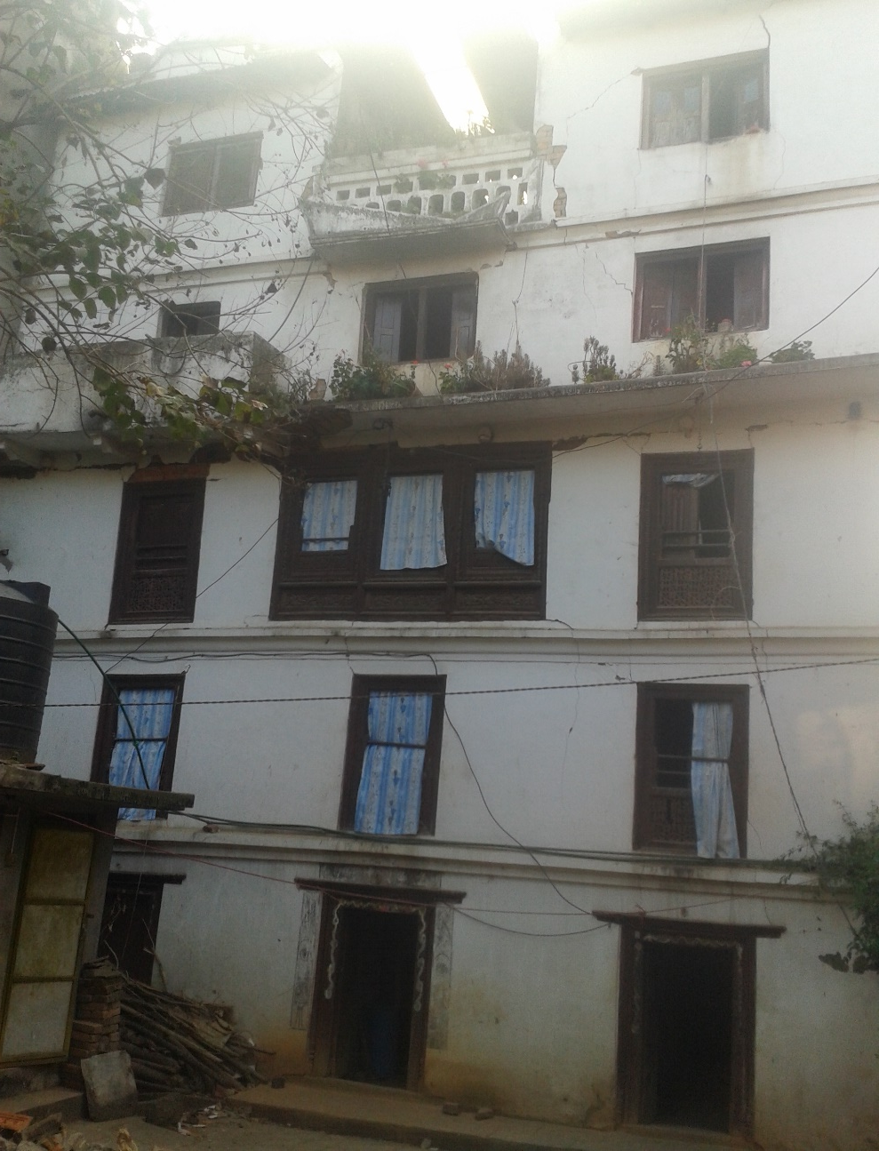
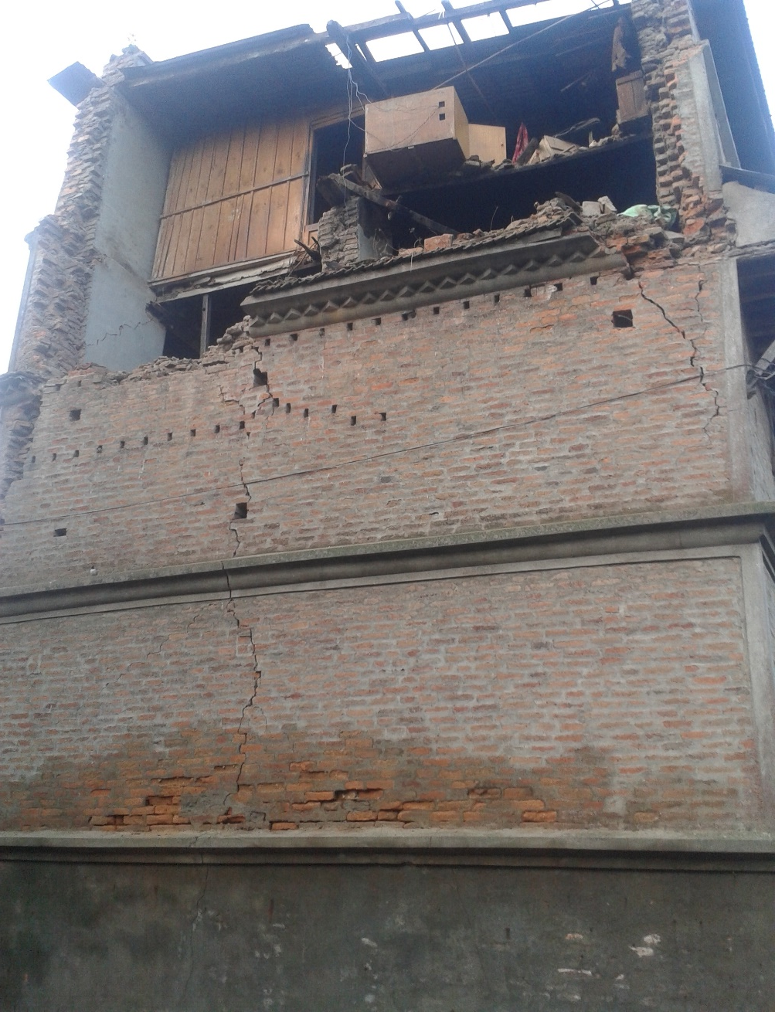
After Gorkha EQ 2015

Slide 20
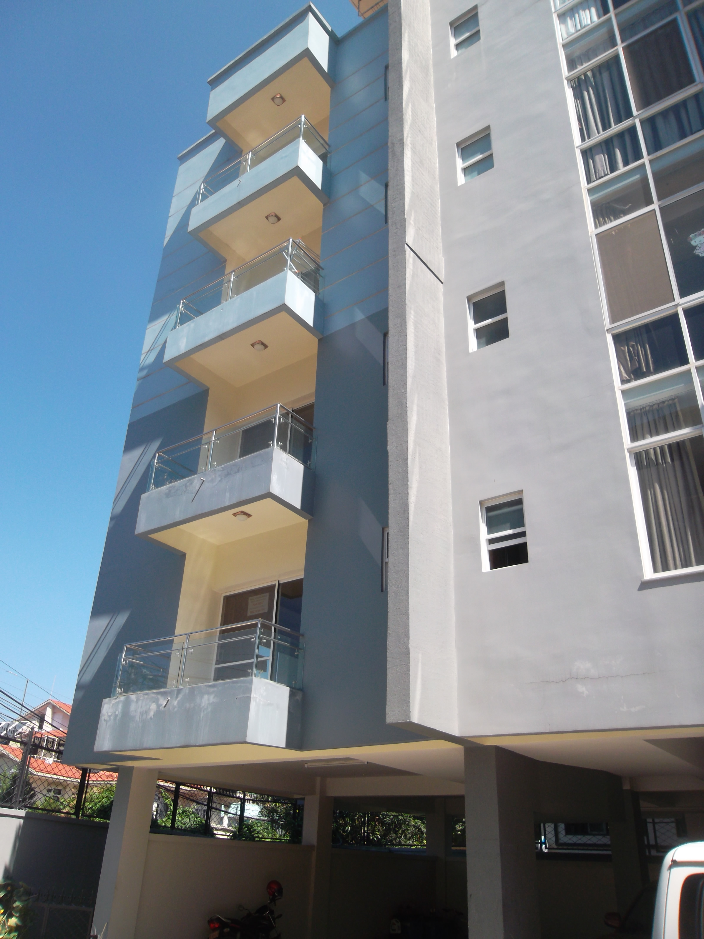
Source: Rekha Shrestha

Slide 21
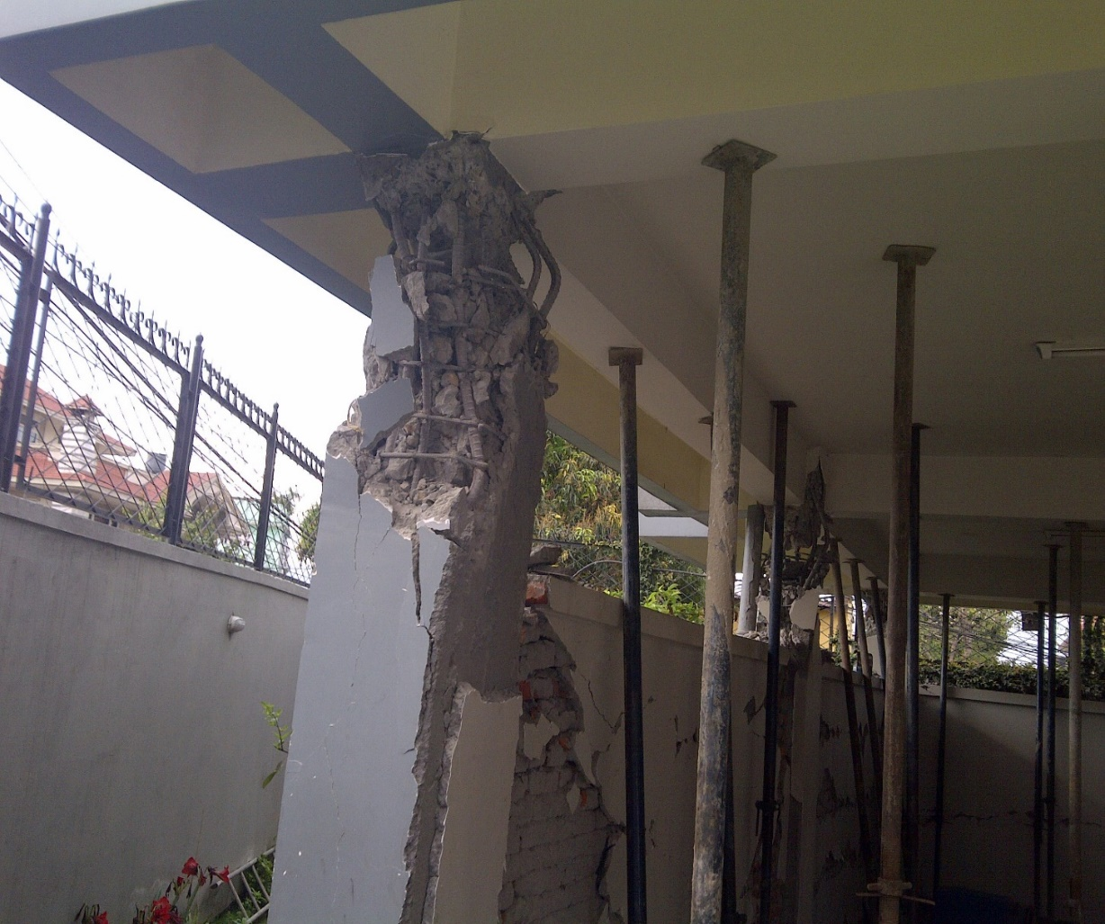
Damage Grade 4
Source: Rekha Shrestha

Slide 22
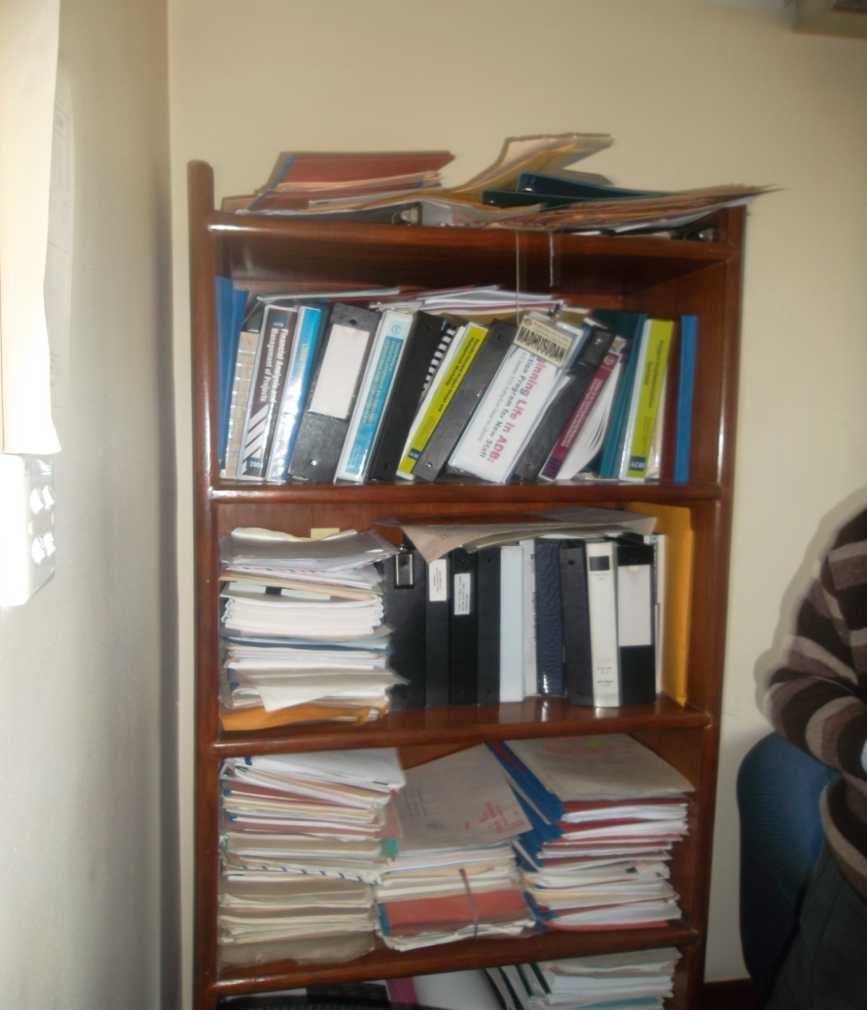
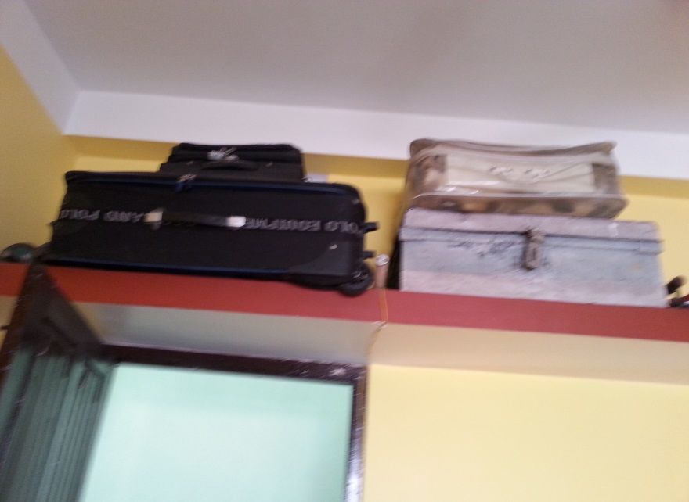
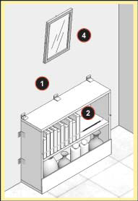
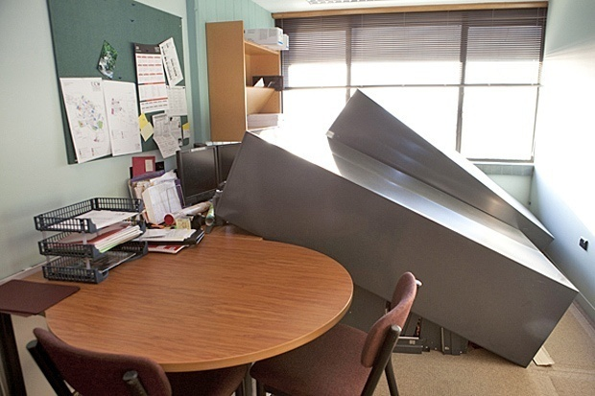
Non-Structural Element

Slide 23
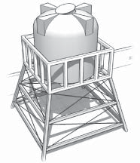
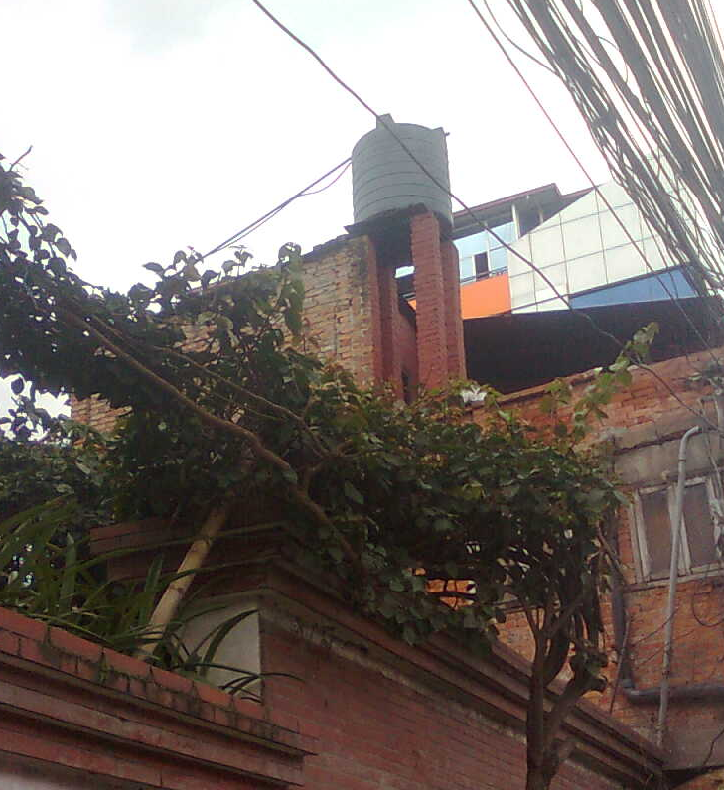
Non-Structural Element

Slide 24
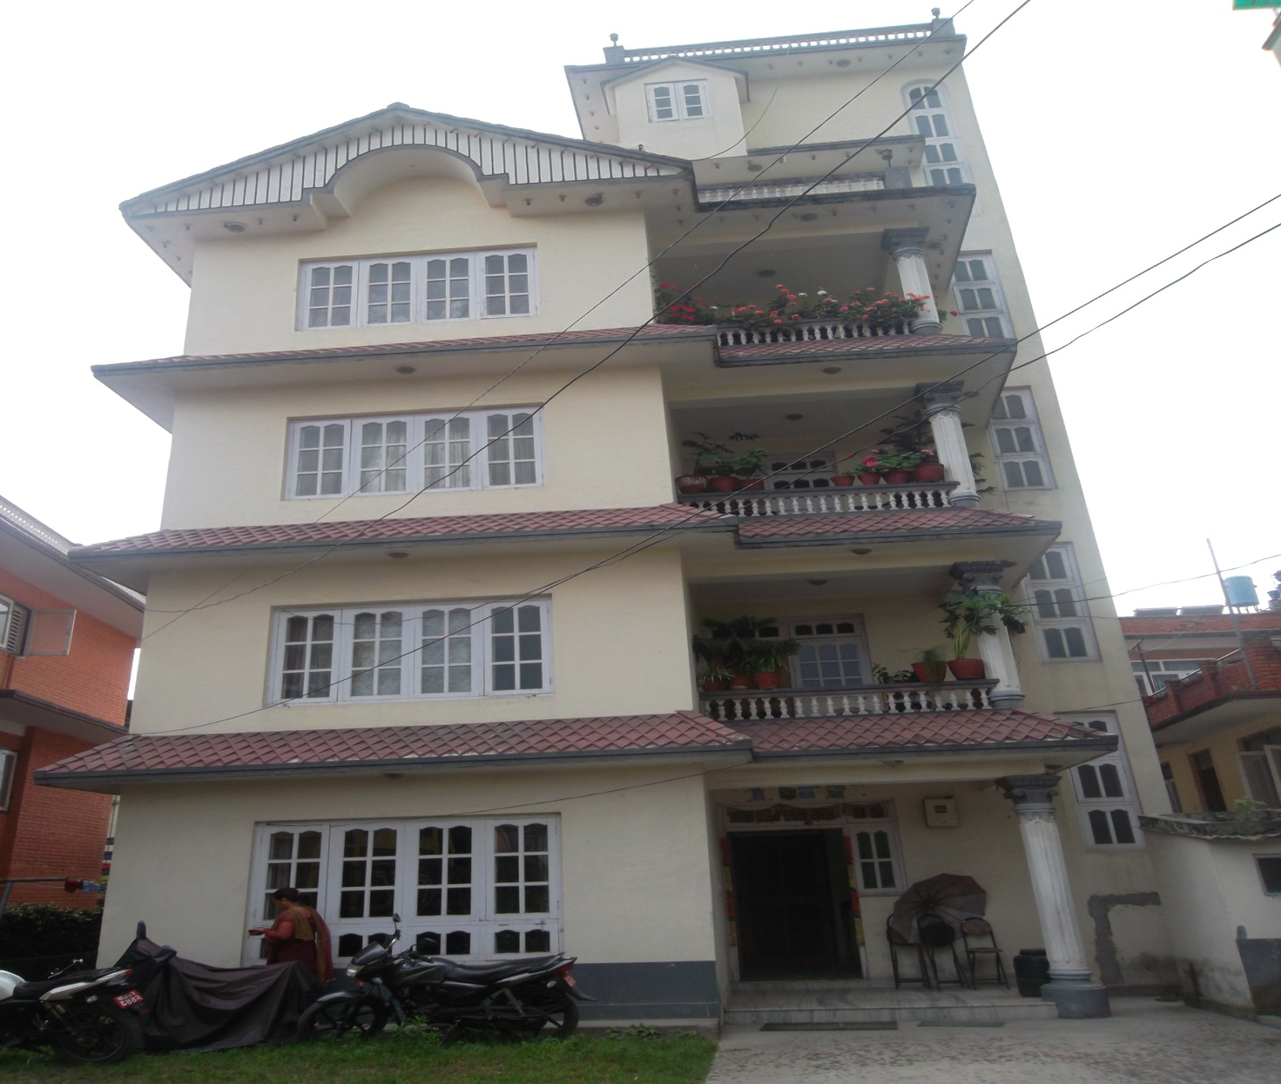
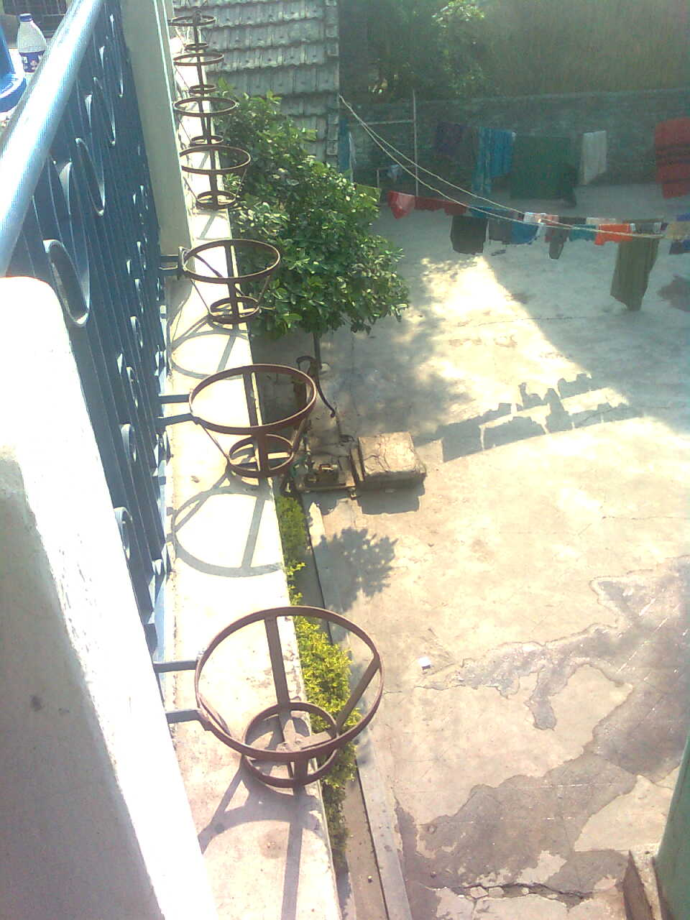
Non-Structural Element

Slide 25
Seismic Vulnerability Evaluation Guideline Part I-final.pdf

Slide 26
SVA
Qualitative seismic assessment.docx

Slide 27
Dadheldhura bld.doc

Slide 28
DVSA.docx

Slide 29
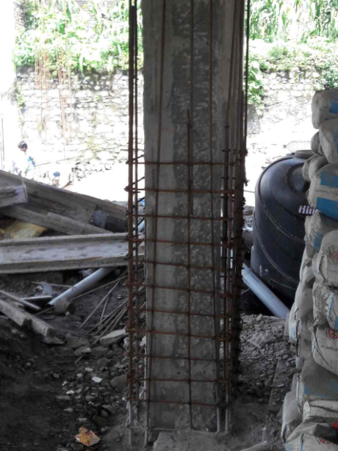

Slide 30
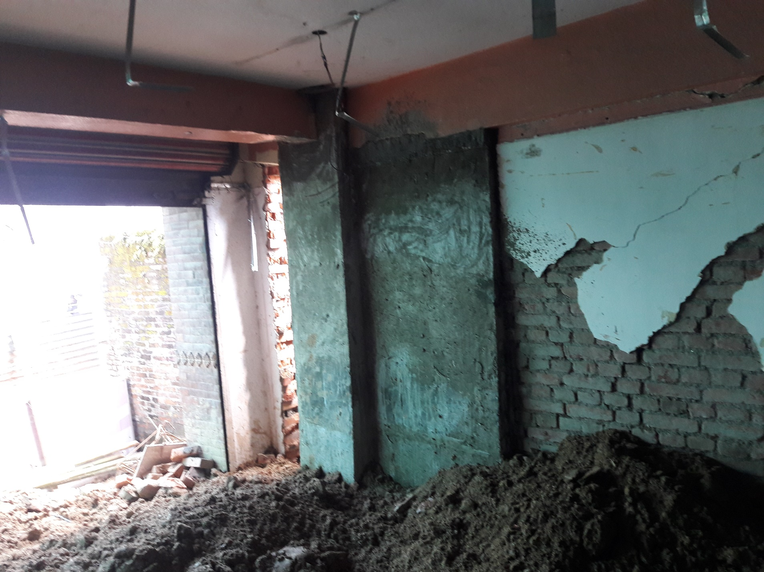

Slide 31
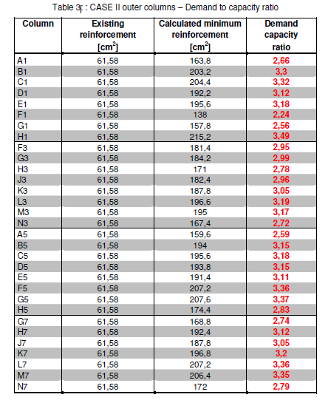

Slide 32
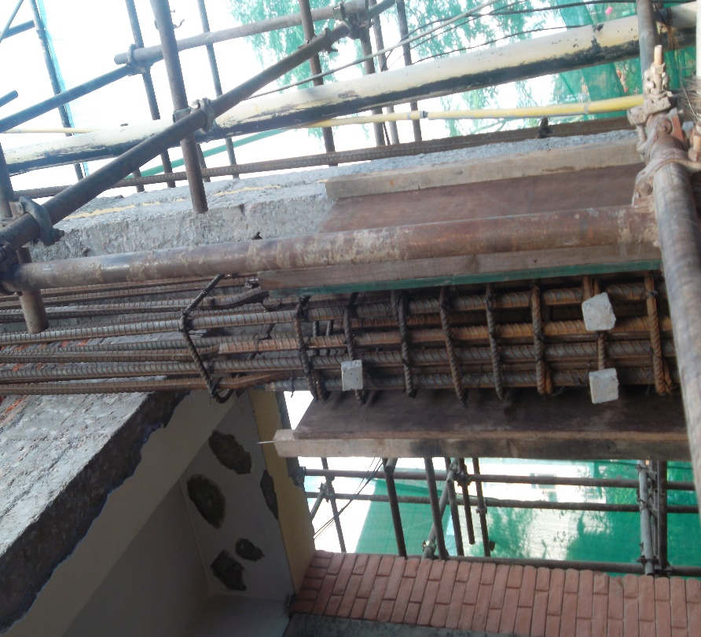
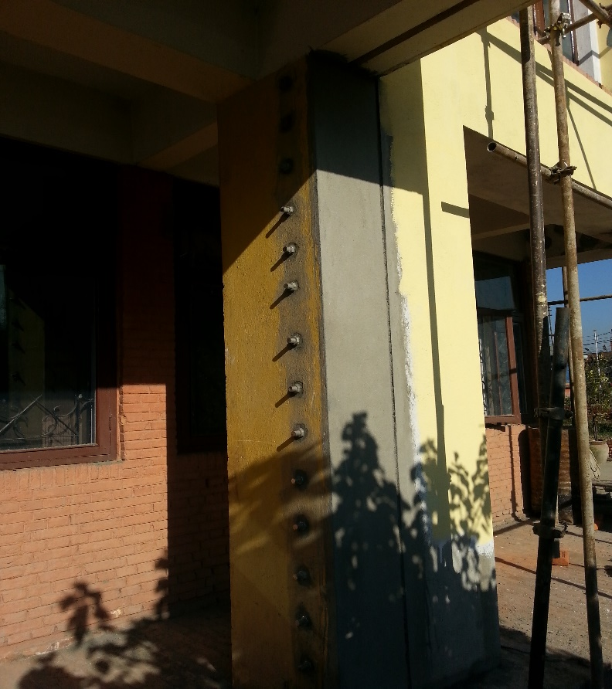
Source:Rekha Shrestha

Slide 33
References
Federal Emergency Management Agency, FEMA 154, 1998.
Rapid Visual Screening of Buildings for potential seismic
hazards: a handbook. Applied Technology Council.
Redwood City, California 185p.
2. Seismic vulnerability evaluation guideline for private and
public buildings, Part I: Pre disaster vulnerabilityassessment:
NSET (http://errrp.org.np/document/study_report/
Seismic%20Vulnerability%20Evaluation%20Guideline%
20Part%20I-final.pdf

Slide 34
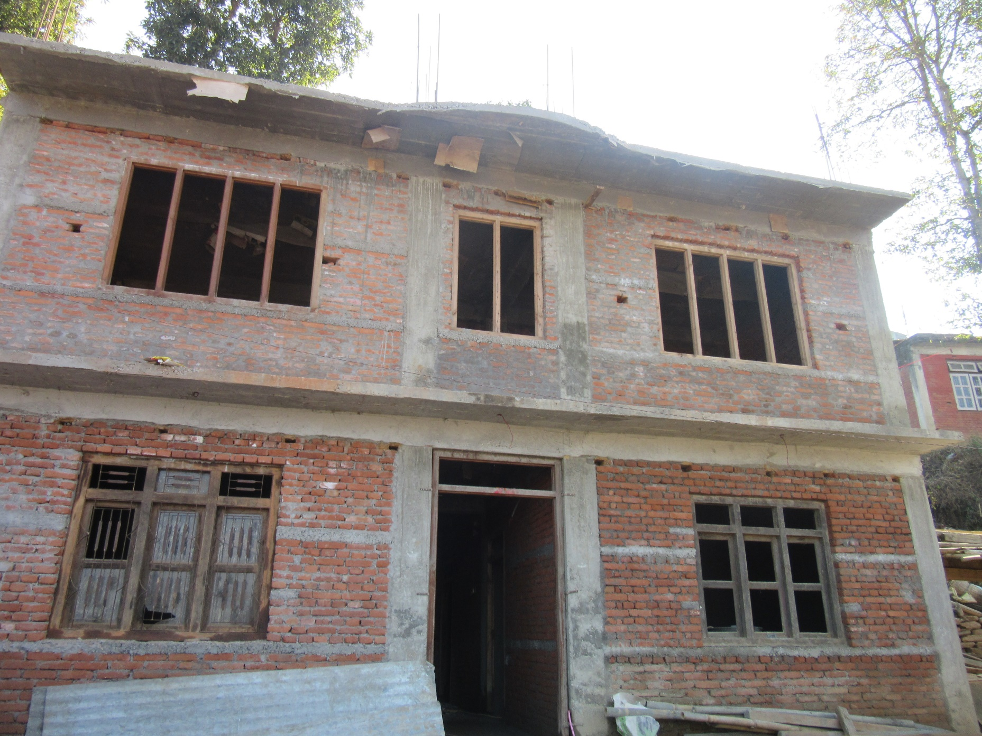
Questions?
Source: Rekha Shrestha

Slide 35


Thank You
Have a Earthquake Resistant House
rekha.shrestha2010@yahoo.com

