Slide 1
Nepal’s Responses to Climate Change
Dr. Balkrishna Sapkota
Principal
Advanced College of Engineering and management

Slide 2
What is climate change?
Climate change is the changes in average weather at a given point and time of year, over a long period (typically 30 years).
It is one of the most important global environmental challenges facing humanity with implications for food production, natural ecosystems, freshwater supply, health, etc

Slide 3
Anthropogenic climate change drivers
Radiative forcing from CO₂, methane and nitrous oxide is +2.30 W m⁻² (± 10%)
Other gases contribute about + 0.7 W m⁻²
Aerosols provide net cooling of about -1.2 W m⁻². Uncertainty in this estimate is the dominant uncertanty in radiative forcing.
Net forcing is + 1.6 W m⁻²

Slide 4
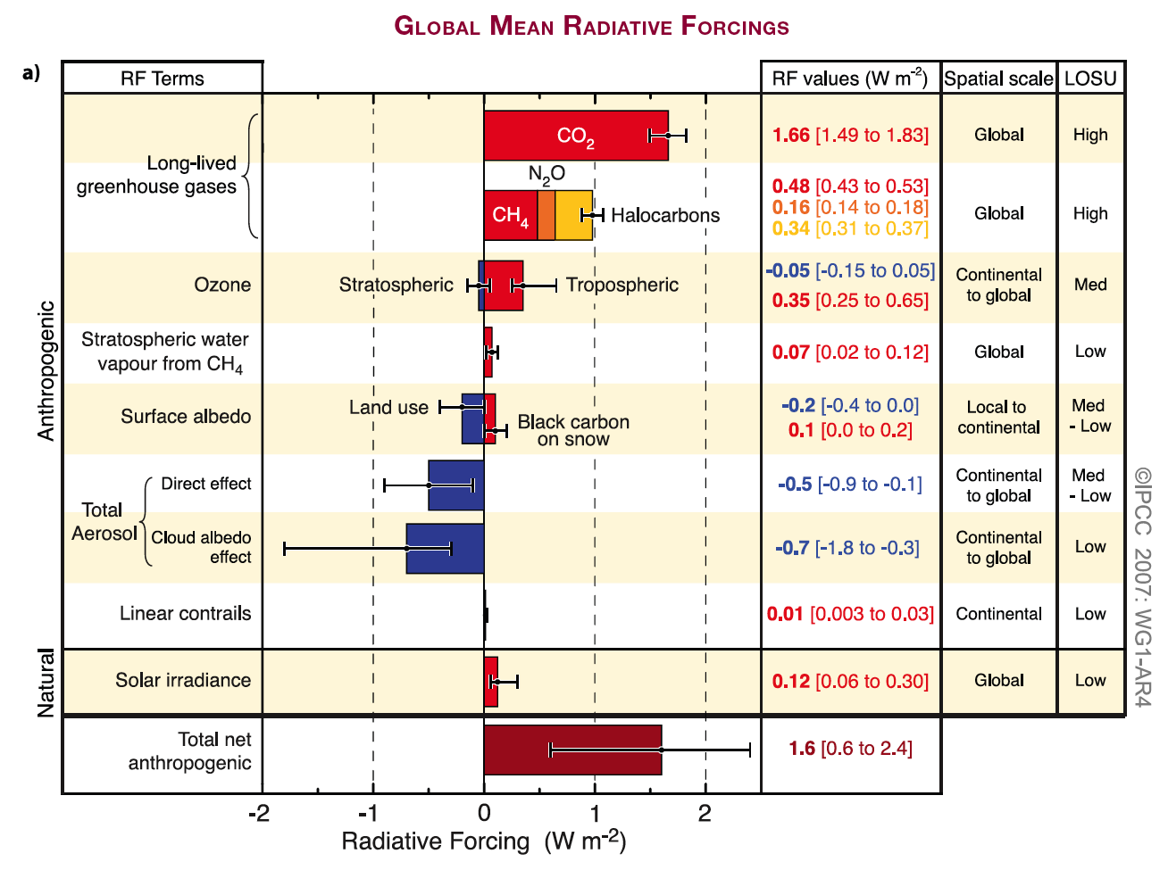
Notes:
Length of column is mean; error bars are shown.

Slide 5
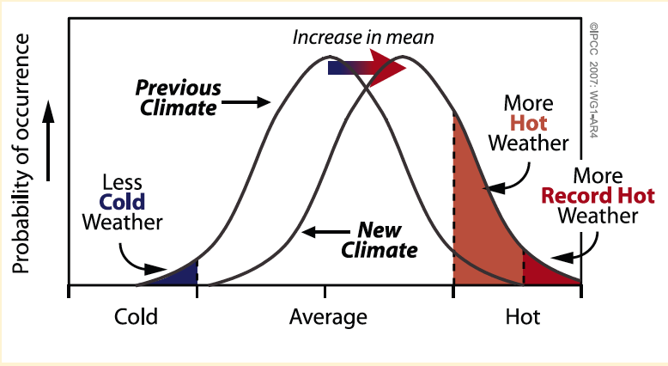
Probability of extreme weather events

Slide 6
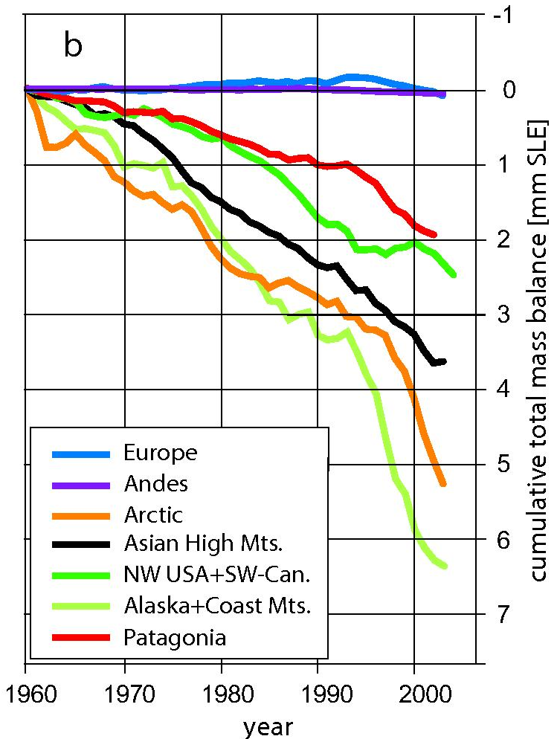
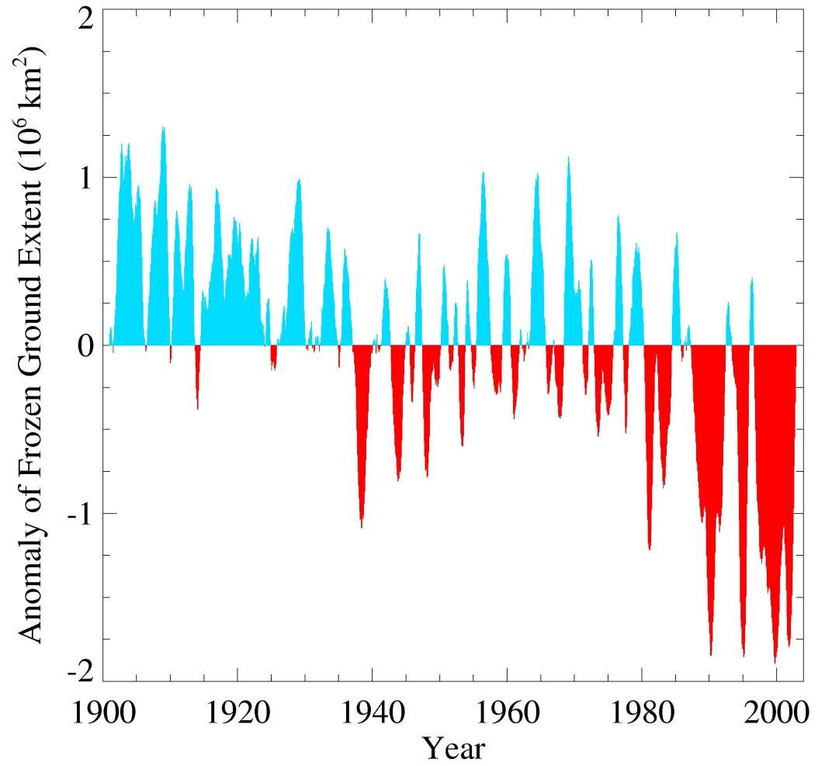
Glaciers and frozen ground are receding
Area of seasonally frozen ground in NH has decreased
by 7% from 1901 to 2002
Increased Glacier retreat since the early 1990s

Slide 7
Who are vulnerable?
Geographical space: “people who live on High mountain areas or, arid or semi-arid lands, in low-lying coastal areas, in water limited or flood-prone areas, or on small islands……”
Social space: “developing countries… have lesser capacity to adapt and are more vulnerable to climate change damages, just as they are to other stresses. This condition is more extreme among the poorest people” (double-exposure).
Source: Olmos, “Vulnerability and Adaptation to Climate Change: Concepts, Issues, Assessment Methods”, Foundation Paper, Climate Change Knowledge network, 2001.

Slide 8
Dealing with Climate Change:
Mitigation and Adaptation
Climate change
Impacts
Mitigation
Adaptation
Responses

Slide 9
Move towards new Paradigm - low carbon economic development strategy must address – Win-Win Situation for Nepal
Development: – sustained real growth of 8-10% over 20 yrs that embeds both adaptation and mitigation into development that is low in carbon content, inclusive and broad based
Adaptation: adjustments in human and natural systems, in response to actual or expected climate stimuli or their effects, that moderate harm or exploit beneficial opportunities (OECD 2009)
Mitigation: consists of activities that aim to reduce GHG emissions, directly or indirectly, by avoiding or capturing GHGs before they are emitted to the atmosphere or sequestering those already in the atmosphere by enhancing “sinks” such as forests (OECD 2009)

Slide 10
Why Climate Change Mitigation?
Fossil Fuel
Burning
8
ATMOSPHERE
billion
tons go in
4
billion tons added every year
800
billion tons carbon
Ocean
Land Biosphere (net)
2
+
2
=
4
billion tons go out
Notes:
Set of graphics related to the mitigation unit that can be used in your classroom

Slide 11
  Science, Vol 305, Issue 5686,
  968-972, 13 Aug. 2004
  Scientific American, Special Issue,
  pp. 50-57, Sept. 2006
Historical emissions profile
Billion of Tonnes of Carbon Emitted per Year
Business as usual –continue at current rate of emission growth
(>800 ppm, +5°C)
14
Hold current emissions (2007) –
(525 ppm, +3°C)
7
Historical
emissions
Cut 2007 emissions in half over 50 years–
(450 ppm, +2°C)
1.9 →
0
1955
2005
2055
2105
Notes:
Carbon emissions from fossil fuel burning have grown rapidly since WWII, from less than 2 billion metric tons in 1955 to nearly 7 billion in 2005. (Metric tons are sometimes abbreviated as tonnes.)

Slide 12
What are the options?
Nuclear Fission
CO₂ Capture
and Storage
16 BtC/y
Fuel Switching
Stabilization
Energy Efficiency and
Conservation
Forests & Soils
Triangle
8 BtC/y
2007
2057
Renewable Electricity and Fuels
Notes:
Options include nuclear power that could offset the use of coal-fired power plants; switching from coal to natural gas; energy efficiency, including increasing car fuel efficiency or building heat efficiency; using renewable energy like wind or solar power; changing land use practices, like switching to no-till agriculture, or reversing deforestation; and carbon sequestration, which entails capturing CO2 from power plants and storing it safely in geologic formations.
YOUR TASK: You have definitions of each of the wedges, and what each would require. You must now look at each of the definitions and pick the 7 that you think most likely economically, politically, and socially. You have 20 minutes to pick your favorite 7 wedges, and then will be asked to explain your choices.
NOTE: There is no “right” answer. The point of the exercise is that these are achievable goals, but each will require significant effort by society. Also, it is unlikely that any one technology can save the day alone – it will take a suite of technologies.

Slide 13
Measures to mitigate climate change
Para. 37 of Decision 17/CP.8
Articles 4.1 and 12.1 of the Convention, commits Parties to develop national and, where appropriate, regional programmes and measures that will result in the mitigation of human induced climate change.
Although developing countries are not required to take on emission reduction commitments, undertaking climate change mitigation and assessment could provide ancillary benefits for sustainable development, such as particulate pollution reduction, ../..
Notes:
Introduction
A national greenhouse gas inventory is a key element of the national communication. As an introduction, this section should include information on how inventory work is organized and carried out. The following diagram of various stages of inventory work may be useful. The stages of the inventory from which the work was started should be described.

Slide 14
Why Nepal concerned?
Nepalese should be concerned about climate change since this phenomenon might have substantial adverse impacts on them.
Main categories of impacts are : water resources and hydro power; agriculture and human health.
Each of these impacts poses serious threats to economy of Nepal
Therefore, Nepal has to initiate mitigation measures for its own sake

Slide 15
Developing Mitigation strategy:
Identifying target GHG and sources

Slide 16
GHG emissions from Nepal in the base year 2000 (MOEST, 2014)
Total ghg emission =24877 Gg CO2 equivalent (eq)

Slide 17
Key sources
The first five emission sources in the list of key emission sources in Nepal, together accounting for 90.2% of emissions, are as follows:
  Enteric Fermentation
  Agricultural Soils
  Residential (CH4 emission)
  Road Vehicles
  Residential (CO2 emission)
  Manure Management

Slide 18
Sectoral GHG emission

Slide 19
The methane emission from overall livestock sector is in increasing trend with the growth rate of 1.46% per annum

Slide 21
Growth rate:
2000/01-2005/06: 20.5 Gg/yr
2006/07-2011/12: 222.38 Gg/yr

Slide 22
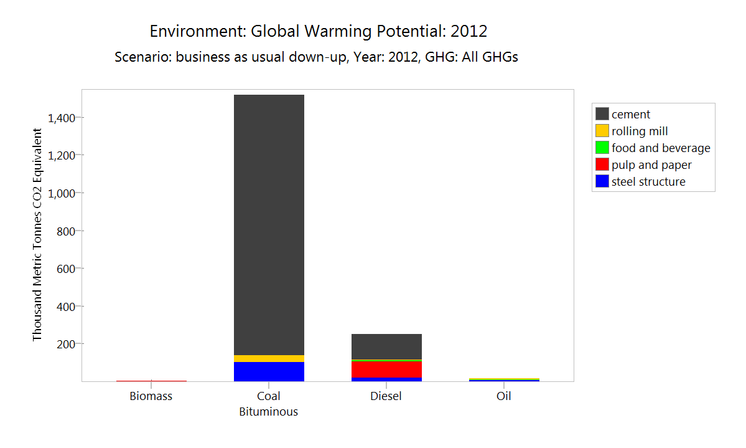

Slide 23
Calculated annual GHG emissions by different types of vehicles in 2012/13

Slide 25
Climate Effects of Black Carbon Aerosols in China and India
Surabi Menon, James Hansen, Larissa Nazarenko, Yunfeng Luo
In recent decades, there has been a tendency toward increased summer floods in south China, increased drought in north China, and moderate cooling in China and India while most of the world has been warming. We used a global climate model to investigate possible aerosol contributions to these trends. We found precipitation and temperature changes in the model that were comparable to those observed if the aerosols included a large proportion of absorbing black carbon ("soot"), similar to observed amounts. Absorbing aerosols heat the air, alter regional atmospheric stability and vertical motions, and affect the large scale circulation and hydrologic cycle with significant regional climate effects (Science, 27 September 2002).

Slide 26
Diurnal Variation of BC EC February 2016 (T) and 2010 (B) in KTM

Slide 29
Impact------
Days & nights becoming warmer - cool days & cool nights becoming less frequent (Baidya et. al.2008)
Majority of glaciers retreated by 30-60m & glacier surface thinning (Mool et. al. 2002; Shrestha et. Al 2012).
Winter rains failed in 2005 and 2008 (NAPA, 2010)
Across hills & mnts, springs & rivers drying causing drinking water scarcity (WFP 2009; Regmi and Adhikari 2007)
Biodiversity affected due to drought, forest fires, land use changes & desertification in some of the areas (Regmi and Adhikari 2007)
Extreme Weather Events (floods, landslides etc) on rise
Floods & landslides resulted in over Rs 9 billion ($ 90 million) worth of damages (2001-2008) (Banskota 2011)
Highly dependent on climate-sensitive economic activities such as agriculture, forestry, tourism etc are affected.
Notes:
Nepal’s population is about half of one percent of the global population and the country accounts for about 0.025 percent of global GHG emissions.
Poor, dependent on the climate sensitive economic sectors (agriculture and forestry) and with almost 50 percent of the people living in the mountains
Fossil fuels are carbon based , thus emits carbon by products such as CO2 and CO, along with other emissions such as SOx, Nox, and VOCs.
Poor inefficient technologies results incomplete combustions which means lesser amount of energy with higher amount of emissions
Thus a proper policy is required not only to meet the low emission standards but also to aid the development goals, decrease the fuel dependency and use of indigenous resources

Slide 30
Mitigation option: Livestock and Paddy
Population management and genetic improvement (management and animal breeding, increase production efficiency, reduction in the number of low productive cattle, disposal of unproductive animals, improved feeding practices)
Manure management
Pasture Management (avoid over grazing and careful selection of new species)
Paddy: water and soil management and fertilizer application

Slide 31
Livestock, Paddy and forestry-Projection
Use of EXACT Model developed by FAO
2015-2035
Assumptions
Livestock
Low- 3% replacement
Medium- 5% replacement
High- 7% replacement
Source for all scenario: LCED (2014), ADAPT- Nepal

Slide 32
Source: LCED (2014), ADAPT- Nepal

Slide 33
Source: LCED (2014), ADAPT- Nepal

Slide 35
Forestry
The high LCED scenario is set to achieve 40 percent forest cover as per the national vision and Millennium Development Goal (MDG).
Medium LCED scenario involves abatement activities at the moderate intensity and aims to achieve half the targets of the high LCED scenario.
Low LCED scenario involves the abatement options are planned and implemented at the minimum level of a quarter of the targets of the high LCED

Slide 36
Carbon balance (net emissions versus sequestration) in baseline (in million tCO_{2-eq}) and LCED scenarios without double accounting due to deforestation (2015-35)

Slide 37
Energy: Overall Scenarios
Replacement of traditional and fossil fuels by clean energy alternatives – electricity, LPG and ICS.
Replacement of incandescent bulbs by CFL and LED.
Promotion of electrification in all 5 sectors for lighting, heating and other purposes.
Intervention of more efficient process technologies in industries
Intervention of mass transportation system
Introduction of new electric and bio-fuel transportation technologies

Slide 38
Low Emission Strategic Option Scenario (LESO)
GDP growth rate according to BAU case, i. e. with an average GDP growth rate of 6 %
Electrification in major end-uses in all five sectors.
Total electrification for lighting in rural and urban sub-sectors and cooking in urban sub-sector, with use of efficient lighting technologies such as CFL and LED.
Energy efficiency improvement in industrial sector end-uses such as lighting, process heat.
Fuel switching to modern fuels such as electricity, LPG and other liquid petroleum and renewable energy such as solar, biogas, bio-fuel etc.
Penetration of ICS as efficient biomass conversion technology for cooking.
Mass transportation in transport sector.

Slide 39
High Economic Growth (HIG) Scenario
GDP growth rate was considered 6.5 % for 2015, 11.2 % for 2020 and an average GDP growth rate of 9.2 % from 2025-30
The shares of each demand technology in the energy supply in future years are considered to be invariant i. e. energy mix of total demand will be as similar as in the base year.

Slide 40
Low Emission High Economic Growth (LEHI) Scenario
GDP growth rate according to HIG case
Electrification in major end-uses in all five sectors.
Total electrification for lighting in rural and urban sub-sectors and cooking in urban sub-sector, with use of efficient lighting technologies such as CFL and LED.
Energy efficiency improvement in industrial sector end-uses such as lighting, process heat.
Fuel switching to modern fuels such as electricity, LPG and other liquid petroleum and renewable energy such as solar, biogas, bio-fuel etc.
Penetration of ICS as efficient biomass conversion technology for cooking.
Mass transportation in transport sector.

Slide 41
Source: LCED (2014), ADAPT- Nepal
 | 2010 | 2015 | 2020 | 2025 | 2030 | Reduction
BAU | 4 | 5 | 7 | 9 | 13 | -
LESO | 4 | 5 | 6 | 7 | 8 | 42%
HIG | 4 | 5 | 7 | 11 | 18 | -
LEHI | 4 | 5 | 6 | 8 | 10 | 43%

Slide 42
Nepal’s Response
Climate Change Policy, 2011.
  Vulnerability Assessment
  Capacity Enhancement
  Resource Allocation
  Mainstreaming in Planning Process
  Social Mobilization
National Periodic Plan (2013/14-2015/16)
  Information Dissemination
  Integration in Development Programs
  Capacity for Climate Change Resilient
Climate Change Budget Code, 2012
  Budget tracking

Slide 43
NAPA/LAPA
National Adaptation Program of Action (NAPA)
  Country Vulnerability Assessment
  Coping Strategy Development
  Community Engagement
  ( The total cost for implementing National Adaptation program of Action (NAPA) is estimated at US$ 350 million)
Local Adaption Plan for Action (LAPA)
  Integrating climate change into local participatory planning process.
  Implementing adaptation actions
(80% of estimated NAPA cost is committed to be spent at the local - village/municipal level)

Slide 44
Climate Public Expenditure
About 2 % of GDP and 8% of Government Expenditure is on climate activities . The trend is increasing.
Around 80% of climate change expenditure relates to adaptation activities.
Around 60% of the expenditure is executed directly by Central Agencies and 40% through Local Agencies (Unconditional Capital grants ).

Slide 45
Conclusion
Adoption of forest conservation, reforestation, afforestation and sustainable forest management practices can contribute to conservation of biodiversity, watershed protection, rural employment generation, increased incomes to forest dwellers and carbon sink enhancement.
Livestock: Population management and genetic improvement can reduce methane emission substantially
Efficient, fast and reliable public transport systems such as Mass transport system, electric driven buses can reduce urban congestion, local pollution and greenhouse gas emissions

Slide 46
Conclusion
Adoption of cost-effective energy-efficient technologies in Industry, Transport, electricity generation and end-use can reduce costs and local pollution in addition to reduction of greenhouse gas emissions.
Shift to renewable, some of which are already cost effective, can enhance sustainable energy supply, can reduce local pollution and greenhouse gas emissions.

Slide 47
Improvement Required
Wide gap on words and action
Need to move away from the “DAD” approach (Decide, Announce, Defend) towards a participatory approach to policy development.
A clearly defined standard policy development process can discourage “selective” consultation.

Slide 48
Thank You

