Slide 1
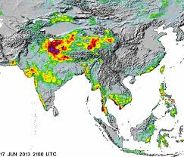
Nepal India and Inundation Problems
Er. Shital Babu Regmee

Slide 2
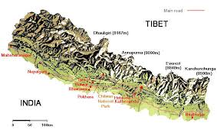
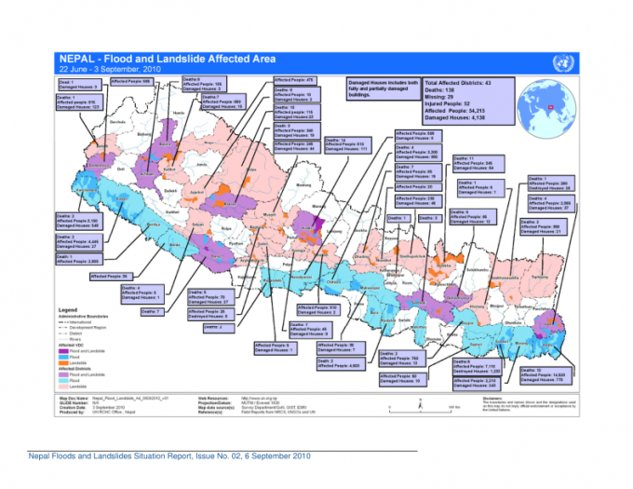
Introduction
Area: 147,181 square kilometer
900 km east- west and
200 km north-south
Terai plain about 20% of the total area
Rest is hills and mountains.
The average annual precipitation:1600 mm
less than 300 mm in the rain shadow
around 5000mm in the wet region.
total annual outflow: 225 billion cubic meters.

Slide 3
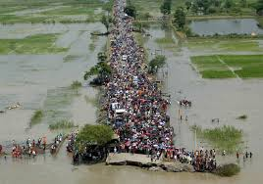
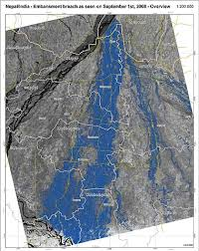
Background
King of Nepal and Prime Minister of India, decided to form a Standing Committee in Inundation Problems between Nepal and India (SCIP) in the SAARC meeting at Dhaka in December, 1985.
First meeting held in July 1986 in Kathmandu
33 concerns
29 by Nepal
4 by India

Slide 4
Background
SCIP replaced by Nepal-India Joint Committee on Inundation and Flood Management (JCIFM)
Existing Committees
Ministerial level (Joint Ministerial Level Commission on Water Resources, JMCWR),
Secretary Level (Joint Committee on Water Resources, JCWR),
Joint Secretary Level (Joint Standing Technical Committee, JSTC),
Department Chief Level, (Joint Committee on Inundation and Flood Management, JCIFM).
Other committees and working groups like technical expert level High Level Technical Committee (HLTC) and field officers level committees formed as and when necessary.
There are many committees between the two countries
Meetings of the committees are not regular
Effectiveness has not been up to the expectation.

Slide 5
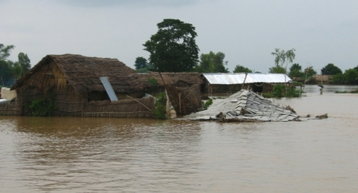
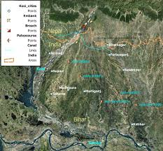
Problems
Due to the obstructions created, the natural course of the river is confined to a fixed waterway causing backwater effect that cause water- logging
Swinging of rivers creates land use and entitlement problems in Nepal
Nepal has no reservoirs to store flood water so whatever water comes through river as flood has to pass to India as it is generated

Slide 6
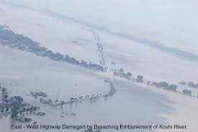
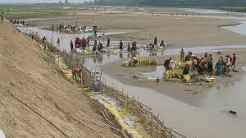
Problems
Infrastructures like embankments, bridges, roads, irrigation systems, buildings etc are being constructed in a rapid pace in the territories near Nepal- India boarder
All water flowing through Nepal has to pass through India so any obstruction has backwater effect

Slide 7
Major Irritants
Mechi Embankment
Koshi Project
Gaur and vicinity
Gandak Project
Lumbini Area: Rasiawal Khurd-Lotun
Kapilvastu Sagars
Marthi, Siswa, Bajha and Mohali
West Rapti
Karnali River
Mahakali River

Slide 8
Major Issues
All Nepalese rivers drain to India
High flood discharge and low dry season flow
Reservoir construction
Climate change
Less information
Unilateral infrastructures construction
Mistrust

Slide 9
Major Issues
Jacketing of rivers in India
Country slopes are milder.
There will be backwater flow in tributary drains.
Flood may outflank bank and convert area to inundation and ponding.
Poor maintenance system makes it unreliable.
New area may get flooding.
Centre state jurisdiction
Slow implementation

Slide 10
International Concern
UN Convention on the law of the Non-Navigational Use of Watercourses, 1997
All the rivers that drain to India from Nepal are a part of International Watercourse and Nepal and India are International Watercourse States
Watercourse States are entitled in their respective territories to utilize an International Watercourse in an equitable and reasonable manner

Slide 11
International Concern
Measures to prevent the causing of significant harm to other watercourse States
No country is allowed to use its territory against other country
Timely notification with all the relevant data and information about all use
In cases where negotiation between the parties fail to reach any settlement they have the obligation of settling their difference by peaceful means
* In case of flood control works done by India it is noticed by Nepal only after the construction is over and the subject became a fait accompli

Slide 12
Conclusion
Major policy and legal dimensions
Nepal – India relations
National laws and policy
In case of flood control works done by India it is noticed by Nepal only after the construction is over and the subject became a fait accompli
All flood water from Nepal has to be transferred to India
Joint long term solution must be worked out

Slide 13
Conclusion
Present practice of making embankment unilaterally in India or in Nepal will not solve the problem
River Jacketing may be effective in Nepal but not in flat area of India
Long term solutions may be water retention in reservoirs, joint flood mitigation and adaptation.

Slide 14
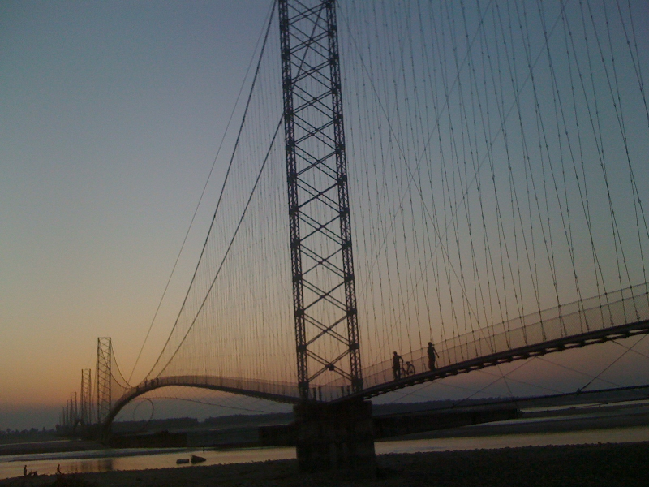
Thank You

