Slide 1
Landslide Dam at Jure
Sindhupalchowk
Tuk Lal Adhikari
Geotechnical Engineer

Slide 2
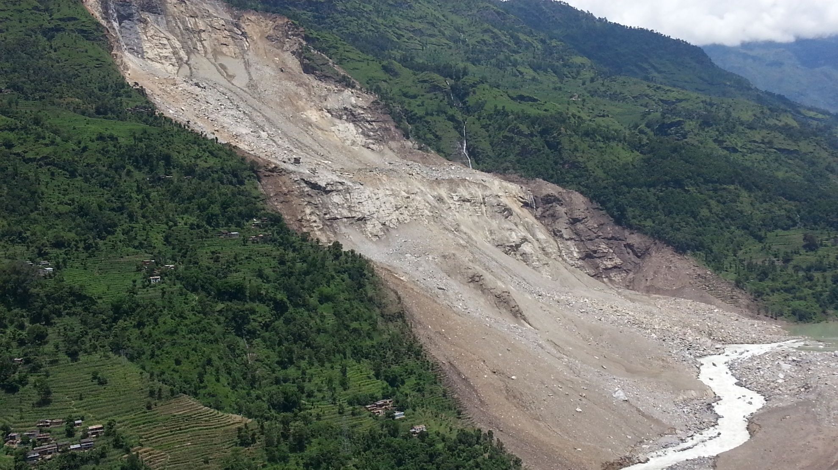
Landslide Dam at Sunkoshi River at Jure

Slide 3
Landslide Dam at Sunkoshi River at Jure
Colin Stark, Goran Ekstrom and Clement Hibert have been looking at the seismic signals generated by the earthquake – it was recorded as an Msw=4.7 (approx.) event. The signal suggests that the landslide occurred at 20:51:44 UTC on 1st August (which is 02:36:44 on 2nd August local time). The landslide force inversion suggests that the landslide mass was about 13.5 million tonnes, which corresponds to a volume of about 5.5 million cubic metres, give or take a bit.
Source: Prof. Dave Petley, University of Durham

Slide 4
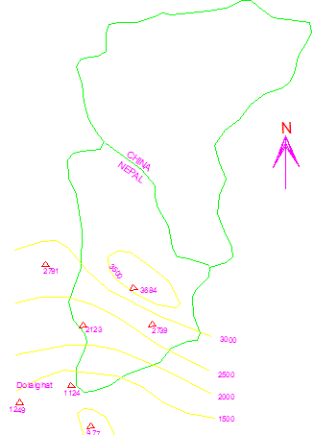
Catchment Area Map of Sunkoshi River

Slide 5
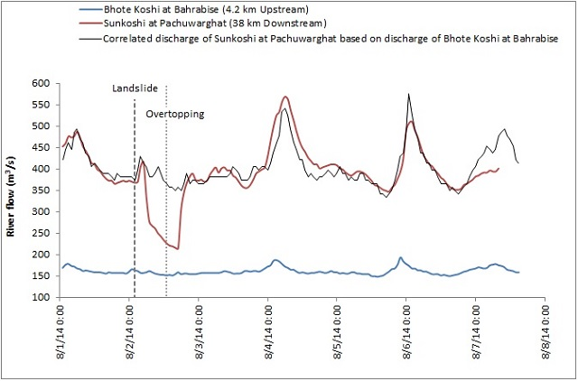
Catchment Area Map of Sunkoshi River
Ripendra Awal, Texas
Sunkoshi barrage: hourly data available before event but no data after the event.

Slide 6
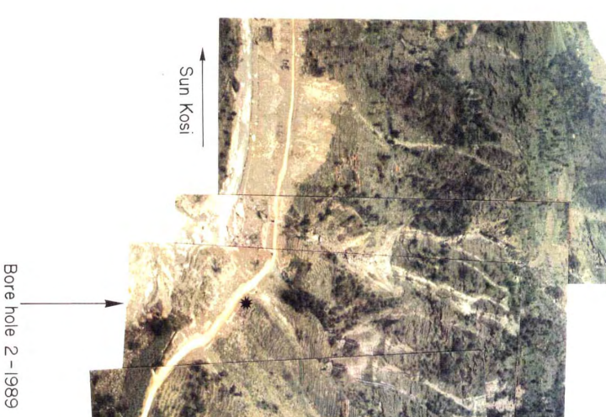
Helicopter Photo, 1989

Slide 7
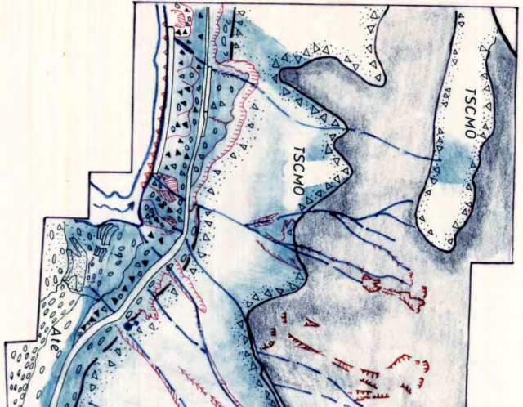
Geo-morpholigical Interpretation, 1989

Slide 8
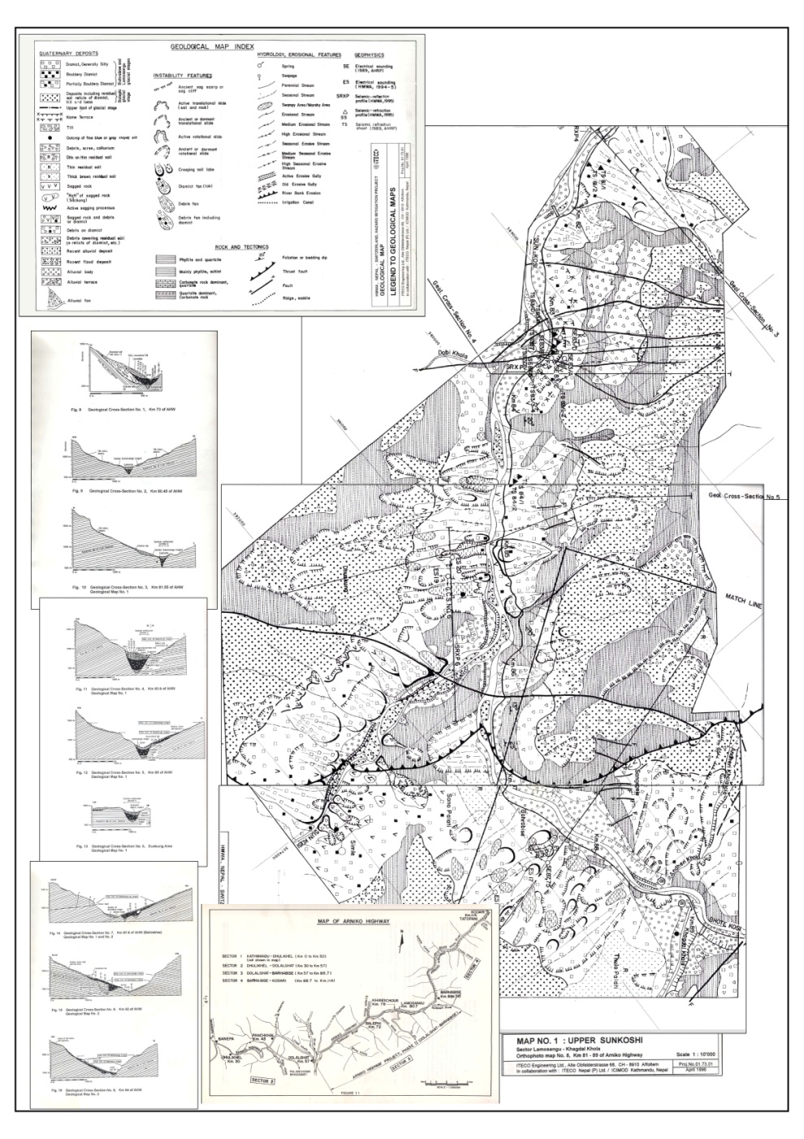
Geological Map (1:10,000), 1989

Slide 9
Geological Map (1:10,000), 1989

Slide 10
Geological Section 3, 1989

Slide 11
Geological Section 4, 1989

Slide 12
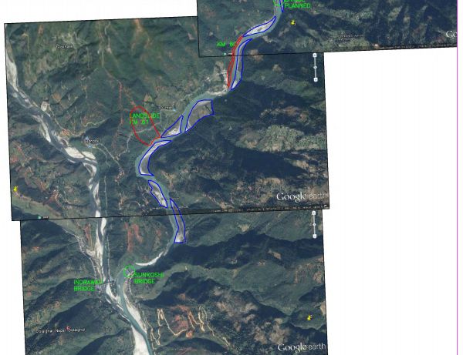
Downstream Critical Zones

Slide 13
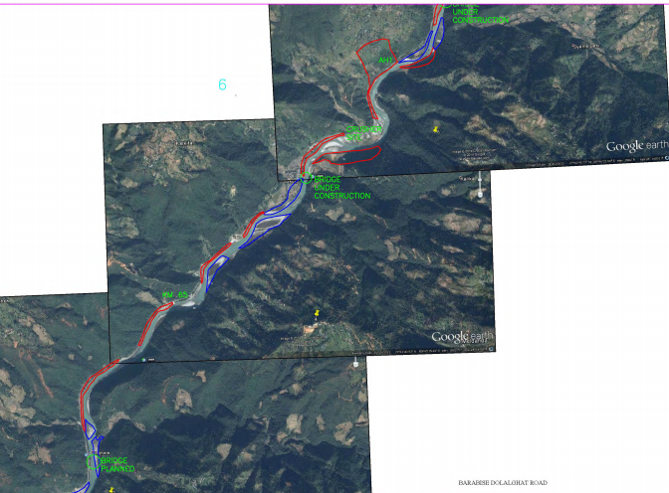
Downstream Critical Zones

Slide 14
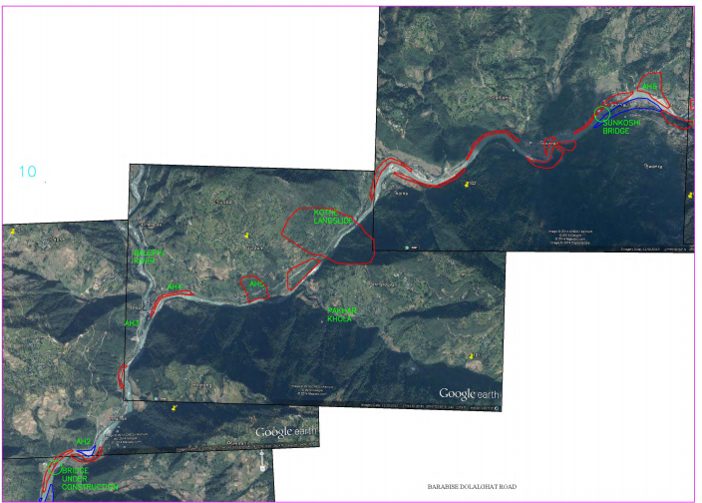
Downstream Critical Zones

Slide 15
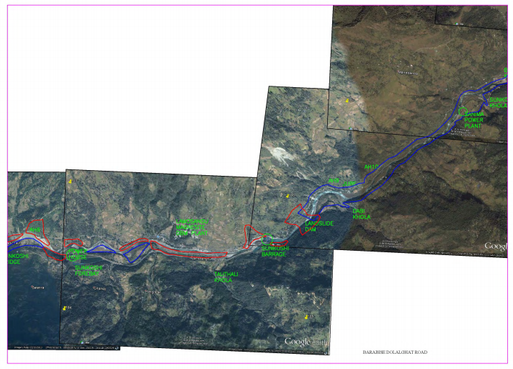
Downstream Critical Zones

Slide 16
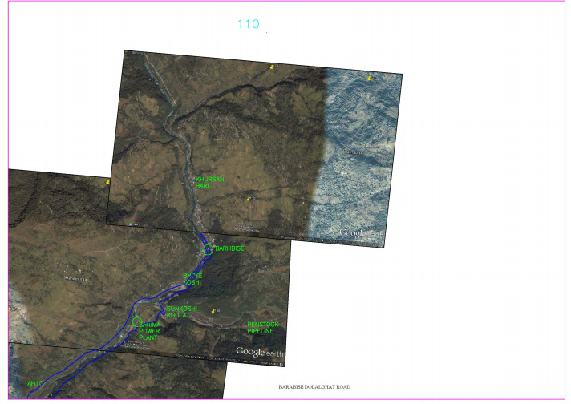
Downstream Critical Zones

Slide 17
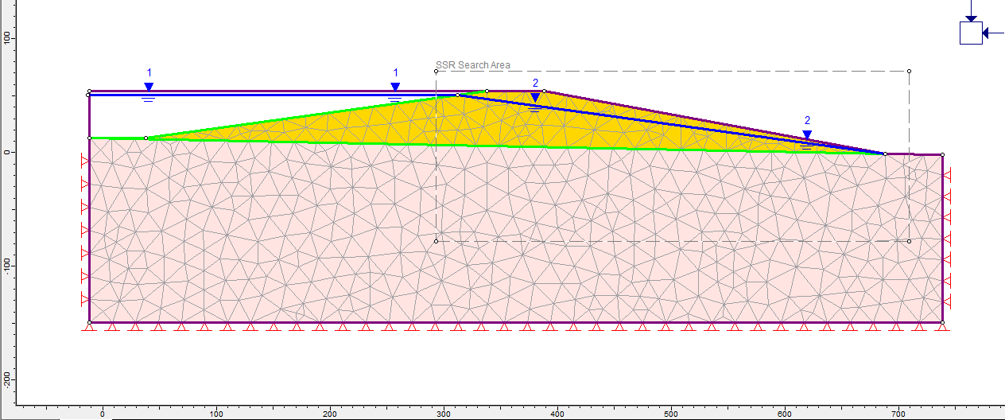
Model for Dam Stability Analysis
Material: Landslide Debris
Unit weight: 22 kN/m3
Elastic type: isotropic
Young's modulus: 20,000 kPa
Poisson's ratio: 0.3
Peak friction angle: 28 degrees
Peak cohesion: 0 kPa
Material: Existing River Bed Material
Unit weight: 25 kN/m3
Elastic type: isotropic
Young's modulus: 60,000 kPa
Poisson's ratio: 0.3
Peak friction angle: 35 degrees
Peak cohesion: 10 kPa

Slide 18
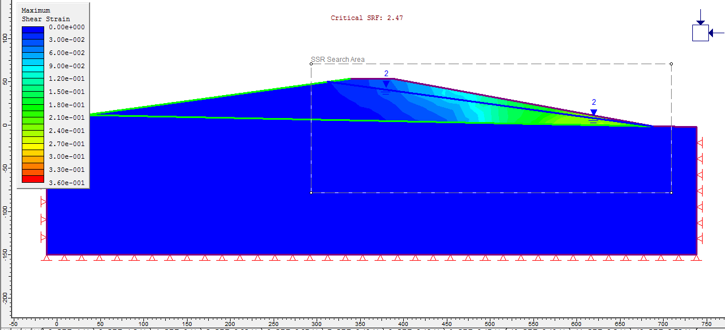
Dam Stability Analysis – Static Case
FoS = 2.47

Slide 19
Further Study - Urgent
Topographical survey using reflectorless total station of entire problem area
Multichannel Analysis of Surface Waves (MASW) to determine subsoil parameters and surprises
Soil / Rock testing
Detailed stability analysis for varied loadings including reservoir routing and seismic condition

