Slide 1
TRENCHLESS TECHNOLOGY
AN OVERVIEW
March 2018 Naresh Koirala, P.Eng.
NoDigSolutions

Slide 2
Presentation Outline
Open Cut Method
Trenchless method
Type of Trenchless methods
New construction by Trenchless
5. Case histories

Slide 3
Open Cut
Asphalt
Road base
Import backfill
material
Native Soil
Native soil
(Open cut to
Install pipe)
Open cut area
Surround bedding
Zone affected when
pipe is installed by
Trenchless method
Installed Pipe

Slide 4
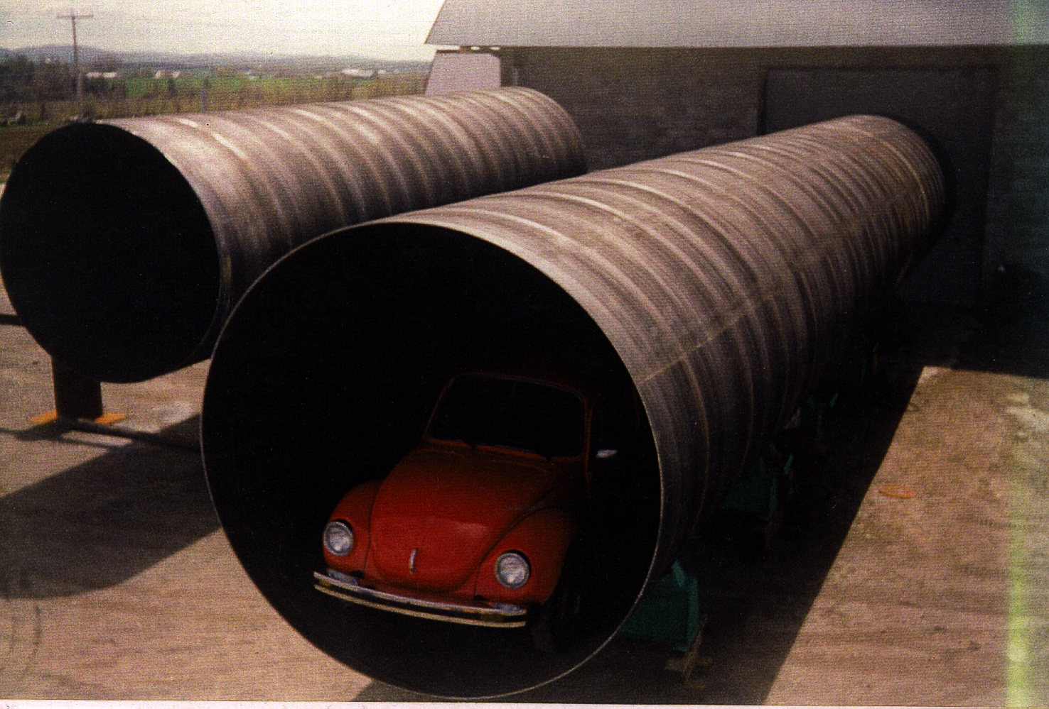

Slide 5
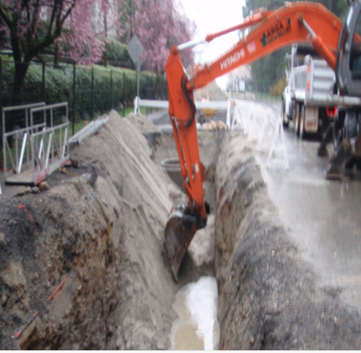
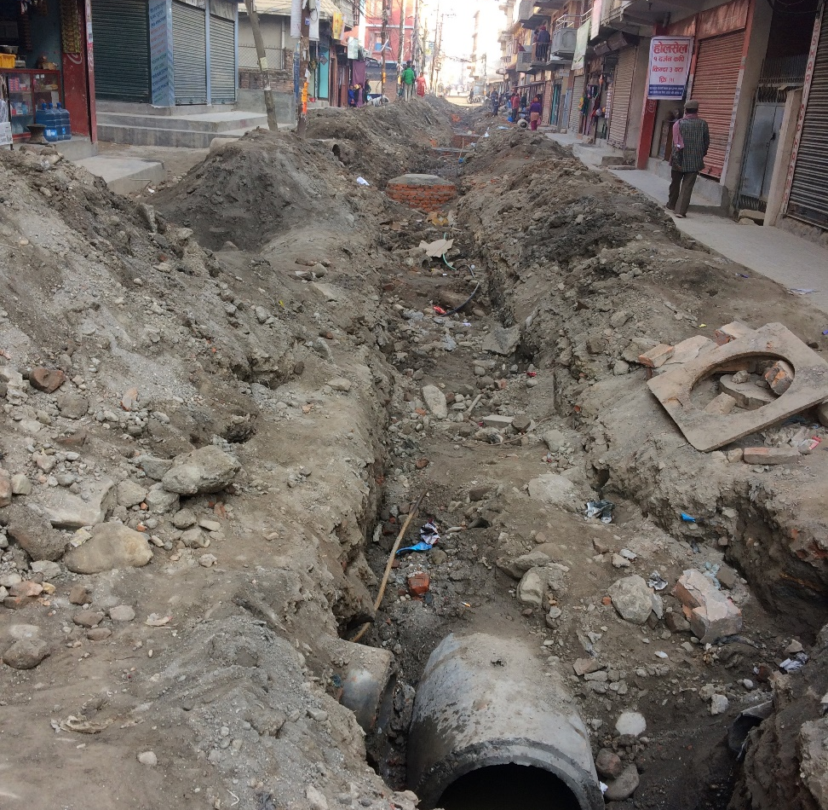
Open Cut
Vancouver
Kathmandu

Slide 6
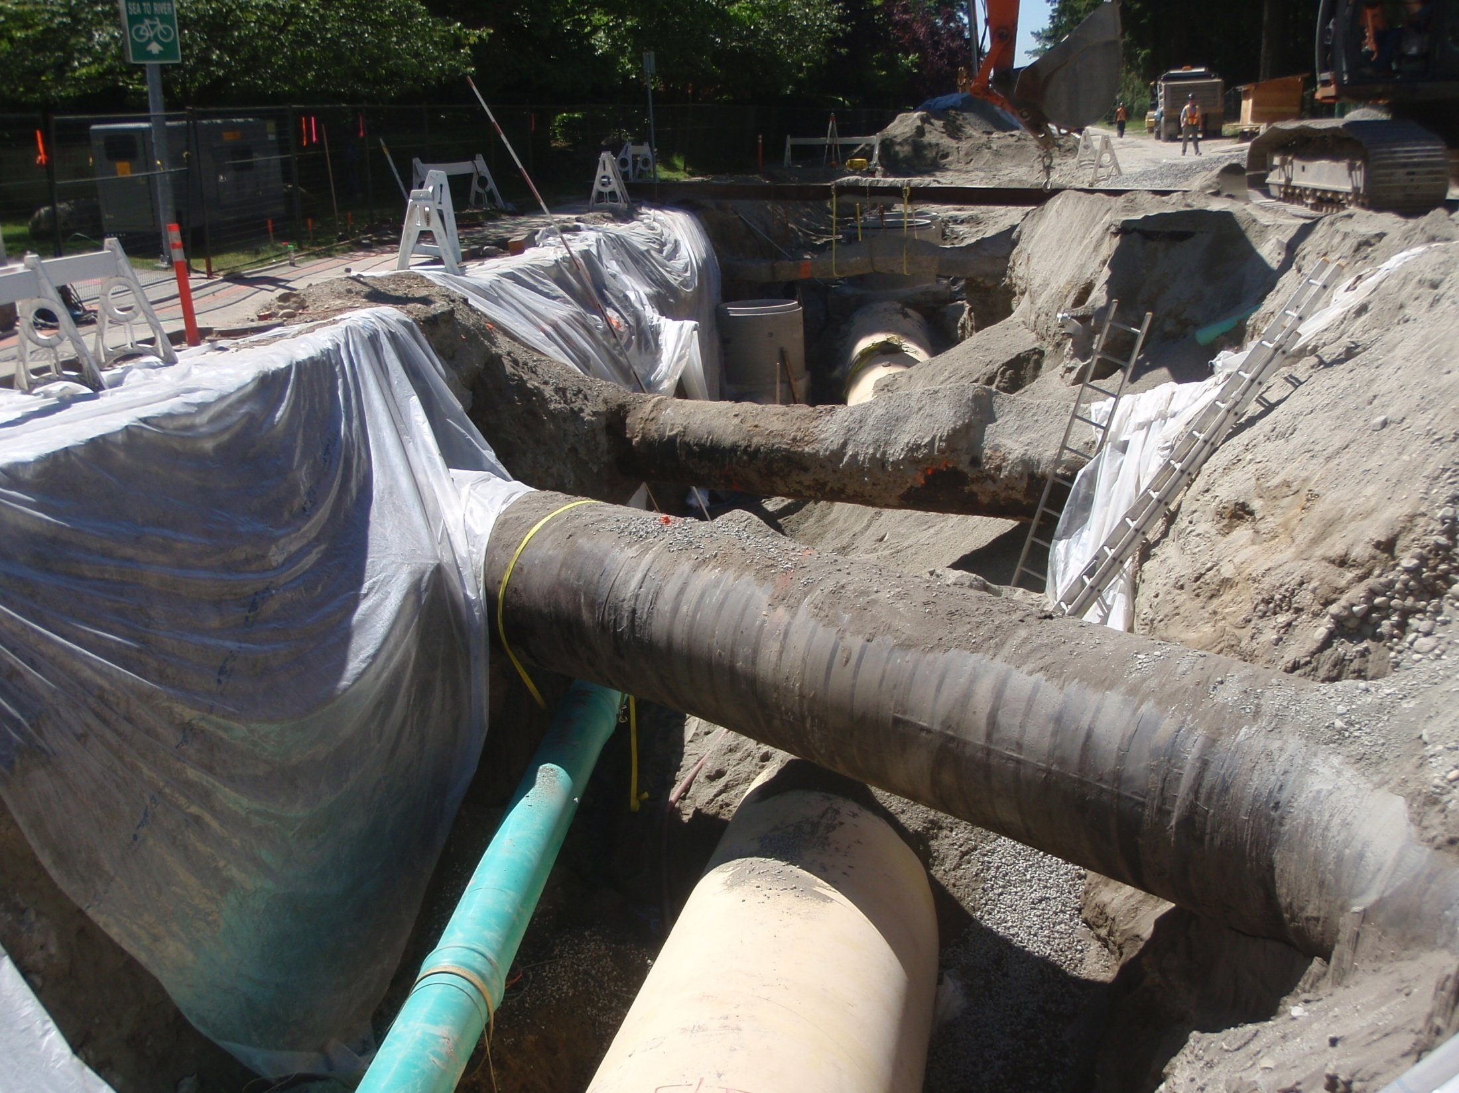

Slide 7
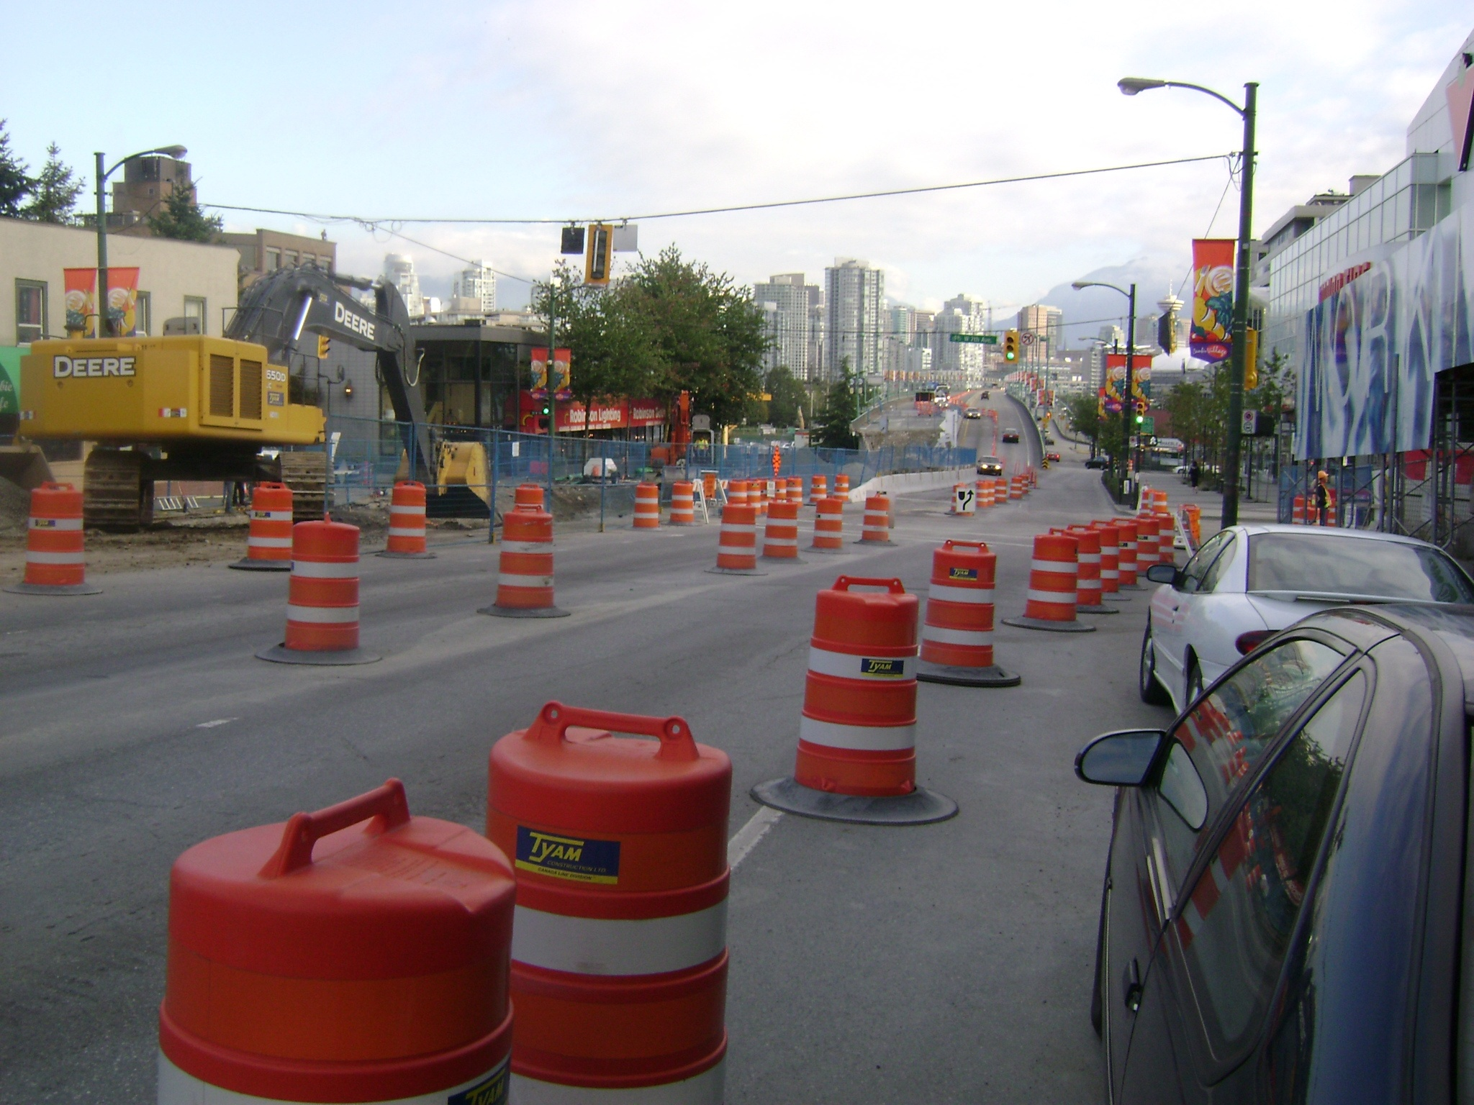

Slide 8
Traffic
Idling traffic. Waiting for a lane to open
Forcing traffic to merge into fewer lanes
Causing traffic to be diverted to a different route
As we slow (or speed up) traffic from 40mph to 50mph we increase fuel consumption by 33%
Victoria Transport Policy Institute, 2003
  average car cost /mile: 23 cents;
  bus: 35 cents

Slide 9
Fuel Consumption vs. Speed

Slide 10
Open Cut
Traffic Disruption
Social Cost
Environmental cost
Green House Gas
Not always cost effective
Not a feasible option

Slide 11
Trenchless Technology
New Method

Slide 12
Definition
"A family of Construction techniques for installing or rehabilitating underground infrastructure with minimal disruption to surface traffic, businesses, and residents”
NASTT, 2015

Slide 13
ILLUSTRATION OF TRENCHLESS AND OPEN CUT METHODS
Trenchless Method
Conventional Open Cut Method
Asphalt
Road base
Import backfill
material
Native undisturbed
soil
Native soil
(Open cut to
Install pipe)
Open cut area
Surround bedding
Zone affected when
pipe is installed by
Trenchless method
Installed Pipe

Slide 14
Trenchless
Environmentally less disruptive
Cost effective under many situations, particularly if environmental, social cost is accounted for;
No other suitable method
4. This is what public wants

Slide 15
Trenchless Methods
Pipe Renewal
Cured-in-Place Pipe
Thermoformed Pipe
Sliplining
In-line Replacement
  -Pipe Bursting
  -Pipe Replacement
Pipe Removal
(ref: ASTM F-1216- “Standard Practice for Renewal of Existing Pipelines and Conduits by the Inversion and Curing of Resign Impregnated Tube)
New Installation
Pipe Jacking
Microtunnelling
Pipe Ramming
Horizontal Directional Drilling
Tunnelling
Guided Auger Boring /Pilot Tube Tunnelling

Slide 16
New Installations

Slide 17
Planning and Design
Identify need
Service Requirement (water/sewer/telephone cable/electric power line)
Alignment
Hydraulic Design
Pipe Size
Ground Investigation
Selection of Suitable Method
Selection of Pipe Type
Design Standard (design life/seismic requirements)

Slide 18
Ground Investigation
Land Development History(municipal achieves/aerial photograph/surficial geological map/site inspection)
Site Investigation
Laboratory Testing
Develop Geological Profile

Slide 19
PIPE JACKING

Slide 20
Pipe Jacking
"A technique of installing pipes by driving a line of them through
ground with hydraulic rams from
a prepared jacking pit "

Slide 21
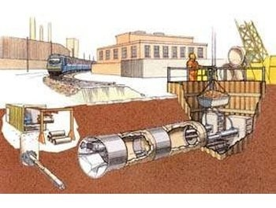

Slide 23
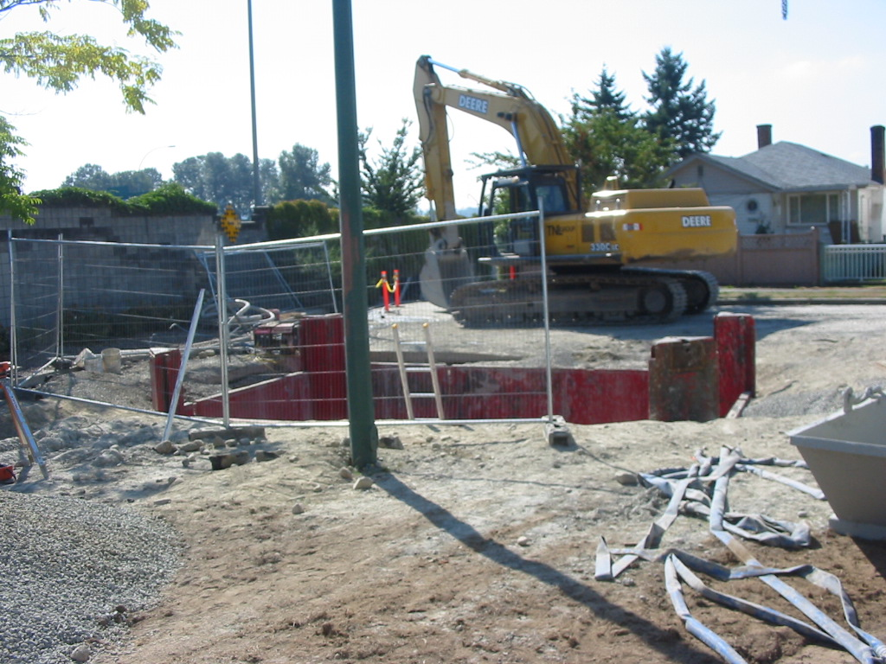

Slide 24
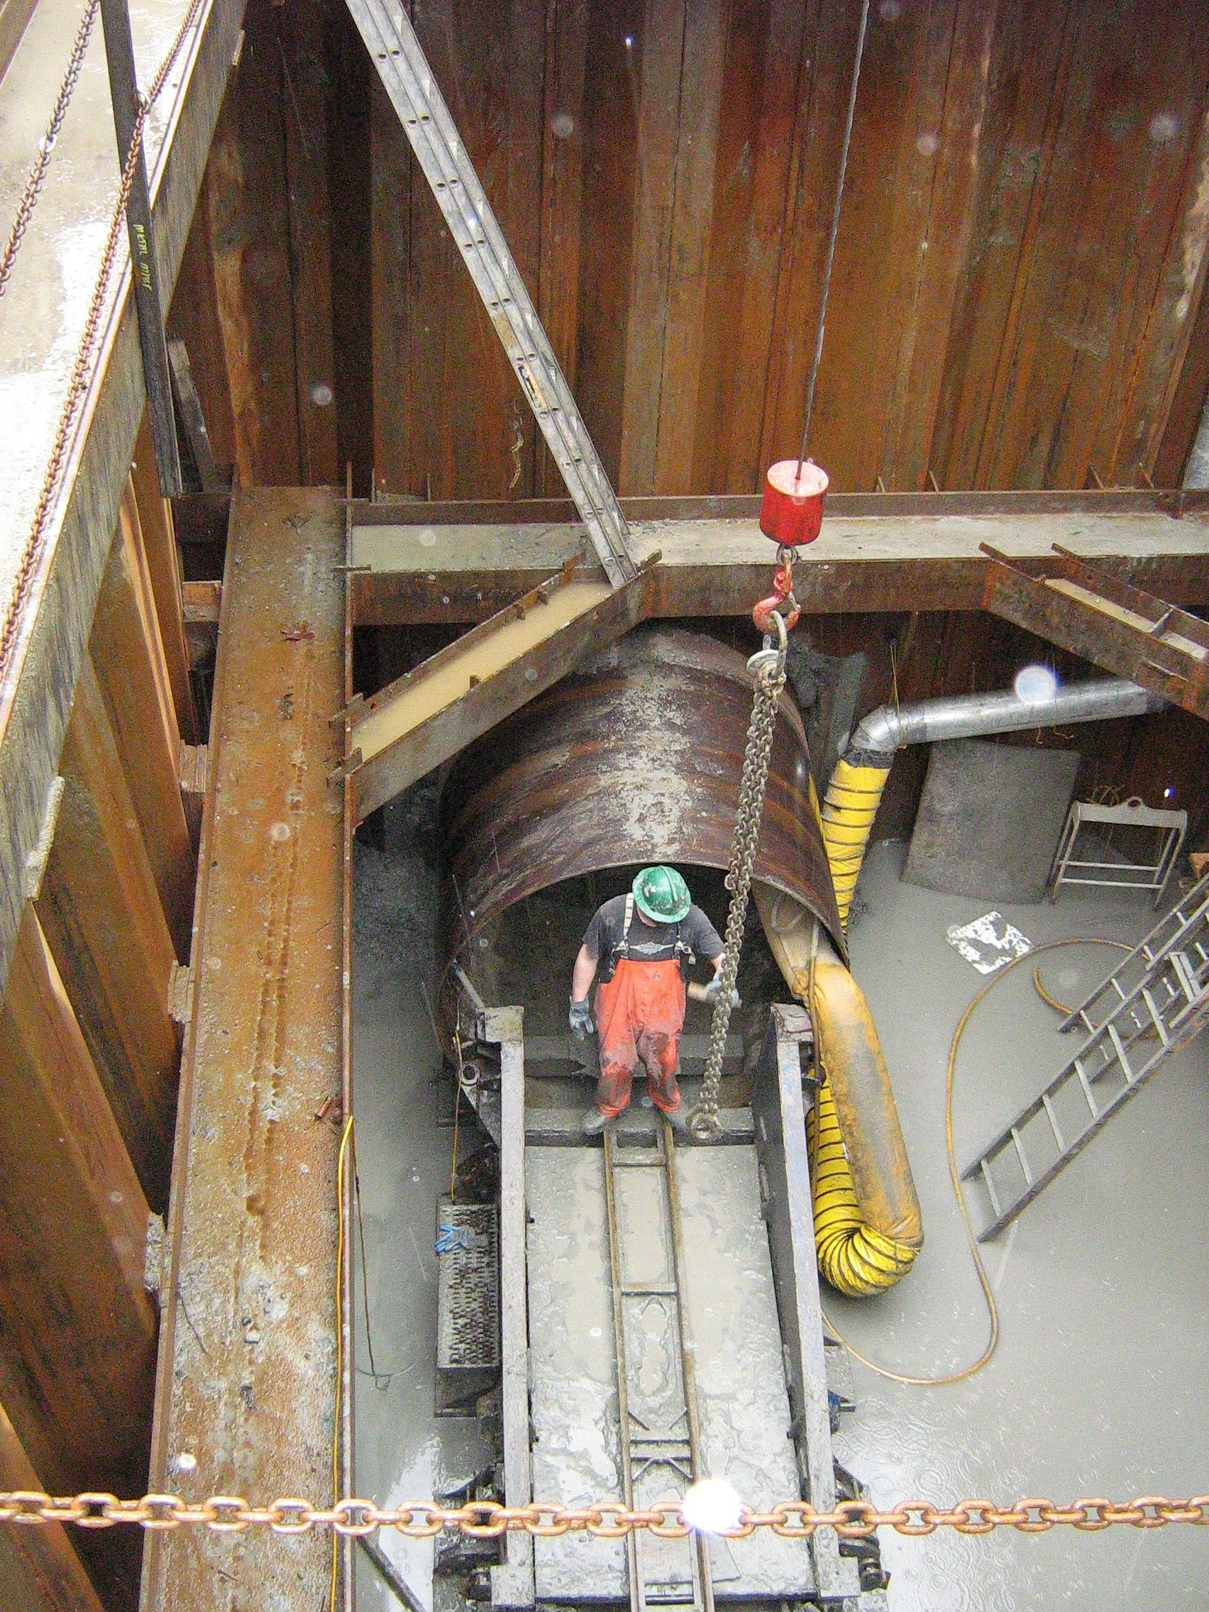

Slide 25
MICROTUNNELLING

Slide 26
Microtunnelling
"A remotely controlled, laser guided, pipe jacking
system in which personnel entry is not required"

Slide 27
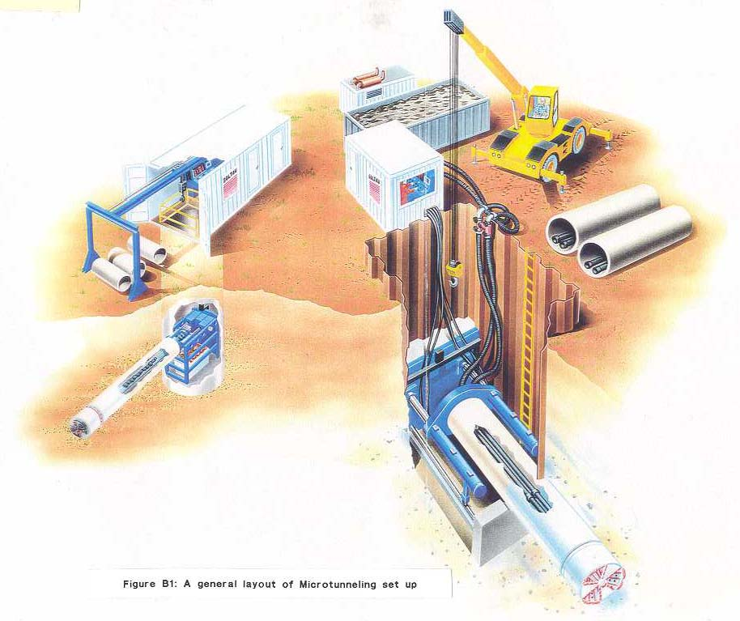
A general layout of Microtunnelling set up

Slide 28
PIPE RAMMING

Slide 29
A method of installing pipes by ramming it using an air Hammer

Slide 30
Howe Sound, BC

Slide 31
Alignment of the Outfall

Slide 32
Site Constraints
Open cut trenching not allowed
Direct effluent discharge into Howe Sound not permitted
Permitting schedule for discharge within intertidal zone does not match construction schedule
Likely contaminated sideslopes / seabed

Slide 33
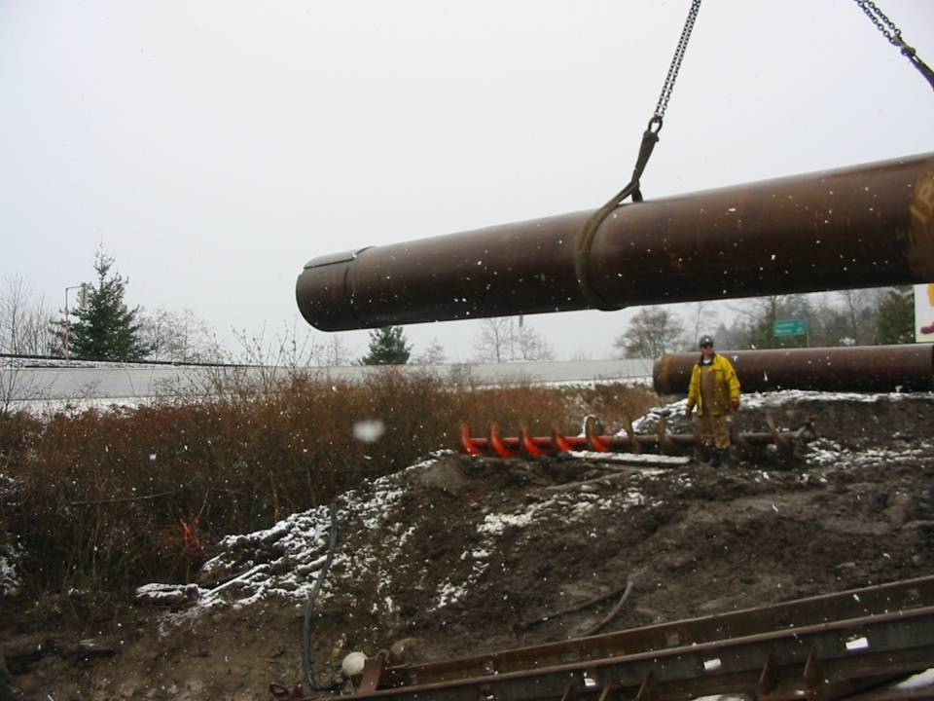

Slide 34
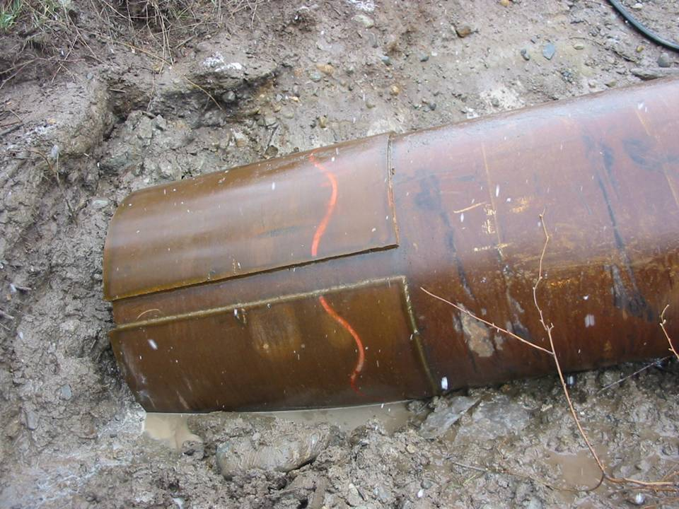
Driving Shoe (36” Diameter Pipe)

Slide 35
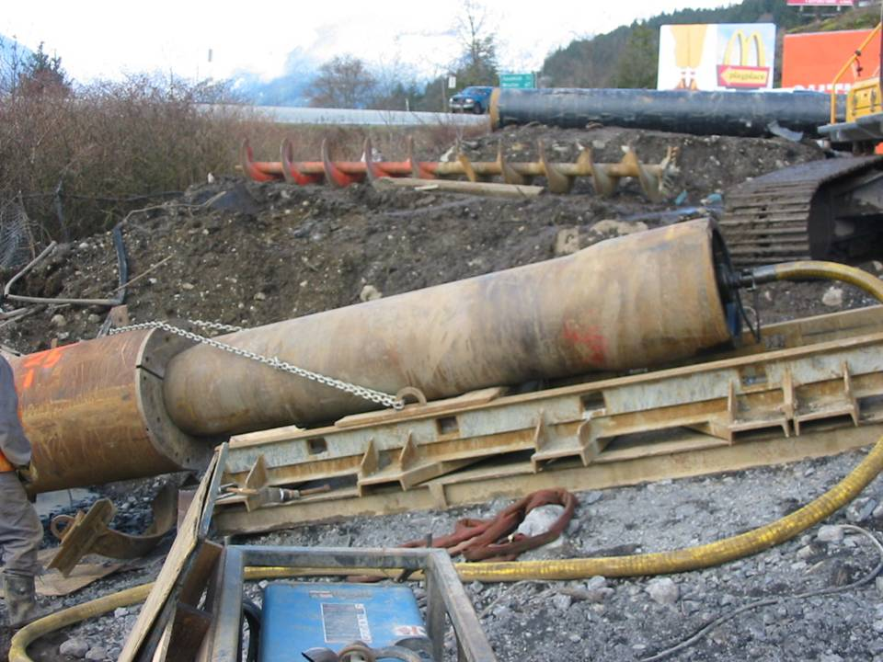
Pipe Ramming (36” Diameter Pipe)

Slide 36
Completion of Telescopic Pipe Ramming
.

Slide 37
HORIZONTAL DIRECTIONAL
DRILLING

Slide 38
Method for the installation of pipes, conduits and
cables using a surface-launched drilling rig.

Slide 39
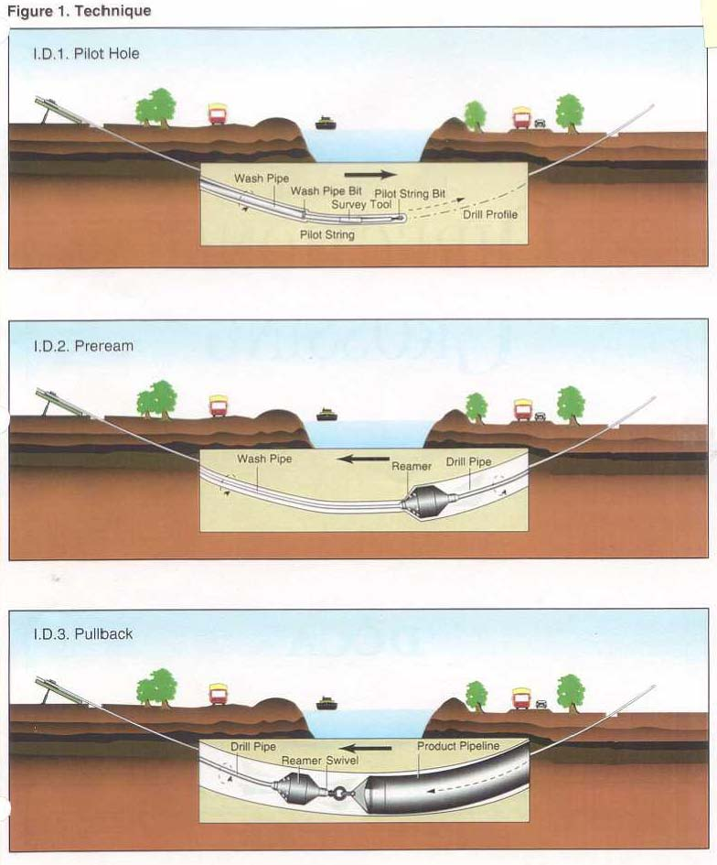
Technique

Slide 40

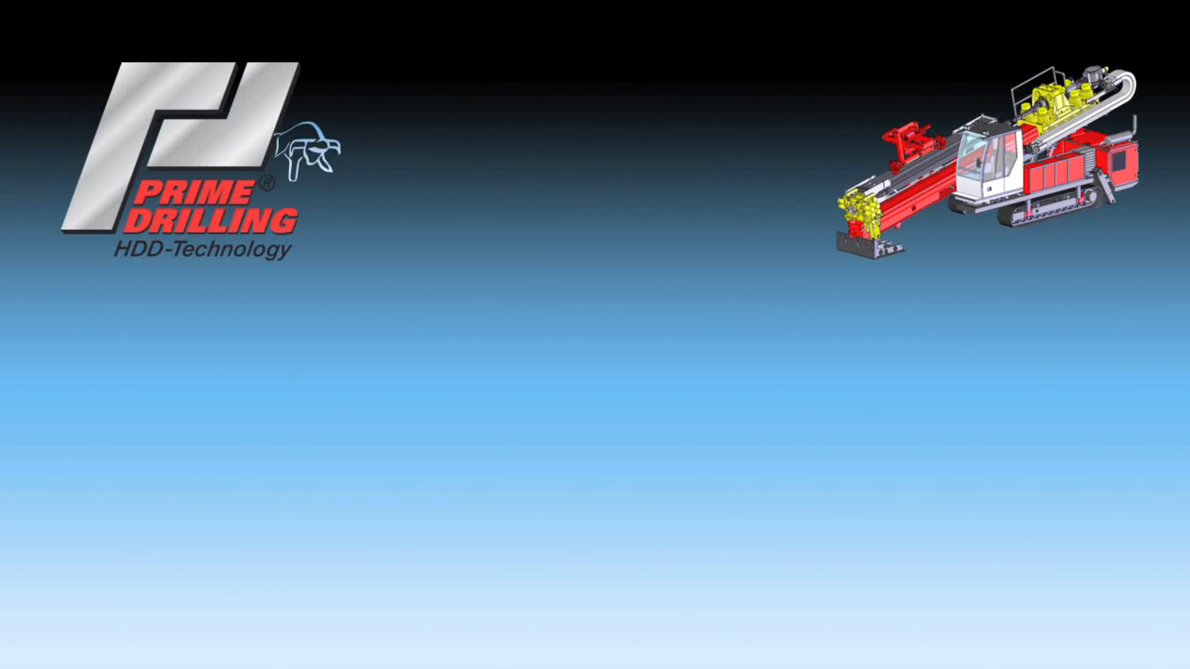

Slide 41
Harrison River Crossing

Slide 42
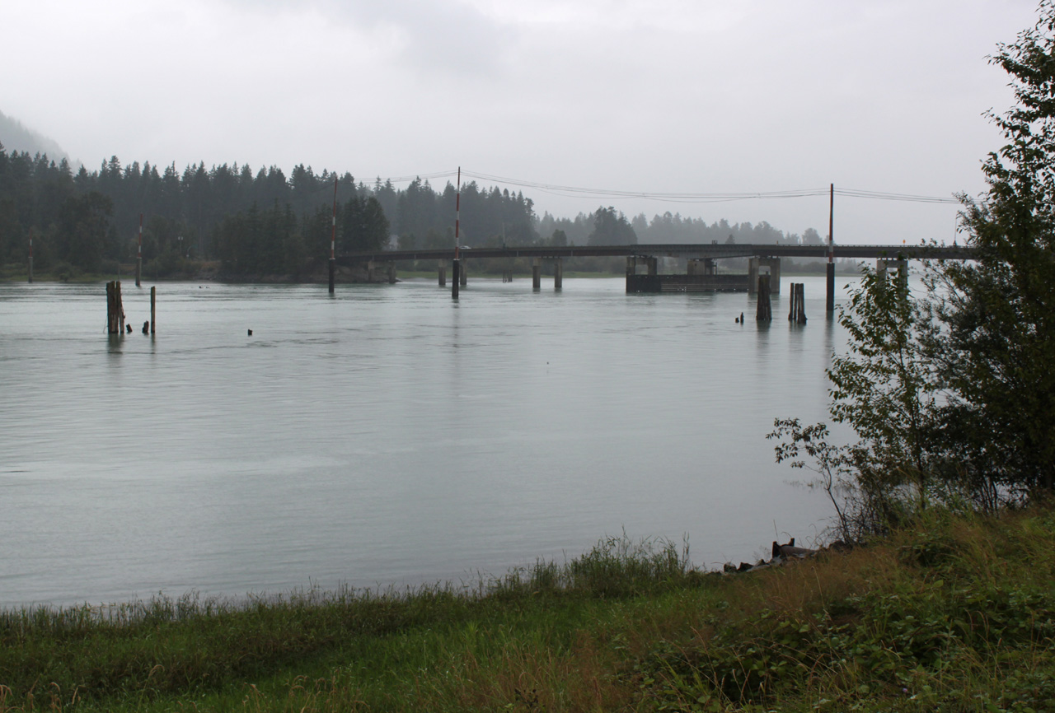

Slide 44
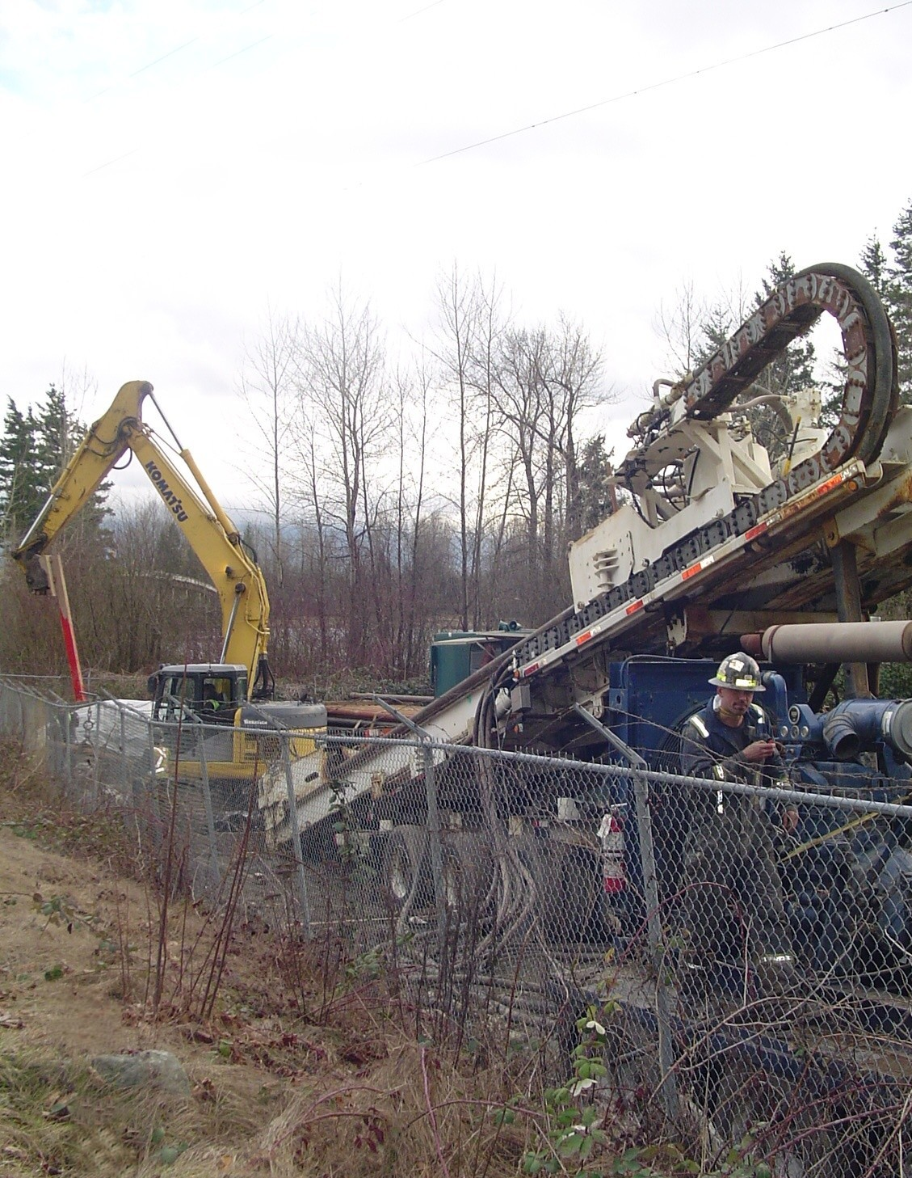

Slide 45
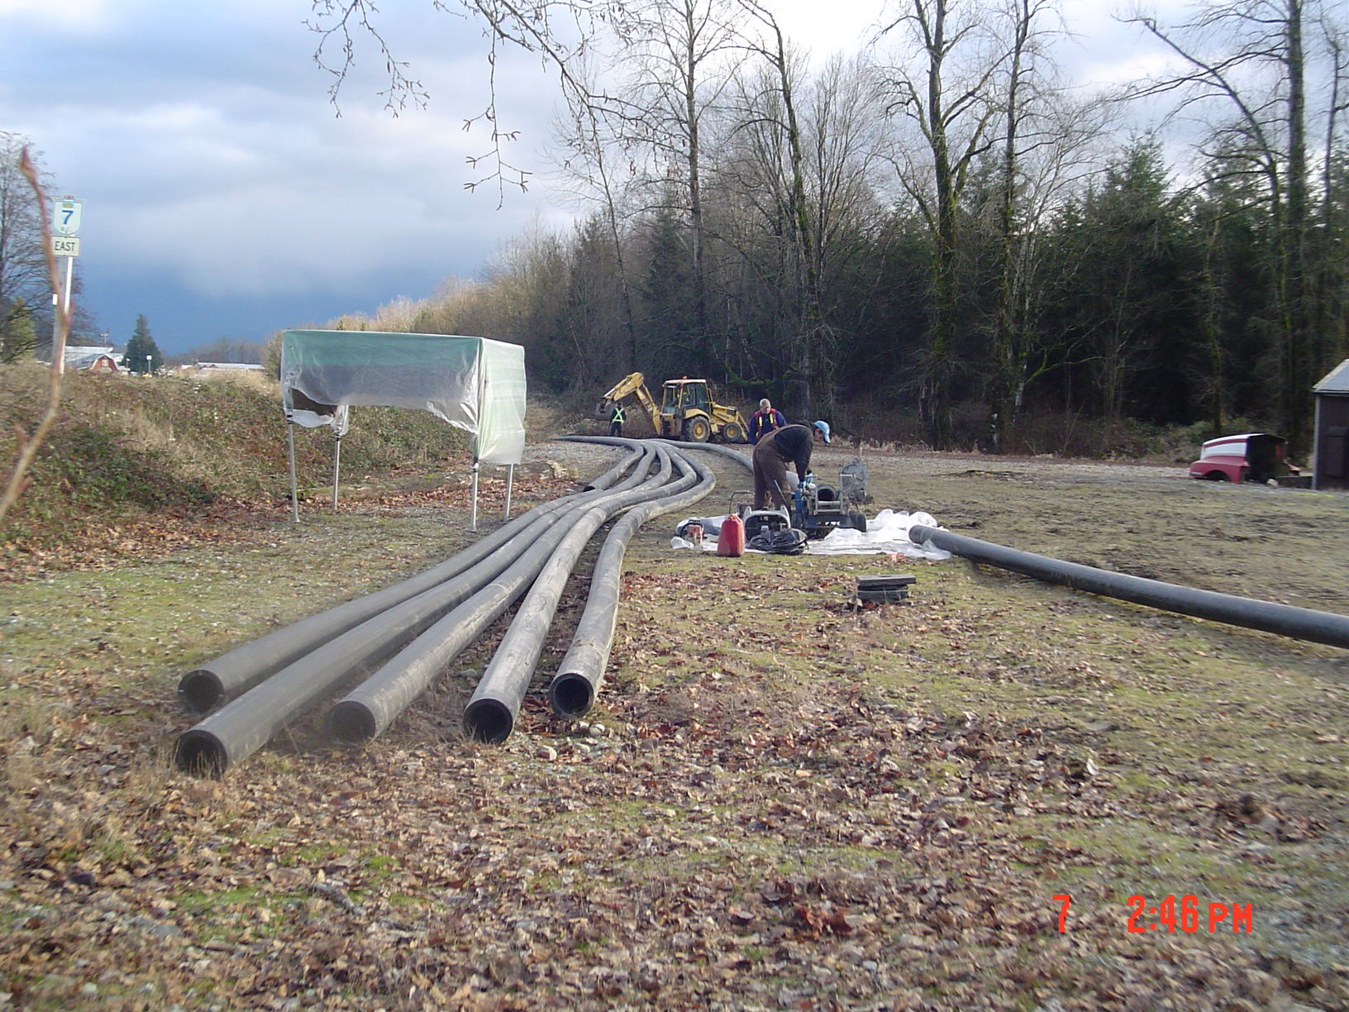

Slide 46
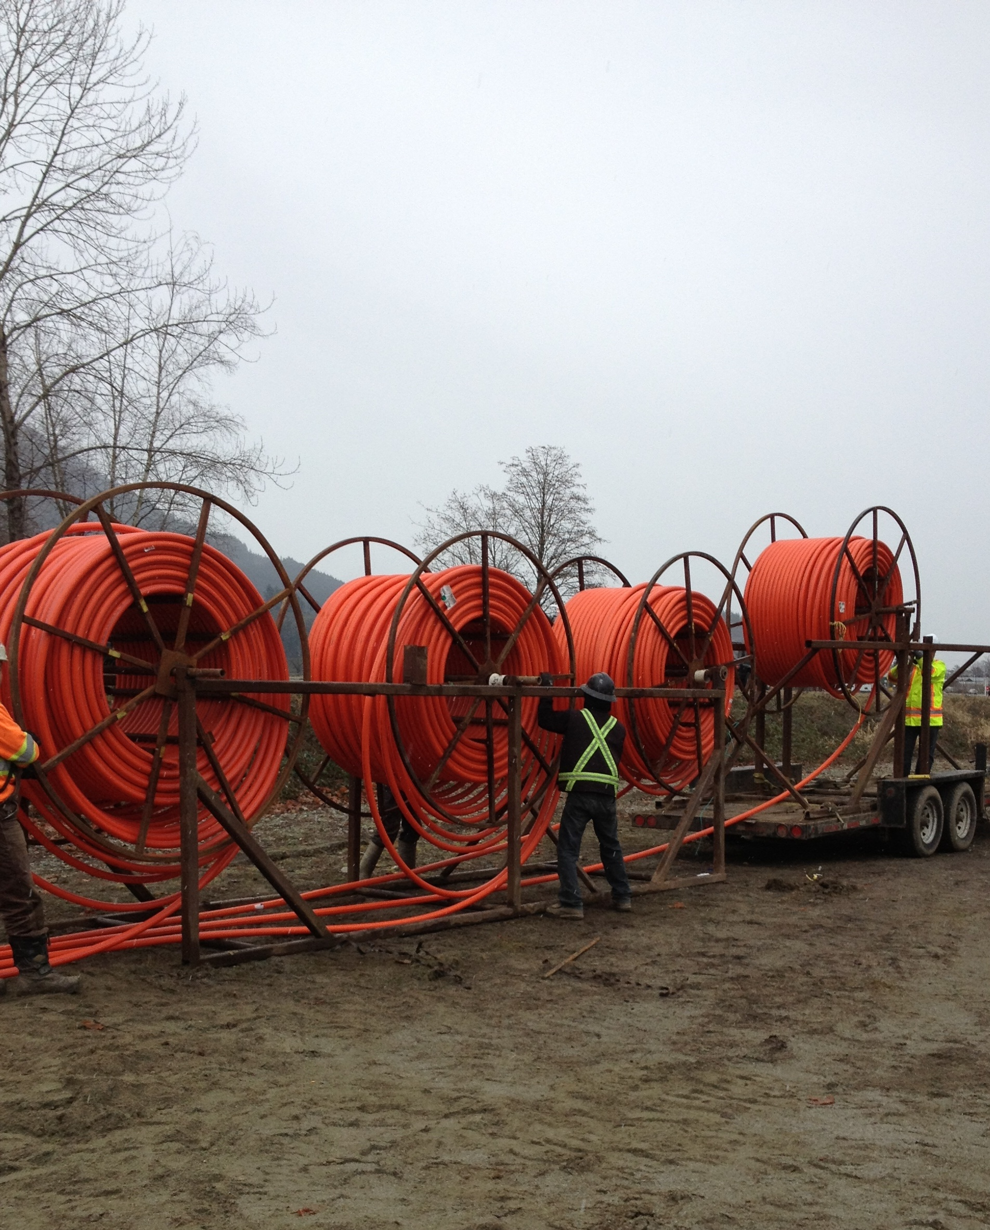

Slide 47
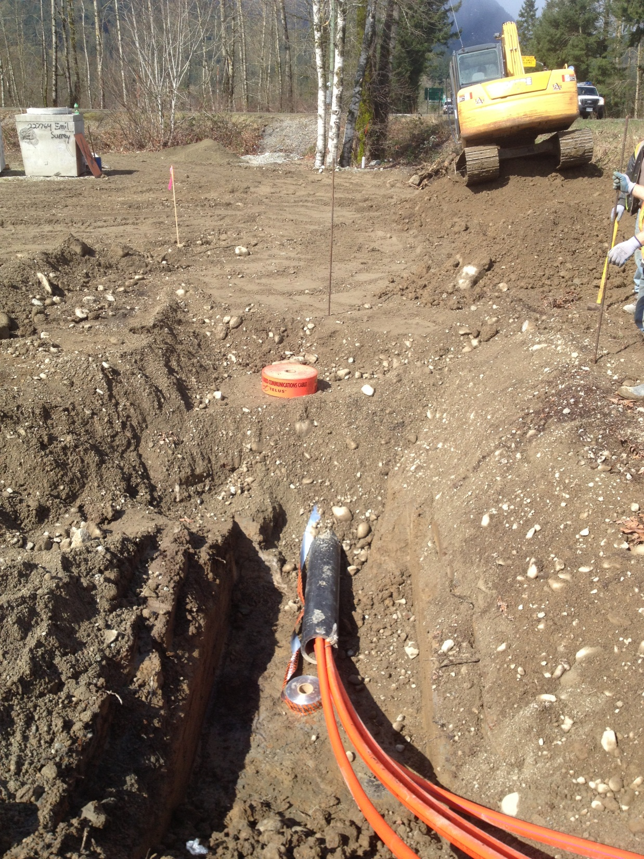

Slide 48
Vancouver City Central Transmission Project

Slide 50
Project
Install a bundle of 5- 10 in. and 8 - 4 in Diameter conduits under False Creek to house electrical cables

Slide 51
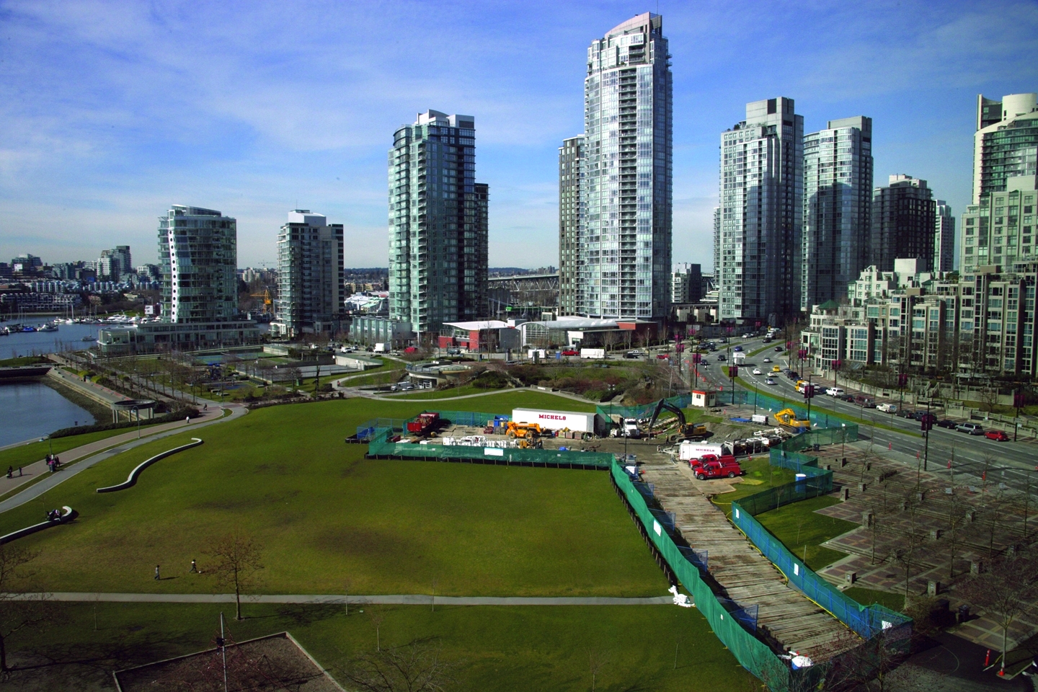

Slide 54
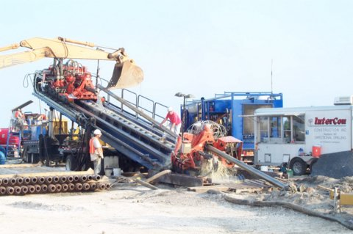

Slide 55
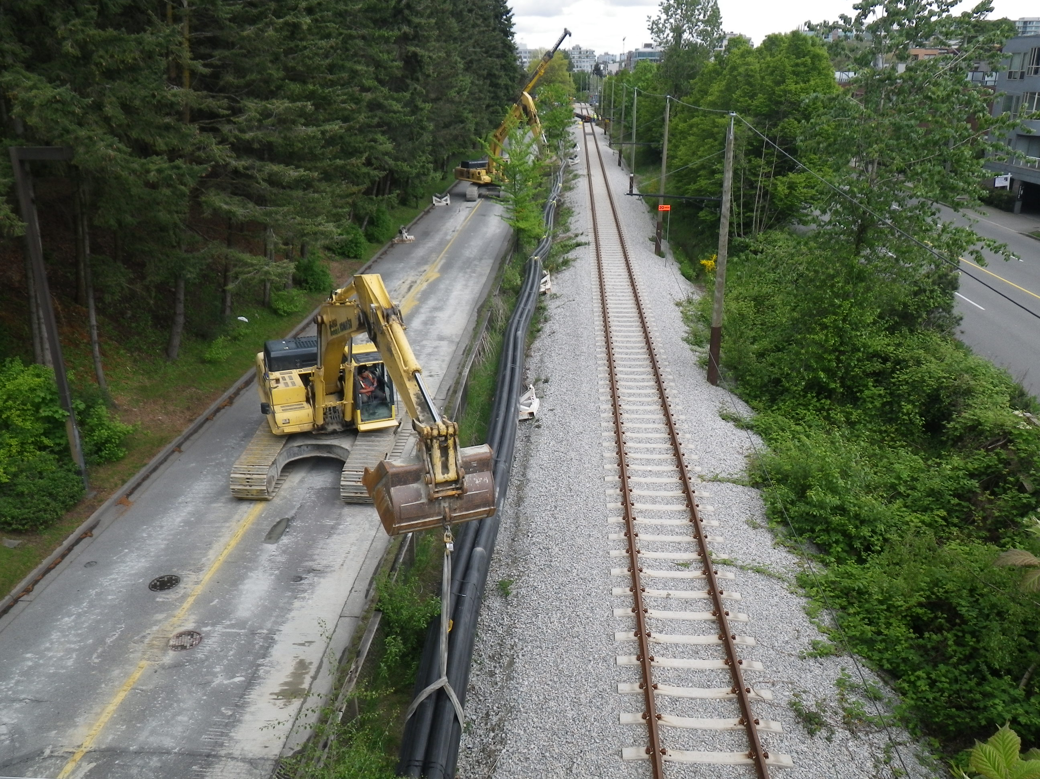

Slide 56
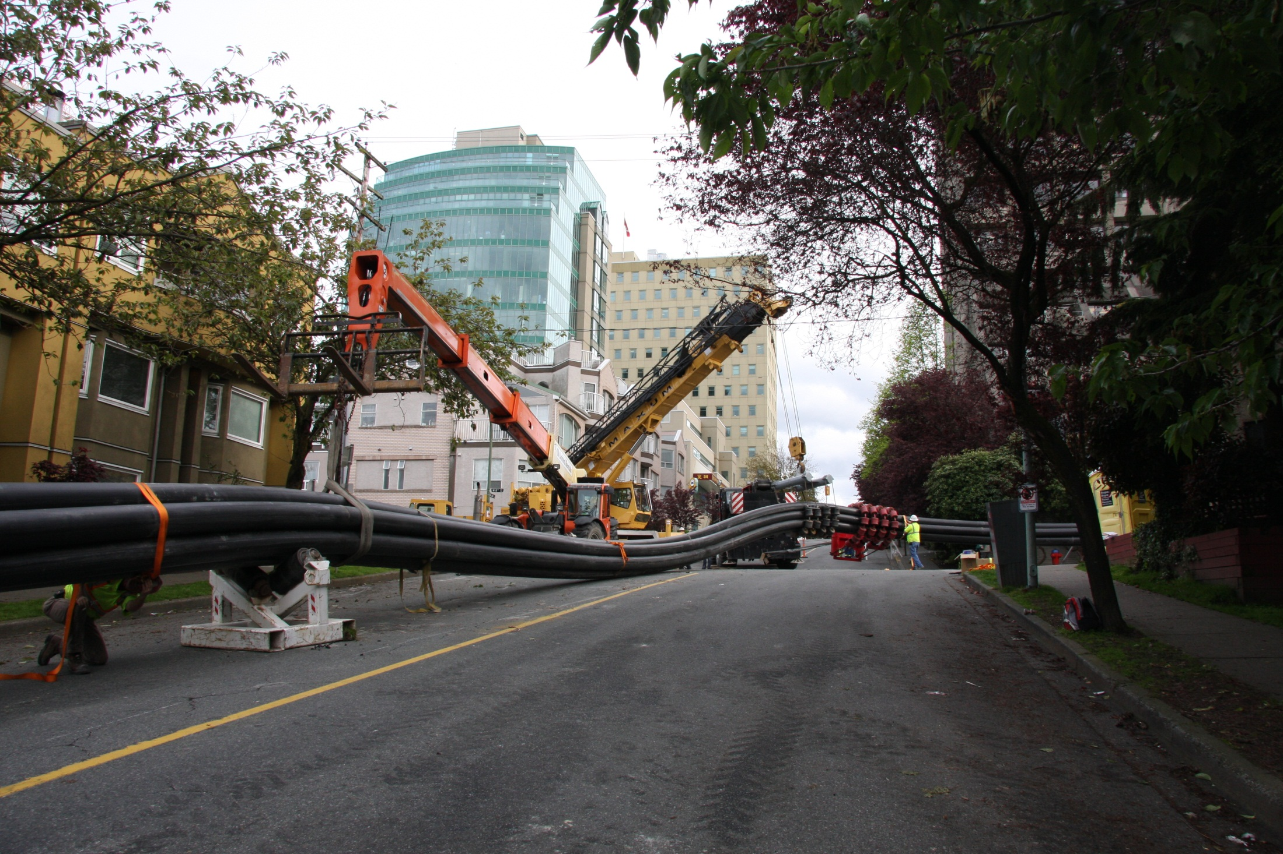

Slide 57
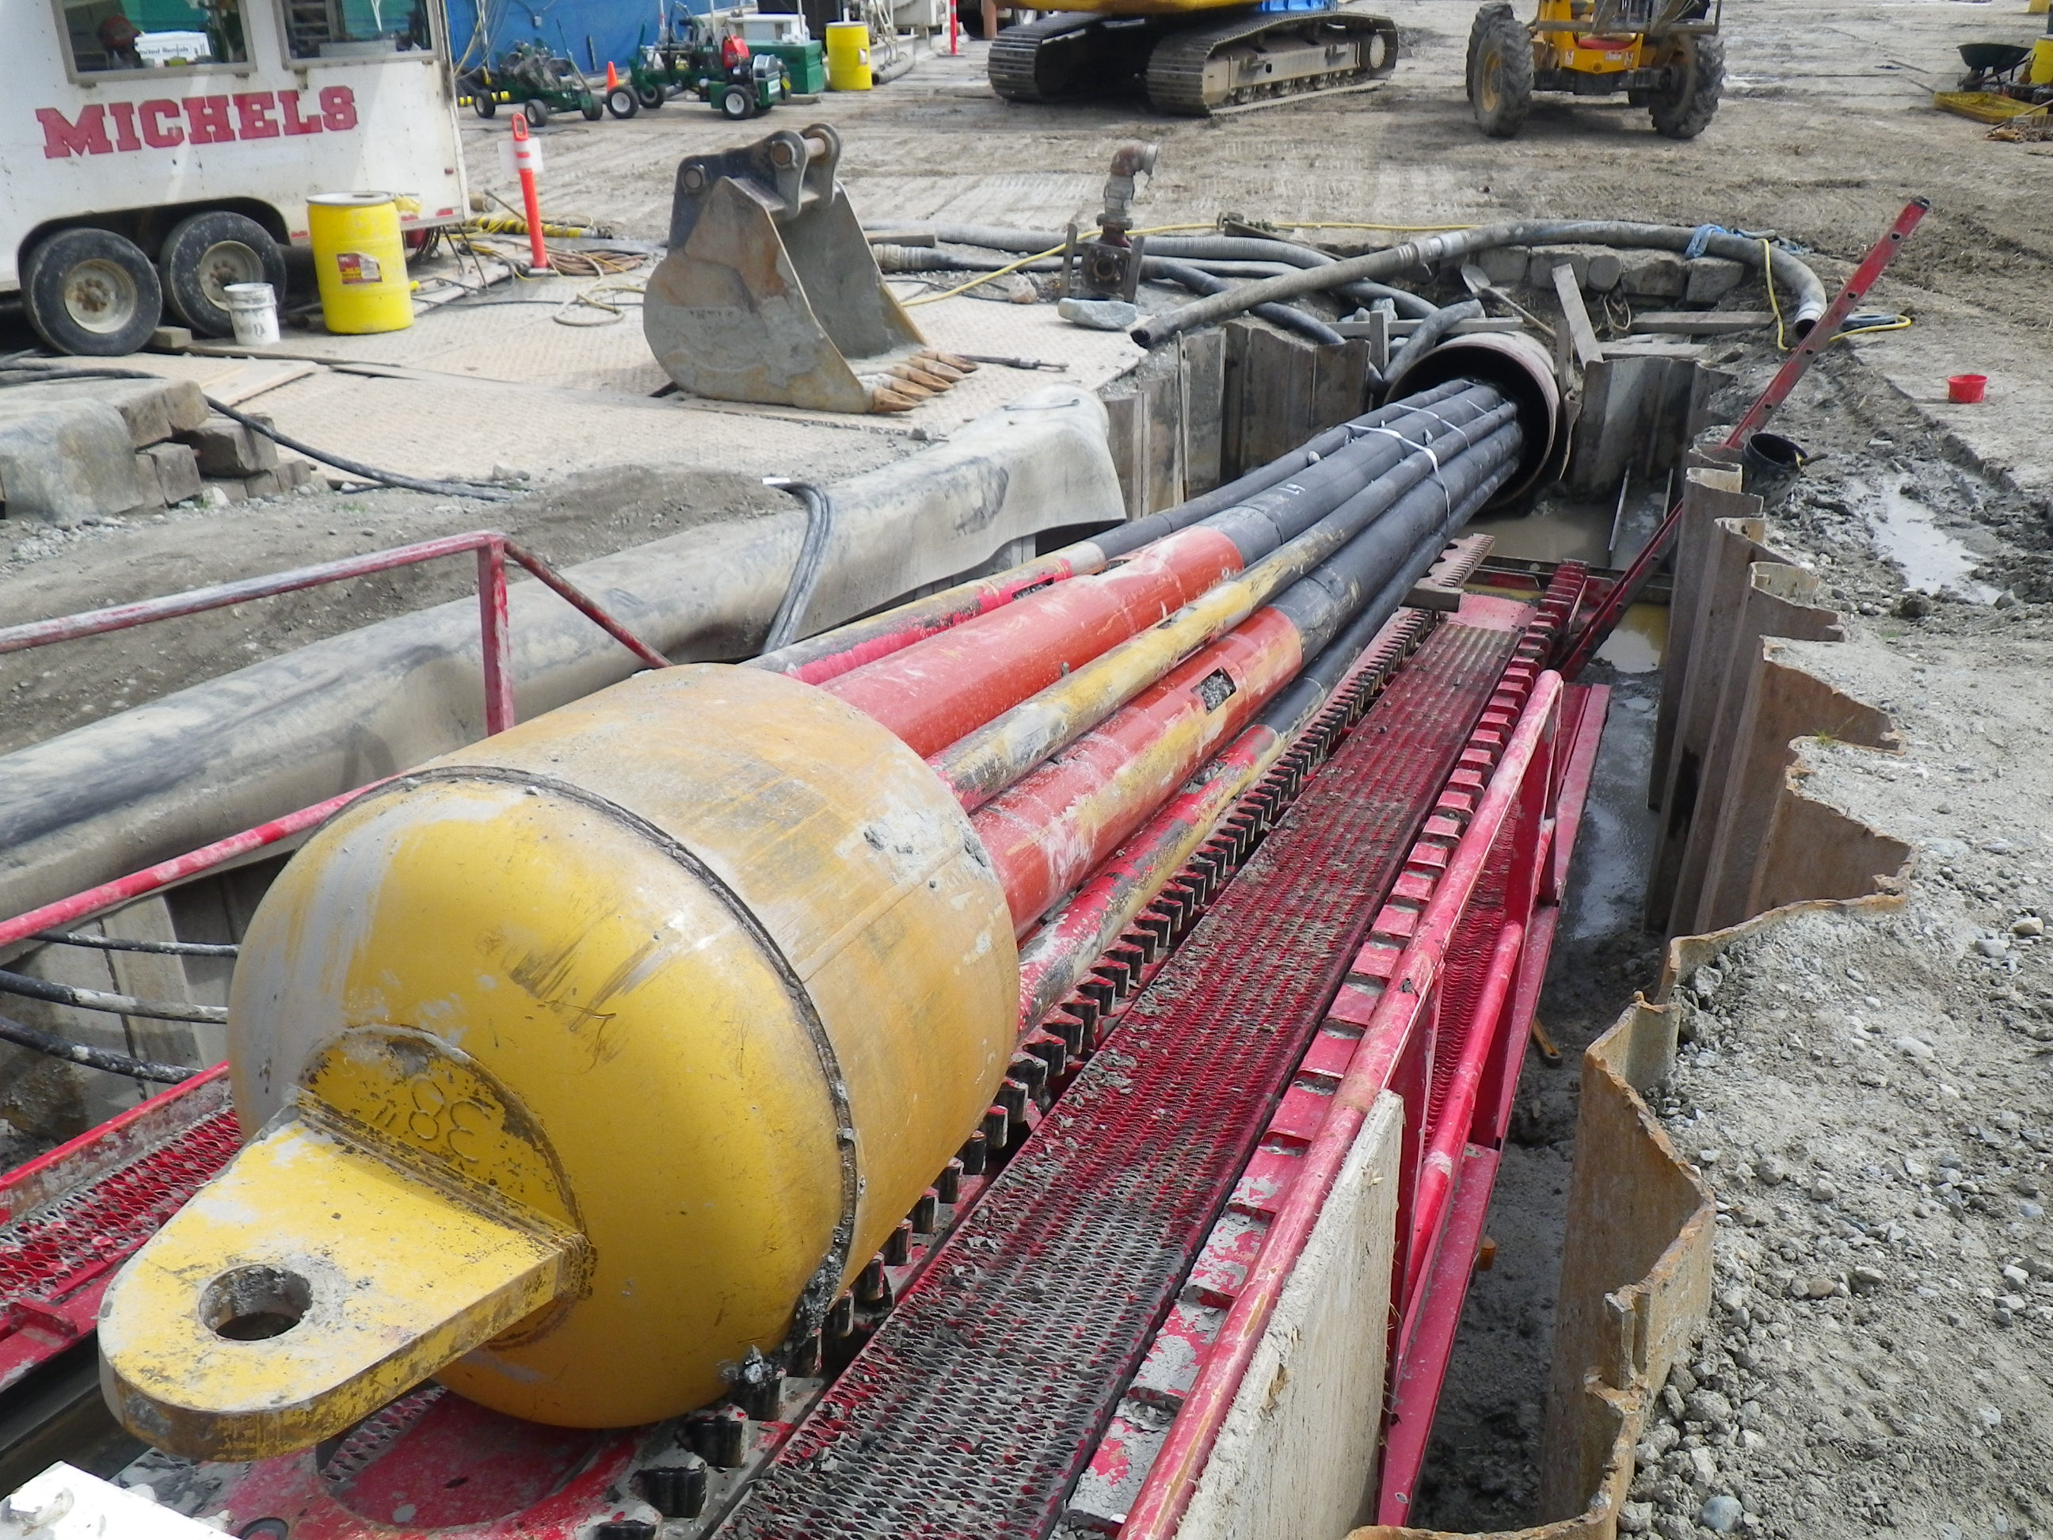

Slide 58


Slide 59
Fraser River Crossing , Terasen Gas

Slide 60
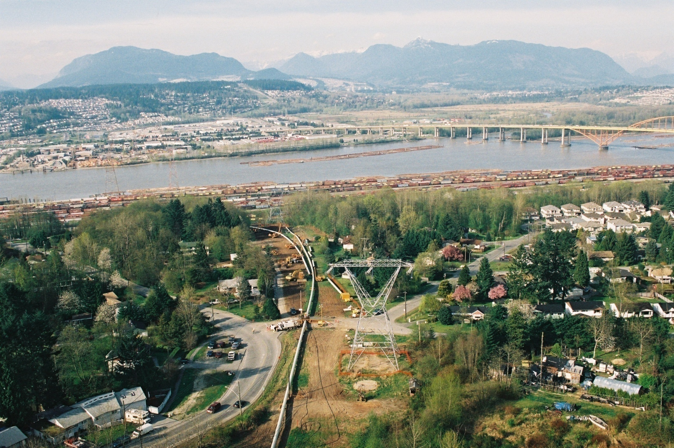
Port Mann Terasson Crossing

Slide 61
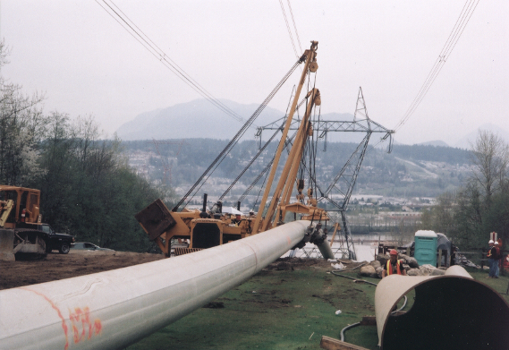

Slide 62
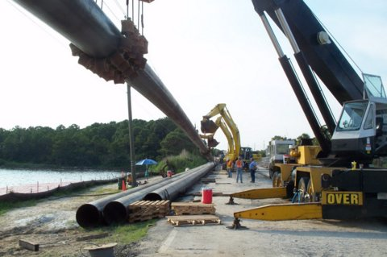

Slide 63
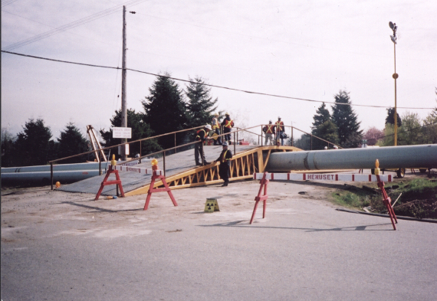

Slide 64
Up North

Slide 65
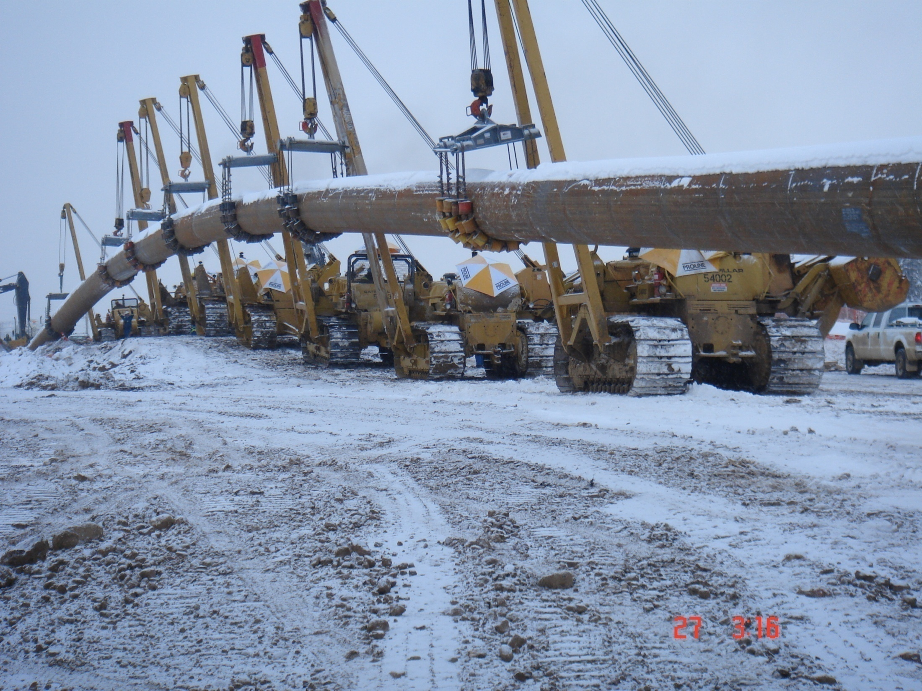

Slide 66
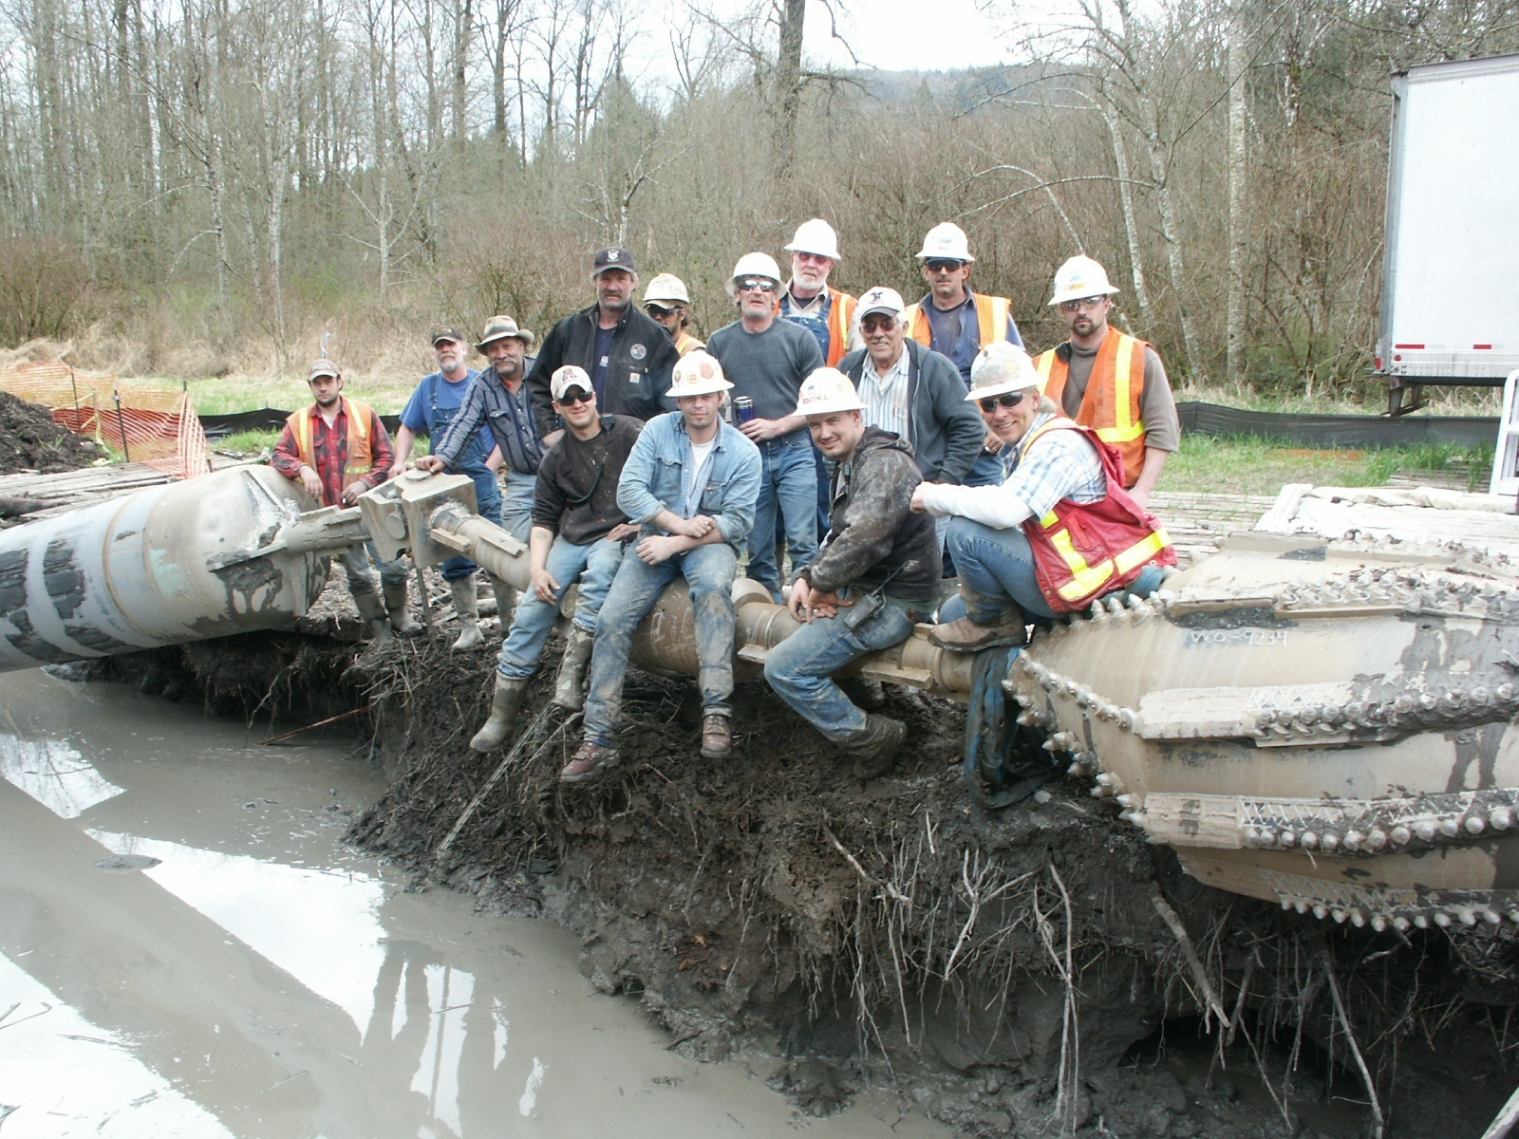

Slide 67
Questions?

