Slide 1
Social Psychological Approach in Civil Engineering
Dr.Tsuyoshi Hatori
Dept. of Environmental Design
Faculty of Collaborative Regional Innovation
Ehime University
Notes:
In recent years, I have applied social psychological approach to the field of civil engineering.
Today, at first, I will briefly talk about the role and significance of this approach in civil engineering.
Then, I will introduce one study on disaster mitigation, which I made on the basis of social psychology.

Slide 2
Fundamentals of Civil Engineering
Ultimate purpose of civil engineering is to promote well-being and realize “good society”.
Civil engineering keeps aimed at achieving this goal through designing and managing infrastructure facilities (transportation, construction, mining, disaster prevention, architecture, etc.).
Notes:
Ultimate purpose of civil engineering is to promote well-being and realize “good society”.
I think everyone agrees with this.
Civil engineering should keep aimed at achieving this goal through designing and managing infrastructure facilities, including transportation, construction, mining, disaster prevention, architecture, and so on.

Slide 3
…However…
Even if infrastructure facilities are appropriately planned and designed by civil engineering technique,
when people
behave in a selfish manner
-destruct environment (waste energy, throw litter, use cars excessively…)
-don’t contribute any efforts to their communities
-distrust in the government and reject any infrastructure projects
our well-being would not be improved and “good society” would not be realized forever!!
Notes:
However, even if infrastructure facilities are appropriately planned and designed by civil engineering technique,
when people behave in a selfish manner, like
-destruct environment (waste energy, throw litter, use cars excessively…)
-don’t contribute any efforts to their communities
-distrust in the government and reject any infrastructure projects
3. our well-being would not be improved and “good society” would not be realized forever!!

Slide 4
…However…
Important roles of Social Psychology
Even if infrastructure facilities are appropriately planned and designed by civil engineering technique,
when people
▶ An important concept: “social dilemma”
behave in a selfish manner
-destruct environment (waste energy, throw litter, use cars excessively…)
-don’t contribute any efforts to their communities
-distrust in the government and reject any infrastructure projects
behave in a pro-social manner
-maintain environment (save energy, buy environment-friendly goods, use public transportation…)
-contribute voluntarily to their communities
-trust in the government and accept appropriate infrastructure projects
our well-being would not be improved and “good society” would not be realized forever!!
Notes:
Therefore, it is important to promote people to behave in a pro-social manner.
This is an important role that social psychology can play in civil engineering.
A key concept developed in social psychology is “social dilemma”.

Slide 5
Social Dilemma
Defection: acting in one’s own self interests
e.g. destructing landscape, no contribution to communities…
Cooperation: acting in the interest of the collective
e.g. taking care of landscape, contributing to communities…
Attitude & behavior change from defection to cooperation
Notes:
Social dilemma is defined as a conflicting situation where an individual has to choose defection or cooperation.
Here, defection means acting in one’s own self interests, while cooperation means acting in the interest of the collective.
An important question is: how to promote attitude & behavior change from defection to cooperation.

Slide 6
Psychological Processes towards Cooperative Behavior
Attitude
“prefer cooperation”
Communication as a prescriptive measure
Morality
“ought to cooperate”
Implementation intension
“when, where, and how to cooperate”
Behavioral change to cooperation
Behavioral intension
“willing to cooperate”
Perceived behavioral control
“it’s easy to cooperate”
Place attachment
“love our residential place”
Notes:
In the field of social psychology, many research have proposed various models to describe psychological processes, in which people change their behavior from defection to cooperation.
This figure is one of these models, composed of several psychological factors like….
Given such a model, it is important to promote each factor by encouraging communication as a prescriptive measure.

Slide 7
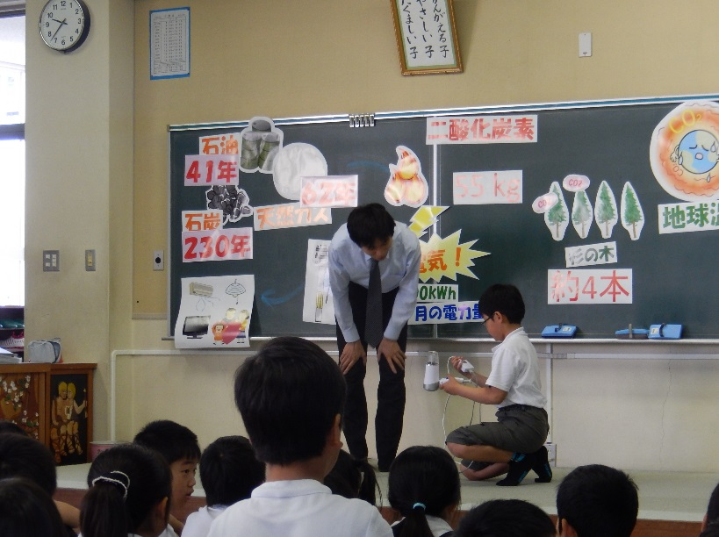
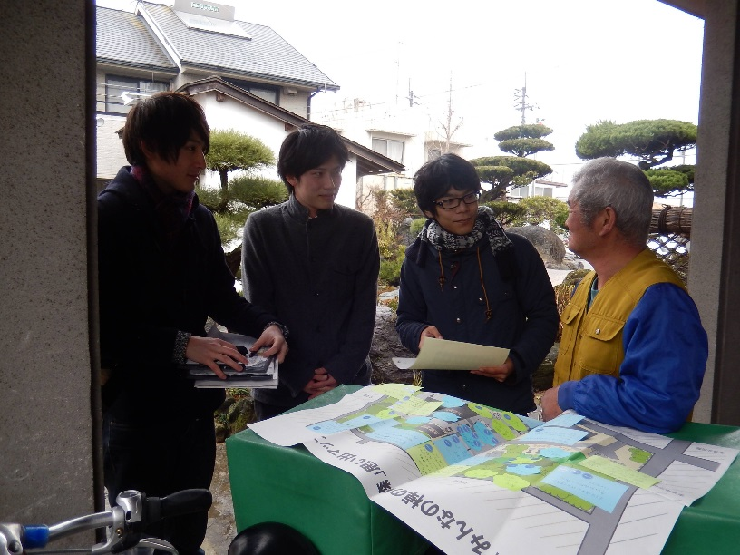
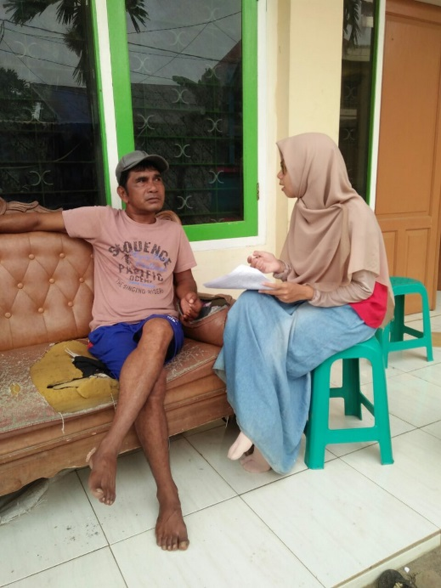
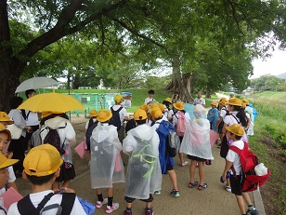
Prescriptive measures for promoting cooperation
Environmental education for “smart” use of electricity
“Community memory map” for civic pride
Trust formation
around relocation
program
Walking event for place attachment
Notes:
So, I have made prescriptive measures for promoting cooperation on the basis of psychological theory, like….
I then examined the effects of these measures empirically.

Slide 8
The Roles of Social Psychology in Civil Engineering
Social psychology is just one of various approaches of social sciences.
But, this approach, through inducing attitude & behavior changes, may make an important contribution to human well-being and “good society” which civil engineers seek to achieve.
Notes:
Social psychology is just one of various approaches of social sciences, which can be applied to civil engineering.
But, this approach and attitude & behavior changes induced by it may make an important contribution to human well-being and “good society” which civil engineers seek to achieve.

Slide 9
Metacognitive Awareness of Unexpected Risk and a Method for its Promotion
Tsuyoshi Hatori
（Ehime University）
Notes:
Next, I will introduce one study regarding disaster mitigation, which I made on the basis of social psychological approach.
The title is: Metacognitive Awareness of Unexpected Risk and a Method for its Promotion.

Slide 10
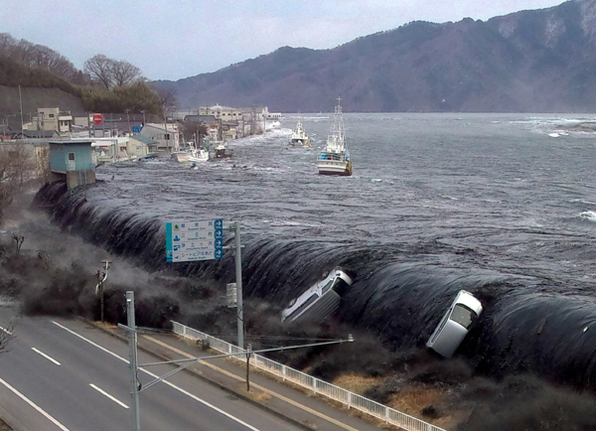
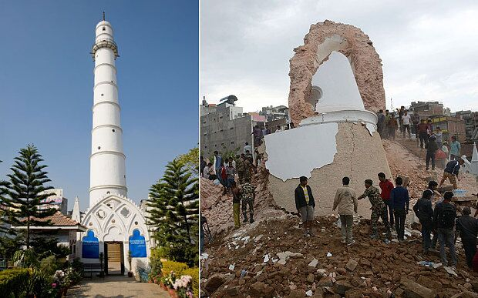
How to deal with unexpected disasters?
The 2011 Tohoku earthquake
The 2015 Gorkha earthquake
Notes:
These are photos of the 2011 Tohoku earthquake and 2015 Gorkha earthquake.
An important problem for disaster prevention is how to deal with unexpected disasters such as these.

Slide 11
How to deal with unexpected disasters?
It is important to mitigate the risk of the unexpected through hard and soft disaster prevention measures
(e.g. earthquake-resistant measures, prediction, and evacuation planning).
However…
It is impossible to prevent the occurrence of the unexpected completely, even if any measures are taken.
Therefore…
People are required to understand that unexpected events (events beyond their own expectations) can take place during natural disasters.
Notes:
For this problem, it is important to mitigate the risk of unexpected events through hard and soft disaster prevention measures.
However, it is impossible to prevent the occurrence of the unexpected completely, even if any measures are taken.
Therefore, people are required to understand that the unexpected, that is events beyond their own expectations, can always take place during natural disasters.

Slide 12
Public Judgments of Disaster Risks
1. Disaster awareness
People have various assumptions about the likelihood and severity of disaster events (e.g. tsunami heights, human and economic losses).
2. Metacognitive awareness of unexpected risks
People can also expect that events beyond their own assumptions will occur during disaster.
(high metacognitive awareness) If people can expect the unexpected,…
they will prepare for and deal with the unexpected appropriately.
(low metacognitive awareness) If people cannot expect the unexpected,…
they will not prepare for and cannot deal with the unexpected,
and as a result they suffer serious damages.
Notes:
This study assumes two components of public judgments around disaster risks, that is, disaster awareness and metacognitive awareness.
First, people have various assumptions about the likelihood and severity of disaster events.
Furthermore, they can have metacognitive awareness of unexpected risks.
It means that they can expect that events beyond their own assumptions will occur due to disaster.
Such a metacognition is important for disaster prevention,
because if people can expect the unexpected, they will prepare for and deal with the unexpected appropriately.
On the other hand, If people cannot expect the unexpected, they will not prepare for and cannot deal with the unexpected, and as a result they suffer serious damages.

Slide 13
Lack of Metacognitive Skill (Previous Research)
Dunning = Kruger Effect (Kruger & Dunning, 1999)
Incompetent individuals lack the metacognitive skills necessary for accurate self-assessment.
People may have little insight into their own ignorance.
Illusion of understanding (Rozenblit & Keil, 2002)
People think they understand the world in far more detailed way than they really do.
Notes:
Several research suggests that people often lack metacognitive skills.
For example, according to Dunning = Kruger effects, incompetent individuals lack the metacognitive skills necessary for accurate self-assessment.
This implies that people may have little insight into their own ignorance.
Also, Rozenblit and Keil provide much evidence about illusion of understanding among lay people.
They show that people think they understand the world in far more detail than they really do.

Slide 14
Dunning = Kruger Effect (Kruger & Dunning, 1999)
100
90
Lack of metacognitive skill
●
80
■
70
■
Perceived Ability
60
■
●
■
50
40
●
30
Actual Test Score
20
10
●
0
Bottom
Quartile
2nd
Quartile
3rd
Quartile
Top
Quartile
Notes:
The result of their experiment is interesting and also understandable.
They divided students into 4 groups according to their test score.
They also asked students to estimate their own score.
The graph shows the result.
Of course, actual test score become higher from bottom to top group.
On the other hand, their self-estimations vary but little.
This means that those who actually got low scores estimated that they got higher scores.
So, they are considered to lack metacognitive skill.

Slide 15
Purpose of the Present Study
In order to mitigate disaster damages through appropriate judgment of residents, it is important to promote their metacognitive awareness of the unexpected.
This study proposed a new type of hazard map as a method to provide disaster information in order to promote metacognitive awareness.
It examined its effect through an experiment targeting floodplain residents.
Notes:
As already mentioned, in order to mitigate disaster damages through appropriate judgment of residents, it is important to promote their metacognitive awareness of the unexpected.
This study proposed a new type of hazard map as a method to provide disaster information in order to promote metacognitive awareness.
It examined its effect through an experiment targeting floodplain residents.

Slide 16
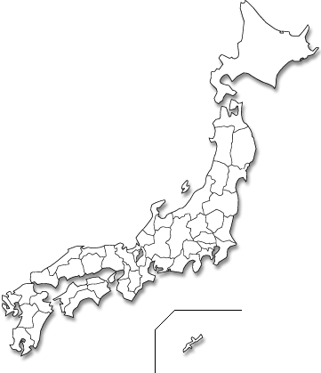
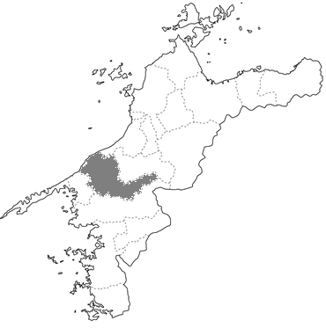
Hazard Map
A hazard map is a map that highlights areas that are affected by or vulnerable to a natural disaster (such as earthquakes, volcanoes, flooding and tsunamis).
Ehime Pref.
Flood hazard map of
Hijikawa River Basin
Notes:
A hazard map is a map that highlights areas that are affected by or vulnerable to a natural disaster (such as earthquakes, volcanoes, flooding and tsunamis).
This is the flood hazard map that is distributed in the research area, Hijikawa River Basin, in Ehime Pref.

Slide 17
Hazard Map
Merit
Promoting disaster awareness and evacuation activity of residents.
Demerit
Hazard map depends on some specific assumptions.
…In case of Hijikawa River Flood Hazard Map…
total amount of rainfall for two days = 300 mm
(not assumed) flood from inland waters and local heavy rainfall
It may discourage metacognitive awareness of the unexpected when residents accept these assumptions to be true without any questions
Notes:
As the merit of Hazard Map, it can promote disaster awareness and evacuation action of residents.
On the other hand, there is also demerit.
Hazard map depends on some specific assumptions.
In case of Hijikawa River Flood Hazard Map, total amount of rainfall for two days is assumed to be 300mm.
Also, flood from inland waters and local heavy rainfall are not assumed.
Therefore, the Hazard Map may discourage metacognitive awareness of the unexpected events when residents accept these assumptions as true without question.

Slide 18
Hazard Map with Reflective Thinking
This study proposed a hazard map with questionnaires through which residents are asked to consider the possibility that events beyond assumptions of the hazard map can arise due to flooding.
Hazard map
Questionnaires
If the total amount of rainfall is over 300mm,…
“what height of inundation would you expect?”
“what kinds of damage would you expect?”
+
Promote metacognitive awareness of the unexpected
Notes:
This study proposed a new type of hazard map with reflective thinking, by adding questionnaires through which residents are asked to consider the possibility that events beyond assumptions of the hazard map can arise due to flooding.
In addition to distribute ordinary Hazard Map, we asked residents to consider and image the unexpected events.
It can be expected that such a reflective thinking can promote metacognitive awareness of the unexpected.

Slide 19
Experimental Procedure
Step 1: Measurement of disaster awareness and metacognitive
awareness
(about 2 months)
Step 2: Reading of hazard map
Condition 1: Hazard map with reflection (n = 181; HMR group)
Condition 2: Ordinary hazard map (n = 212; HM group)
Condition 3: No hazard map (n = 212; Control group)
Step 3: Measurement of disaster awareness and metacognitive
awareness
Notes:
First, respondents, they were randomly selected from residents, were asked to answer questions regrading disaster awareness and metacognitive awareness.

Slide 20
Experimental Procedure
Step 1: Measurement of disaster awareness and metacognitive
awareness
1) Disaster awareness (estimation of inundation height)
(about 2 months)
If there is a flood, what height of inundation would you expect more likely at your place?”
Step 2: Reading of hazard map
Condition 1: Hazard map with reflection (n = 181; HMR group)
Condition 2: Ordinary hazard map (n = 212; HM group)
Condition 3: No hazard map (n = 212; Control group)
2) Metacognitive awareness
How likely would you expect the actual height of inundation to exceed your estimation?
Step 3: Measurement of disaster awareness and metacognitive
awareness
Not at all
Very much so
Notes:
Firstly, to measure disaster awareness, they were asked to estimate the height of inundation at their place in case of flooding.
Then, to measure metacognitive awareness, they were asked how likely would they expect the actual height of inundation to exceed their estimation (their answer in the first question).

Slide 21
Experimental Procedure
Step 1: Measurement of disaster awareness and metacognitive
awareness
Reflective thinking about the unexpected
(about 2 months)
Land sliding
Step 2: Reading of hazard map
Outflow of agricultural equipment
Condition 1: Hazard map with reflection (n = 181; HMR group)
Condition 2: Ordinary hazard map (n = 212; HM group)
Danger of driftwood
Condition 3: No hazard map (n = 212; Control group)
Isolation of rural communities
Step 3: Measurement of disaster awareness and metacognitive
awareness
Notes:
Secondly, the respondents were asked to read the Hazard Map.
Here, they were divided into three groups representing these three conditions.
In condition 1, called HMR group, respondents read ordinary hazard map and also answered the questions about events exceeding assumptions of the map.
They assumed various unexpected events like land sliding, outflow of agricultural equipment, danger of driftwood and isolation of rural communities.
In condition 2, called HM group, respondents read ordinary hazard map only.
In condition 3, control group, respondents did not read a hazard map.

Slide 22
Experimental Procedure
Step 1: Measurement of disaster awareness and metacognitive
awareness
(about 2 months)
Step 2: Reading of hazard map
Condition 1: Hazard map with reflection (n = 181; HMR group)
Condition 2: Ordinary hazard map (n = 212; HM group)
Condition 3: No hazard map (n = 212; Control group)
Step 3: Measurement of disaster awareness and metacognitive
awareness
Notes:
Finally, the respondents again answered questions regrading disaster awareness and metacognitive awareness.

Slide 23
Results: Association between disaster awareness and metacognitive awareness
High
Metacognitive awareness
(Likelihood of events exceeding his or her own estimation)
Low
（n=605）
Those who underestimate the height of inundation tend more to underestimate the possibility of occurrence of situations exceeding their estimation.
Notes:
This graph shows the association between disaster awareness and metacognitive awareness.
On the basis of respondents’ estimates of inundation height, they were divided into two group: high estimate group and low estimate group.
The mean height among high estimate group was 4.85m, and that among low estimate group was 1.47m.
Vertical axis shows the average score of metacognitive awareness, that is, likelihood of events exceeding his or her own estimation.
As shown in this figure, those who underestimate the height of inundation tend more to underestimate the possibility of occurrence of situations exceeding their estimation.

Slide 24
Results: Differences between respondents’ estimates and estimates shown in Hazard Map
High estimate group in HMR group
Difference between respondent’s estimate and estimate shown in Hazard Map
High estimate group in HM group
Low estimate group
in HMR group
Low estimate group in HM group
Before reading HM
After reading HM
Estimates of those who read ordinary Hazard Map tend more to be closer to the estimates shown in the map.
In especial, those who originally overestimate inundation height tend to decrease their estimation.
Notes:
This graph shows the effect of reading hazard map on respondents’ estimate of inundation height.
Vertical axis shows the differences between respondents’ estimates and estimates shown in Hazard Map.
Respondents are also divided on the basis of their estimates of inundation height and experimental condition.
So, there are four groups; High estimate group in HMR group, Low estimate group in HMR group, High estimate group in HM group, and Low estimate group in HM group.
It can be understood that estimates of those who read ordinary Hazard Map tend to be closer to the estimates shown in the map.
Especially, those who originally overestimate the inundation height tend to decrease their estimation.
It implies that an ordinary hazard map can reduce disaster awareness.

Slide 25
Results: Changes in disaster awareness and metacognitive awareness
Disaster awareness
(Estimate of inundation height)
Metacognitive awareness
(Likelihood of events exceeding his or her own estimation)
HMR group
HM group
HMR group
HM group
Control group
Control group
Before
After
Before
After
Respondents tend more to recognize the possibility of occurrence of situations exceeding their own estimation through reading the new type of flood hazard map than through an ordinary hazard map, indicating the importance of reflective thinking.
Notes:
These graphs show the changes in disaster awareness and metacognitive awareness in three experimental conditions.
Disaster awareness and Metacognitive awareness were enhanced both in HMR group and HM group.
Yet, as for metacognitive awareness, the effect was stronger in HMR group than in HM group.
It suggests that respondents tend more to recognize the unexpected, that is, possibility of occurrence of situations exceeding their own estimation, through reading the new type of flood hazard map than through an ordinary hazard map.
It also indicates the importance of reflective thinking.

Slide 26
Conclusion
Both disaster awareness and metacognitive awareness are promoted through the reading of ordinary hazard map and hazard map with reflective thinking.
Metacognitive awareness tend more to be promoted through a hazard map with reflective thinking than through an ordinary hazard map.
When providing a hazard map,…
by adding questionnaires about assumptions of the map, metacognitive awareness of the unexpected can be effectively promoted.

