Slide 1

Bipin Jha, Data Analyst
UNRCO/NRRC/CFP

Slide 2
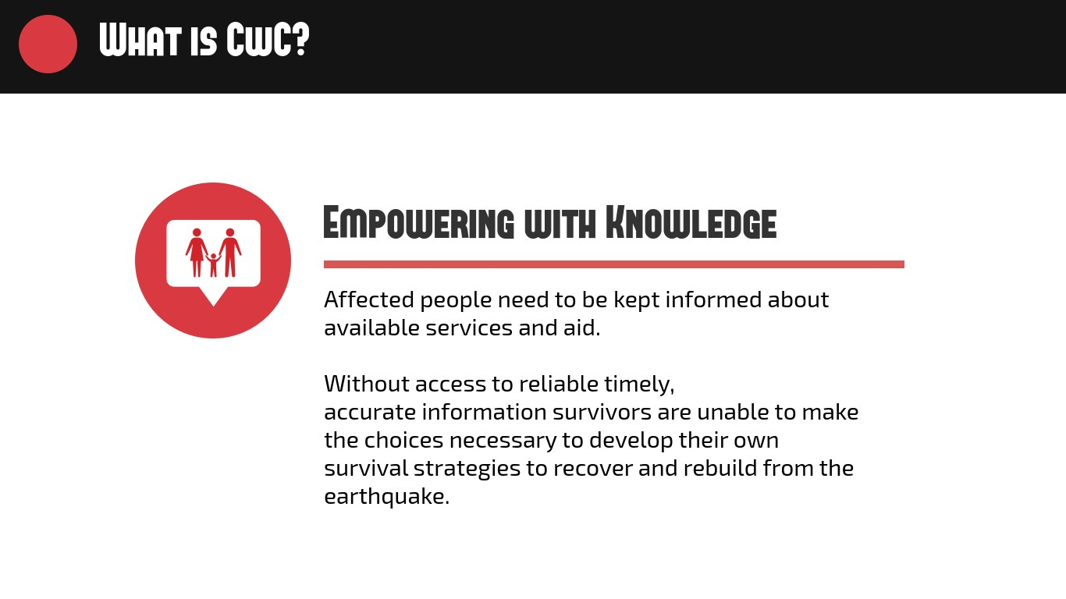

Slide 3

How do communities feel?
The CFP provides monthly analysis on community feedback and perceptions related to the response
Collected feedback through partnering agencies provide critical insight into how the humanitarian response system is being perceived by the community and how humanitarian partners can adapt response efforts to address community concerns

Slide 4
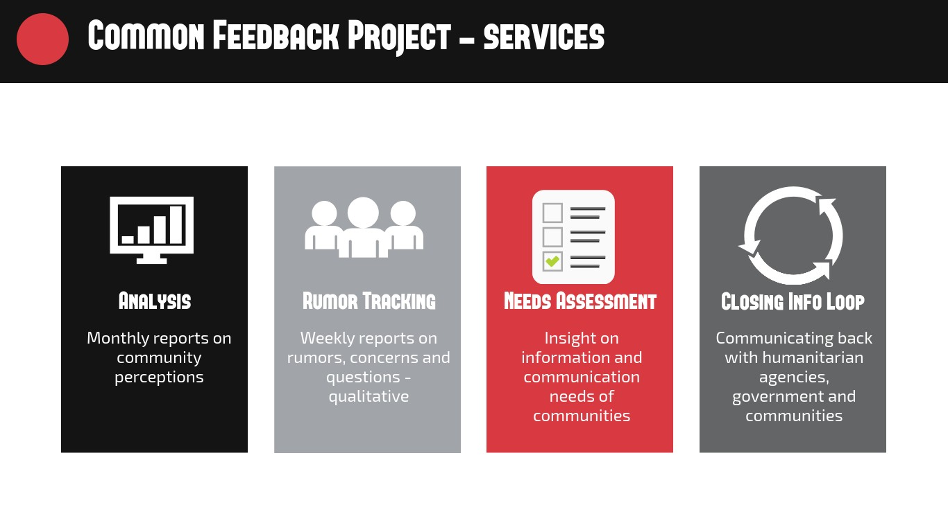

Slide 5
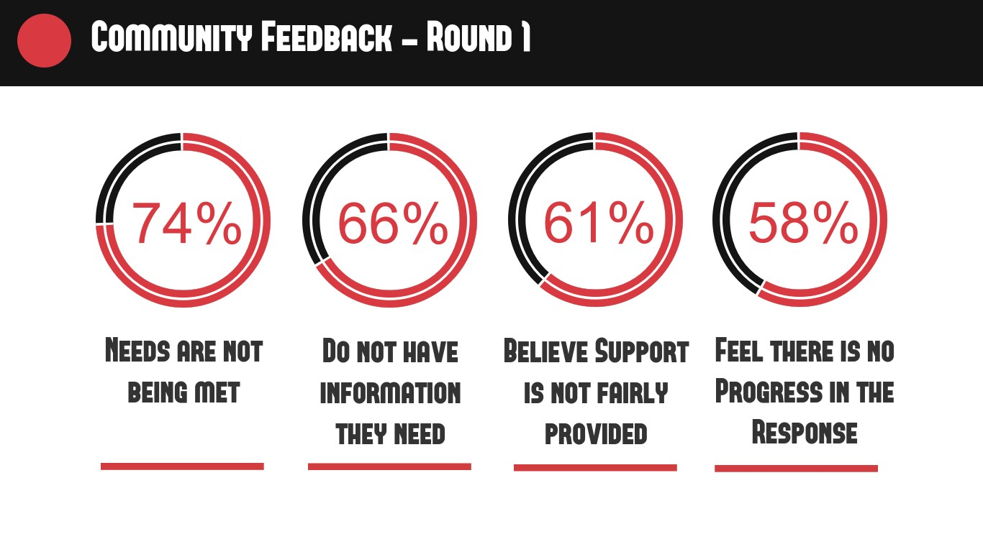

Slide 6
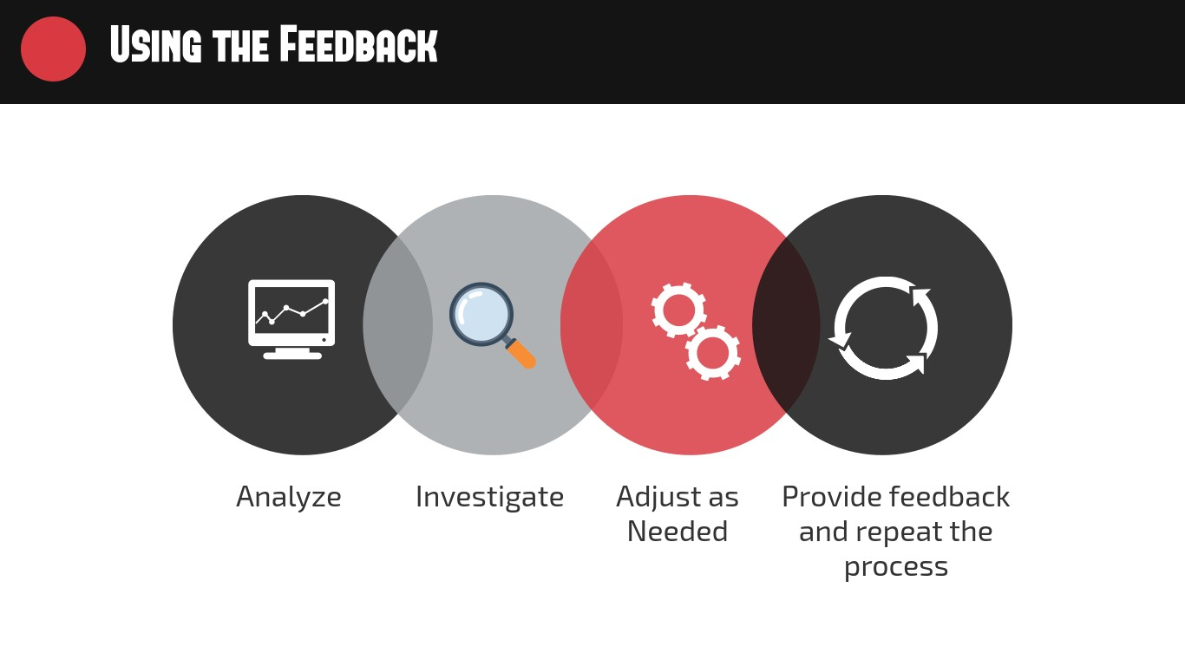

Slide 7
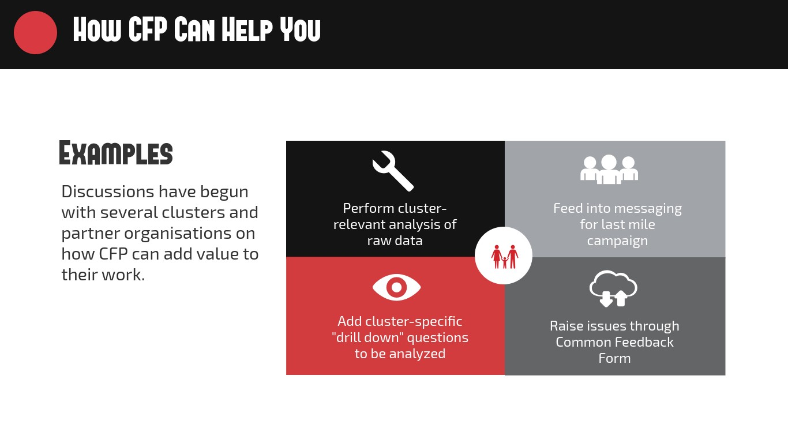

Slide 8
RUMOR TRACKING
In Makawanpur,
people are scared of earthquake on the 12th day of every month. They are also afraid that structures already damaged would collapse and cause loss of life and property
In Okhaldhunga,
people think their children’s are suffering from pneumonia due to cold

Slide 9
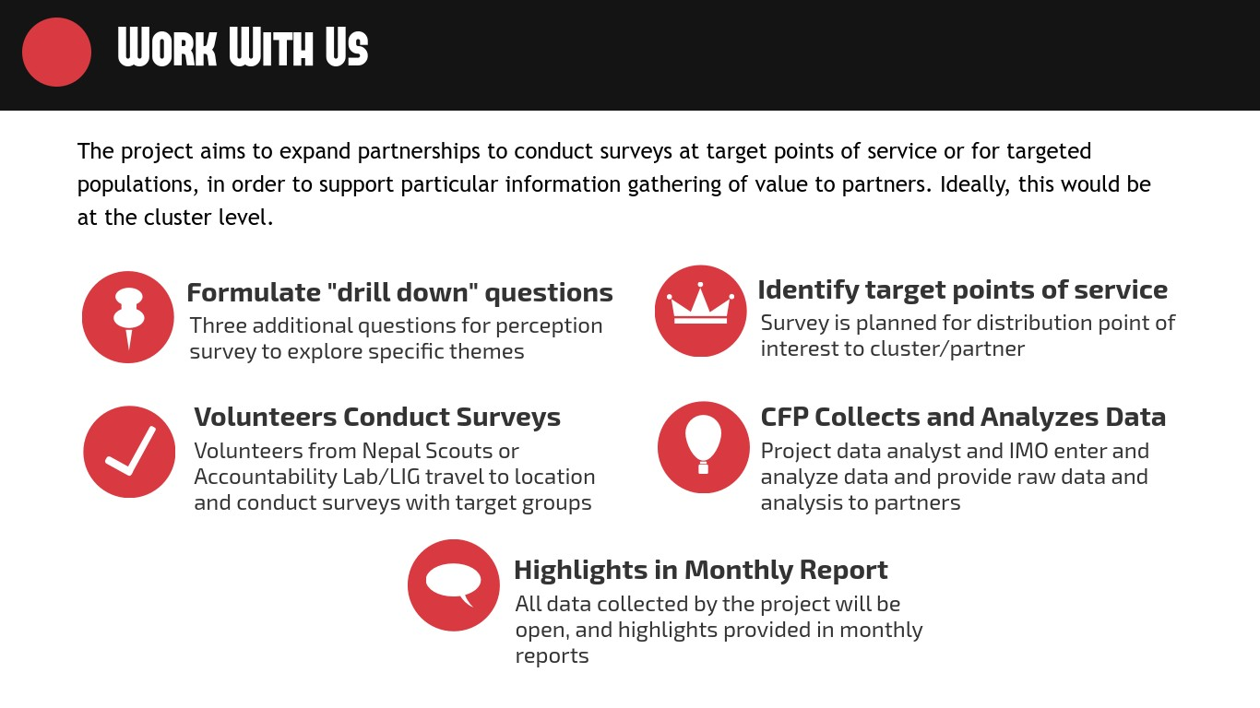

Slide 10
Thank you!

