Slide 1
“ Challenges in Road Widening of Kathmandu Valley.”
(Jestha 2, 2071 / May 16, 2014)
Dr. Bhai Kaji Tiwari.
Deputy Development Commissioner
Kathmandu Valley Development Authority (KVDA)

Slide 2
Picture Speaks louder than words…

Slide 3
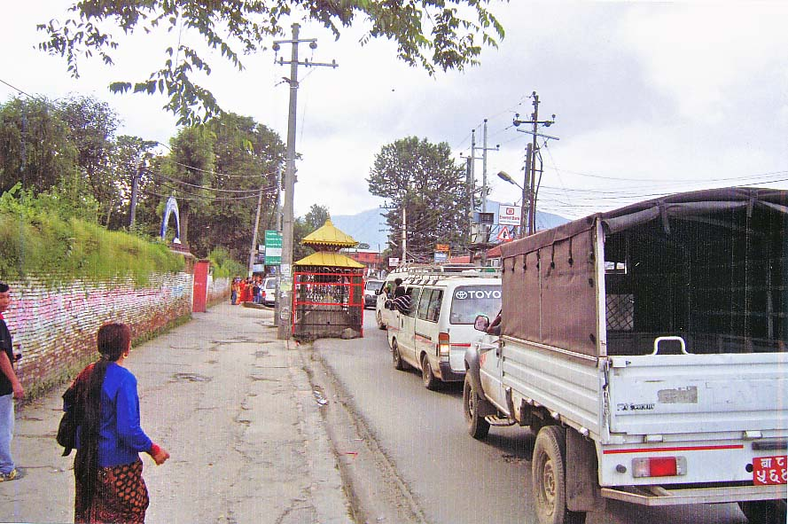
Lainchaur Road Junction
(Before Road Widening)

Slide 4
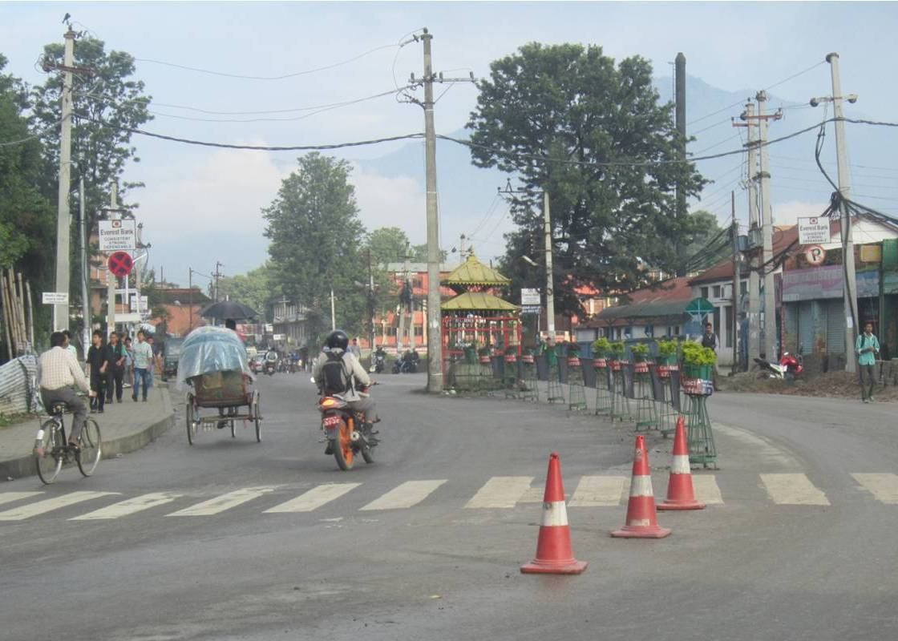
Lainchaur Road Junction
(After Road Widening)

Slide 5
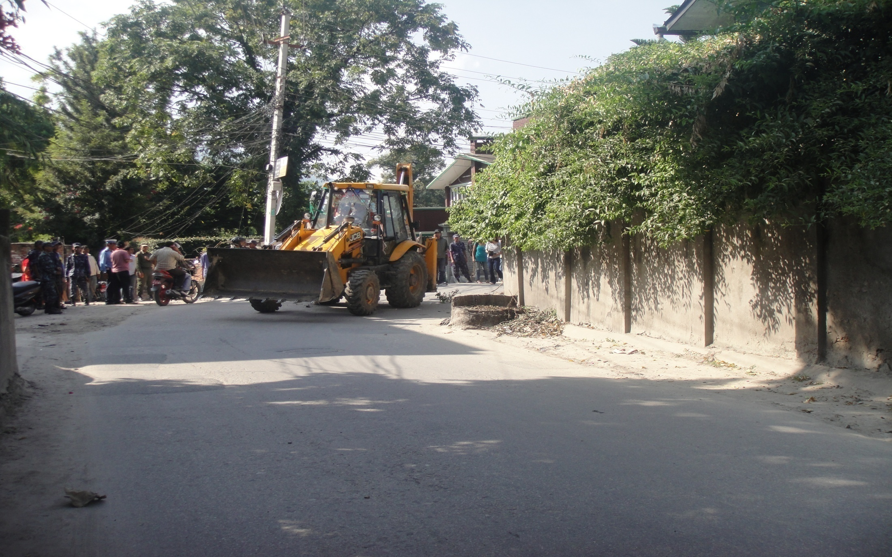
Thirbum Road Corner
(Before Road Widening)

Slide 6
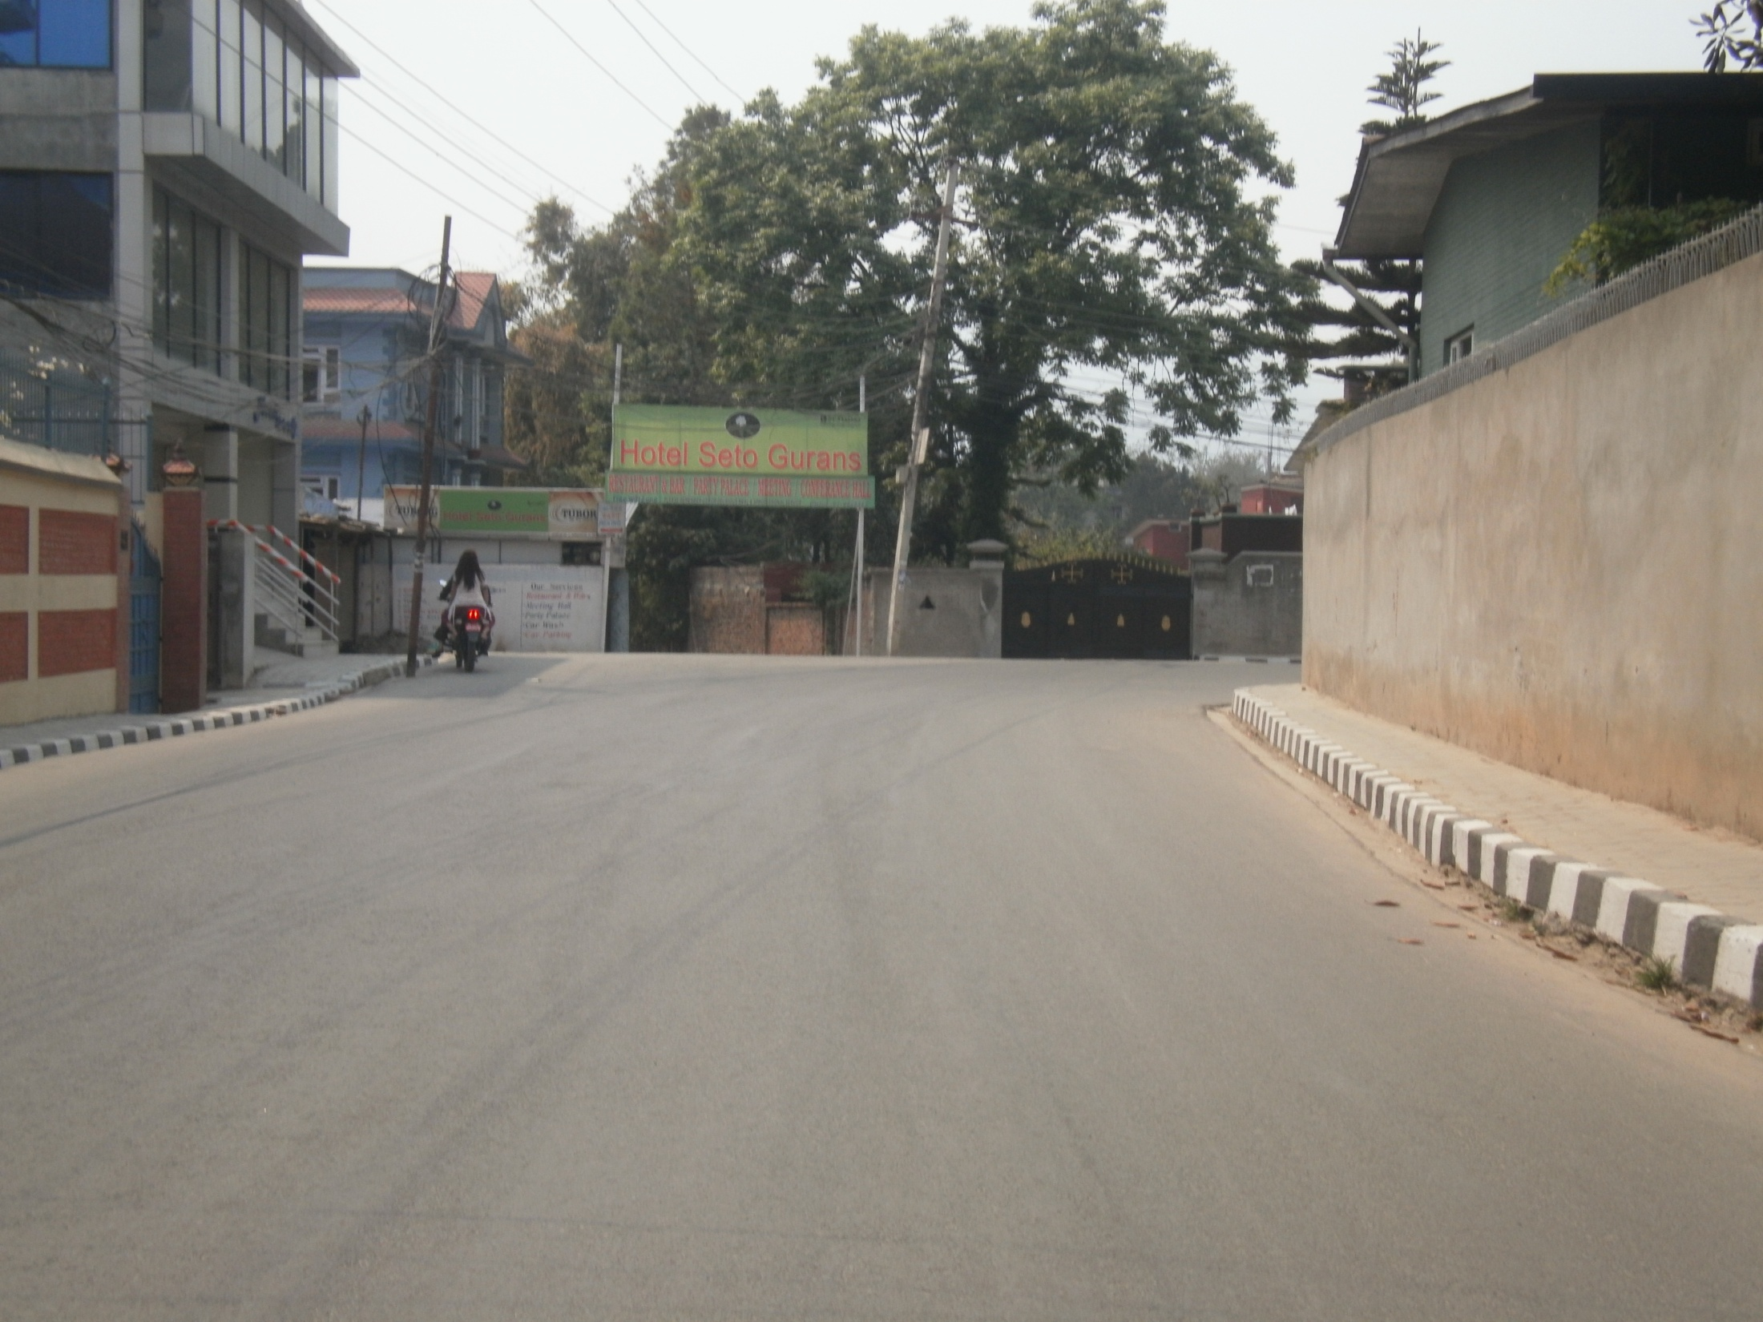
Thirbum Road Corner
(After Road Widening)

Slide 7
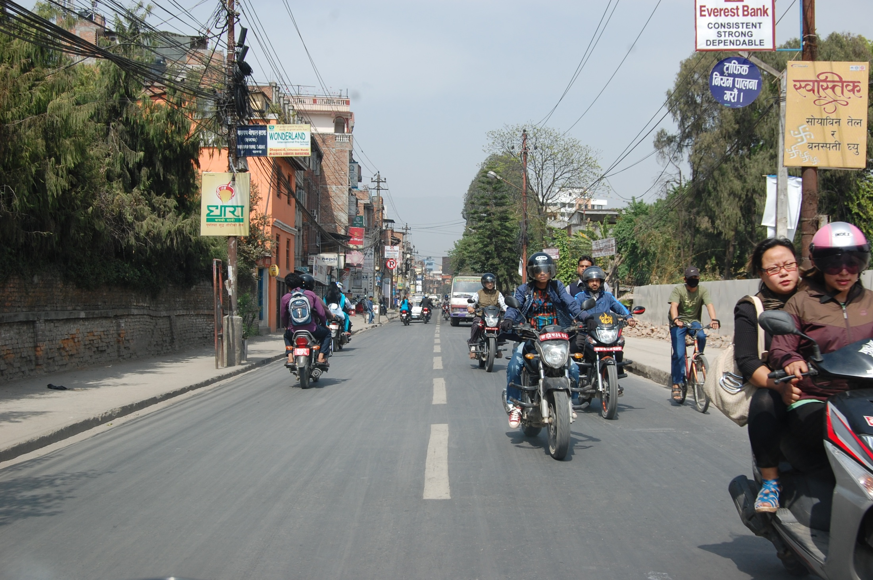
Lazimpat Road
(Before Road Widening)

Slide 8
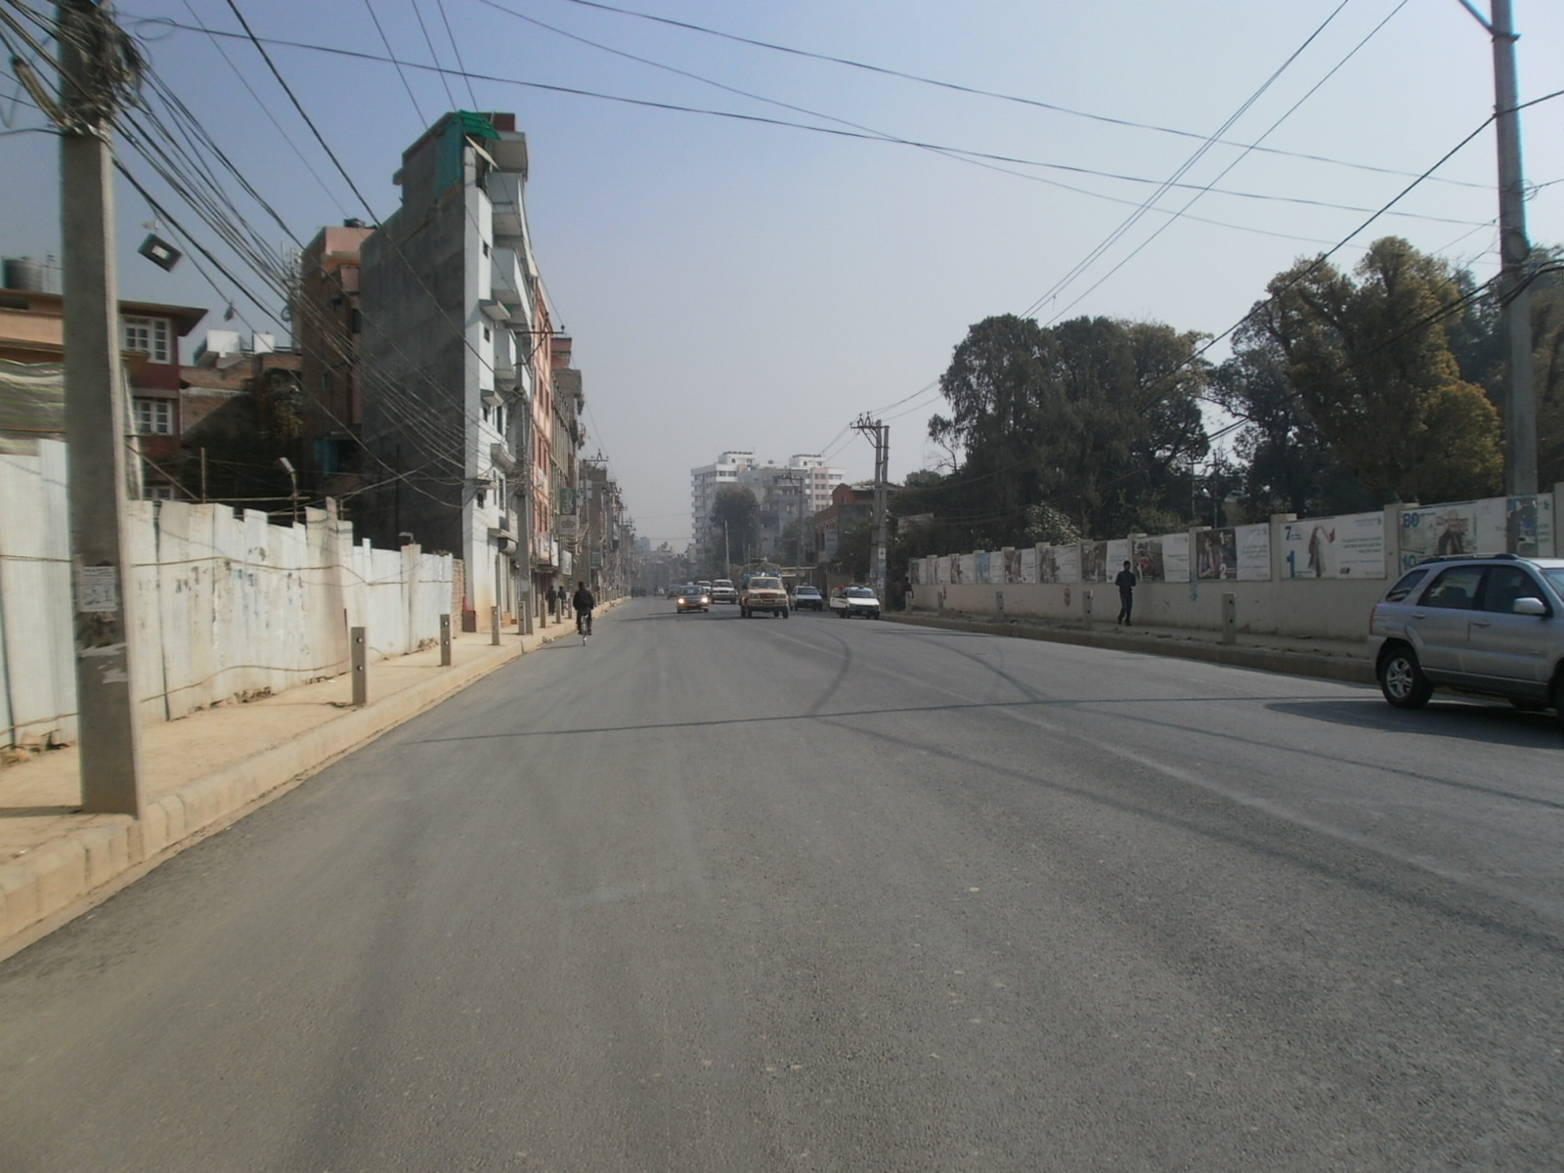
Lazimpat Road
(After Road Widening)

Slide 9
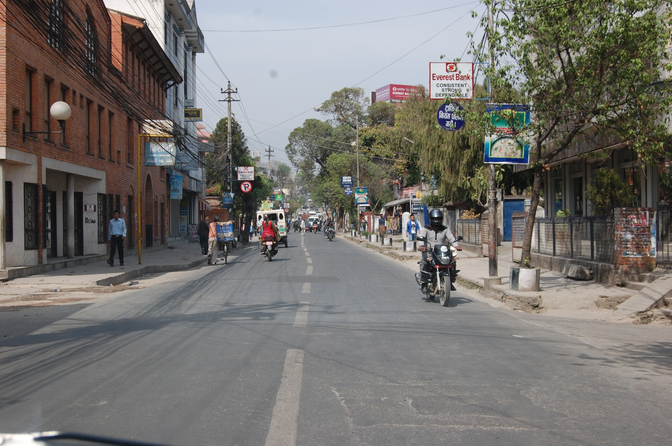
Lazimpat Road
(Before Road Widening)

Slide 10
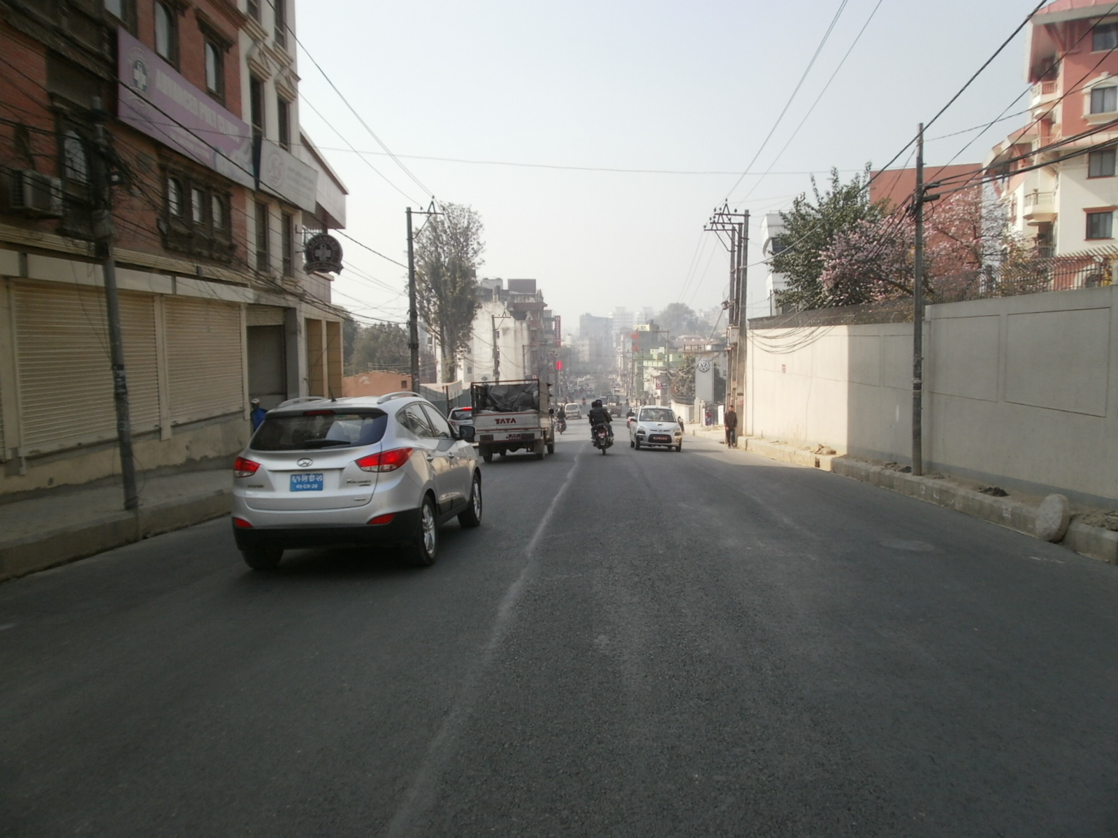
Lazimpat Road
(After Road Widening)

Slide 11
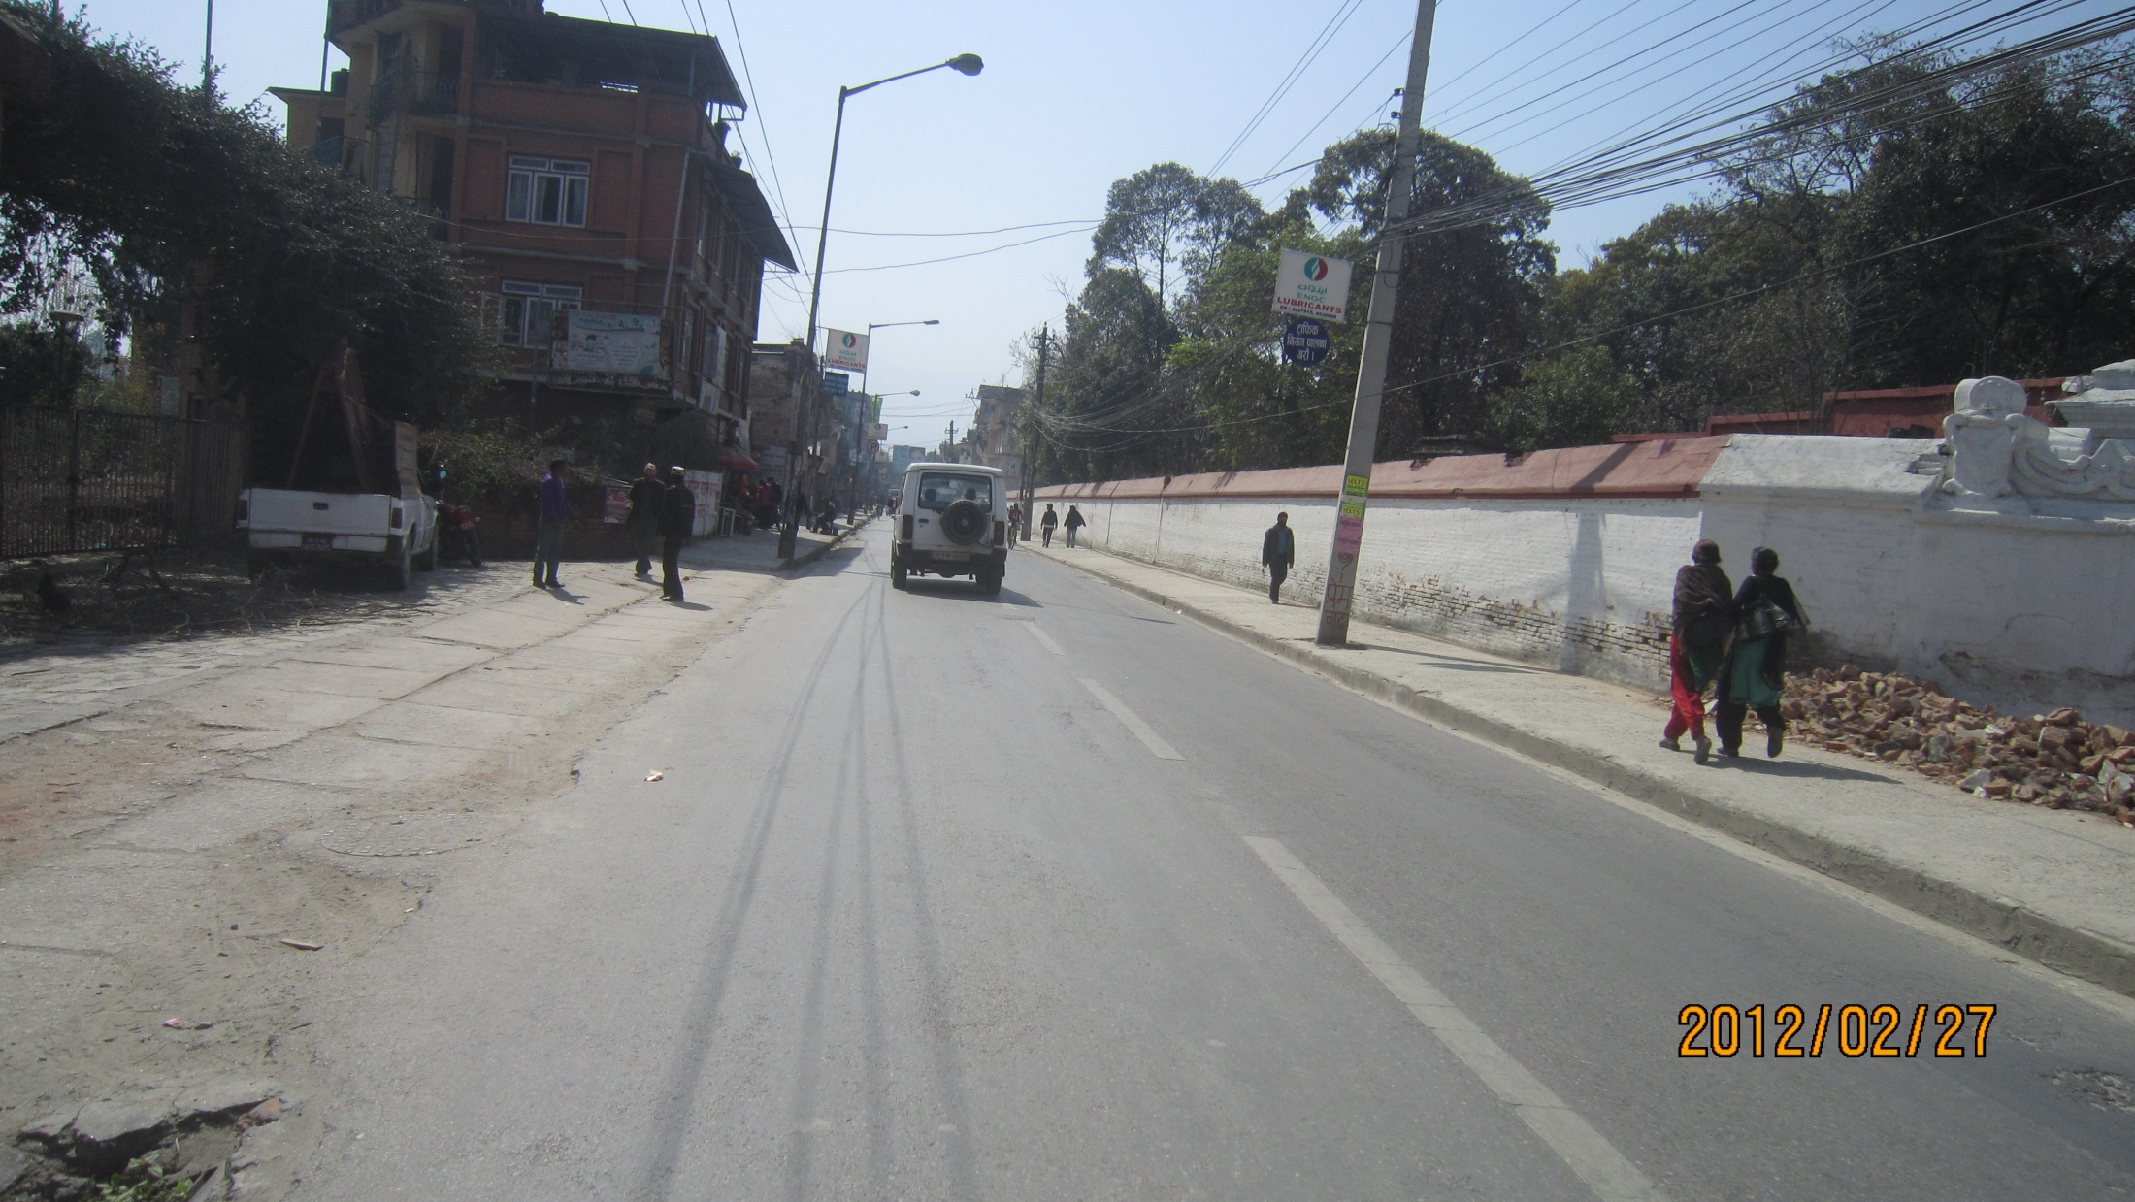
Road in front of Shital Niwas
(Before Road Widening)

Slide 12
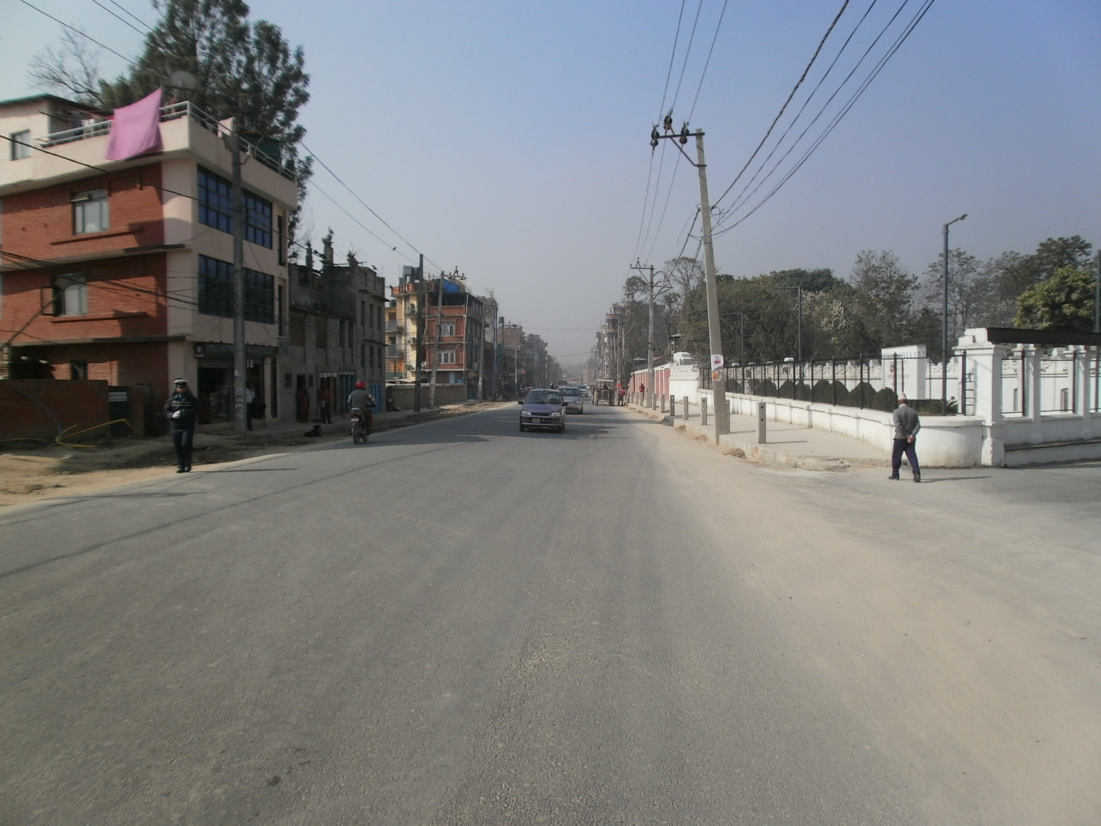
Road in front of Shital Niwas
(After Road Widening)

Slide 13
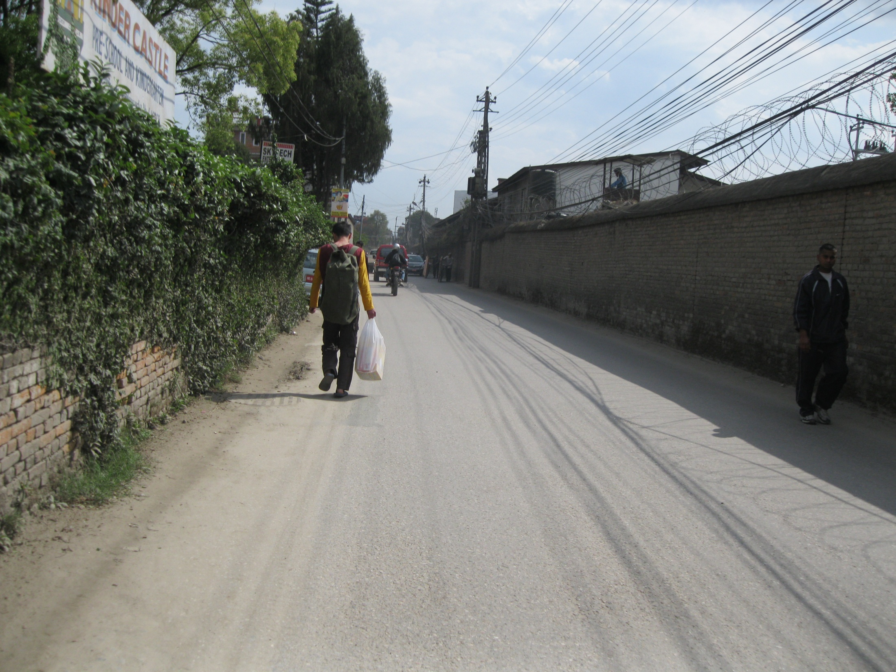
Road in front of Police Headquarter
(Before Road Widening)

Slide 14
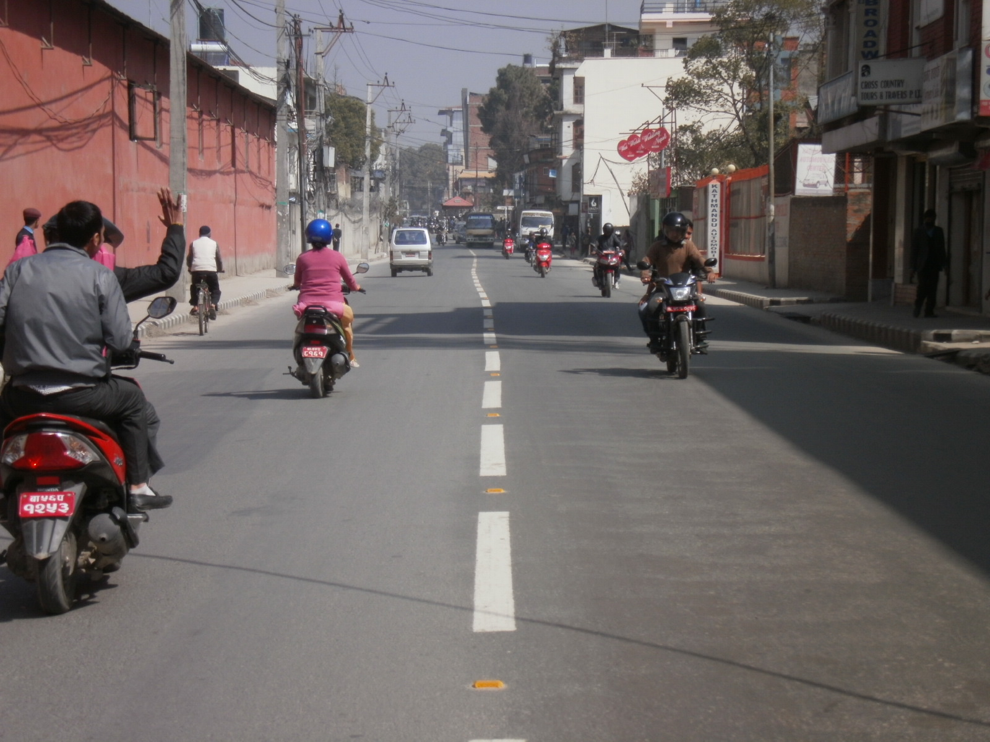
Road in front of Police Headquarter
(After Road Widening)

Slide 15
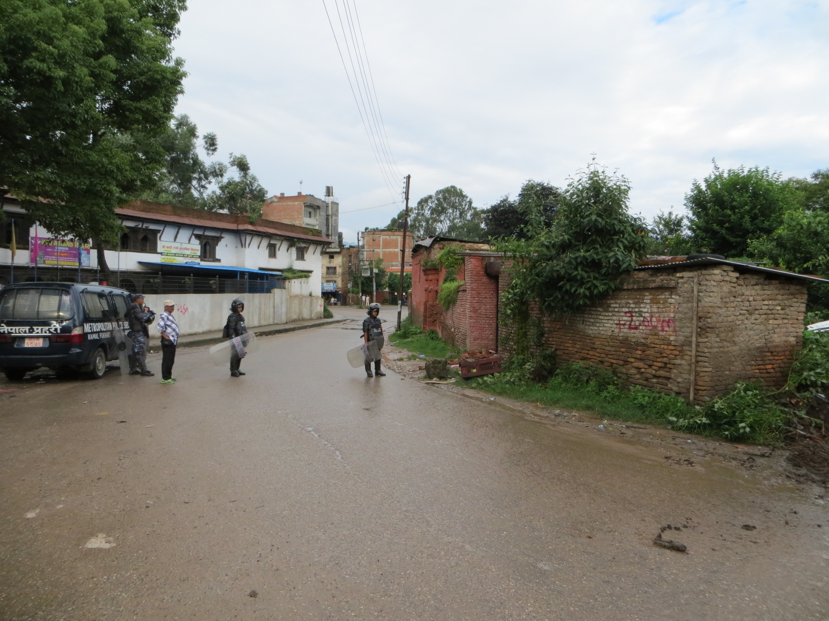
Road in front of NarayanChaur, Naxal
(Before Road Widening)

Slide 16
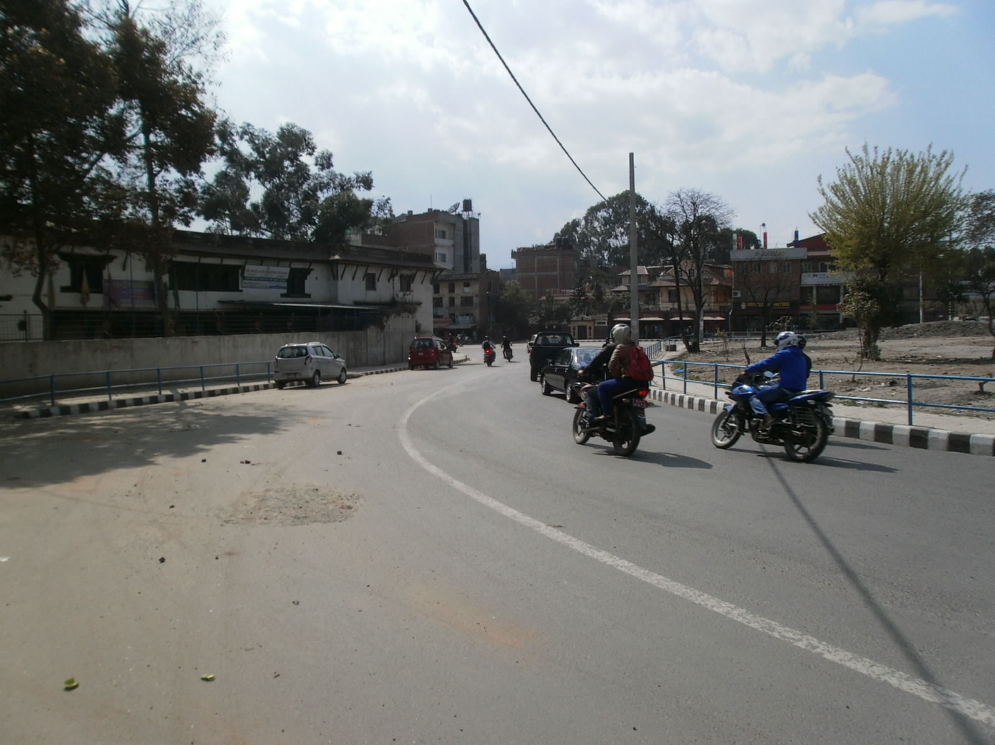
Road in front of NarayanChaur, Naxal
(After Road Widening)

Slide 17
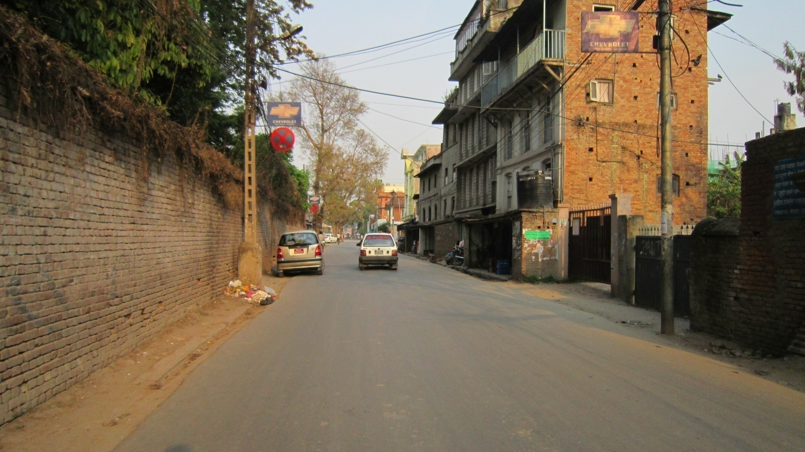
Bhagawati Bahal- Sanogaucharan Road
(Before Road Widening)

Slide 18
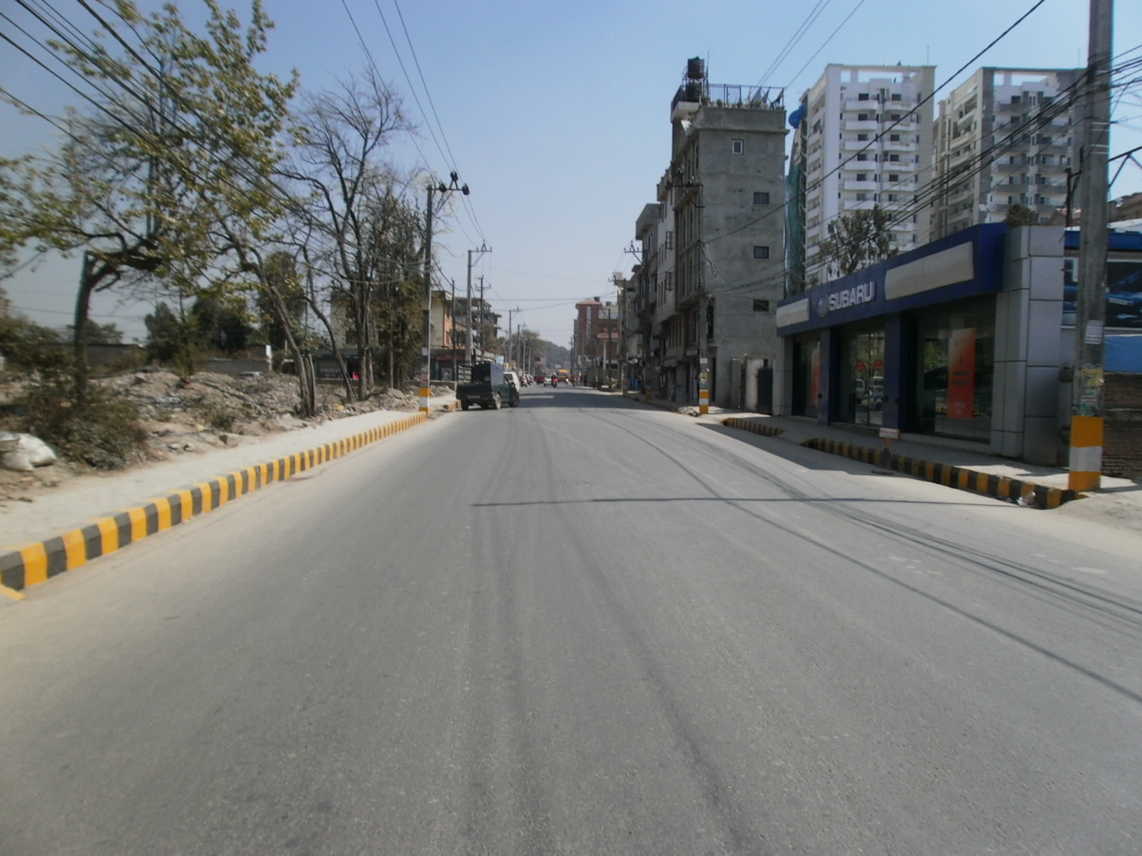
Bhagawati Bahal- Sanogaucharan Road
(After Road Widening)

Slide 19
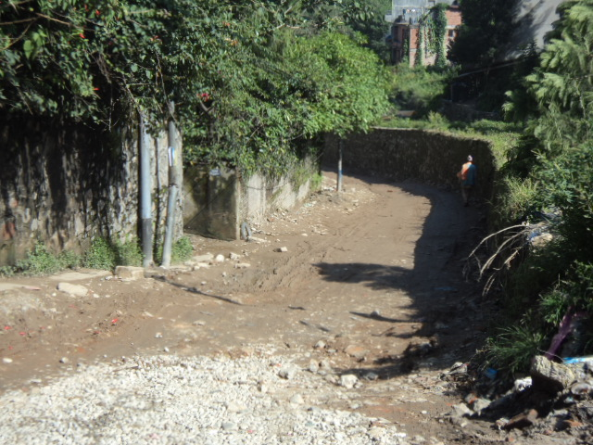
Mitrapark – Jayabageshwori Road
(Before Road Widening)

Slide 20
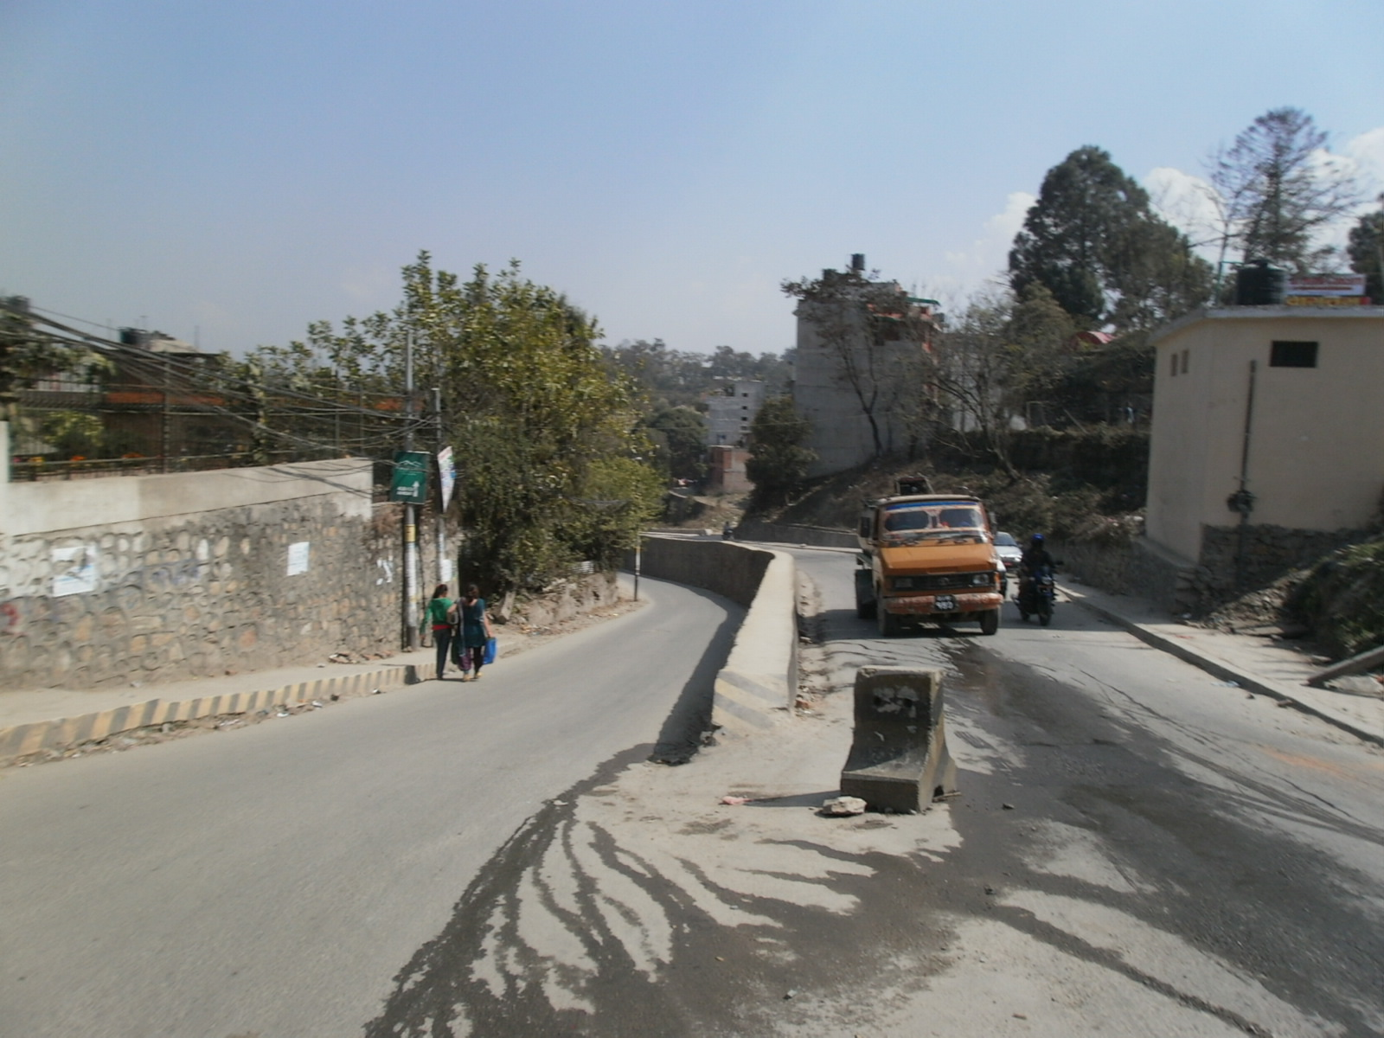
Mitrapark – Jayabageshwori Road
(After Road Widening)

Slide 21
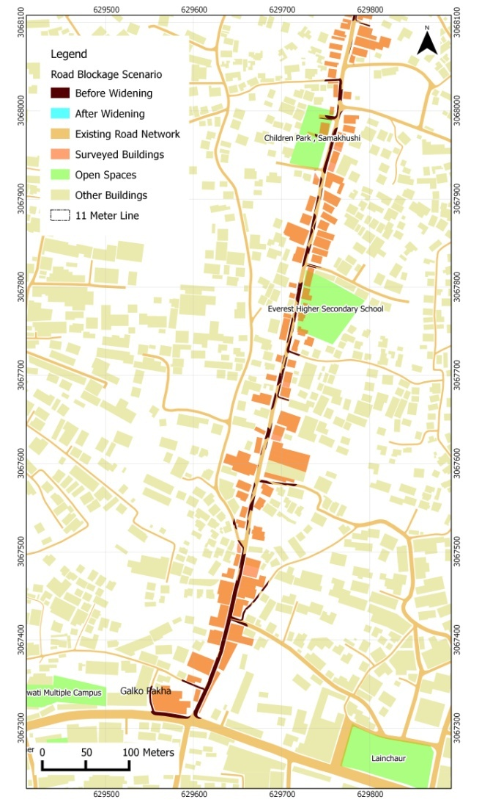
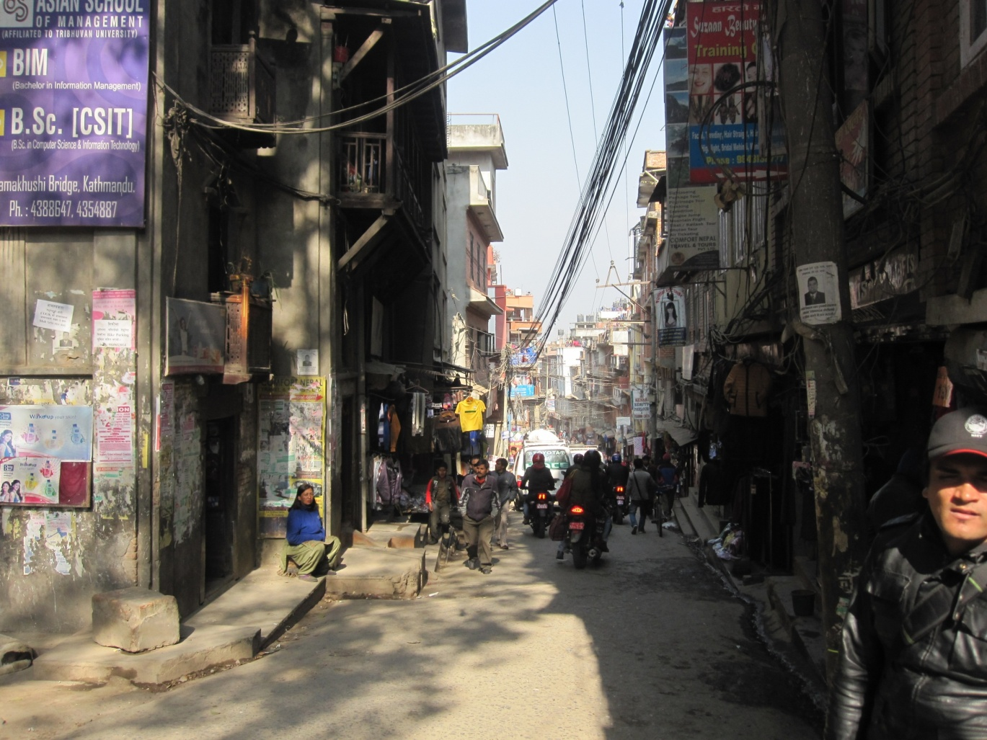
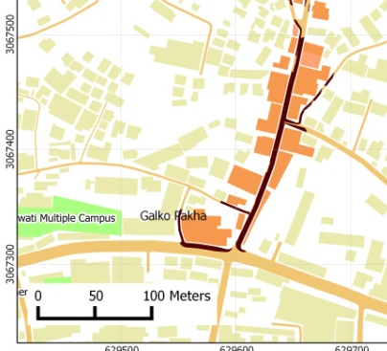
Galkopakha – Gangabu Chowk

Slide 22
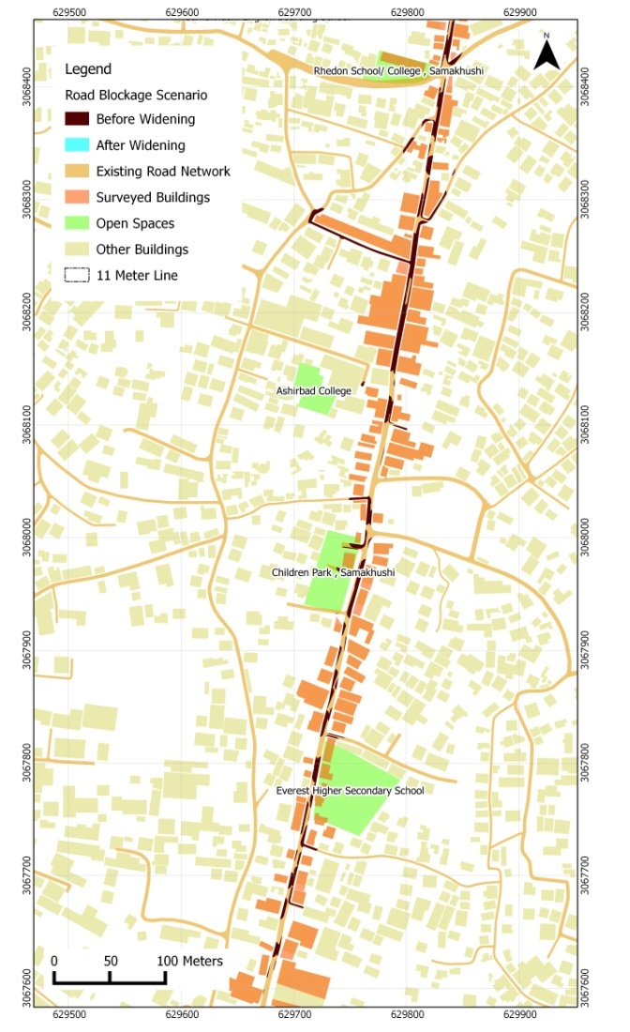
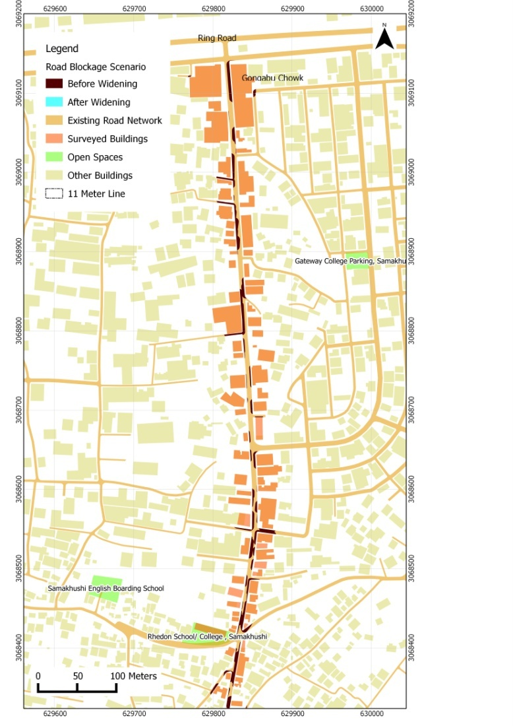
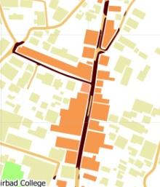
Galkopakha – Gangabu Chowk

Slide 23
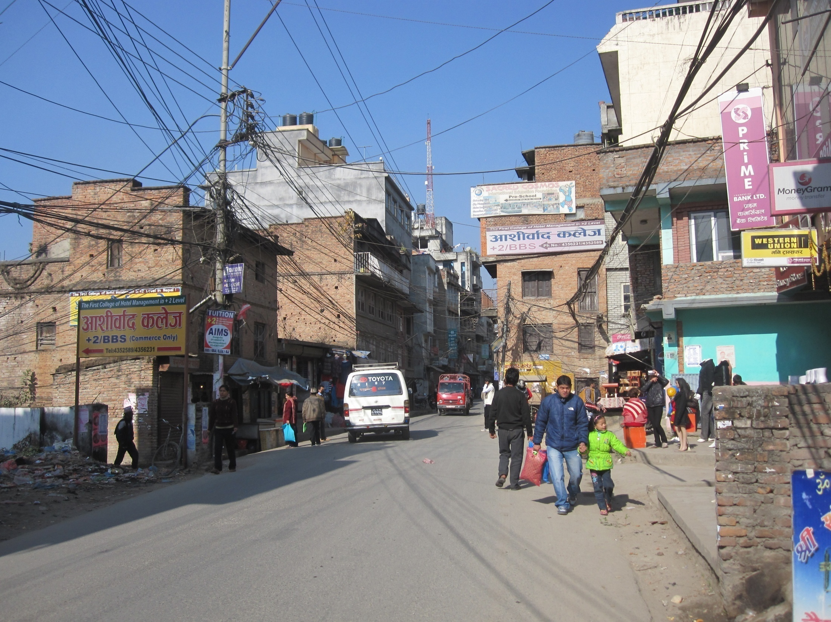
Galkopakha – Gangabu Chowk

Slide 24
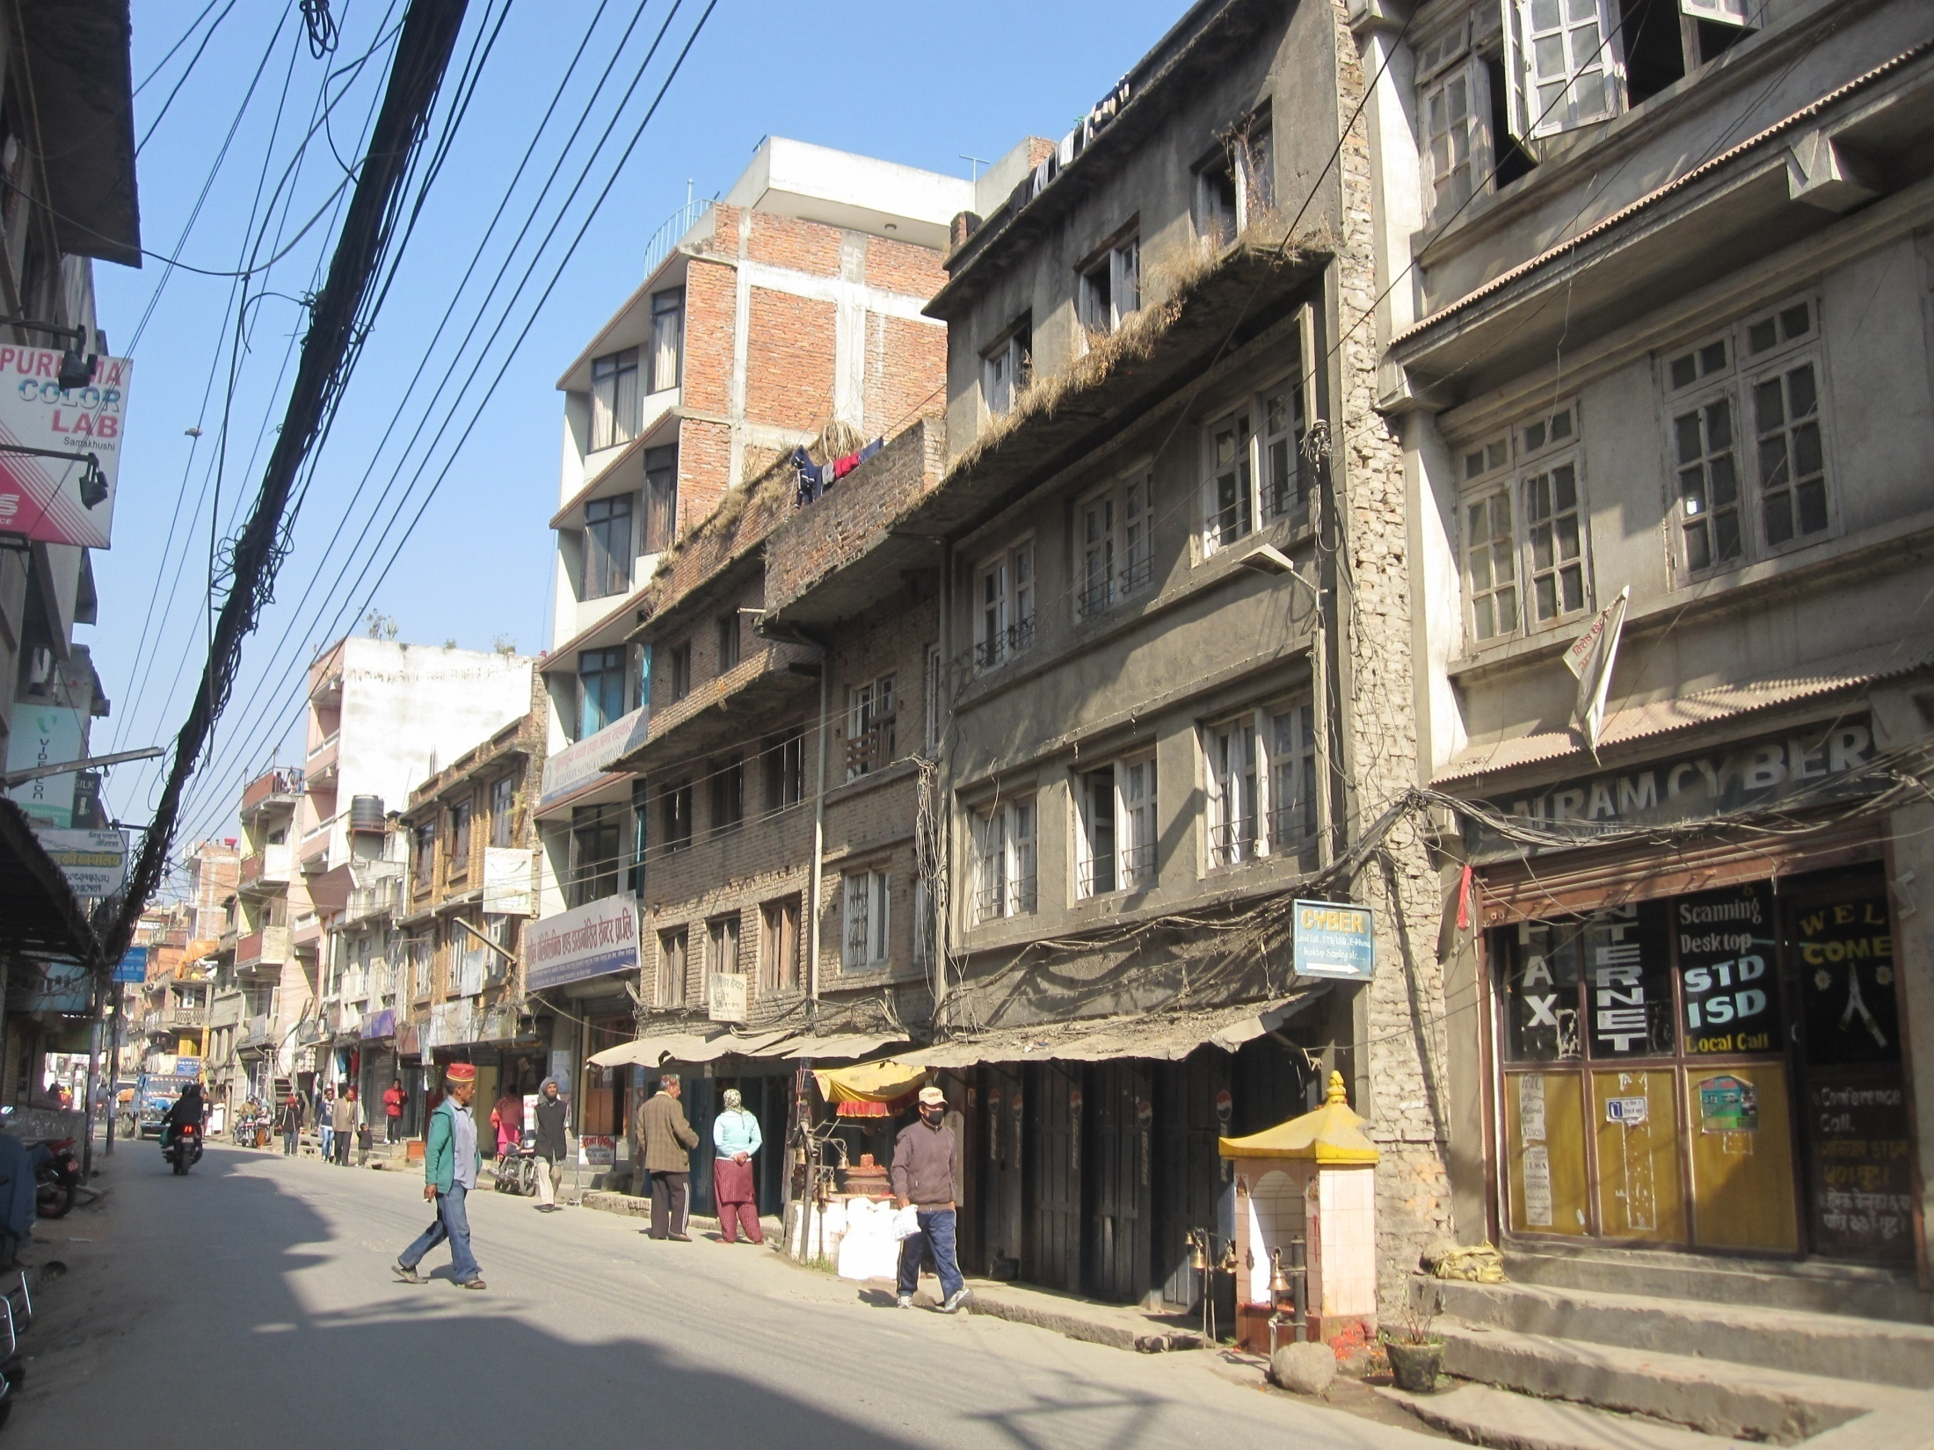
Galkopakha – Gangabu Chowk

Slide 25
Road Blockage Scenario…

Slide 26
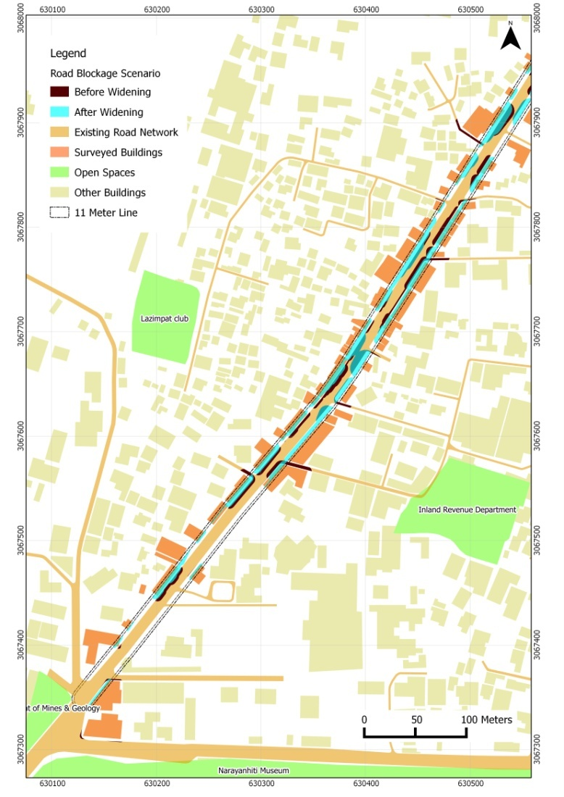
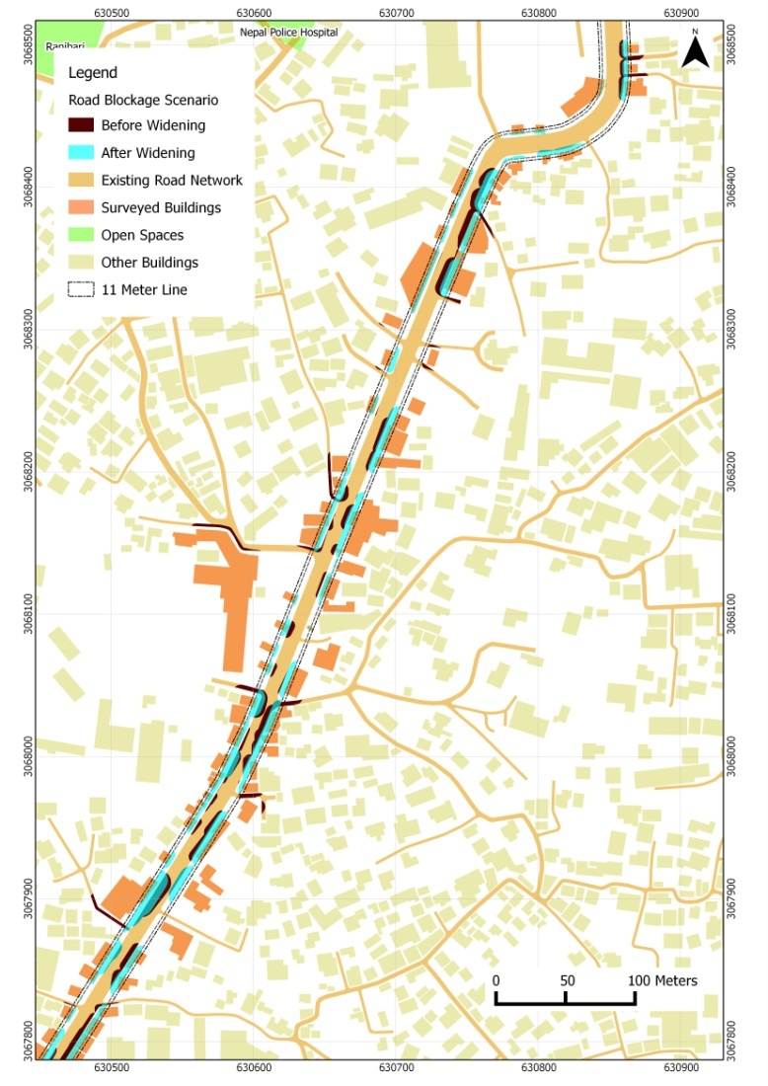
Lainchour – Narayan Gopal Chowk

Slide 27
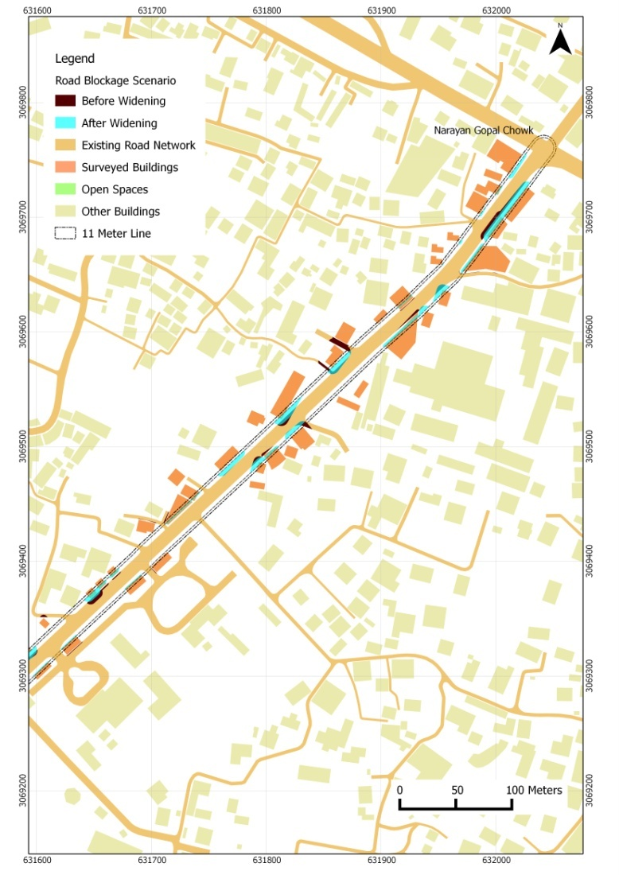
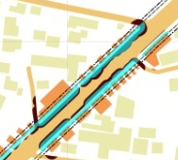
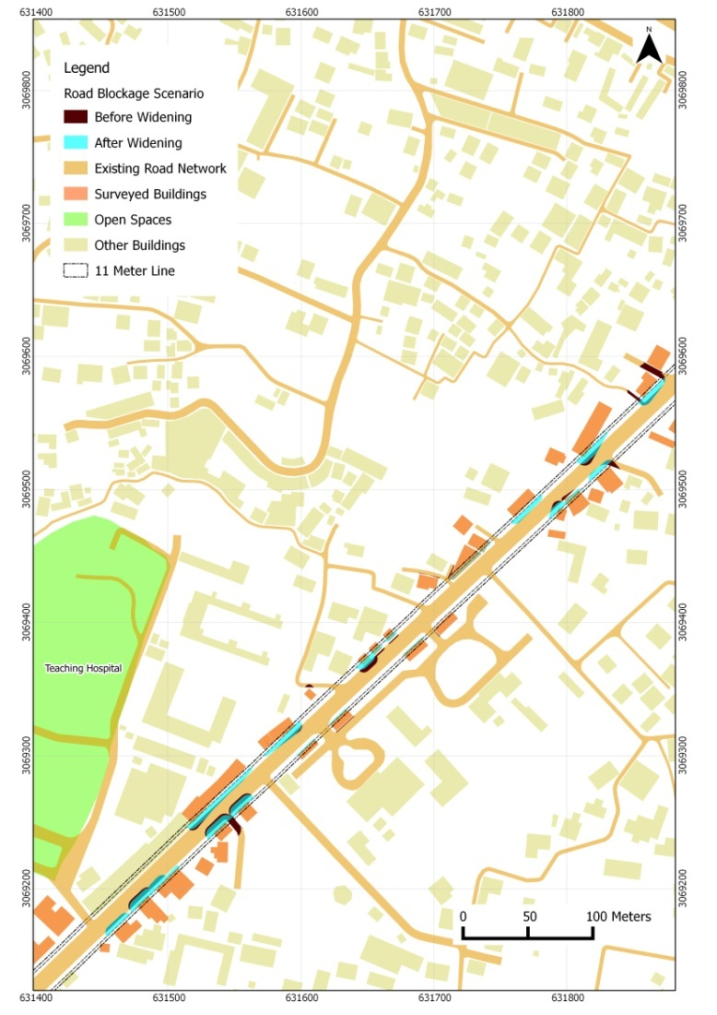

Lainchour – Narayan Gopal Chowk

Slide 28
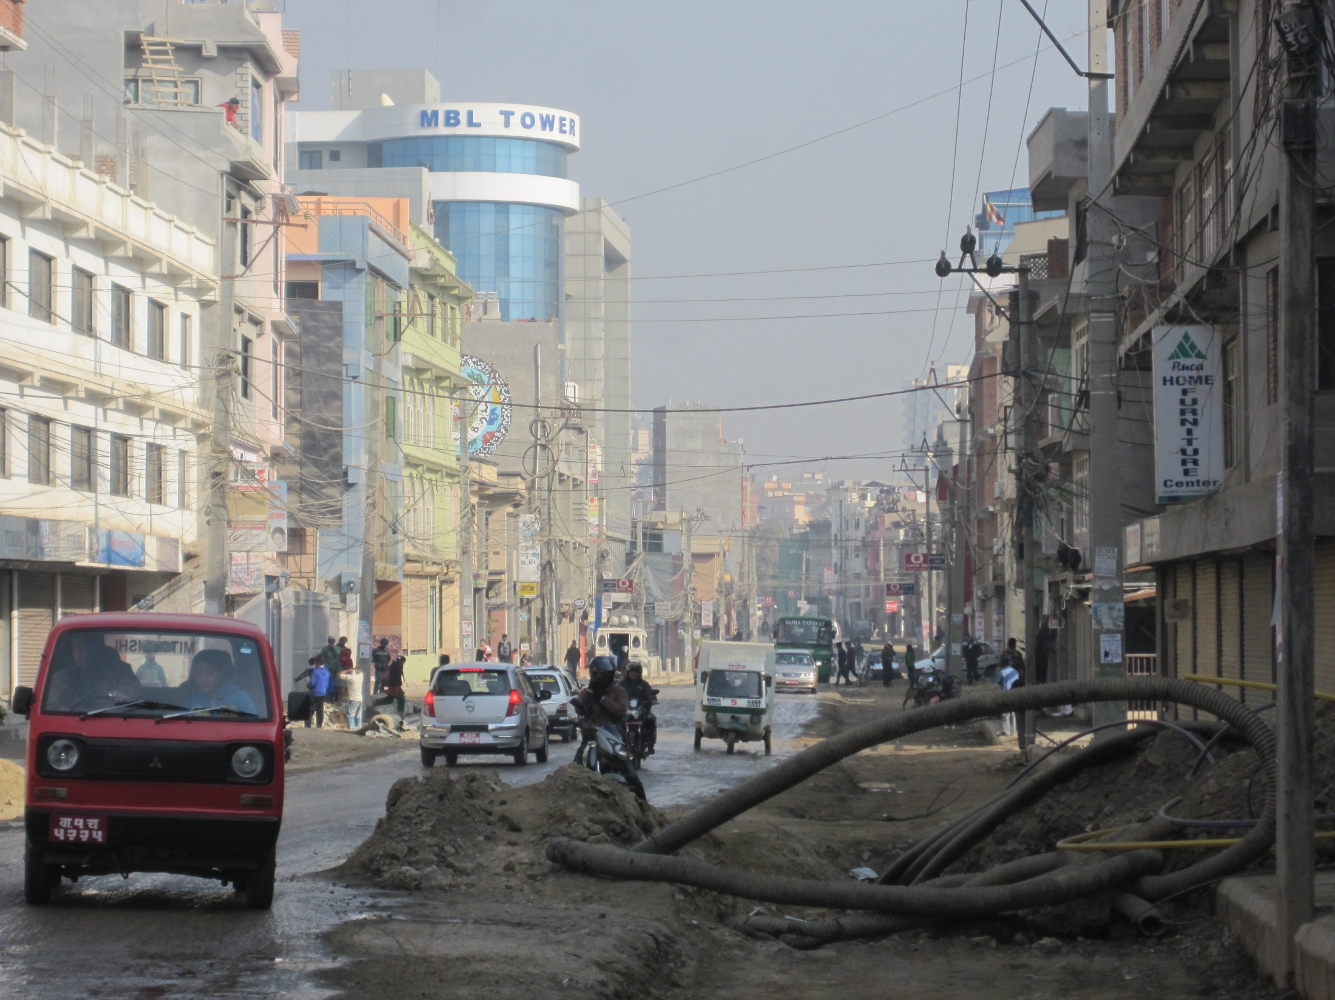
Lainchour – Narayan Gopal Chowk

Slide 29
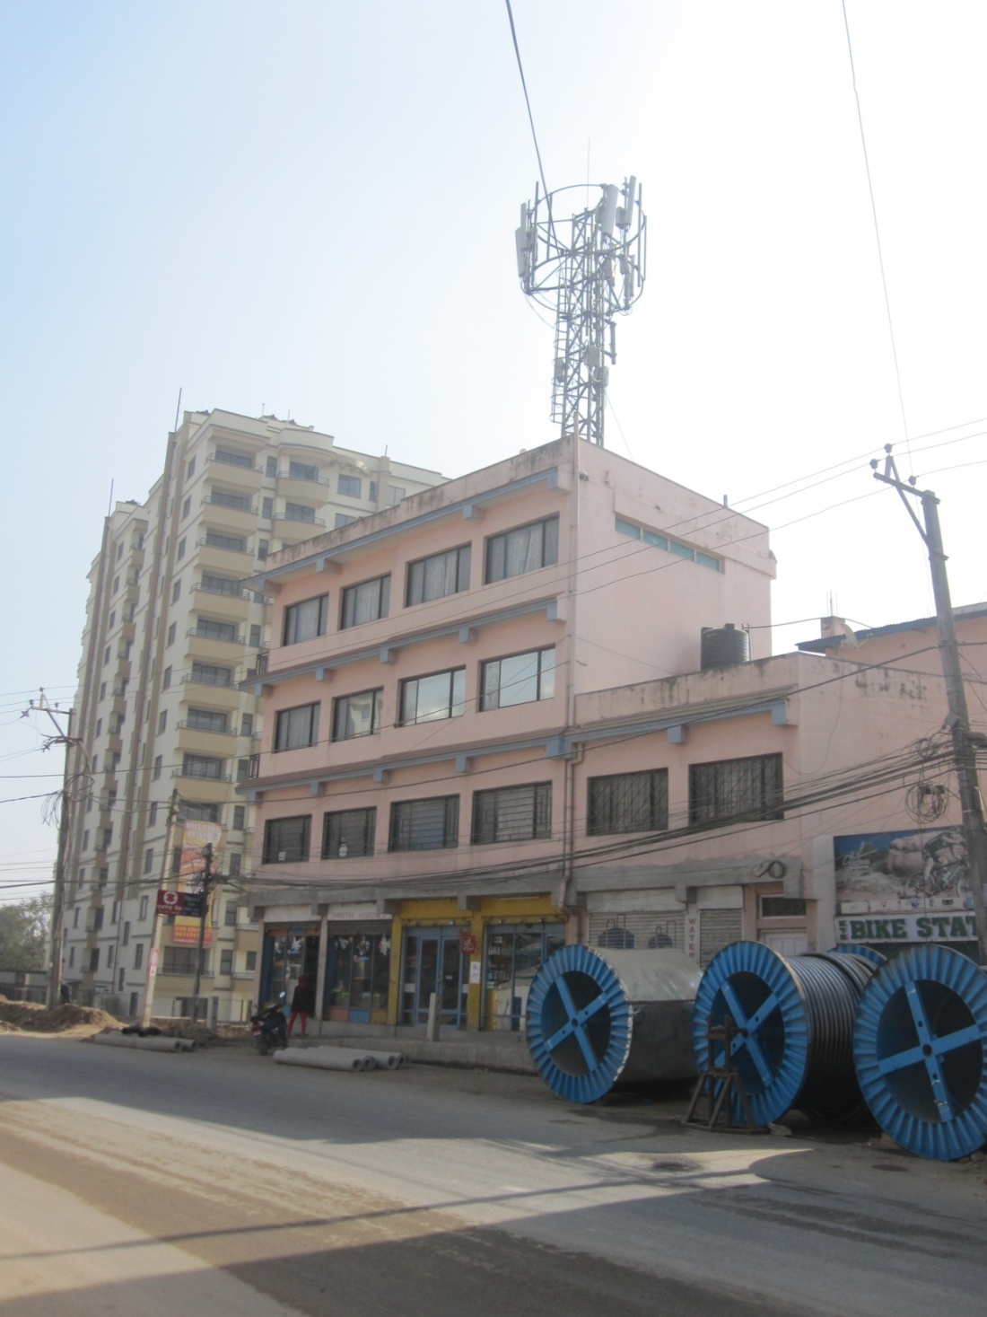
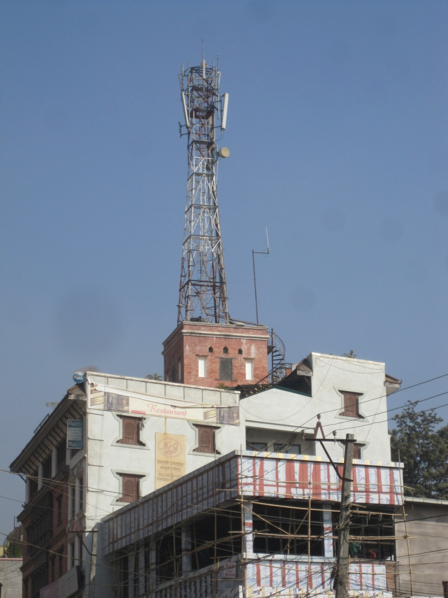
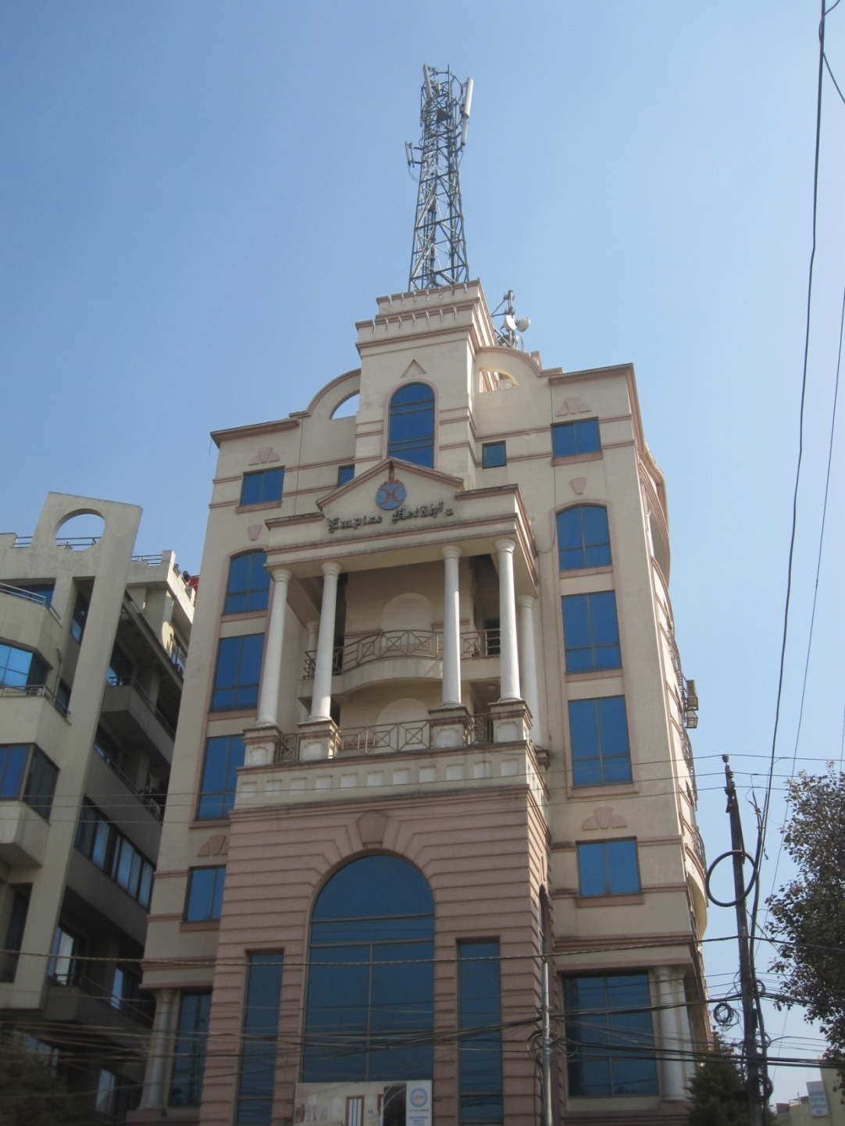
Lainchour – Narayan Gopal Chowk

Slide 30
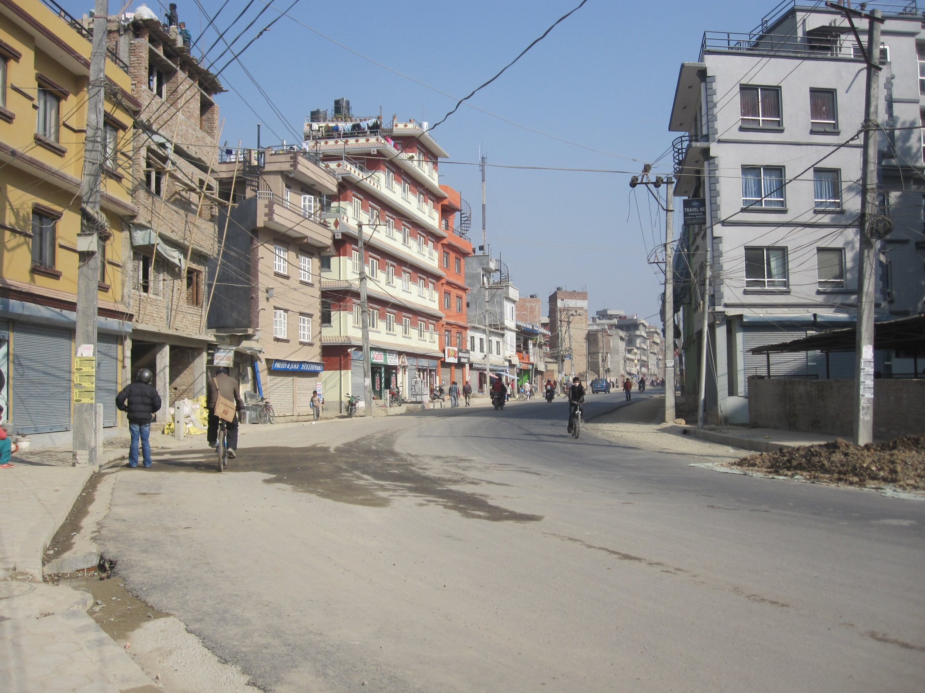
Lainchour – Narayan Gopal Chowk

Slide 31
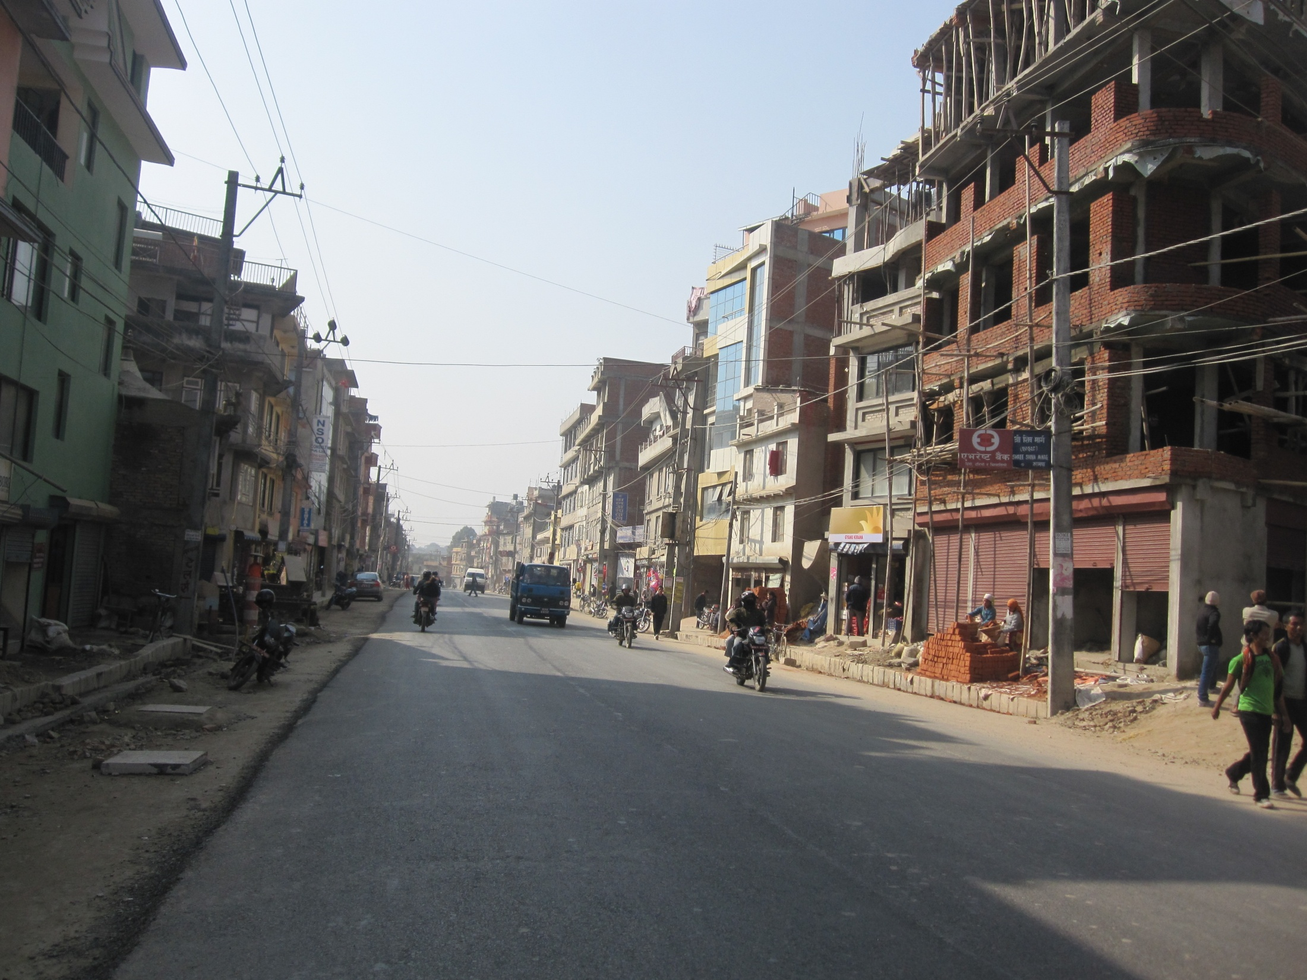
Lainchour – Narayan Gopal Chowk

Slide 32
Challenges of Road Widening
Negligence of Government Authorities.
No enough budget allocated on time.
Lack of Institutional Capacity ( manpower, budget, infrastructures, equipments etc).
Lack of integrated planning approach between various line agencies.
Lack of coordination with local community .

Slide 33
Challenges of Road Widening
Lack of work not being able to complete on time.
Single contractors and consultants work in various projects simultaneously.
Lack of detail work schedule.
Easily date extended if work not completed on time.
Various other problems in execution.

Slide 34
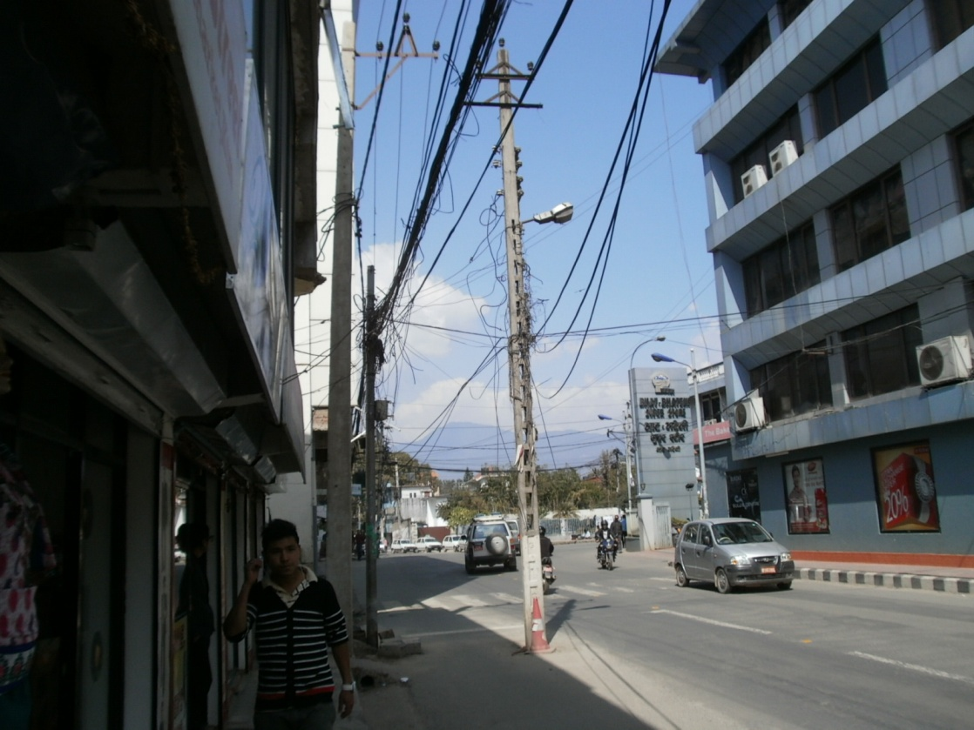
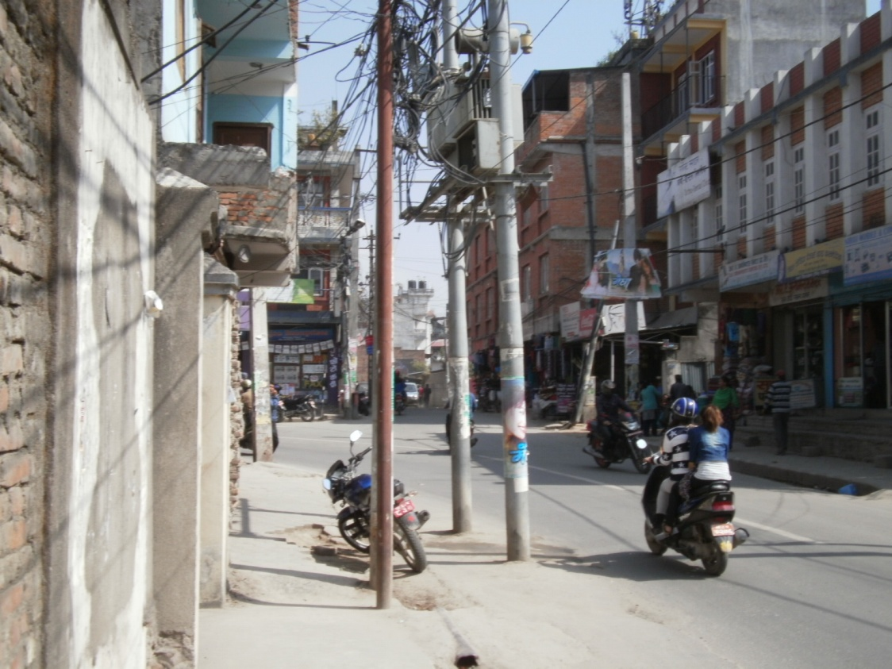
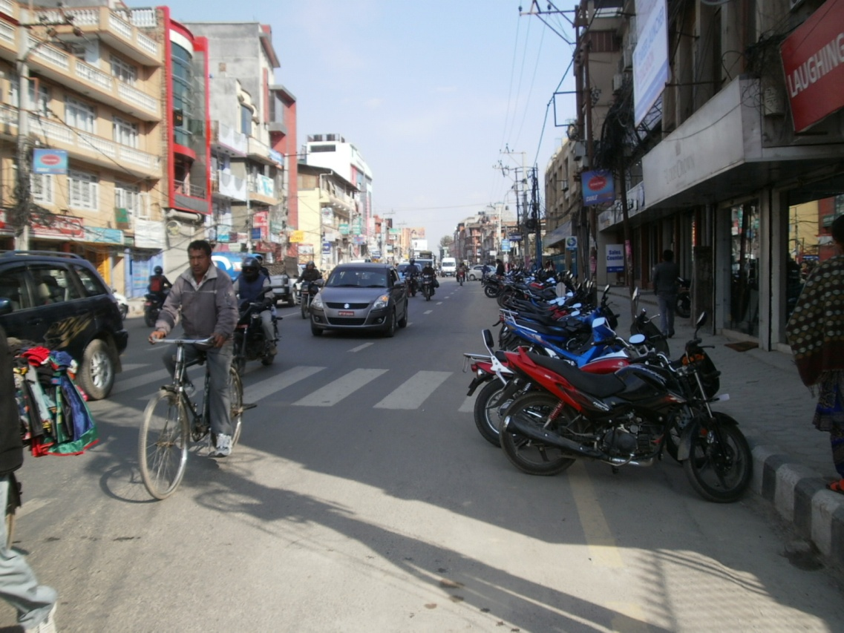
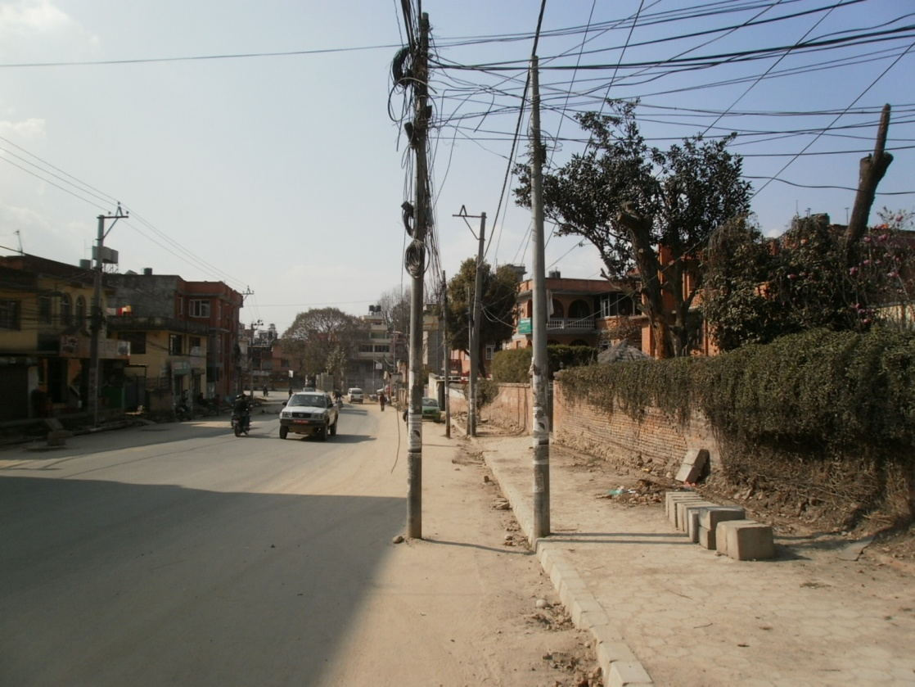
Lack of coordination between authorities.

Slide 35
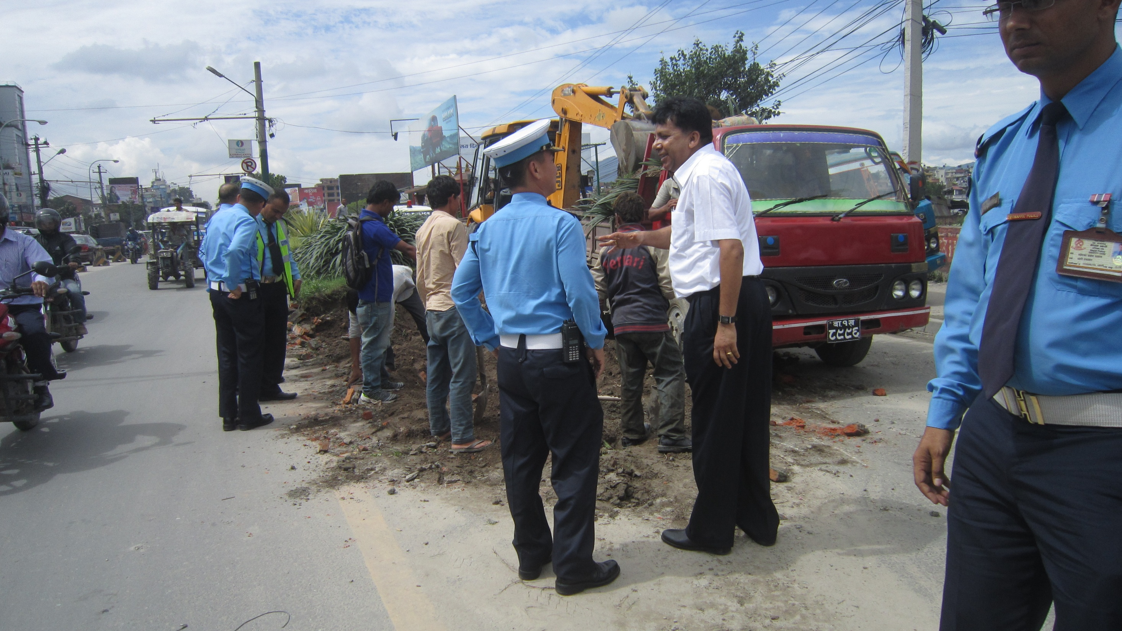
Thank You

