Slide 1
Future Vision Of Nepal Engineers’ Association EMPOWERING ENGINEERS FOR PROSPEROUS NEPAL
1fg g} zlQm, >d g} elQm
Er. Dhruba Thapa
President
NEPAL ENGINEERS’ ASSOCIATION

Slide 2
Role of Engineers
1fg g} zlQm, >d g} elQm
Engineers are the creator
Presently, all human activities are based on engineering. From the very moment we weak up, till go to bed, we make use of engineering piece of work.
No life in the modern days can be imagined without engineering

Slide 3
Infrastructure Development
1fg g} zlQm, >d g} elQm
Very important for the overall development of the country.
In Nepalese Context
Underdeveloped country
Very less infrastructural ( both rural urban).
Scattered settlements pattern .
Poor people (Labour intensive project can contribute)
Federal system( if it happens) ?

Slide 4
Why ?
1fg g} zlQm, >d g} elQm
Infra structure developments cause to increase productivity then economic activities.
Helps to increase GDP and create employment
Improves lifestyle
Contributes to restore/ keep PEACE in the society
Helps to stabilize the Politics

Slide 5
Major Issues in Dev. Sector
1fg g} zlQm, >d g} elQm
Policy
Less engineering input in project planning
Institutional problems
Ambiguity in role & responsibility

Slide 6
Major Issues in Dev. Sector….
1fg g} zlQm, >d g} elQm
Misuse of budget (Bull Dozer Culture and Spread/scattered investment) in Rural Sector
No return
No data base
Env. degradation
Misleading assumption of users committee
Low quality of work
Low morale of Engineers (practically more accountable )
More work load

Slide 7
Empowering Engineers
1fg g} zlQm, >d g} elQm
Why?
Today, our country needs innovative ideas, rapid development, new and fast improving technology to provide better facilities and services to the society.
Infrastructural Dev. is the base for Economic development.
Engineers are the king pin bearing in this context.
Empowered Engineer can contribute more effectively, efficiently, enthusiastically .
Not for the personal benefit but for the national benefit

Slide 8
Empowerment in various sectors
1fg g} zlQm, >d g} elQm
Legal empowering
Institutional empowering
Technical empowering
Managerial empowering
Political empowering
Social empowering

Slide 9
Institutional empowerment
1fg g} zlQm, >d g} elQm
Strengthening of NEC
Establishment of Eng. Staff college for CPD
Reform of the concerned institution
Institutional organogram (LDO of same rank is unjustified)
Additional Post (over loaded engineers, Eng. in the village level?) to reduce the un-engineered capital investment and Bull Dozer Culture.

Slide 10
Legal empowerment
1fg g} zlQm, >d g} elQm
Involvement in all related policy level
Engineering job to be performed by engineers.
Design, estimation, tech. auditing & arbitration
Engineering Service Act
Ambiguity among acts and regulation
LDO should be an engineer (Dev. Professionals ?)

Slide 11
Technical Empowerment
1fg g} zlQm, >d g} elQm
Establishment of Tech. University.
Eng. Staff College
Concept of Internship and orientation training
Sufficient budget allocation for HR Dev
R & D Unit (Innovative technology)
Study Centres

Slide 12
Managerial Empowerment
1fg g} zlQm, >d g} elQm
Management is a skill, rather knack.
Vital to complete job with Time, Cost & Quality
Engineers are weaker
No synergetic effect
To be incorporated in the Eng. course
Training is necessary.

Slide 13
Political Empowering
1fg g} zlQm, >d g} elQm
Inclusion of engineers in the decision making process
National and Local level project planning
Policy making related to development works
More and more engineers’ involvement in politics

Slide 14
Social Empowerment
1fg g} zlQm, >d g} elQm
Image building
Service delivery
Quality of work
Self realization (individual effort)
Incorporation of social studies in the course
Appreciative role of organization like NEA, NEC
Marketing/Publicity
Of profession
Of role, importance and contribution
Achievements and remarkable works
Media support

Slide 15
NEA Vision
1fg g} zlQm, >d g} elQm
Establishment of Engineering College
Tabulation of Engineering Service Act to the parliament and lobbing for approval (passing and activation the same)
Start the study centre at least in 3 areas

Slide 16
NEA Vision…
1fg g} zlQm, >d g} elQm
Management of Youth Engineer
Major Challenges
Brain drain ruins the country
Loss of high investment
No Financial returns
No good quality HR in the country
Prescription
Employment cell
Lobbing to create more posts (public and private sector)
Not sufficient/ Not the solution

Slide 17
NEA Vision….
1fg g} zlQm, >d g} elQm
The Way out..
Self Employment Promotion
Engineers must be job providers
Motivating young engineers towards entrepreneurship
Providing entrepreneurship training
Develop confidence
Easy loan from bank
Arrangement of business incubation
Other required supports
Not an Easy Task but may be the Right Madicine !!

Slide 18
NEA Vision….
1fg g} zlQm, >d g} elQm
Digitization of NEA
Data Base
Status update online
Renewal and up-gradation of membership online
Online voting ( may be in later stage)
Engineers Social Responsibility (Social Work)
Other contemporary Issues are to be resolved
NEA Day 3rd Shrawan

Slide 19
Conclusion
1fg g} zlQm, >d g} elQm
Ownership of the concept of “Empowering Engineers”
Support from all the engineers and organizations
Many problems will be solved if we can give a break through for the common goal
Empower yourself !
Empower your community !!
Empower the nation !!!

Slide 20
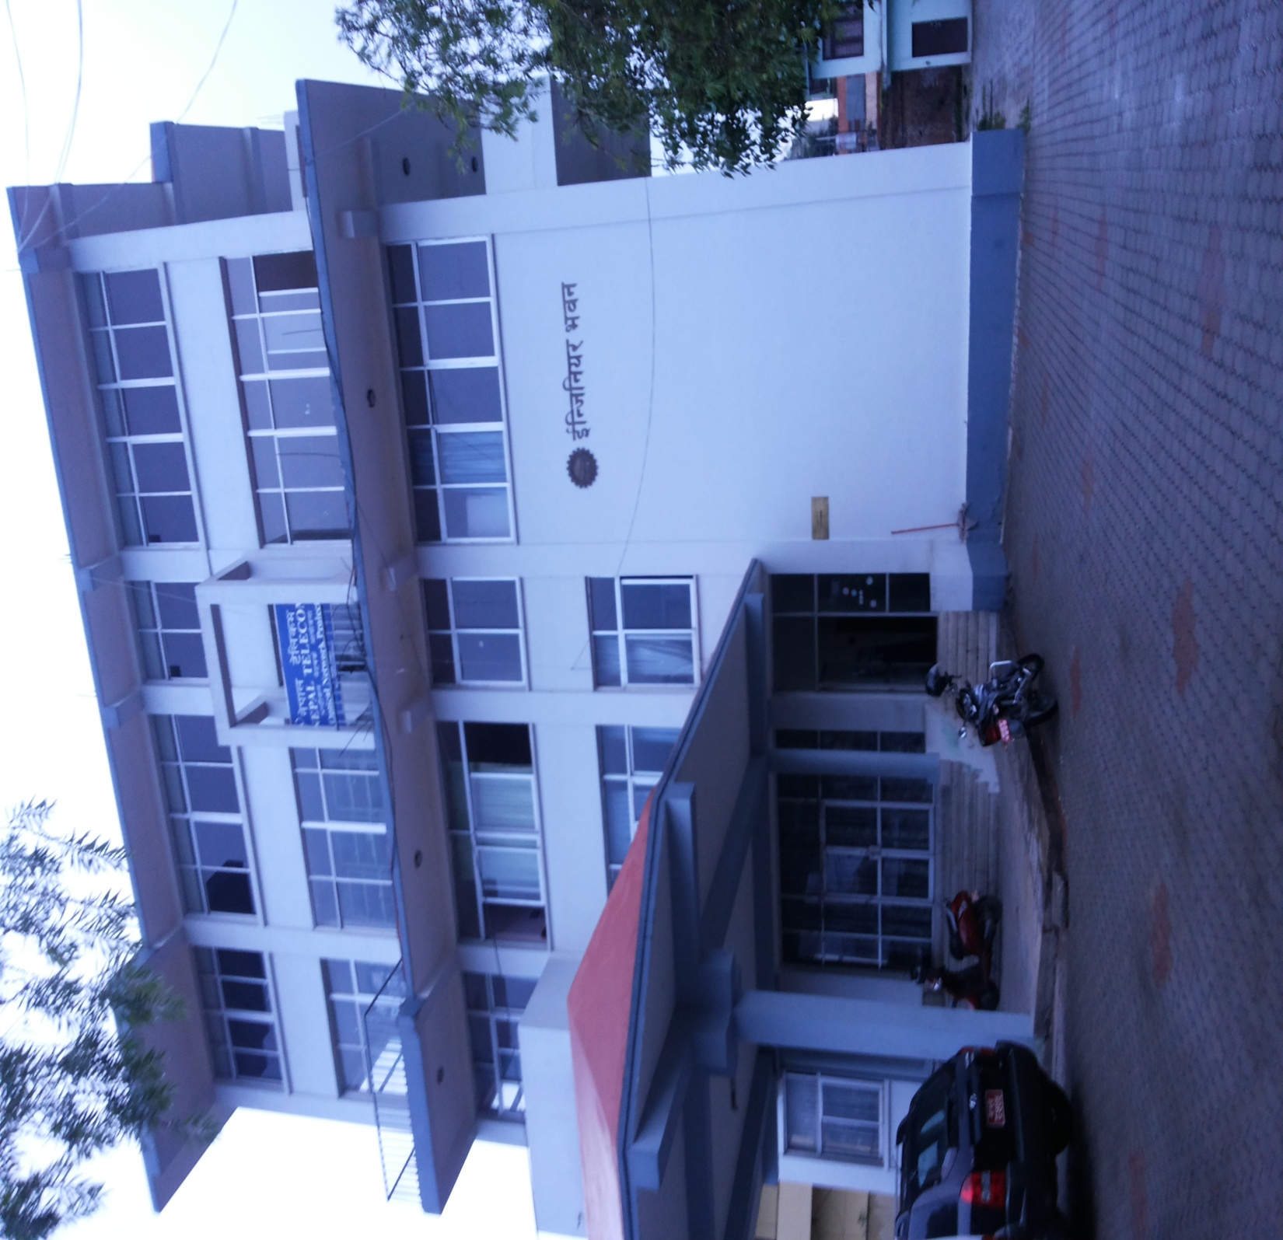
Thank you

