Slide 1

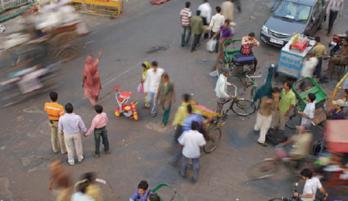
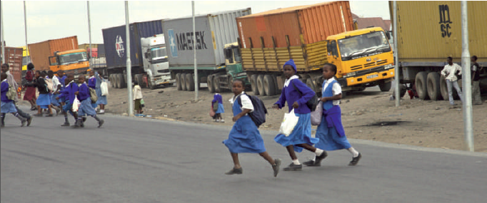
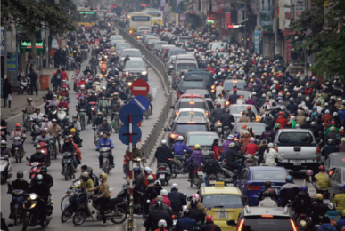
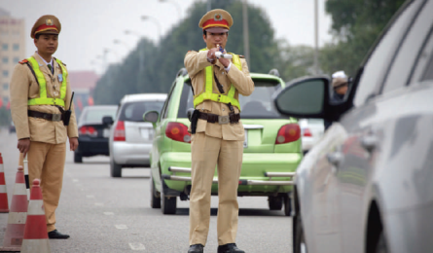
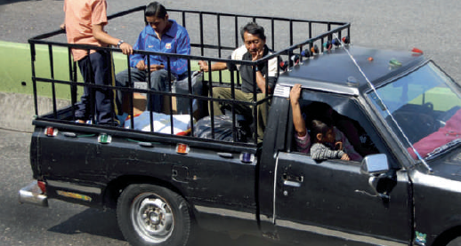
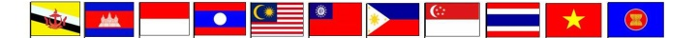
ROAD SAFETY EXPERIENCES OF THAILAND AND UNIVERSITY COURSE CURRICULUM ON ROAD SAFETY
Asst. Prof. Dr. Pongrid Klungboonkrong
Sustainable Infrastructure Research and Development Center (SIRDC)
Department of Civil Engineering, Faculty of Engineering, Khon Kaen University, Thailand

Slide 2
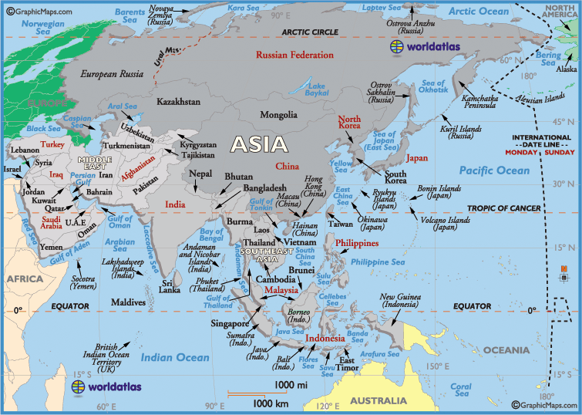


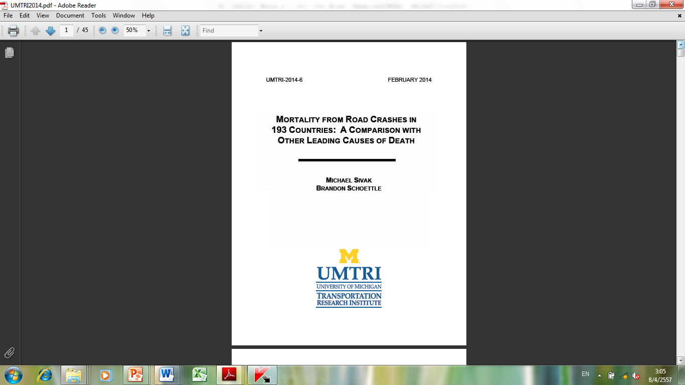
Global Status on Road Safety for Nepal & Thailand
Based on the Global Status Report on Road safety reported by WHO (2009 and 2013) in 2007 and 2010 and Sivak and Schoettle (2014), Road Traffic Fatalities (RTFs) and other related information of each Asian countries were analyzed and compared.

Slide 3


Estimated RTF for 2010
Reported number of deaths for 2010 = 13,766
Estimated total RTI deaths for 2010 =26,312
(13 variables used for estimation: GDP, vehicle/capita, road density, national speed limit urban-rural, health system access, alcohol consumption, population working, percentage motorcycle, corruption index, national policy for walking /cycling, population)
Estimated total RT fatality rate per 100,000 population =38.07 , Rank the 3th worst in the world
Dr. Witaya Chadbunchachai (2013)

Slide 4
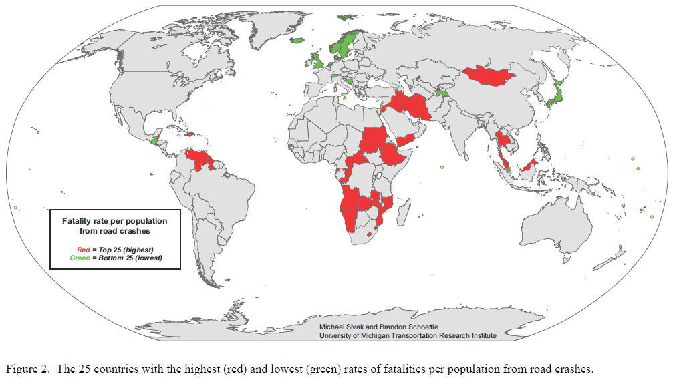
A Map of the Countries with the Most and the Least Dangerous Roads
(based on WHO (2008) data)
Michael Sivak & Brandon Schoettle (2014)

Slide 5
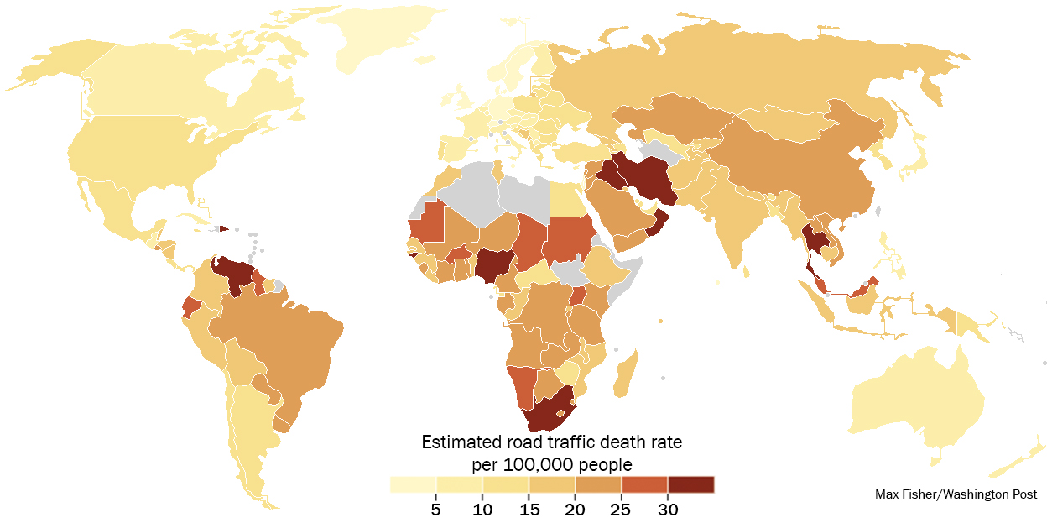
A Map of the Countries with the Most Dangerous Roads (based on WHO (2010) data)
Dr. Witaya Chadbunchachai (2013)
www.washingtonpost.com

Slide 6
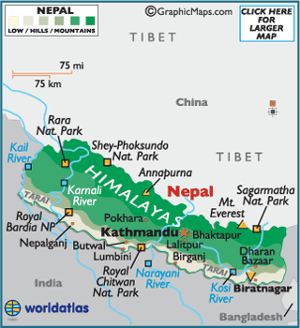
NEPAL

Slide 7
Comparisons of RTF Rates
Countries | Source | Year | Reported RTF | Estimated RTF | Reported RTF per 100,000 Pop. | Estimated RTF per 100,000 Pop. | World Ranking
THAILAND | WHO (2009) | 2007 | 12,492 | 12,492 | 19.6 | 19.6 | 74
 | UMRTI (2014) | 2008 | N/A | N/A | N/A | 44 | 2
 | WHO (2013) | 2010 | 13,365 | 26,312 | 19.3 | 38.1 | 3
NEPAL | WHO (2009) | 2007 | 962 | 4,245 | 3.4 | 15.1 | 100
 | UMRTI (2014) | 2008 | N/A | N/A | N/A | 9 | 147
 | WHO (2013) | 2010 | 1,689 | 4,787 | 5.6 | 16.0 | 87
WHO (2009) : Global status report on road safety: time for action.
WHO (2013) : Global status report on road safety 2013: supporting a decade of action.
Michael Sivak & Brandon Schoettle (2014) MORTALITY FROM ROAD CRASHES IN 193 COUNTRIES: A COMPARISON WITH OTHER LEADING CAUSES OF DEATH

Slide 8
RTFs per 100,000 pop. vs GNI per capita (WHO, 2009)
74
100

Slide 9
RTFs per 100,000 pop. vs GNI per capita (WHO, 2013)
3
87

Slide 10
RTFs per 1,000 veh. vs GNI per capita (WHO,2013)

Slide 11
RTFs per 1,000 veh. vs vehicles per 1,000 pop. (WHO, 2013)

Slide 12
Fleet composition (WHO, 2013)

Slide 13
Proportion of RTFs by road user (WHO, 2013)

Slide 14
Proportion of 2/3-wheelers RTF vs
2/3-wheelers Composition (WHO, 2009 & 2013)

Slide 19
Conclusions
RTFs per population showed low correlation with GNIs per capita.
RTFs per vehicles showed relatively high correlation with GNIs per capita and number of vehicles per population.
As GNI per capita increases, the proportion of 4-wheelers will rise and the proportion of 2- and 3- wheelers will decline.
For L & M income countries, pedestrians, cyclists and 2/3- wheelers were the main contributor to RTFs.
Safer infrastructure, safer vehicles and more effective adoption and enforcement of road safety laws, for cyclists, pedestrians and 2/3 wheelers must be critically considered.

Slide 20
Conclusions
The analysis results must be carefully interpreted.
Besides number of population and vehicles, distance travelled (VKT) by road users should be examined as exposure.
Development of systematic and reliable road safety database systems among Asian countries is crucially needed.

Slide 21
ROAD SAFETY EXPERIENCES OF THAILAND

Slide 22
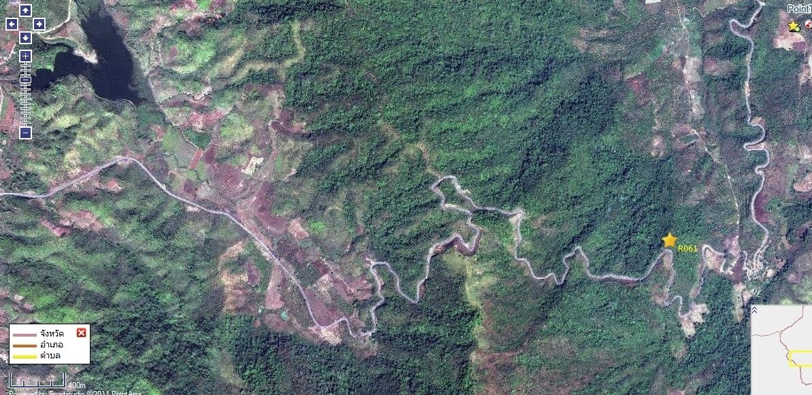
Mr. Lamduan Srisakda
Mr. Lamduan Srisakda
Road Alignment of Highway 118 between Chiangmai Province and Chiangrai Province
Assc. Prof. Landuan Srisakda

Slide 23
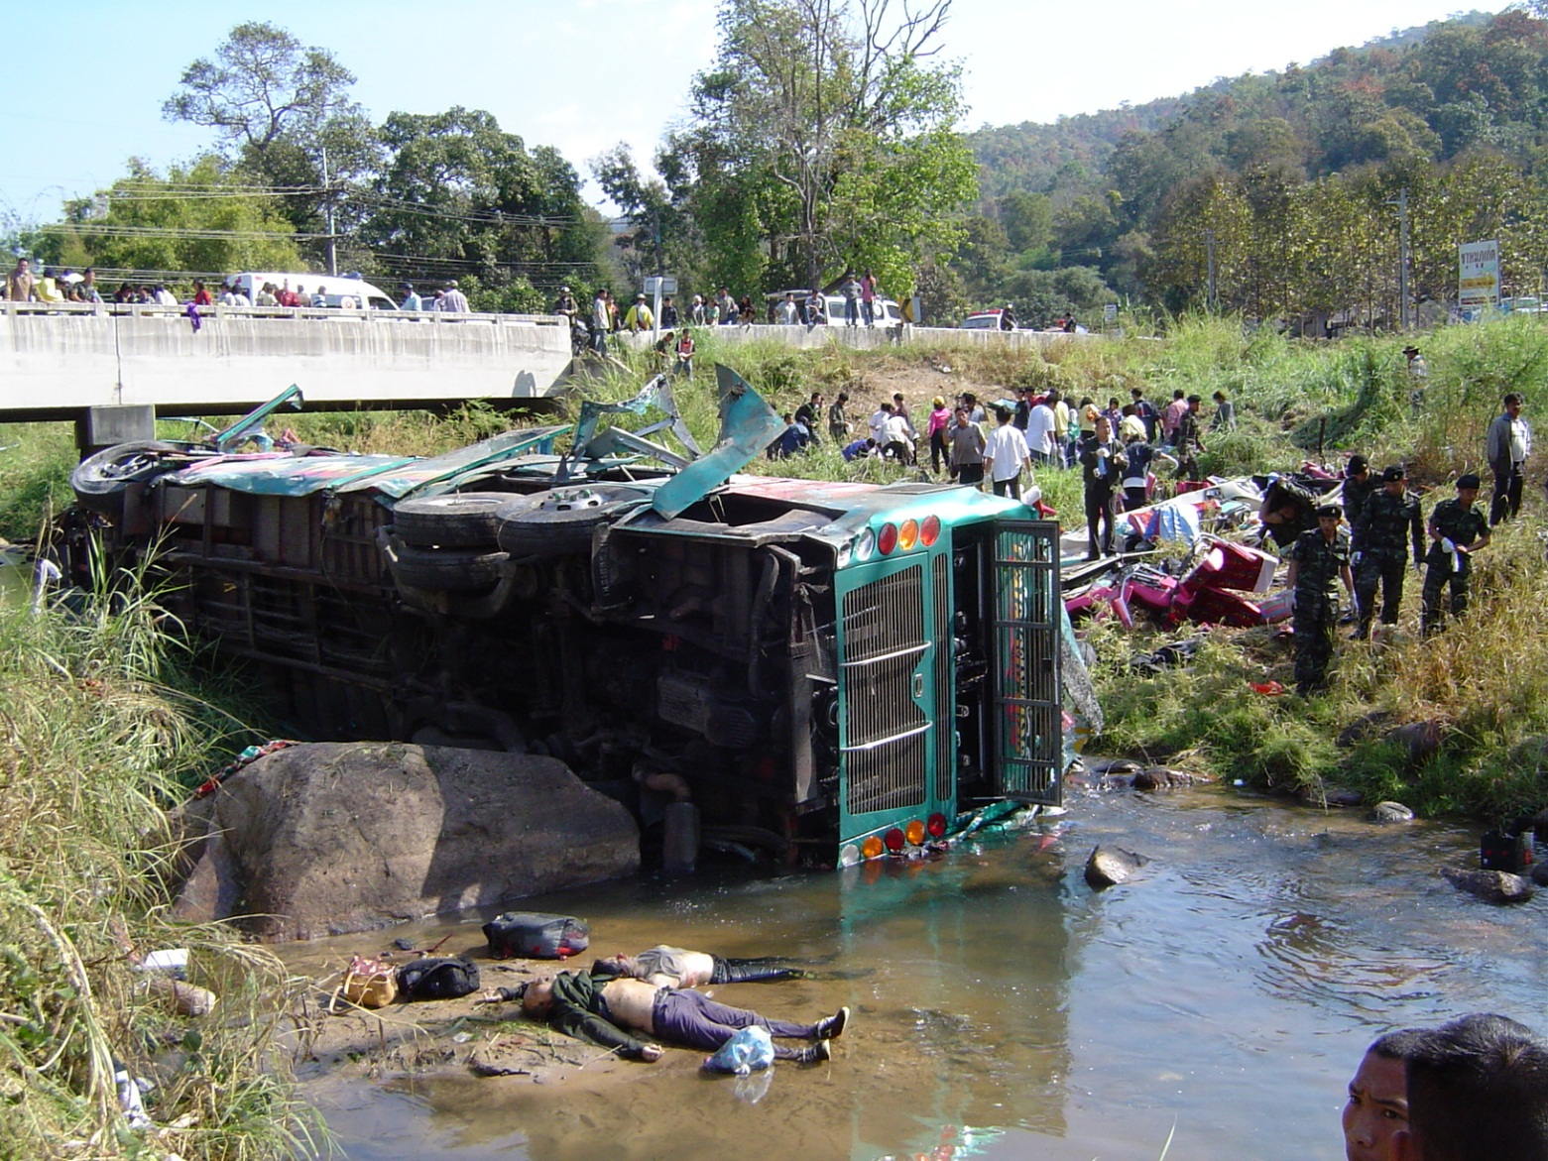
A two-floor bus accident at Highway 118 (Sta. 42) Doysaket Amphur, Chiangmai province on 19 January 2007 (9:30) causing 17 fatalities and 37 serious injuries
Assc. Prof. Landuan Srisakda

Slide 24
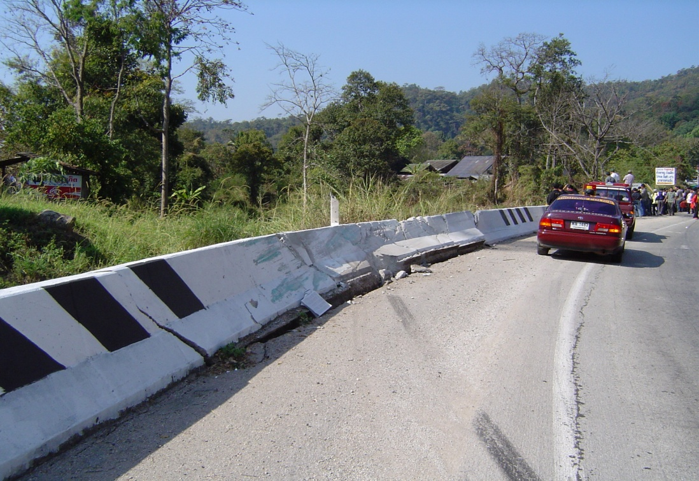
Road and Environment Damages
Mr. Lamduan Srisakda
Assc. Prof. Landuan Srisakda

Slide 25

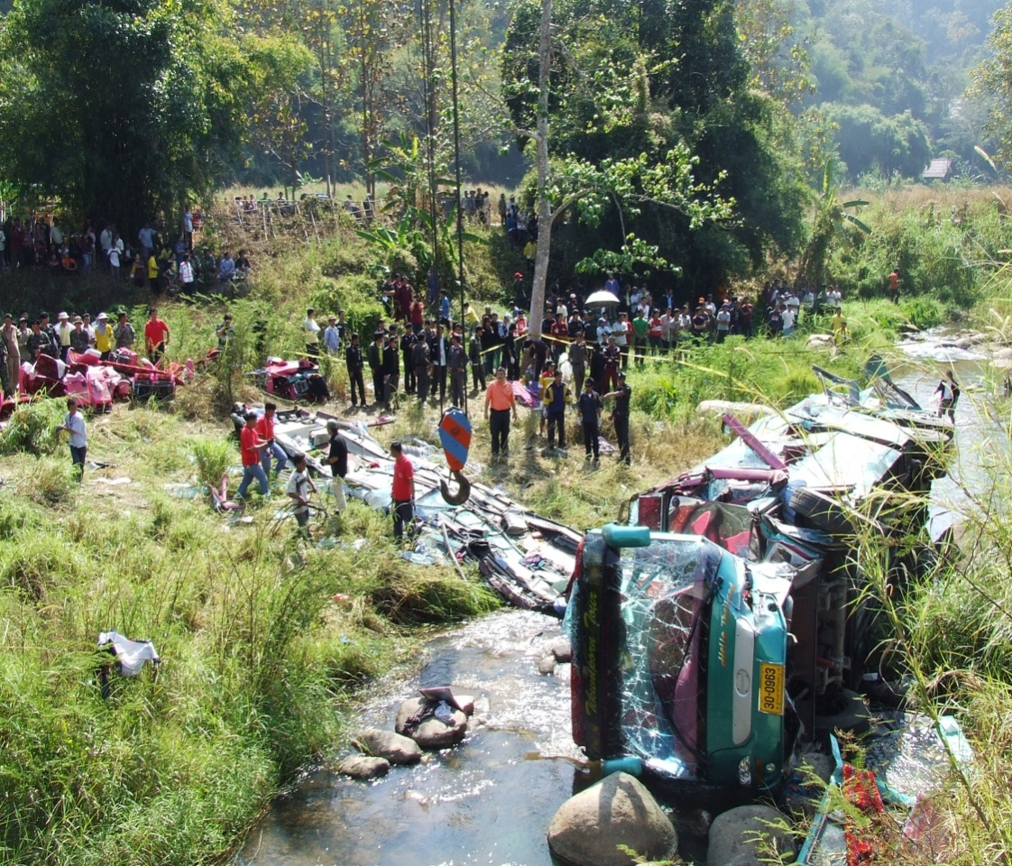
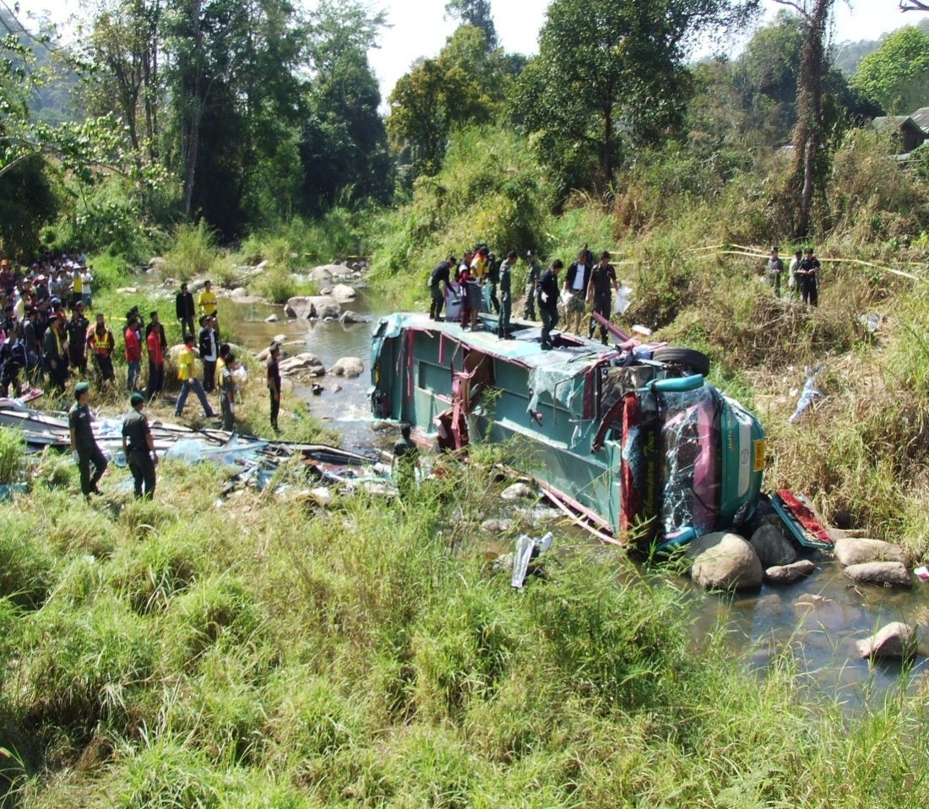
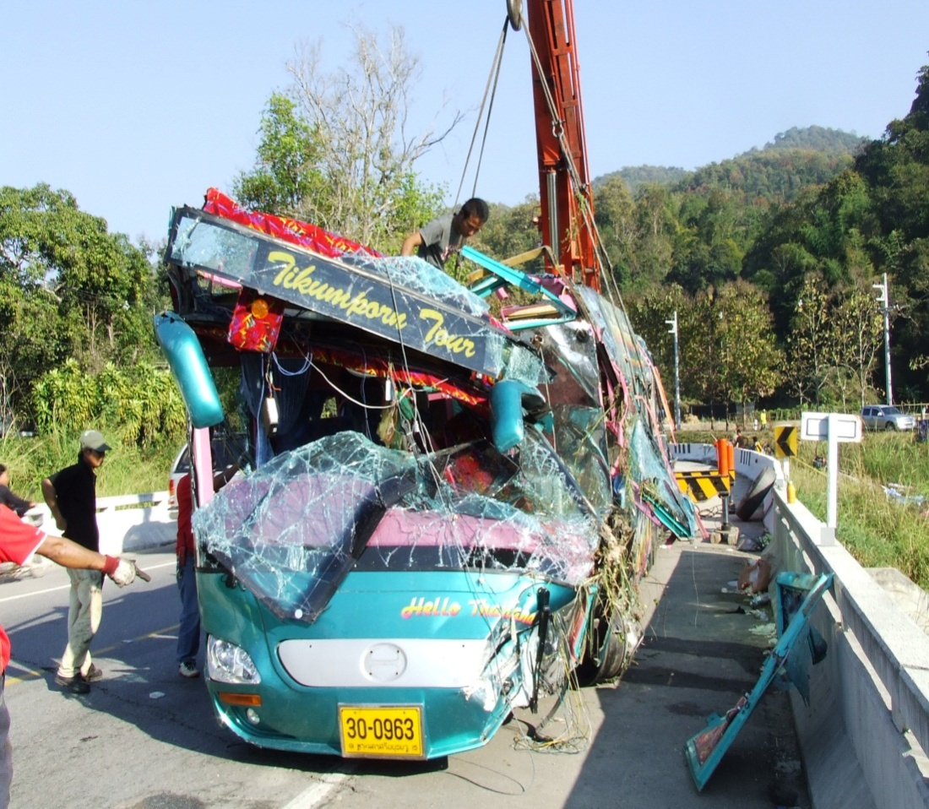
Assc. Prof. Landuan Srisakda

Slide 26
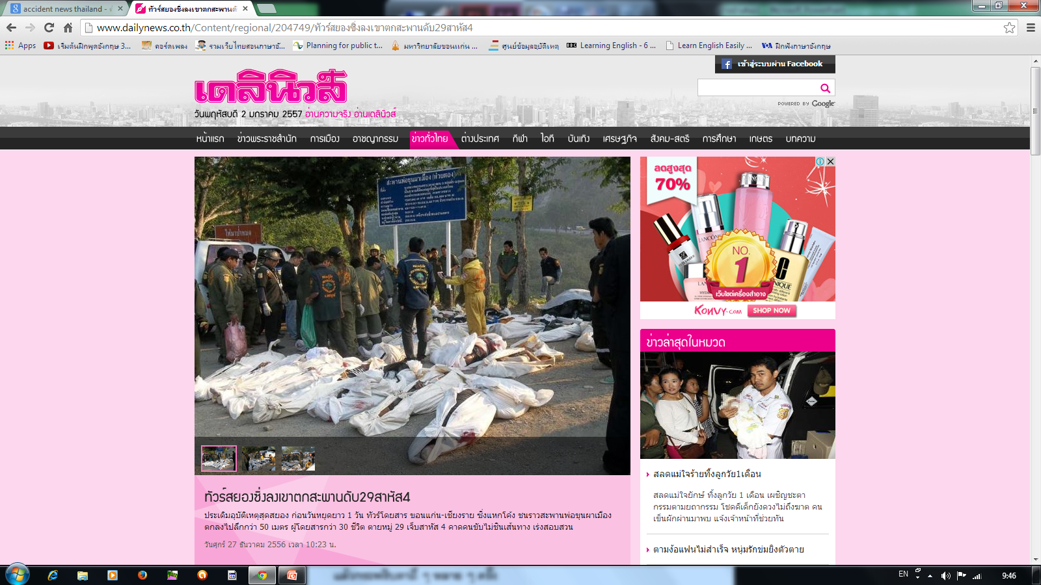
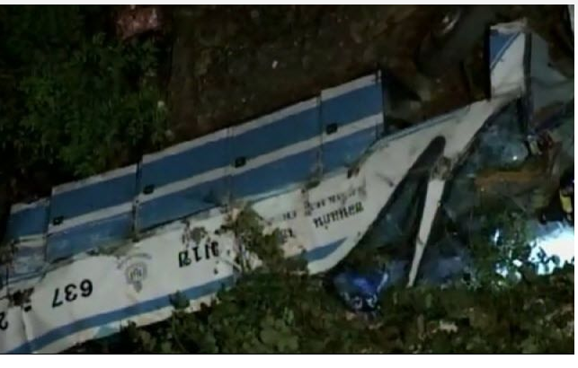
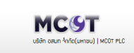
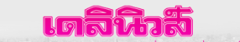
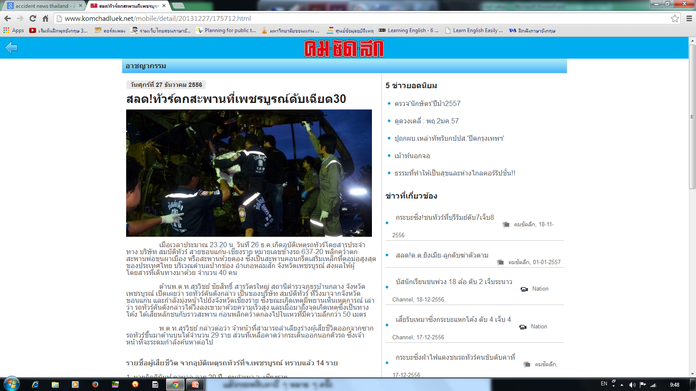
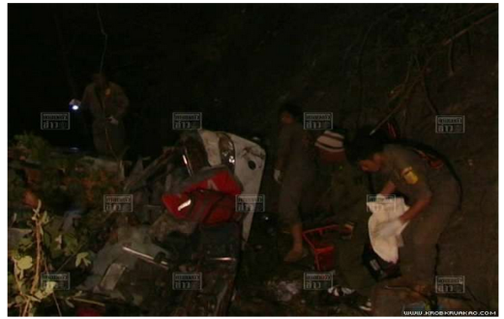

A Thai 2-floor bus plunged off the Khun Pha Muang bridge near the sharp curve at Highway 2 (Sta.375) in the Phetchaboon province and killed 30 people .

Slide 27
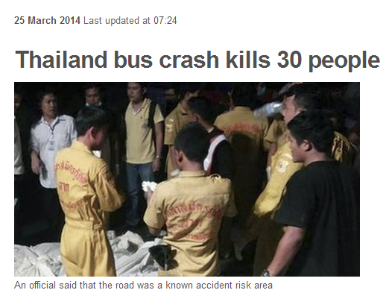
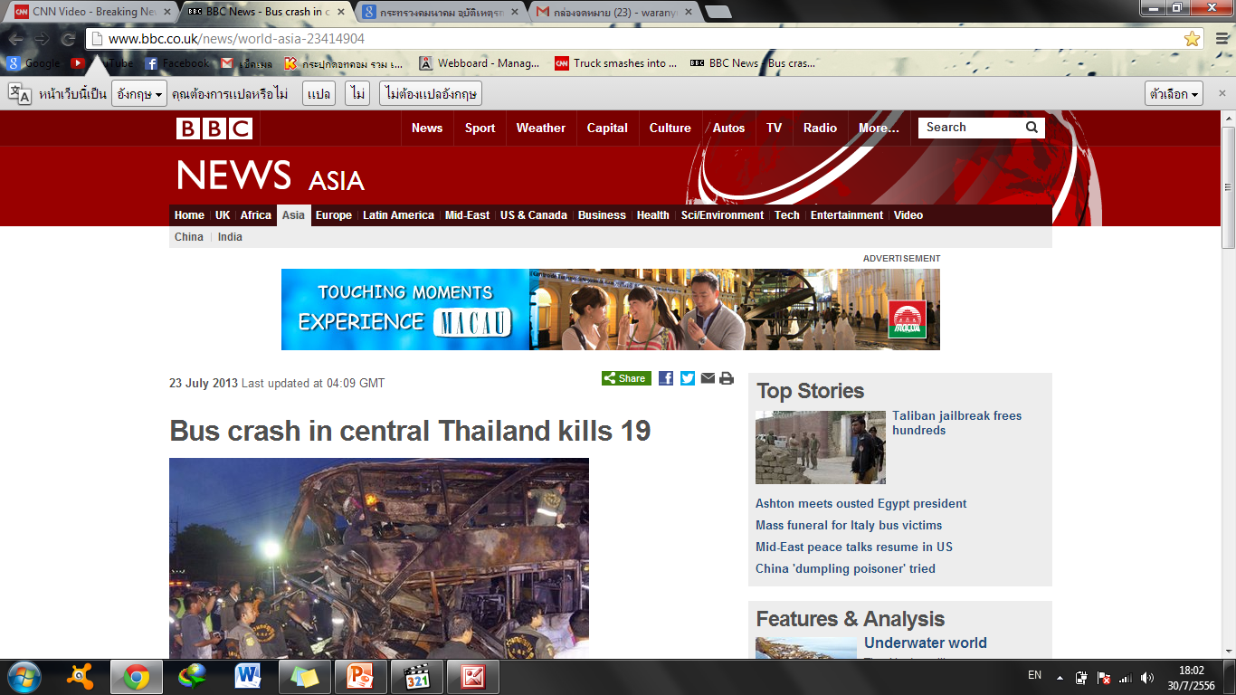
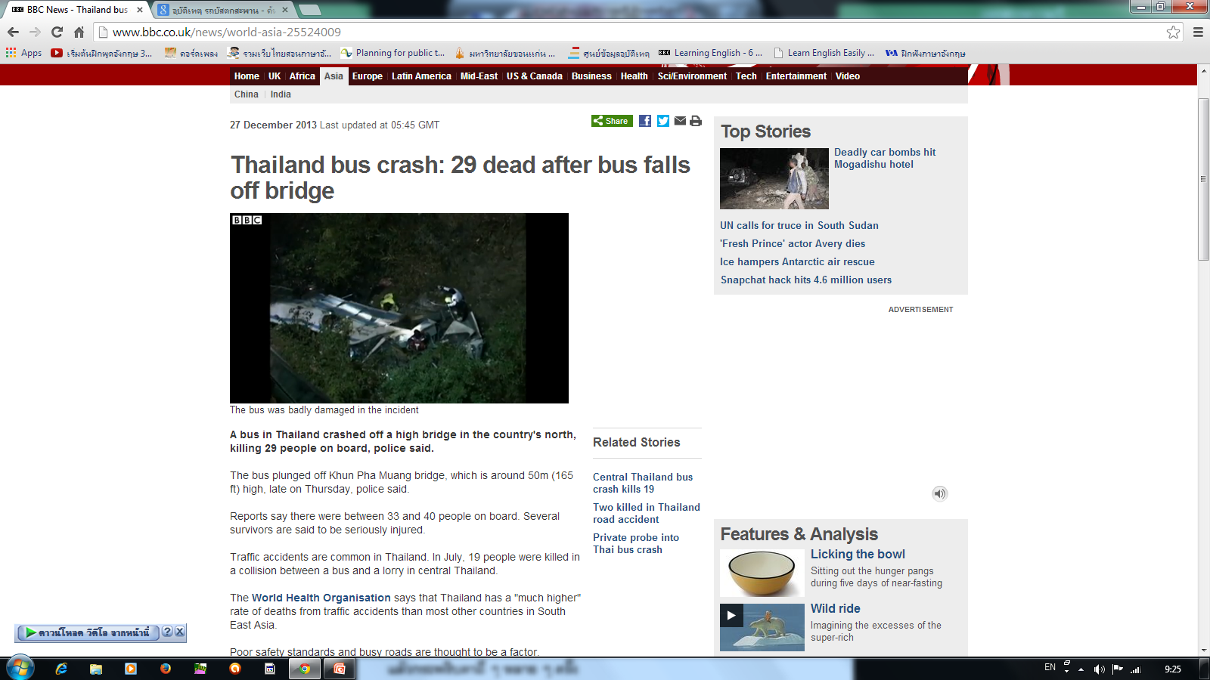
In a separate accident, 30 people died after a bus travelling through the northern province of the Phetchaboon province plunged off Khun Pha Muang bridge.

Slide 28
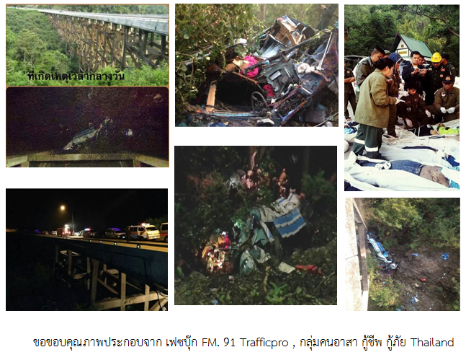
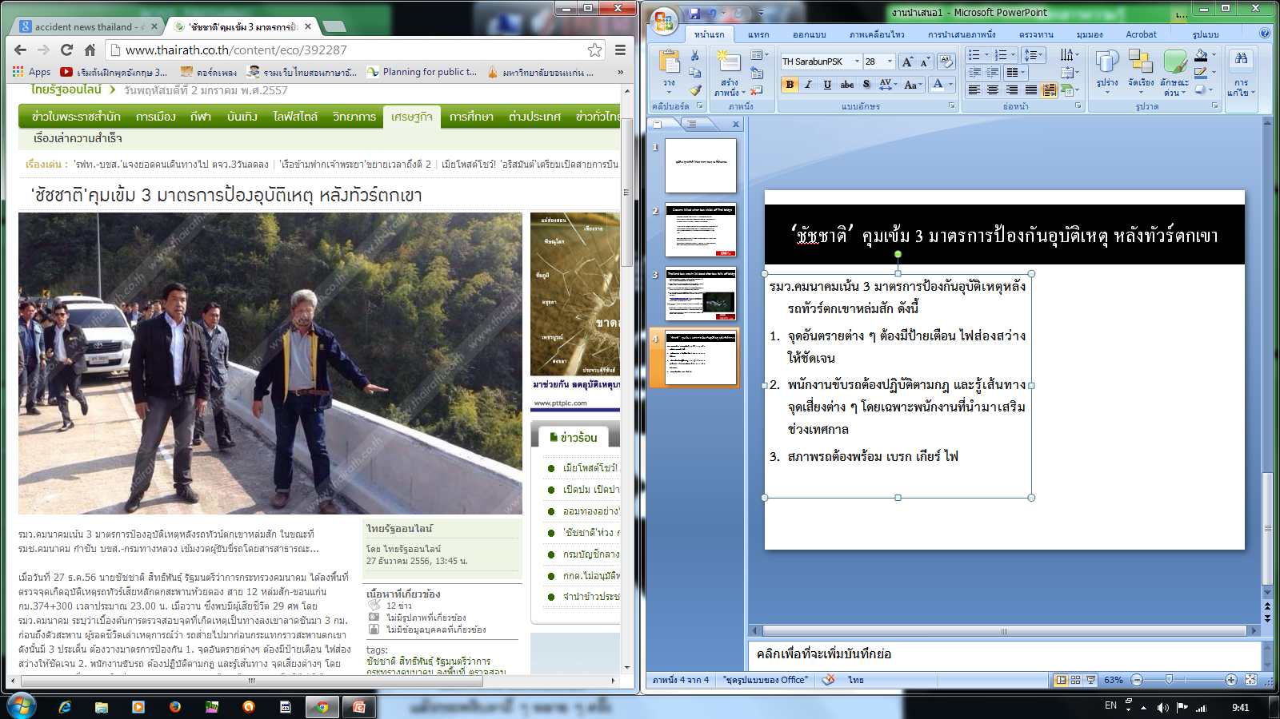
Thai bus crash killed 30 persons

Slide 29
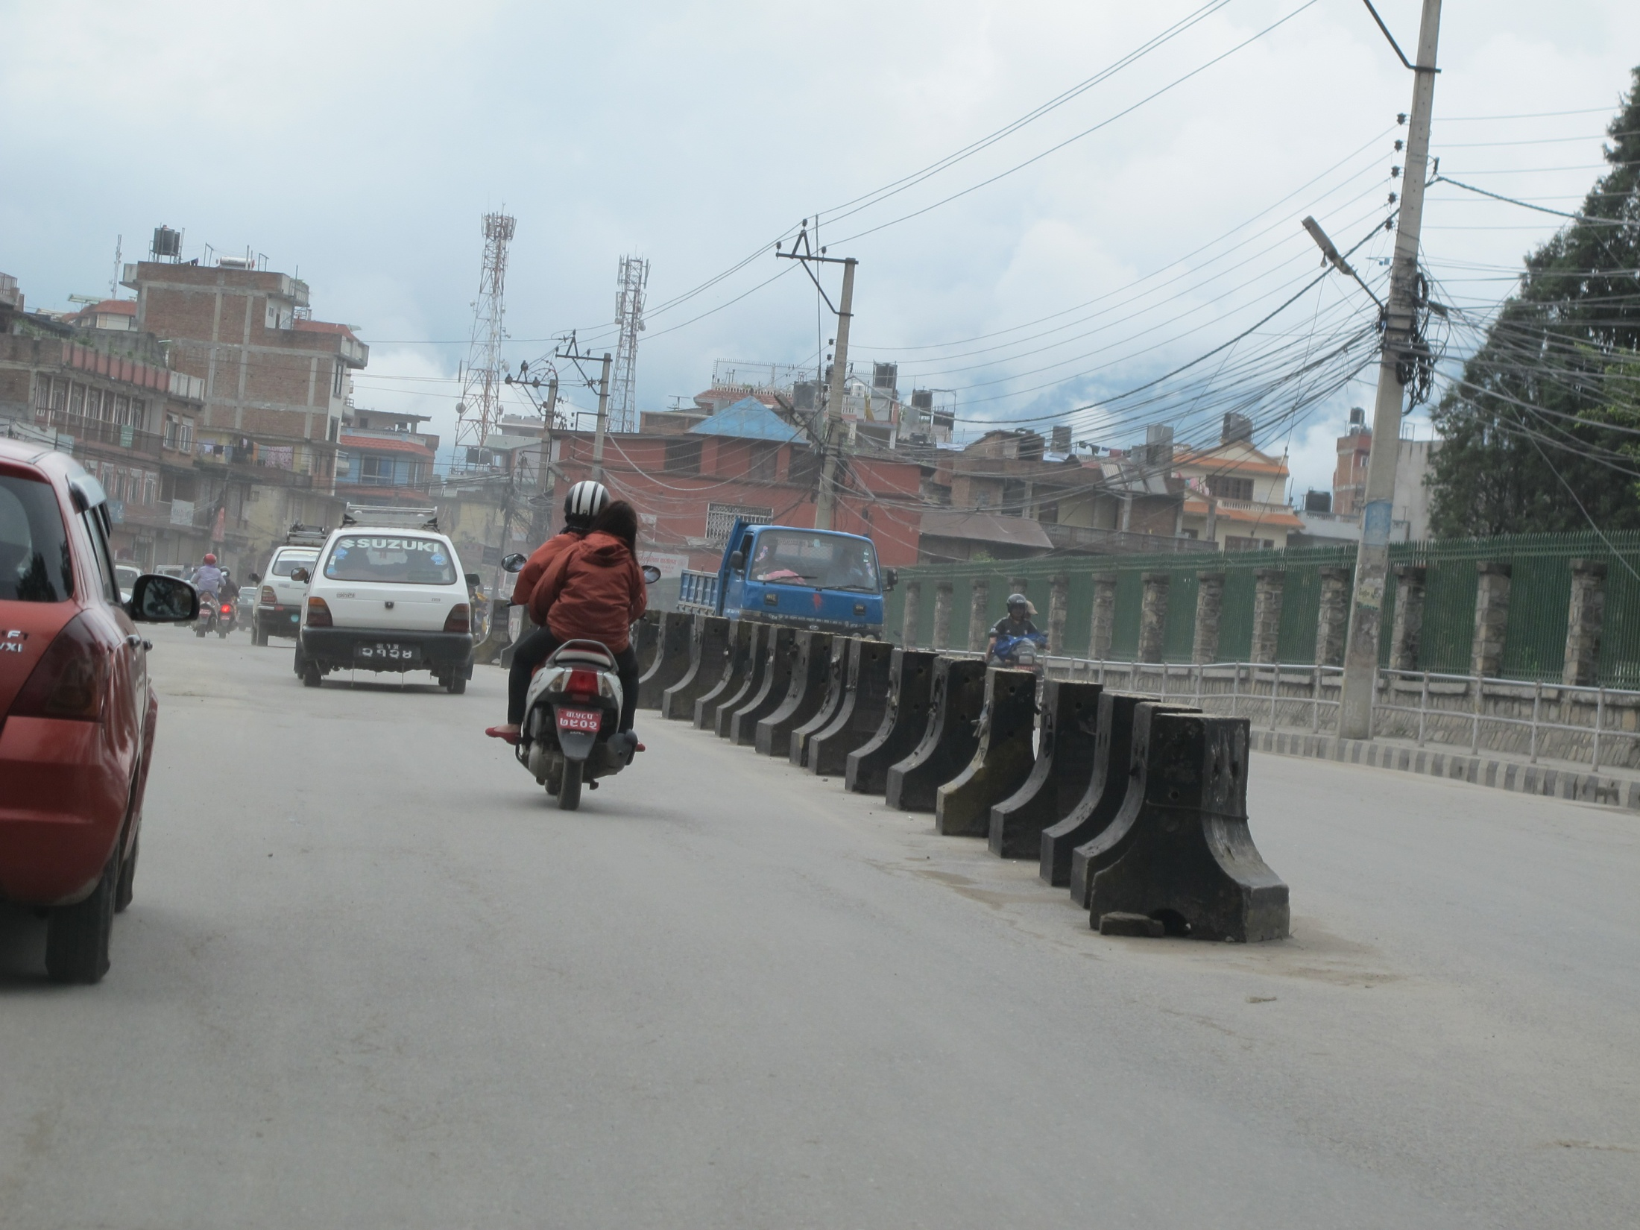
Roadside Hazard

Slide 30
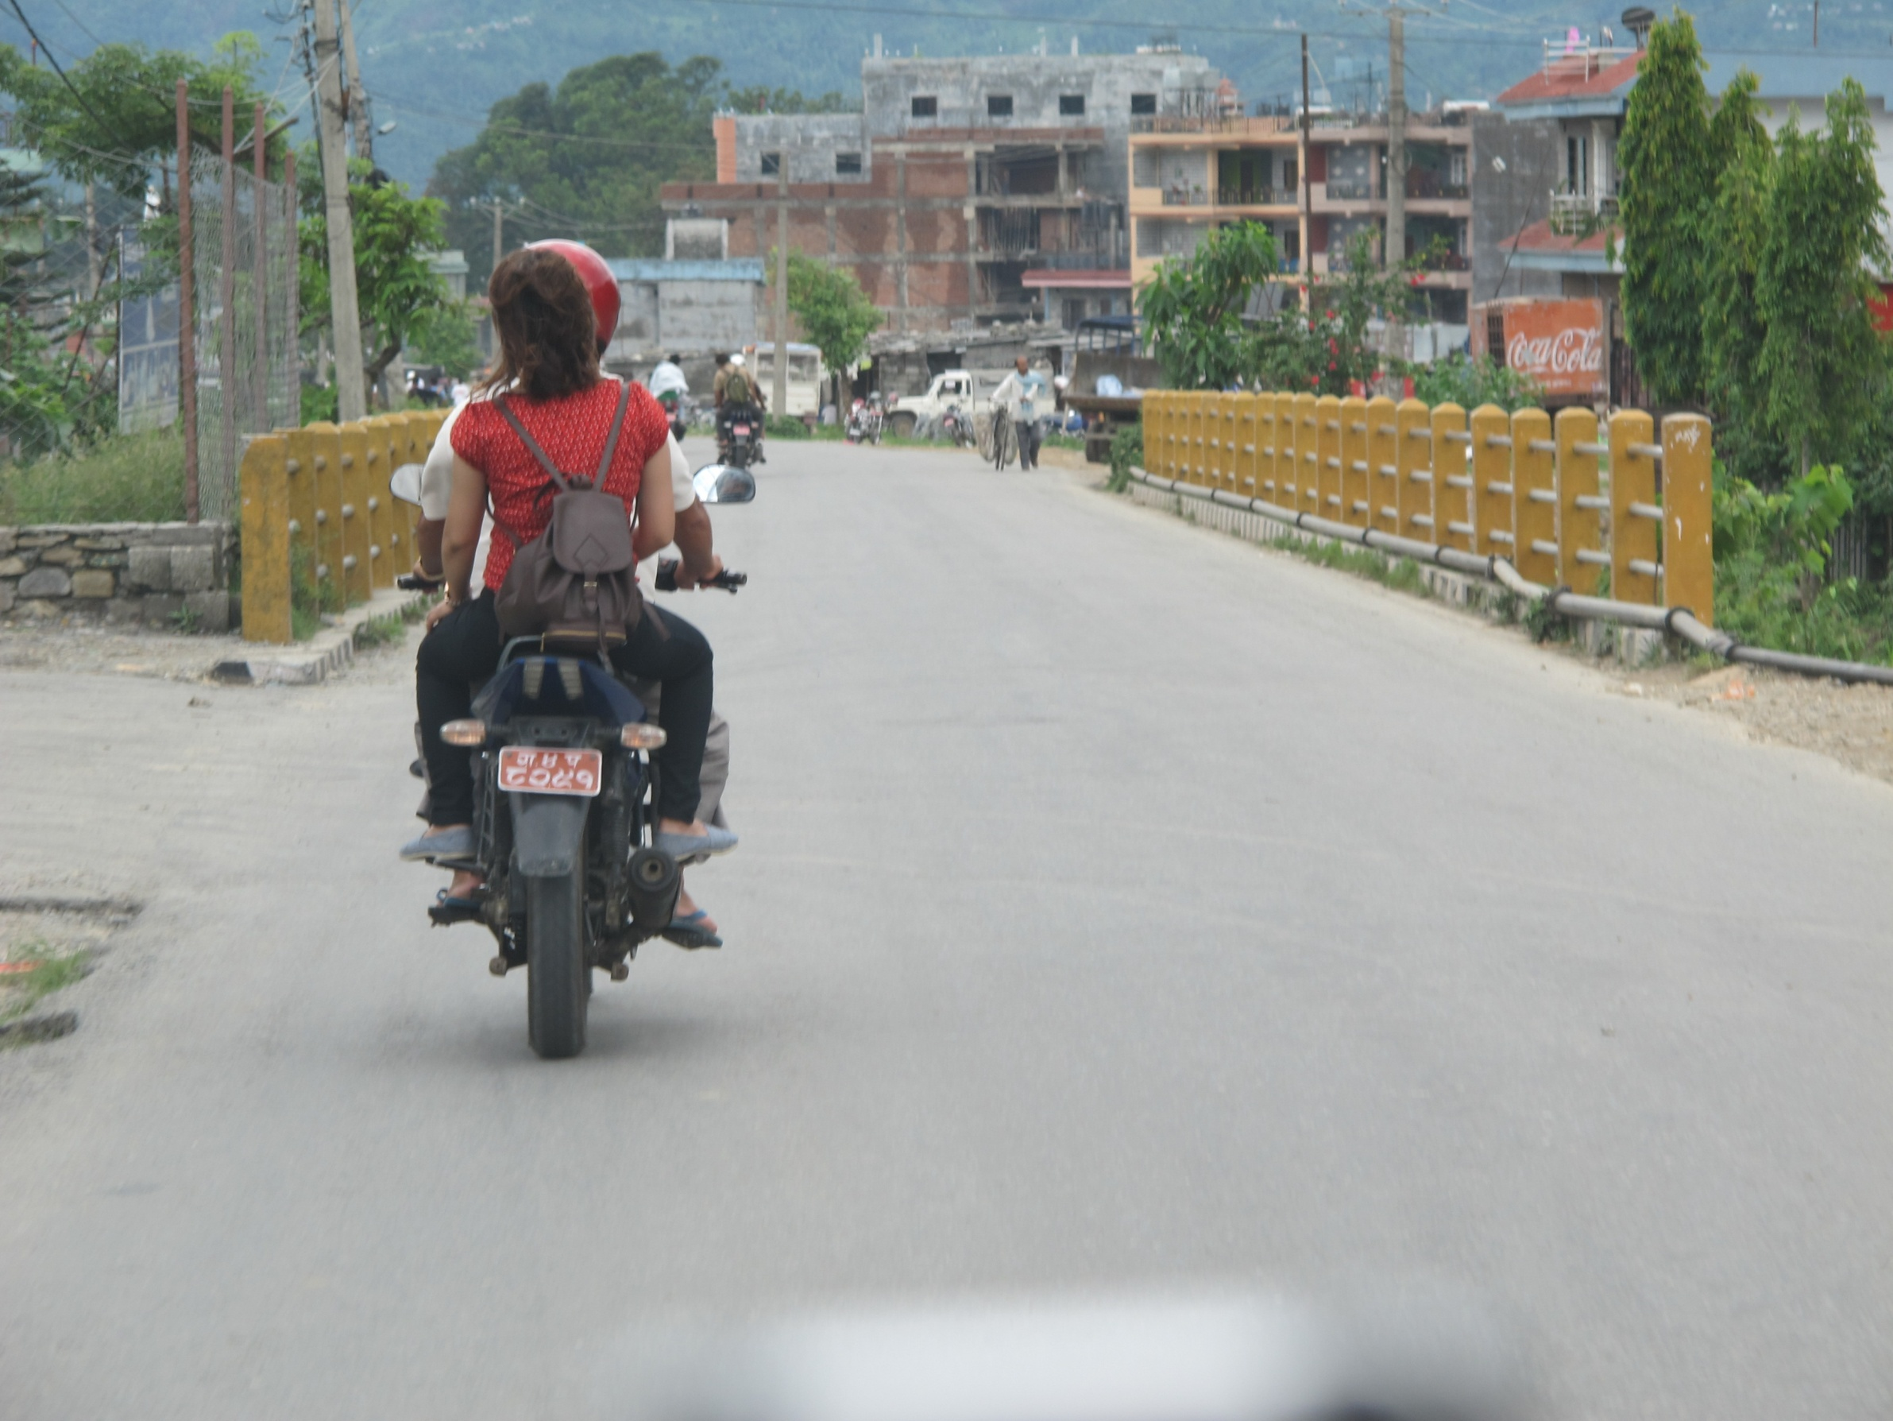
Roadside Hazard

Slide 31
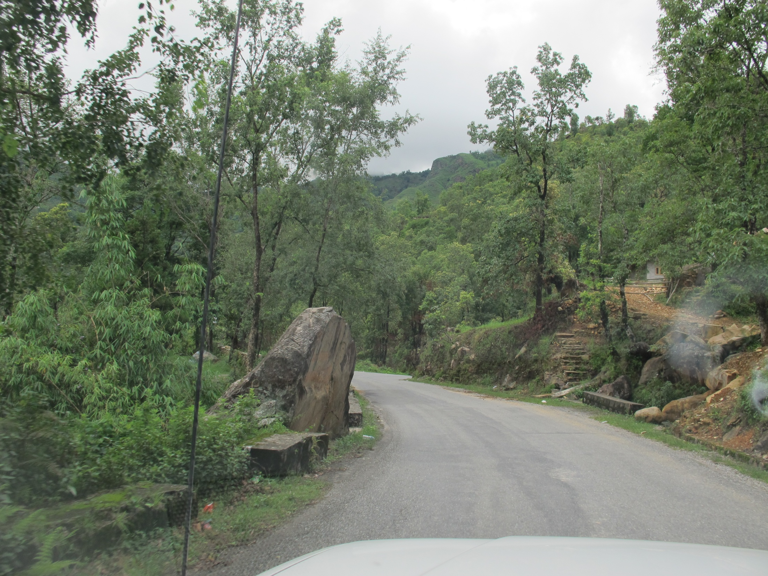
Roadside Hazard

Slide 32
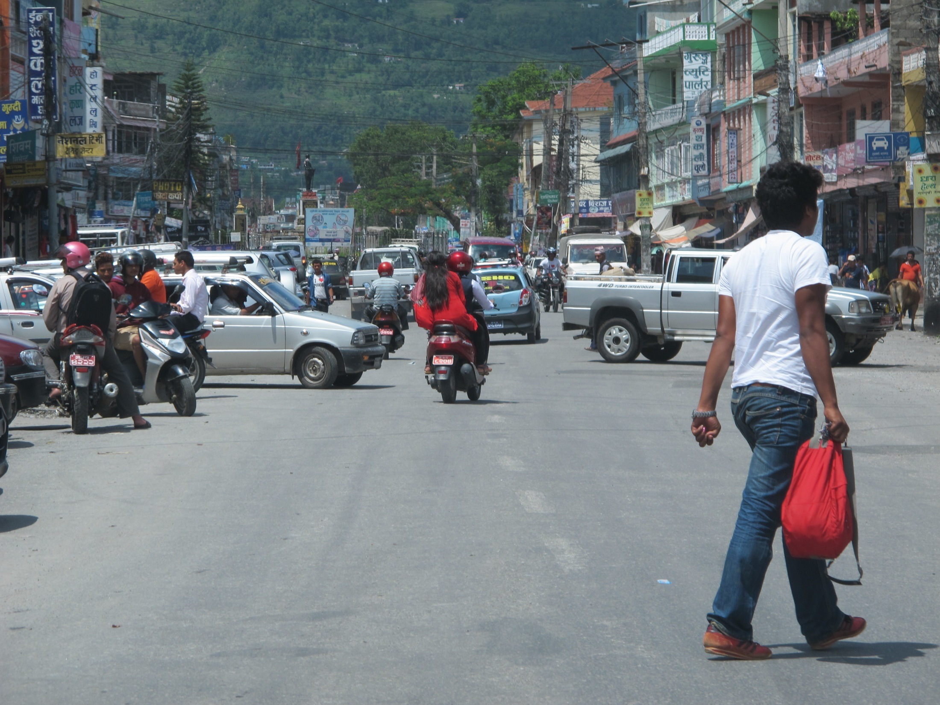
Traffic Conflicts

Slide 33
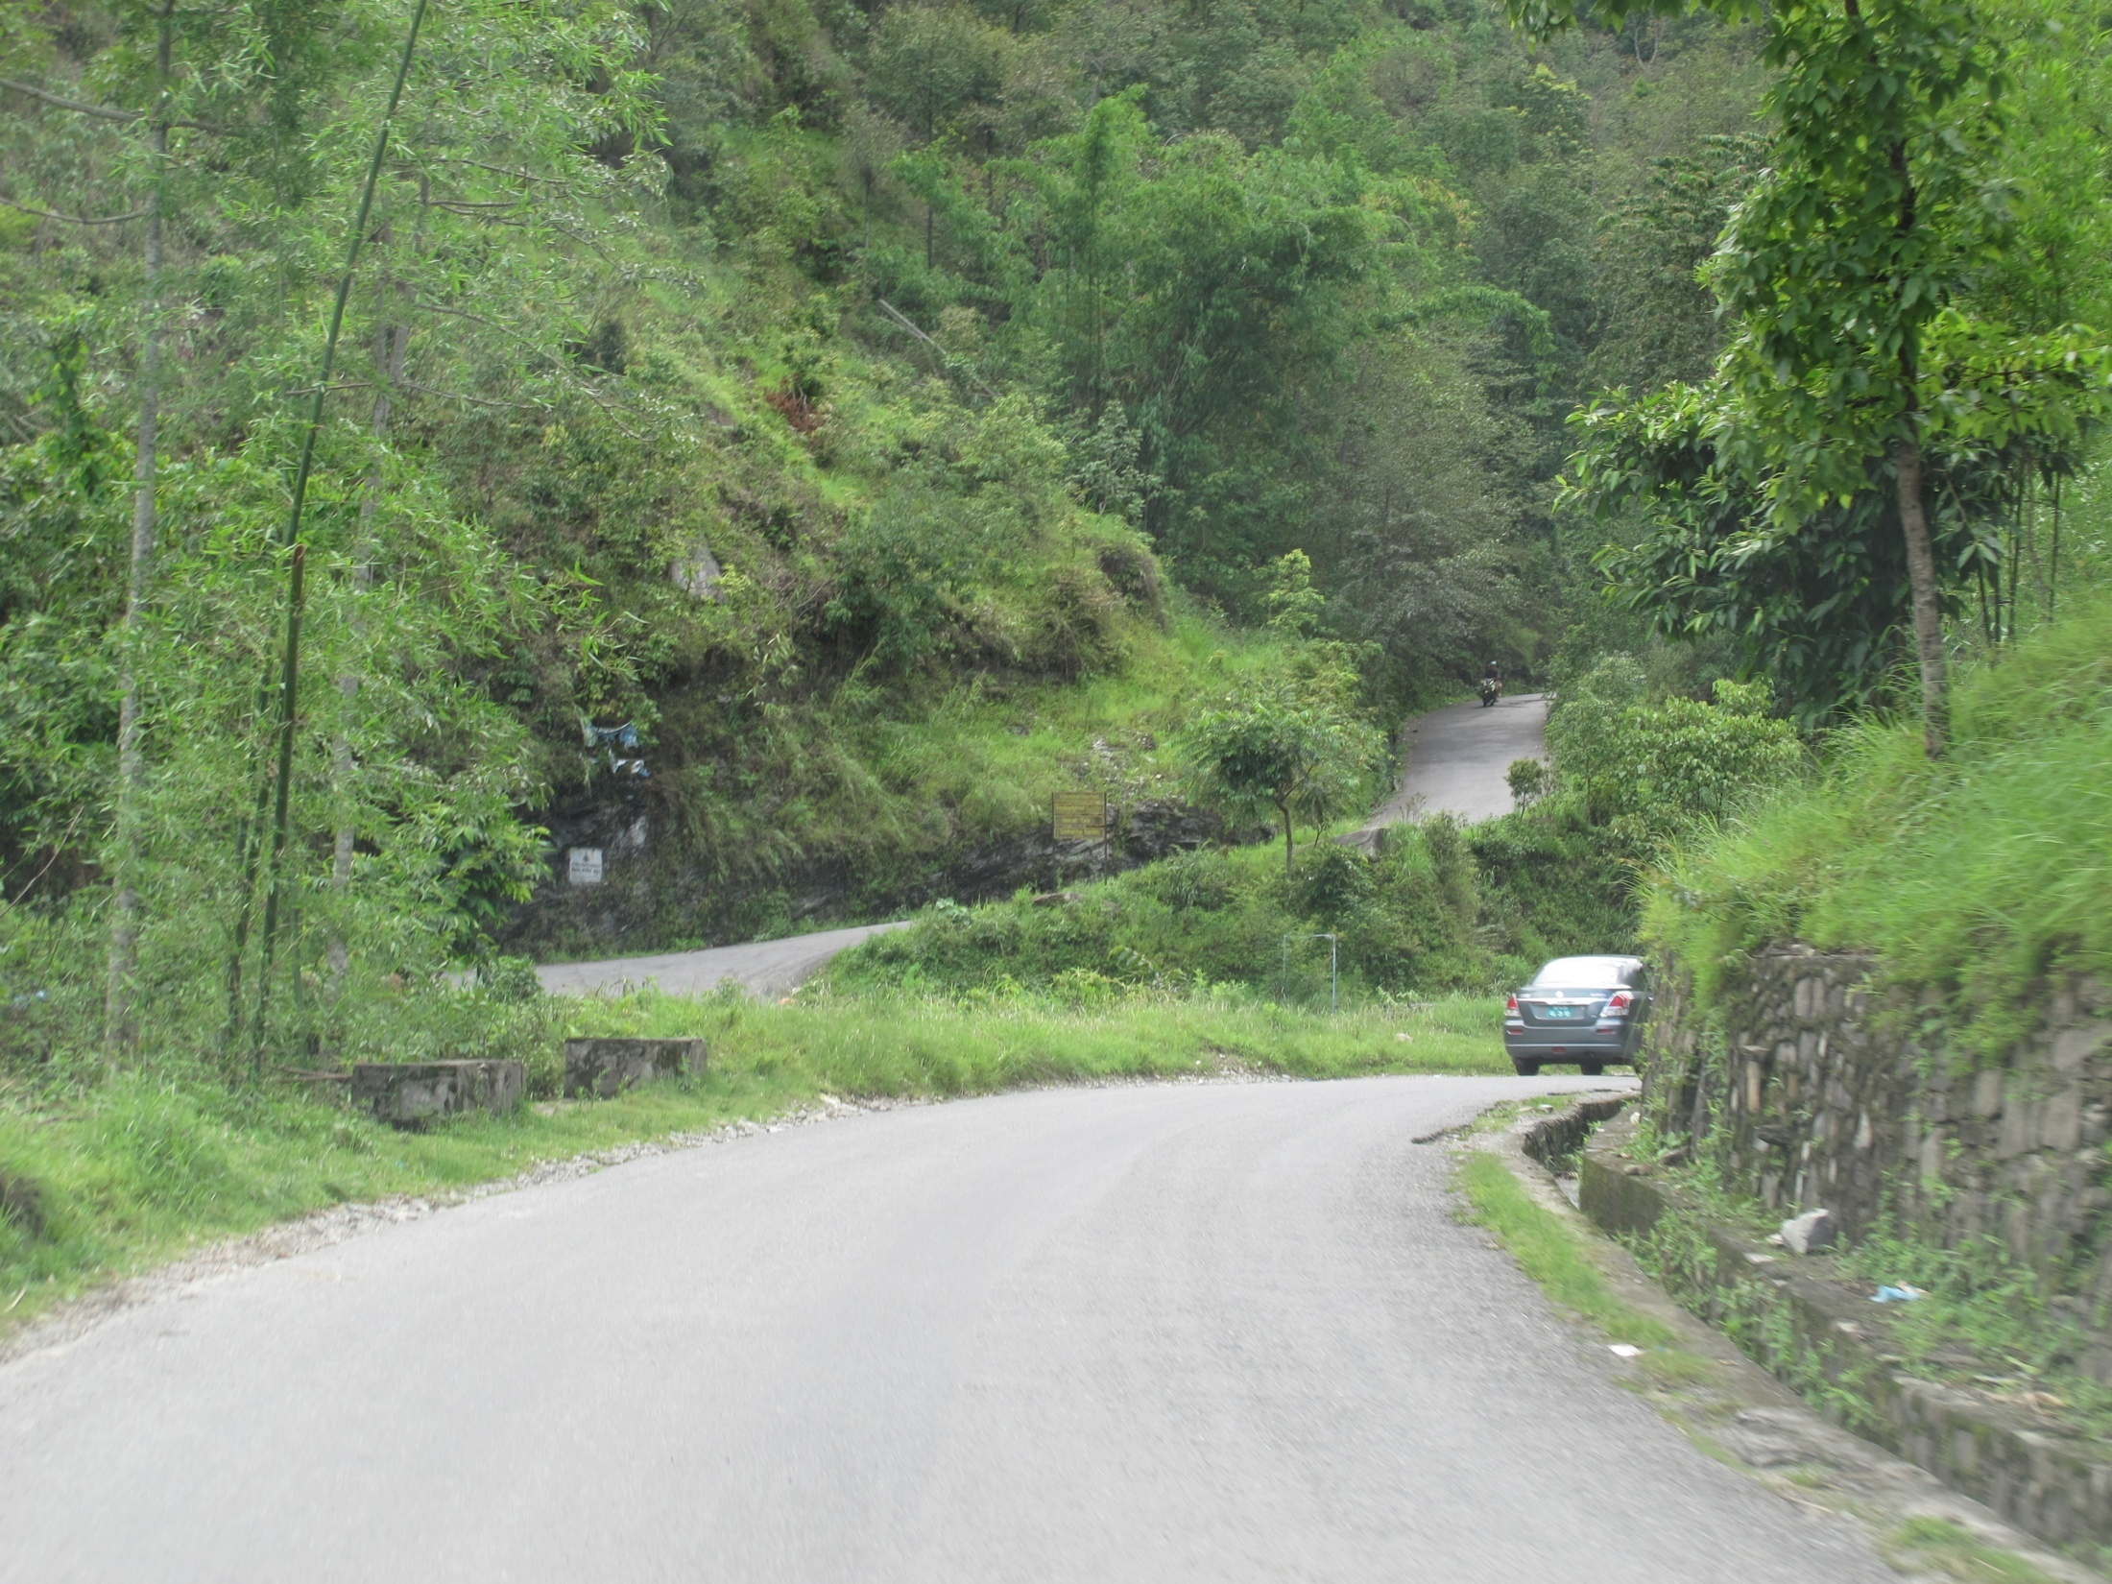
Sight Distance & Roadside Protection

Slide 34
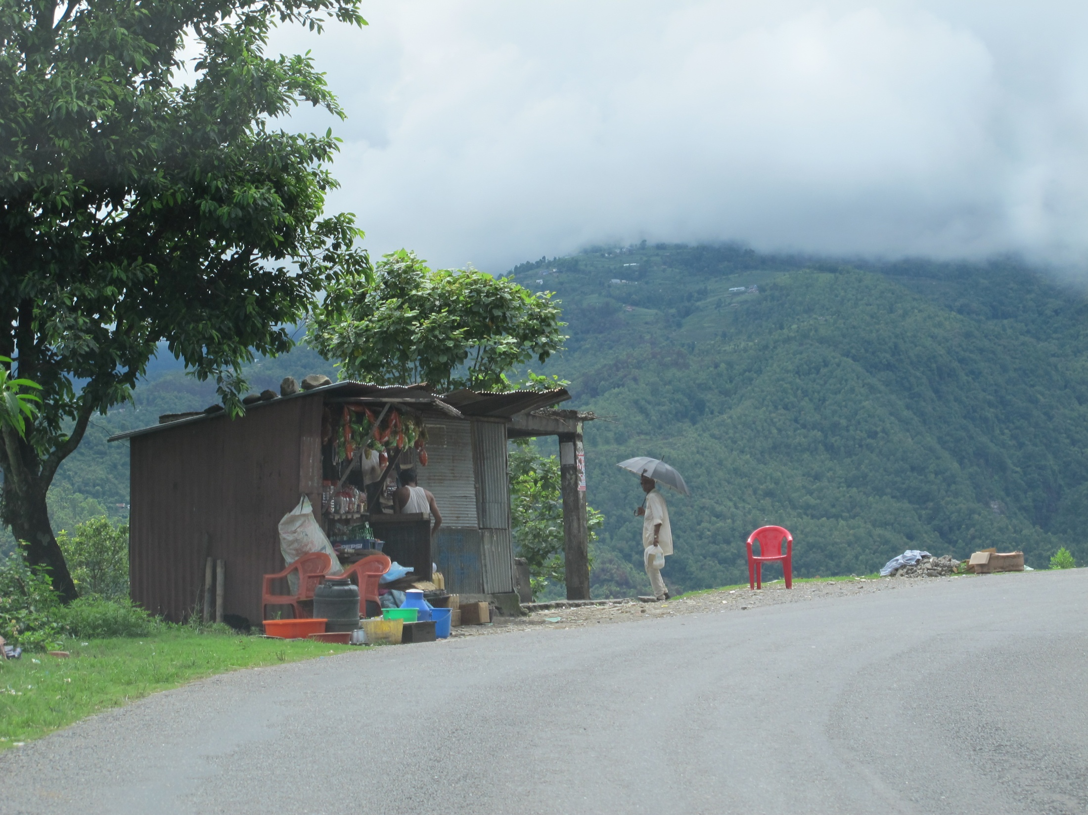
Roadside Protection

Slide 35
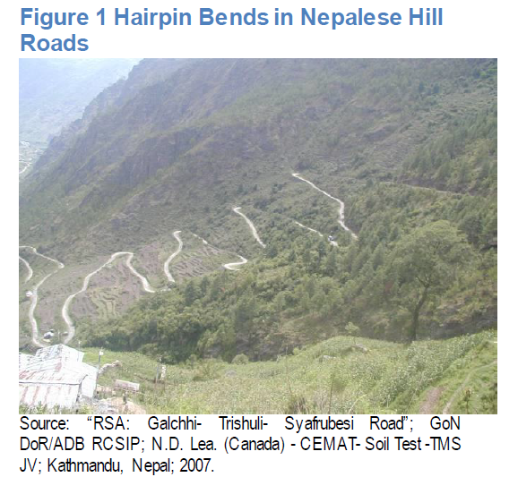
Nepal Road Safety Action Plan (2013-2020)

Slide 36
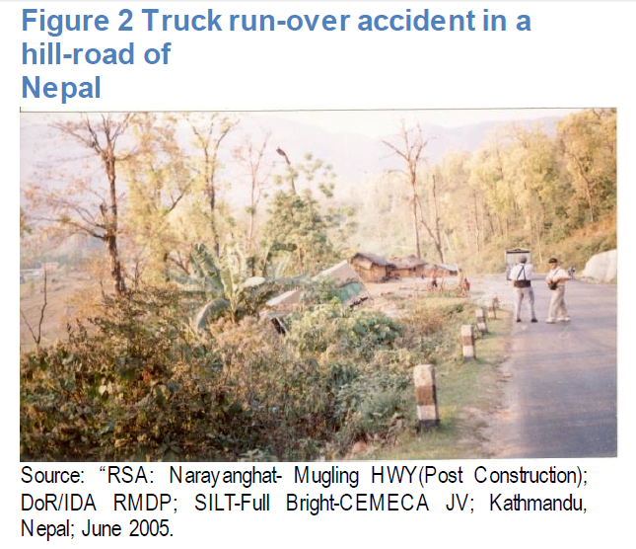
Nepal Road Safety Action Plan (2013-2020)

Slide 37
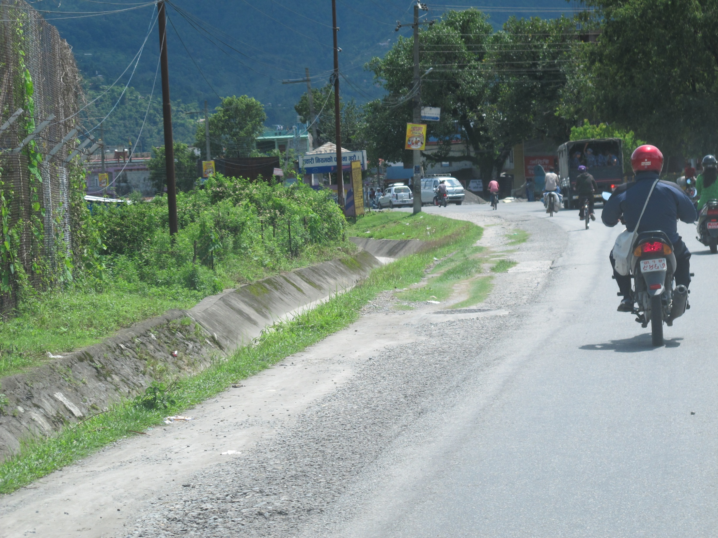
Drainage System

Slide 38
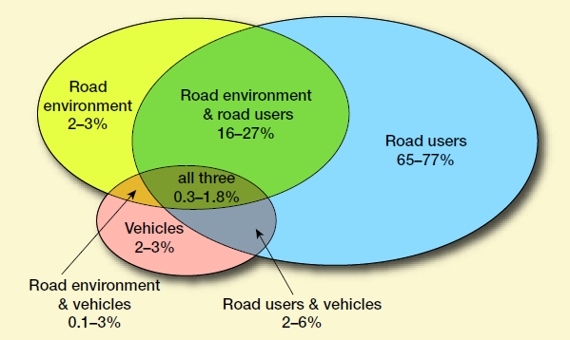
Percent Contribution to Road Crashes
GTZ (2006)

Slide 39
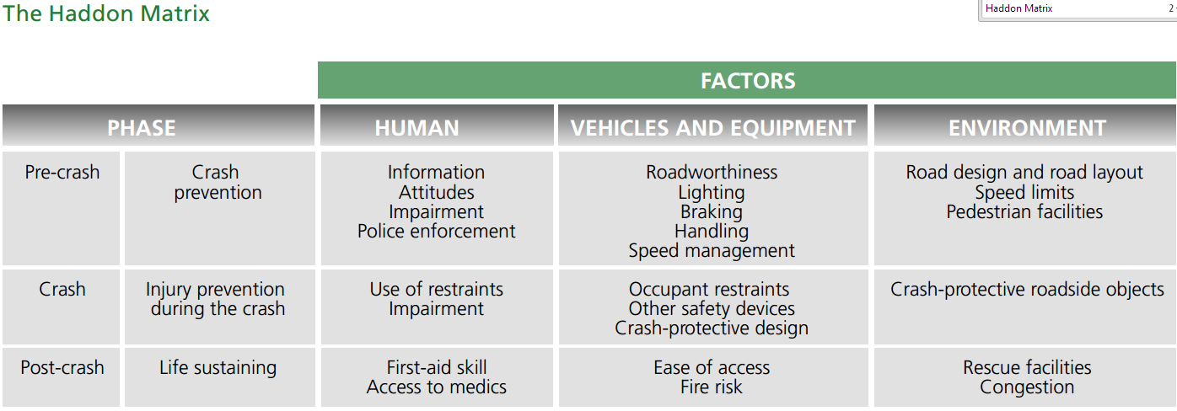
Road Safety Audits
Black Spot Treatment (BST)
Crash Barriers
Crash Cushion
Source : World report on road traffic injury prevention (WHO, 2004)

Slide 40
Pillars of the Plan
DECADE OF ACTION FOR ROAD SAFETY (2011-2020)
Road safety management
Safer roads and mobility
Safer vehicles
Safer road users
Post –crash response
www.decadeofaction.org

Slide 41
A Framework for the Decade (Thailand)
National Activities
Pillar 1 Road safety Management | Pillar 2 Infra- structure | Pillar 3 Safe Vehicles | Pillar 4 Road safety user behavior | Pillar 5 Post crash care
Lead agency Strategy Targets Funding Road safety capacity development | Improved road design for all users Road safety audits Black spot Treatments In-depth crash investigation | Global harmonization vehicles standard All cars equipped with seat-belts “Intelligents” vehicles R&D safety for VRU | Drink& drive Laws Seat-belts & Child restraints Motorcycles Helmet Speed managements | Pre hospital care Trauma care and rehabilitation Quality assurance
Notes:
41

Slide 42
PLAN OF THE ACTION FOR THE DECADE OF ROAD SAFETY
33rd APEC Transportation Working Group, Tokyo, Japan, October 10-14 2010
5 Pillars and the progress of Thailand
1. Road Safety Management:
Declaration of Thailand Decade of Action for Road Safety 2011 – 2020 National Road Safety Plan (2009 – 2012)
The new draft of Office of Prime Minister regulation on Road Accident Prevention and Reduction

Slide 43
PLAN OF THE ACTION FOR THE DECADE OF ROAD SAFETY
33rd APEC Transportation Working Group, Tokyo, Japan, October 10-14 2010
2. Infrastructure
- Government increase the budget for Black Spot Improvement on National Highway Project.
- Public Transportation Improvement Plan
3. Safe Vehicle
- Adjustment of 2 main transportation regulations: Land Transportation and Vehicle Inspection

Slide 44
PLAN OF THE ACTION FOR THE DECADE OF ROAD SAFETY
33rd APEC Transportation Working Group, Tokyo, Japan, October 10-14 2010
4. Road User Behaviors
- Campaign to promote safe driver behavior (always wearing seat belt and helmet, attitude and skill of road safety & license, drink & drive, speed limits and safe vehicle)
- Increase penalty for unsafe driver behaviors (drunk drivers, helmet law penalty, and mobile phone usage while driving, child restrain)
5. Emergency Medical Unit
- National Emergency Medical Institute in 2008
- telephone number for EMS, 1669, which services in 76 provinces of Thailand.

Slide 45
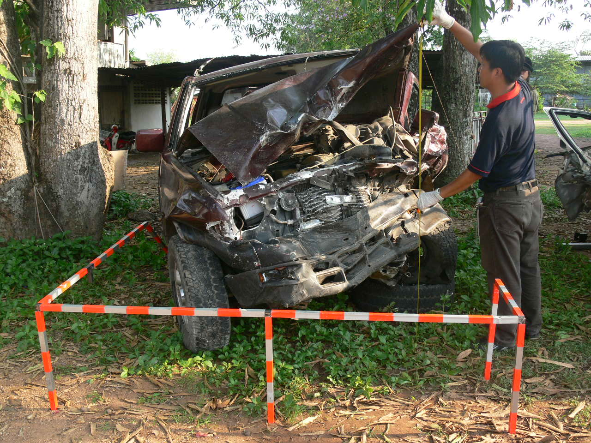
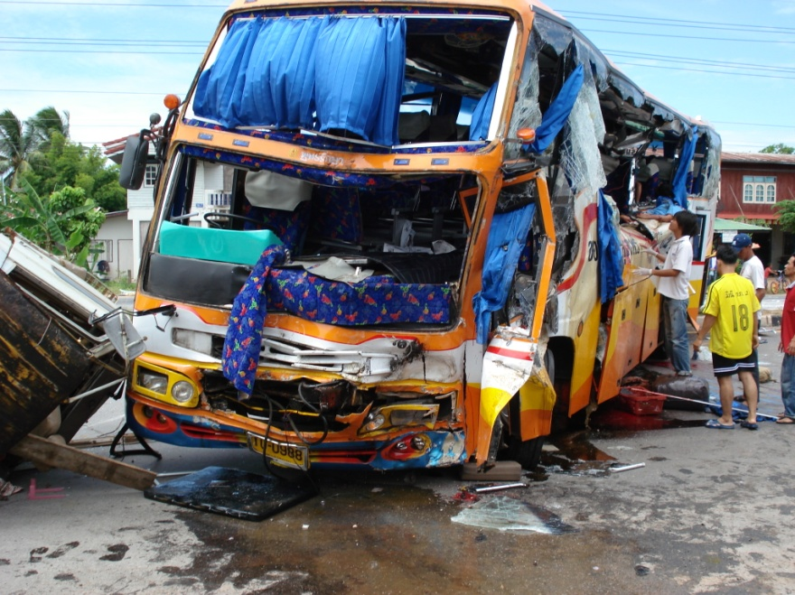
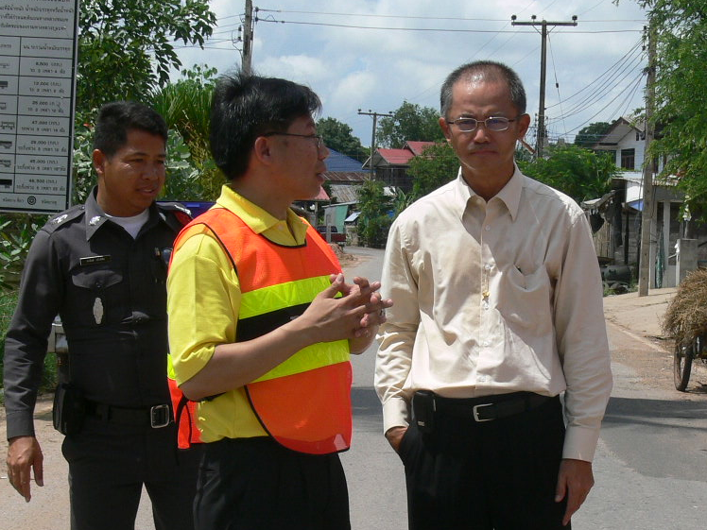
Establishment of
In-Depth Crash Investigation Unit
KKU investigated more than 50 serious accidents in the upper northeastern region of Thailand during 2006-2009.

Slide 46

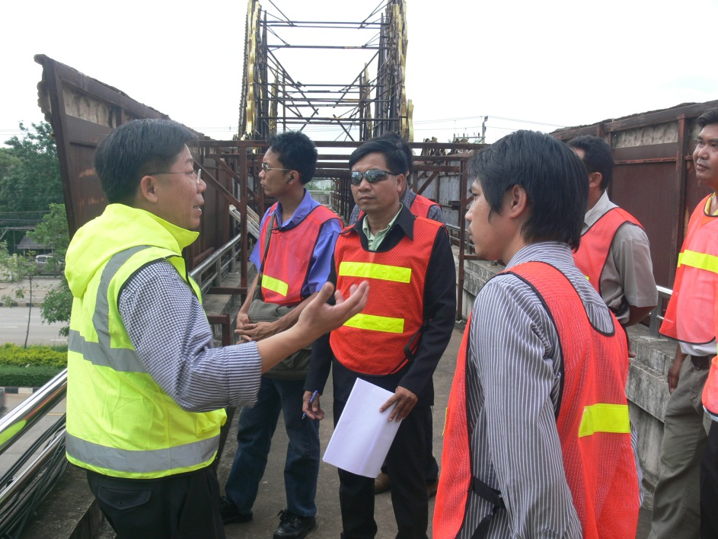
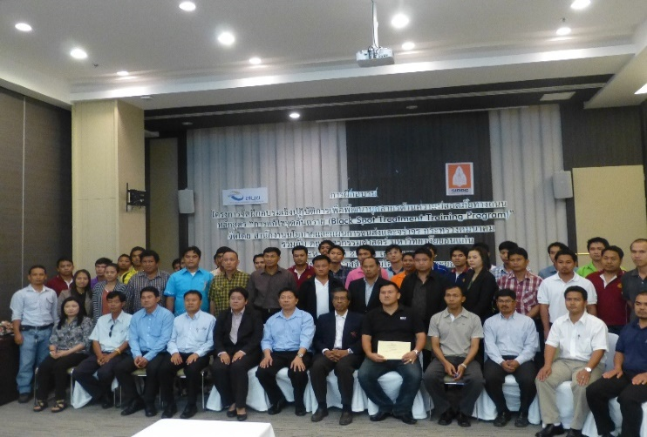
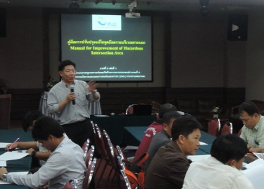
Conducting the Short-term Practical Training Program on Road Safety Audit (RSA)
KKU conducted 50 training programs on RSA for more than 2500 participants during 2005-2009.
46
Notes:
46
46

Slide 47
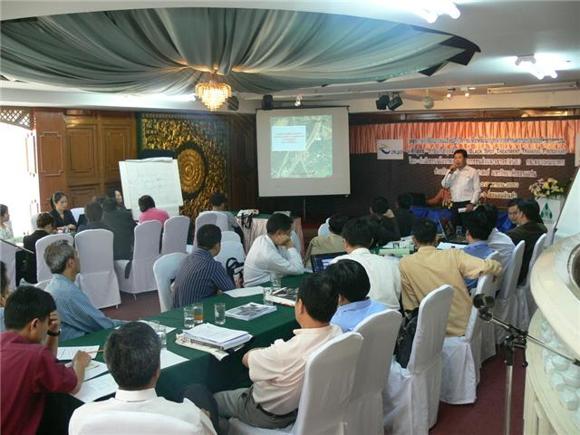
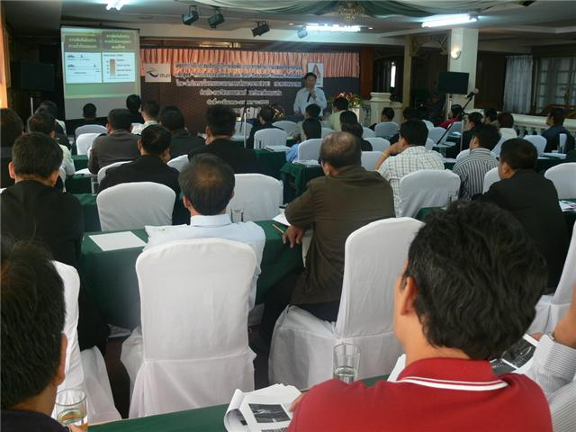
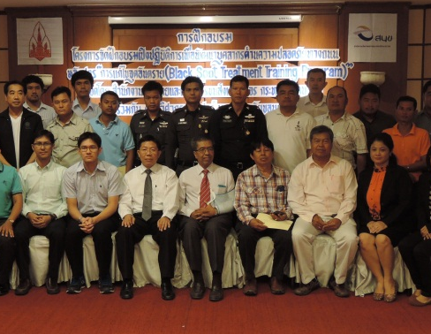
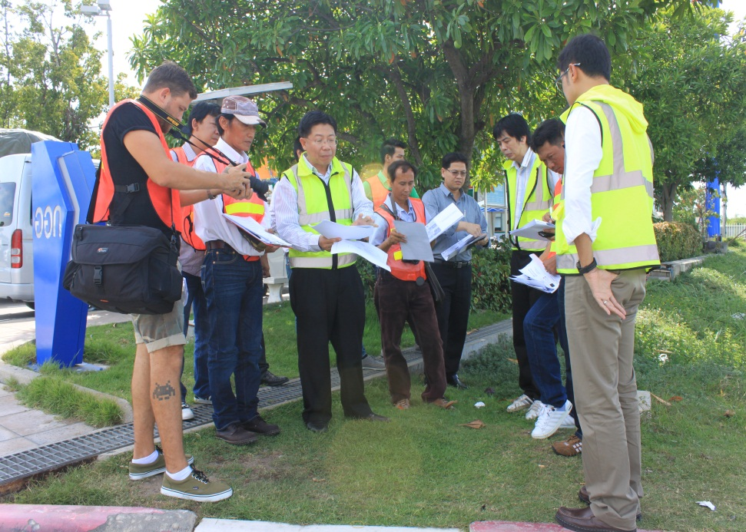
Conducting the Short-term Practical Training Program
on Black Spot Treatment by Office of Traffic and Transport Policy and Planning (OTP), Ministry of Transport
KKU organised 60 practical training programmes on Black Spot Treatment curriculum for more than 3,500 participants during 2009-2014.

Slide 48
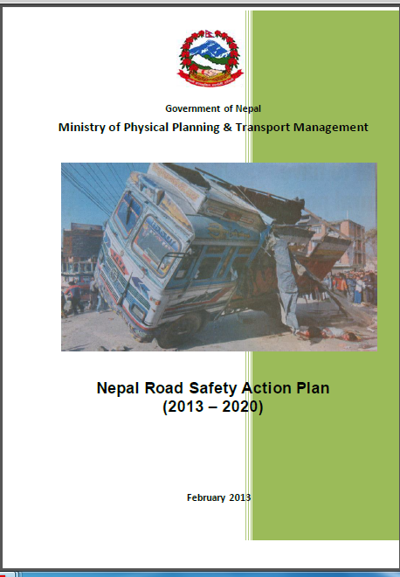

Slide 49
UNIVERSITY COURSE CURRICULUM ON ROAD SAFETY

Slide 50
23 June
Pokhara University
Dr. Suresh Banstola, Dean – Faculty of Science and Technology
Mr. Buddhi Raj Joshi, Director- Civil Engineering Department
24 June
Department of Roads (DoR)
Mr. Sanjaya Kumar Shrestha – DDG
Mr. Ajaya Kumar Mul – SDE
Nepal Engineering College (NEC), Pokhara University
Prof. Dr. Deepak Bhattarai, Founding Principal
Prof. Dr. Khem Raj Sharma, Director, nec CPS, Balkhu
Dr. Thusitha Chandani Shahi, Coordinator, TEAM
Mr. Prabesh Prabesh Adhikari, Assistant Professor, TEAM
UNIVERSITY COURSE CURRICULUM ON ROAD SAFETY
(Meeting Academia and Government Officers)

Slide 51
24 June
Institute of Engineering (IoE), Tribhuvan University
Mr. Anil Marasini, Lecturer
Mr. SubhashDhungel, Visiting Professor
25 June
Department of Transport Management (DOTM)
Mr. Kashi Raj Dahal – DG
Mr. SharadAdhikari – Director – Technical
Mr. Indra K. Thapaliya – Director – Administrative
Dr. PadamShahi – Consultant – Nepal India Transit Project
Department of Local Infrastructure and Local Roads (DOLIDAR)
Mr. Jeewan Kumar Shrestha – Director General
Mr. Ram Chandra Shrestha – Deputy Director General
Mr. Ganga B. Basnet – Senior Divisional Engineer
UNIVERSITY COURSE CURRICULUM ON ROAD SAFETY
(Meeting Academia and Government Officers)

Slide 52
Institute of Engineering, Tribhuvan University, Nepal
University | Institute of Engineering, Tribhuvan University, Nepal
Program | Bachelor of Engineering Program in Civil Engineering
 | Course | Couse Description
Core course | Transportation Engineering II | Accident Studies
Elective course

Slide 53
Institute of Engineering (IoE), Tribhuvan University, Nepal
University | Institute of Engineering, Tribhuvan University, Nepal
Program | Master of Engineering Program in Civil Engineering
 | Course | Couse Description
Core course | - | -
Elective course | Traffic Safety | Safety issues (road/air/rail/water and global scenario, Safety data use, interpretation, Prioritising crash locations, safety issues, Human-vehicle-infrastructure elements in road crashes; new technology; solutions, Crash black spot analysis; investigation, Road safety audits, Safety education /awareness, Vulnerable road-users, Alcohol and speed effects

Slide 54
Khon Kaen University (KKU), Thailand
University | Khon Kaen University, Thailand
Program | Bachelor of Engineering Program in Civil Engineering
 | Course | Couse Description
Core course | Highway Engineering | Road Safety
Elective course | Traffic Engineering | Traffic accidents and safety

Slide 55
Khon Kaen University (KKU), Thailand
University | Khon Kaen University, Thailand
Program | Master of Engineering Program in Civil Engineering
 | Course | Couse Description
Core course | Road Safety Engineering | Road traffic accident situations and contributing factors, human vehicle and road factors in road accidents, hazardous road location, diagnosis of road accident problems, development of road accident countermeasures, road features relating to road safety, vulnerable road users, road safety audit, black spot treatments, in-depth crash investigation, evaluation of road safety program, case studies.

Slide 56
University of South Australia (UniSA), Australia
University | University of South Australia, Australia
Program | Master of Engineering
 | Course | Couse Description
Core course | Road Safety Engineering | Types of traffic accidents; systems for classifying accidents; accident databases; problem identification; identification of hazardous road locations; accident countermeasures, engineering, education, enforcement and encouragement; evaluation techniques and impact assessment; road safety audit.

Slide 57
General Suggestions
BEng program in CE
At least one road safety engineering course should be developed and offered as either a core course or an elective course.
The instuitutes should encourage and create conducive environment for taking road safety engineering topics as their CE project work.

Slide 58
Suggestions
MEng program in CE
Road safety engineering course should be set up as a core course.
The details of course description of road safety engineering subject should be revised to include some of the following topics:
road safety awareness and laws,
behavioral science,
accident database and analysis,
black spot treatment,
traffic calming,
in-depth crash investigation,
development of road accident countermeasures,
monitoring and evaluation of road safety program
case studies

Slide 59
Suggestions
Offer road safety as a Special Study course.
Road safety engineering subjects should be set up and offered as the reserch topics for the MEng or MSc thesis.
Further Recommendations:
As part of human resource capacity development, the short-term training programs on RSA, BST, AIU and traffic calming should be seriously determined.
Collaboration between Nepali universities and overseas universities and academic institutes is highly recommended.

Slide 60
“We have to do the best we can. This is our sacred human responsibility.”
(Albert Einstein)
“Knowledge save lives”
(Prof. Dr. Yordpol Tanaboriboon (AIT))
“Human resource capacity development on road safety save milion of lives in Nepal”

Slide 61

THANKs
FOR YOUR ATTENTION

