Slide 1

Towards a modernized geodetic datum for Nepal: Options for developing an accurate terrestrial reference frame following the April 25, 2015 Mw7.8 Gorkha earthquake
Chris Pearson
School of Surveying, University of Otago,
Niraj Manandhar
Survey Department Nepal

Slide 2
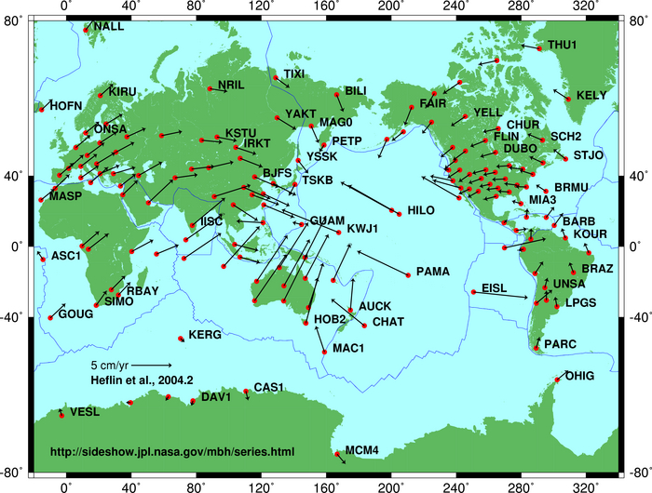
Tectonic Plate Motions

Slide 3
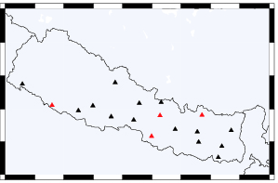
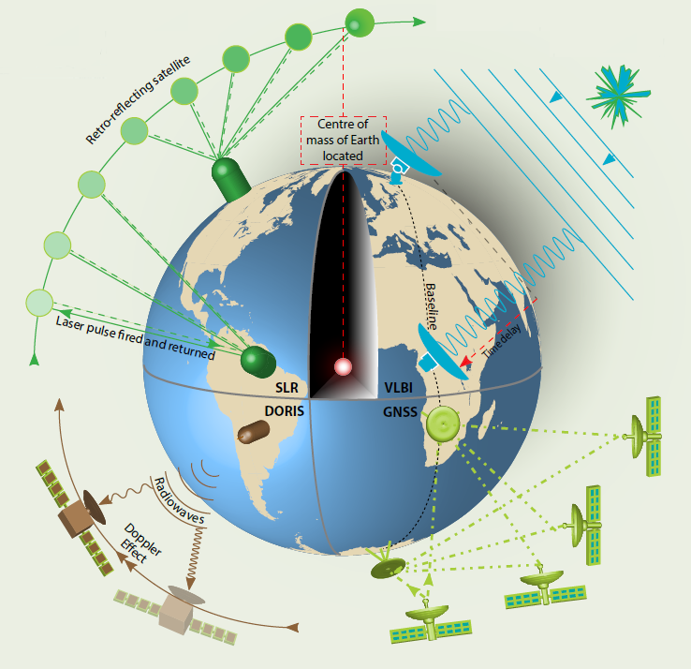
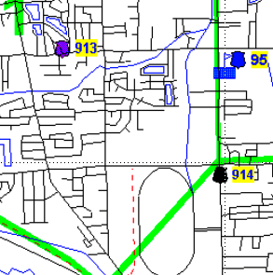
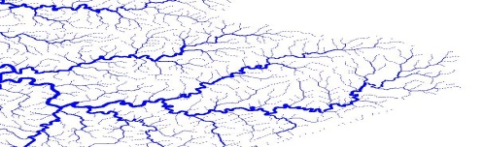
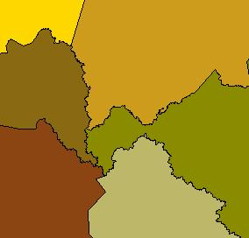
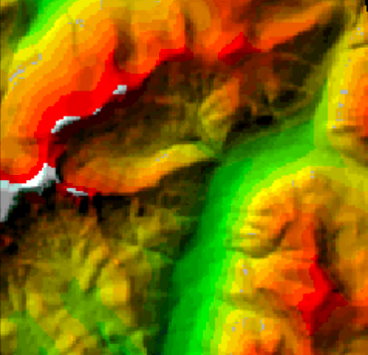
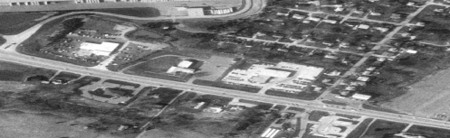
ITRF Measurement Techniques
Satellite Laser Ranging
Very Long Baseline Interferometry
DORIS: Doppler
ITRF2014
NDM
GNSS (GPS)
Required by GPS
Nepal2016
No deformation
model
Datums and epoch dates
change frequently
Stable coords
deformation model
Nepal2016 aligned with ITRF2014
Coordinates transformed to1 Jan 2016 at 00:00 using the Nepal2016 deformation model
Notes:
I want to introduce the concept that NZGD2000 depends on the ITRF. The purpose of the Geodetic control one is to distinguish between the realization of coordinates and the datum. It is a little bit redundant for slide one though.
MB: I added the “ITRF Measurement Techniques” to have a picture that represents ITRF and not just the word.
I also added “ITRF Stations in New Zealand” picture to give a geographic NZ context.
I’m not sure what you mean by “Coords fun of t”
ND: “Coords fun of t” means “function of time”, but audience may not understand this. Perhaps just say “time-varying”
MB: I changed “Coords fun of t” to “Time-varying coords”.
I removed all of my graphics of the individual techniques since they are in your graphic.

Slide 4
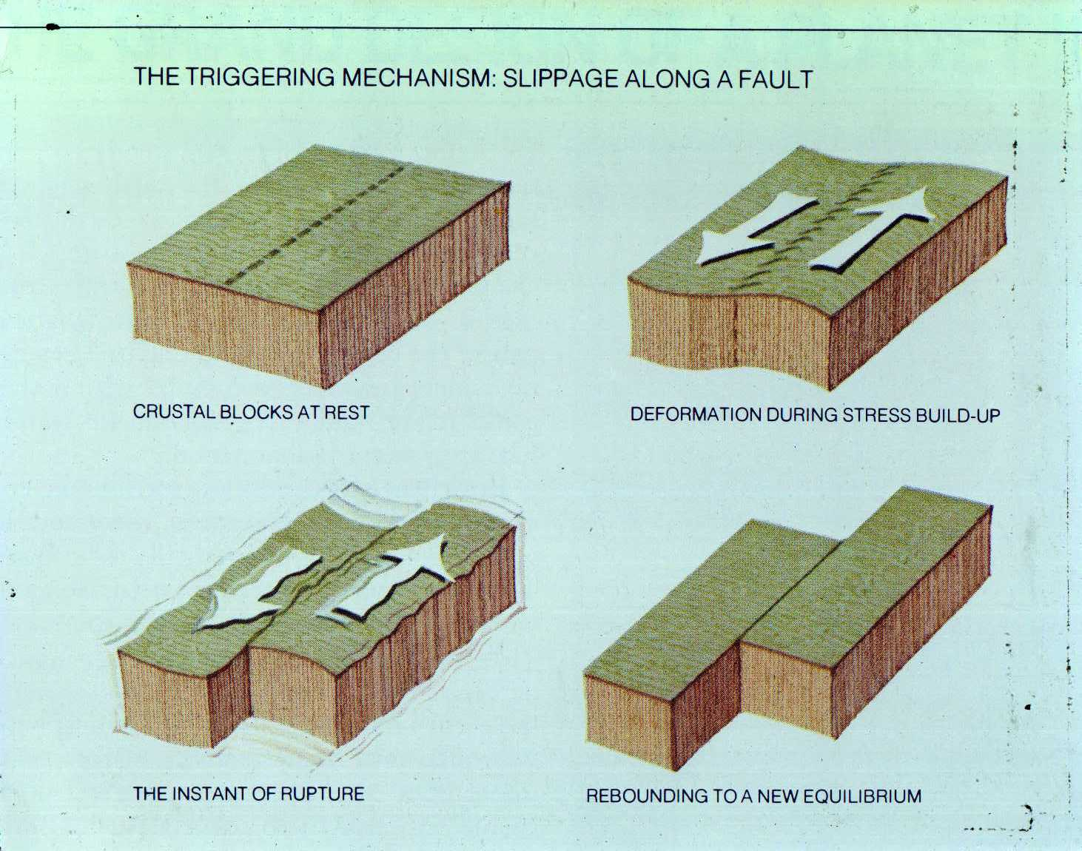

Slide 5
2000
2015

Slide 6
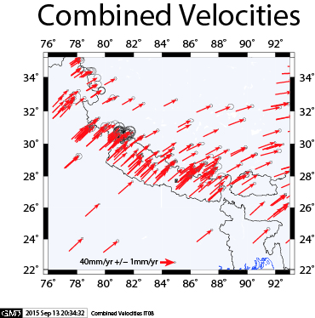
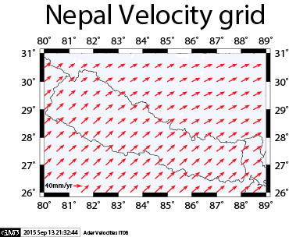
Secular velocity field in the national deformation model
Notes:
The original deformation model was calculated on GPS campaign data from 1992 to early 1998.
This is being updated with a model using data up until 2011 (for the South Island up to September 2010, to avoid contamination by Darfield earthquake displacement).
The new model is extended using the Nuvel-1A NNR (no net rotation) model, which means that it is applicable beyond the land extents of NZ, in particular in the Chatham Islands.
It is clearly substantially the same which provide some confidence, and also means that we can implement the new model without having to make any substantial changes – ie we don’t need to do a lot of rework.
None the less the differences are significant for the most accurate work..

Slide 7
Secular deformation
_{Position}
_{ITF96 coordinate}
_{NDM}
_{NZGD2000 coordinate}
₂₀₀₀
_{Time}
Notes:
Before the earthquake we the NZGD2000 coordinate of a mark is fixed, but the mark itself is moving in terms of a global coordinate such as ITRF96, so it’s ITRF96 coordinate is changing. To transform from ITRF96 to NZGD2000 needs a time dependent transformation function

Slide 8
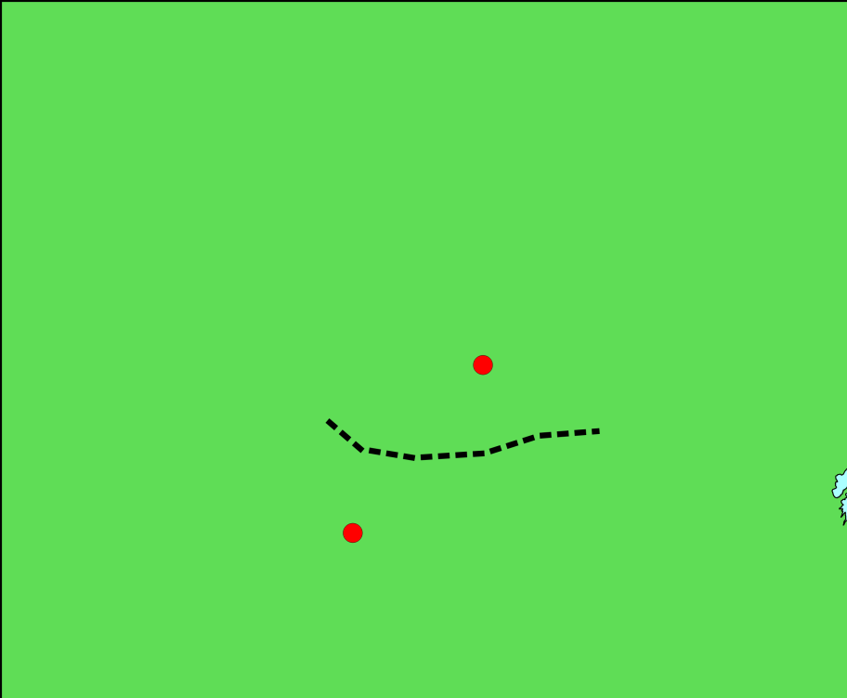
Patching the deformation model
_{Position}
_{Secular velocity}
_{Earthquake} model
_{0.0}
₂₀₀₀
_{Time}
₂₀₁₆
Notes:
So what is a patch, and what is a reverse patch.
Lets’ look at two points, starting in 2000.
*
Over time, they move at about 5cm per year. The points are in the same region of NZ, so they move about the same amount. The NZGD2000 coordinates are not right any more, but the distance between them is – we can still use the NZGD2000 coordinates to navigate from one to the other.
*
If we want the actual location, we can use the velocity model (National Deformation Model) to work out where they are at any given time
*
Now lets see what happens when there is an earthquake in this region (say Christchurch!). And lets assume that the points are on opposite sides of the fault
*
So the points have moved in opposite directions … after the earthquake they are still also moving with the general tectonic deformation…
*
The deformation model can be patched – that is we will include in it a model of the deformation due to the earthquake. We can add this to the NDM to work out the position of the mark at any time.
*
The problem is that the NZGD2000 coordinates don’t represent the relative positions of the marks.
We fix this by shifting the NZGD2000 coordinates to include the deformation due to the earthquake…
*
What does this do to the deformation model?
*
It means that the patch is now a “reverse” patch. We only need to apply it if we want to calculate the position of the mark before the earthquake.

Slide 9
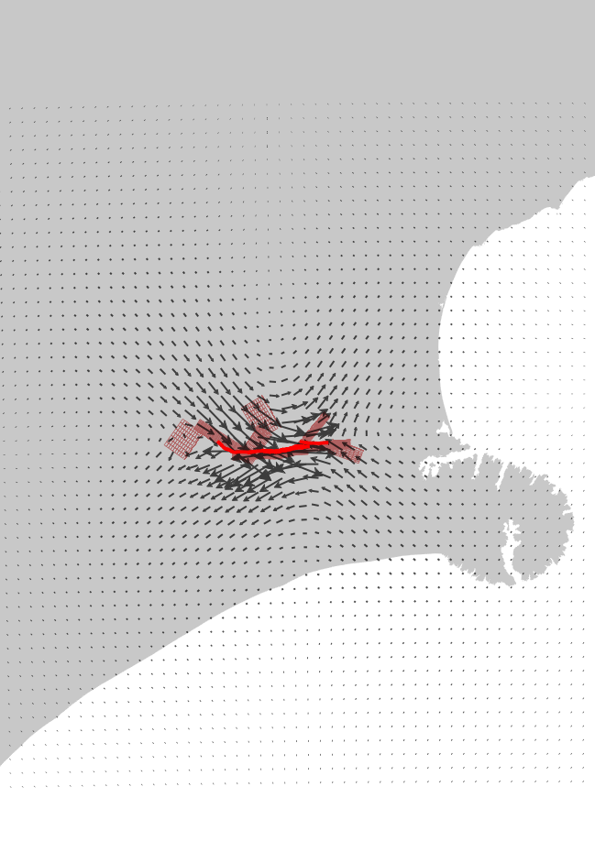
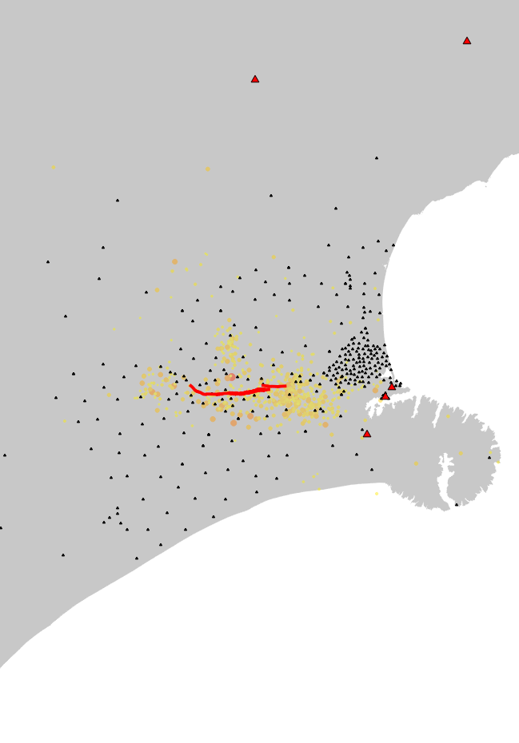
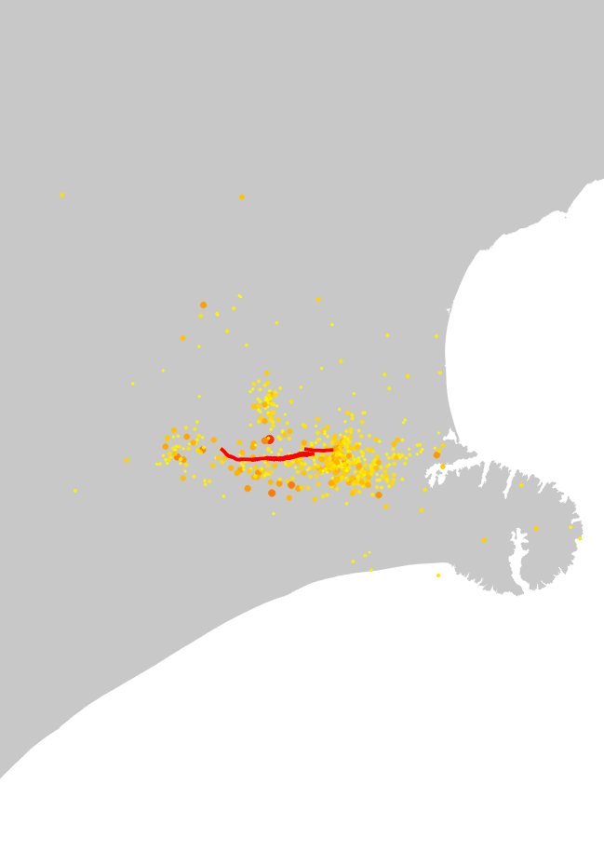
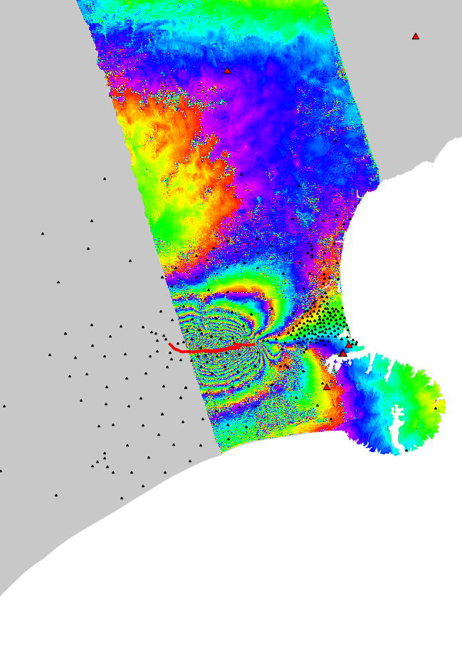
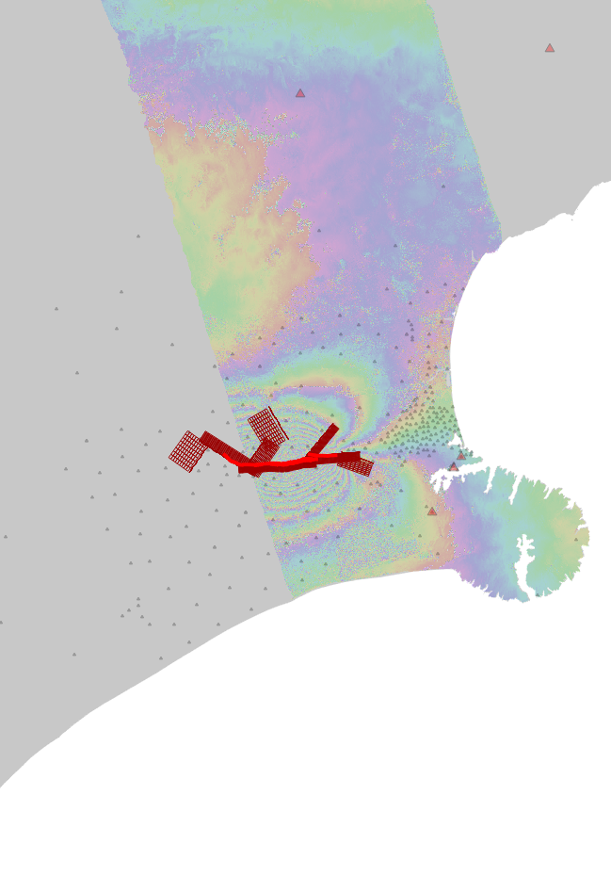
How are Earthquakes modelled
Geology and seismology
CORS and campaign GNSS
InSAR remote sensing
Geophysical fault model
Modelled displacements
Notes:
Just what it says!
Interferometric Synthetic Aperture Radar

Slide 10
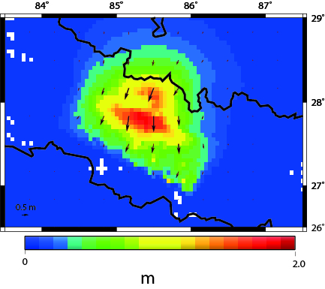
Model of Mw 7.8 Gorkha Earthquake

Slide 11
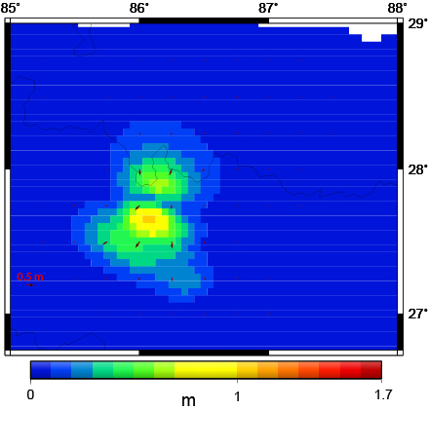
Model of Mw 7.3 12 May Aftershock

Slide 12
Marlborough Example: Forward Patch for an Earthquake
National
Deformation Model
Epoch 2016.0
Forward Patch
Earthquake
Measured Vector
Measured Position
and Vector
Ground Displacement
Corrected Nepal2016 vector
Notes:
Alternative image slide

Slide 13
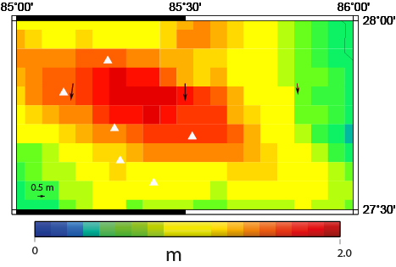
Displacements for the April Earthquake

Slide 14
