Slide 1
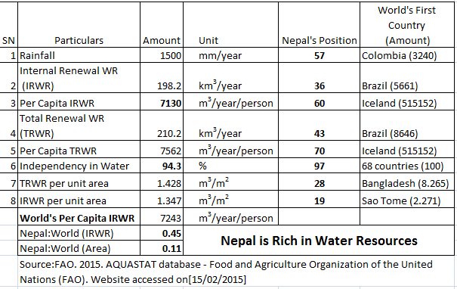
नेपाल जलस्रोतको धनी देश हो, तर
जलस्रोतमा नेपाल विश्वमा दोस्रो धनी देश होइन !

Slide 2
Budhigandaki Hydroelectric Project
Laxmi Devkota, D. Eng.
Chairman
Budhigandaki Hydroelectric Project
Development Committee
E-mail: lpdevkota@yahoo.com

Slide 3
Contents
Hydropower Development and National Development
History of Budhigandaki
Current Status
Results: Phase 1 & Phase 2
Salient Features
Technical and Socio-Environmental Aspects
Schedule, Cost, EIRR/FIRR
Opportunities and Challenges
Perception

Slide 4
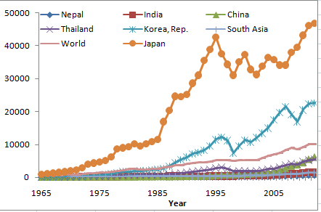
Nepal’s Position in World Map
40-50 years ago:
Our position is comparable to other Asian countries, even to South Korea/Japan

Slide 5
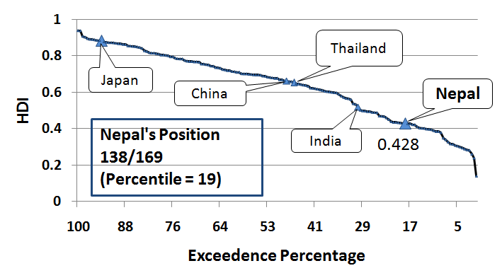
Nepal in Human Development Index
Source: UNDP Report, 2010

Slide 6
S. Korea
Thailand
Japan
  Electricity Consumption of around 3,300 GWh and 119 kWh per Capita (3,000 kWh/Capita world average & Import from India of 793 GWh/y)

Slide 7
SOURCES OF SUPPLY
Capacity supply MW
Energy Supply GWh /day
PARTICULARS | Wet | Dry
ROR | 601 | 200
Storage | 92 | 92
Thermal | 53 | 53
Import | 100 | 130
Total Supply | 846 | 475
Total Demand | 930 | 1026
PARTICULARS | Wet | Dry
ROR | 13.488 | 4.8
Storage | 0.184 | 1.2
Thermal | 0.106 | 0.318
Import | 1.92 | 2.808
Total Supply | 16.61 | 9.126
Total Demand | 14.5 | 16.5
Source: Bhatt(2012)

Slide 8
2021 Case
Power Demand: 2200 MW
Energy Demand: 10,300 GWh
Solution: Buy or Generate
Buy- Energy Security? Expending Foreign Currency?
Generate?

Slide 9
Power: 2200 MW and No Bududhigandaki
Note: Spill = Deficit= 1350 GWh

Slide 10
No load shedding, No Budhigandaki
Spill Amount: 7400 GWh
Note: Generation= 3700 MW

Slide 11
With Budhigandaki
Surplus/Deficit= 300 GWh

Slide 12
Nation’s Challenges and Requirements
Challenges:
To augment the electric energy for the prosperity of the nation
To provide year round electric energy (Seasonal Balance)
To tackle the peak load demand and spilling of energy from the system
Solutions: STORAGE HYDRO POWER PROJECTS

Slide 13
Budhigandaki HEP and Development Committee
Project
  Storage Project
  Close to the Load Centers
  Accessibility
  Transmission Line
Development Committee
  Government Backing
  Fast Track Mode: Alternative model of management
  Cost over run and time over run
  Basis for storage project development
  Budhdigandaki Project: National Pride Project

Slide 14
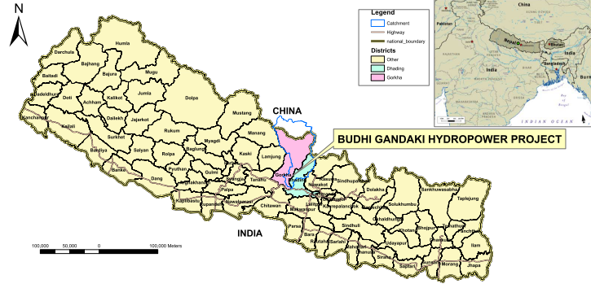
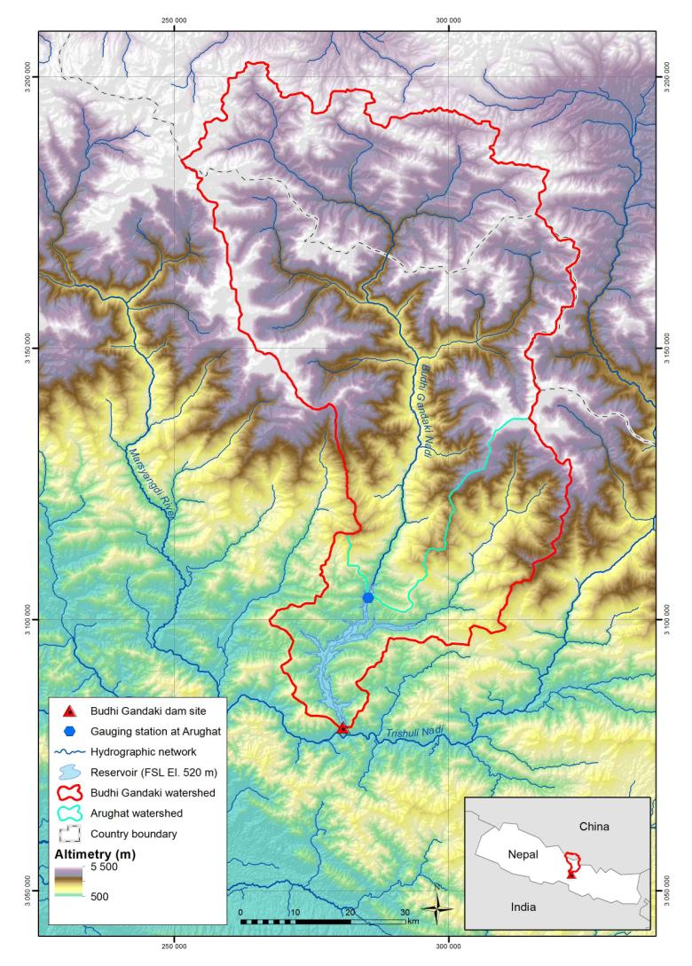
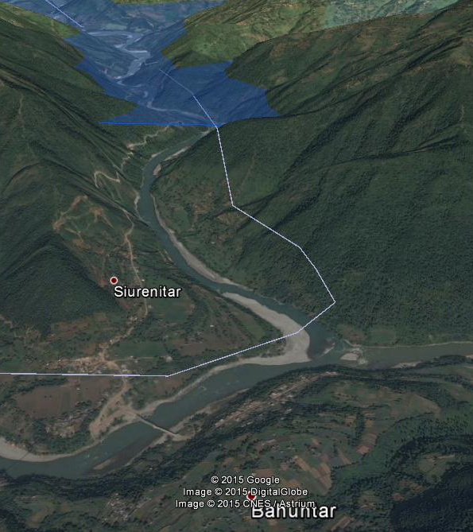
Project Overview
80 km from Kathmandu
Gorkha and Dhading Districts
Budhi Gandaki River, ≈2km from confluence with Trishuli River at Benighat
Catchment Area
Gorkha: 2,705 km²
Dhading: 900 km²
Nuwakot: 35 km²
China: 1,365 km²
Total: 5,005 km²

Slide 15
History of Budhigandaki Project
First identified in 1978 by Snowy Mountains Engineering Corporation (SMEC):
  Storage hydroelectricity project
  Installed capacity 200 to 300 MW
1983 to 1984 - Prefeasibility Study by GoN:
  Storage project
  Installed capacity 600 MW
2010-2011, Nepal Electricity Authority (NEA)
  Long tunnel- 10 km (added to Pre-feasibility study)
2013 – till date –Feasibility Study by Tractebel Engineering SA
    Installed capacity 1200 MW

Slide 16
Pre-Feasibility Study (1983/84)
Type of Dam: Zoned rock filled with inclined core
Height: 225 m
Full Supply Level: 520 masl
Gross Capacity (FSL): 3.32 Billion m³
Effective Storage Capacity: 2.76 billion m³
Surface Area: 54 km²
Power and Energy
Installed Capacity: 600 MW
Annual Energy: 2495 GWh

Slide 17
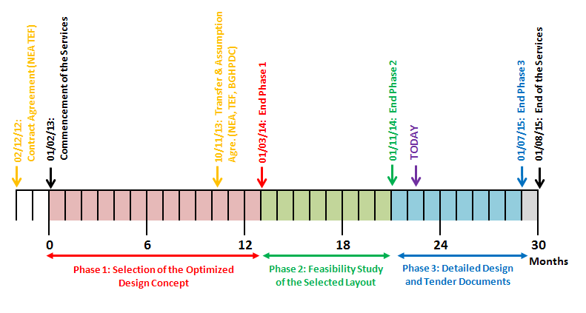
Current Status of Budhigandaki HEP
Key Dates
TODAY
13 months
8 months
9 months

Slide 18
Phase 1
Option Selection:
  No Tunnel, Short Tunnel and Long Tunnel
Full Reservoir Level
Design Discharge

Slide 19
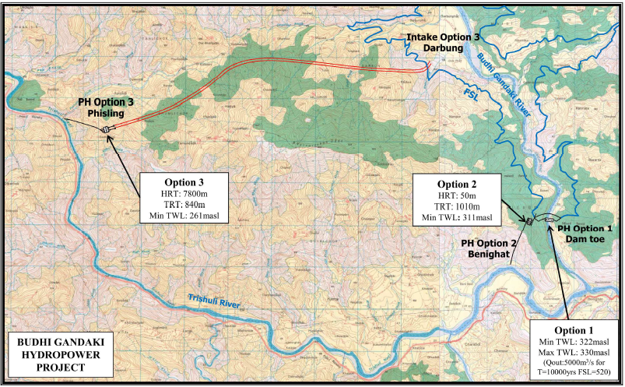
Considered Options

Slide 20
Comparison of Different Options
Topographical constraints
Geological constraints
Hydraulic constraints
Construction constraints
Benefits and Costs
Compensation Reservoir D/S of Budhi Gandaki
Environment

Slide 21
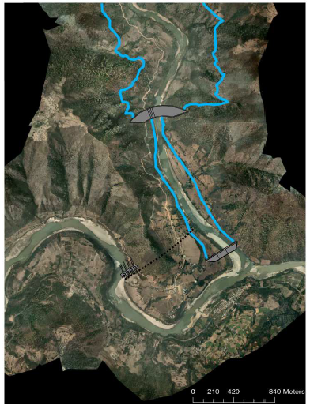
Selected Option
No Tunnel Option: Power House at Dam Toe

Slide 22
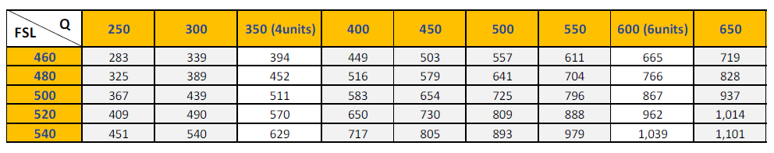
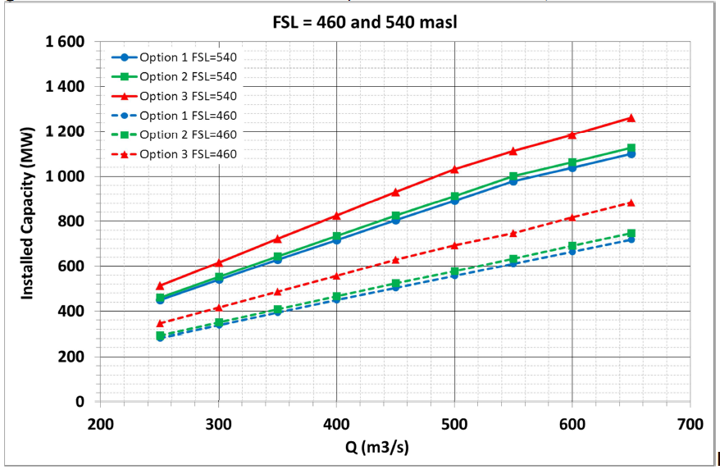
Installed Capacity and Q/H
P
Q

Slide 23
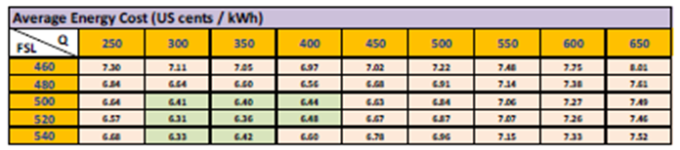
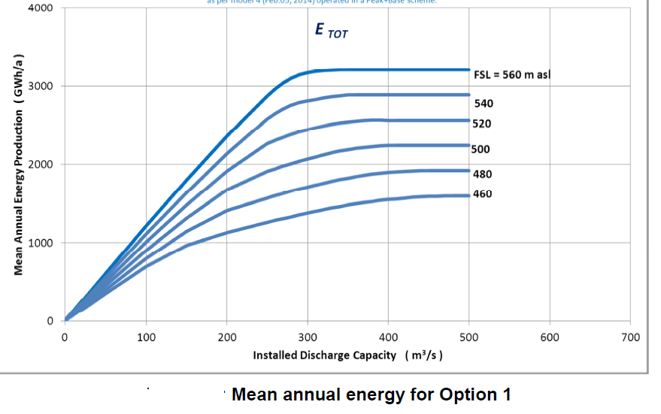
Energy Cost
E
Q

Slide 24
Features of Best Option
Best Waterways Option : No Underground Tunnel
Full Supply Level= 540 masl
Rated discharge = 350 m³/s
Installed Capacity = 630 MW
With the provision for a future upgrade
Rated discharge = 530 m³/s
Installed Capacity = 945 MW

Slide 25
Phase 2: Feasibility Report
Conditions
Maximization of Dry Season Energy
Maximization of Total Energy
Capable to deal with Peak Hour Demand (Minimum 6 hours)
No/Minimum Spillage of Water
Flexibility in operation
Low Cost

Slide 26
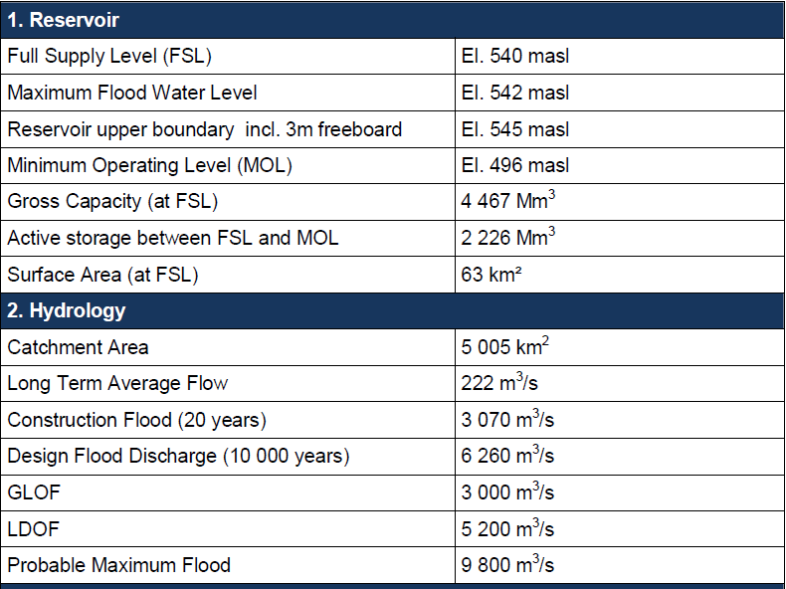
Salient Features of the Project

Slide 27
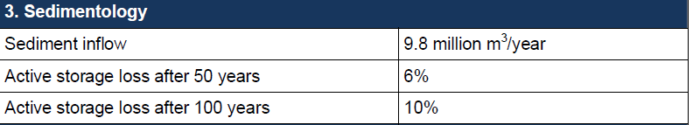
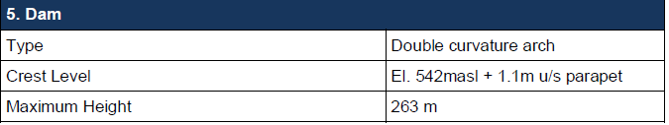
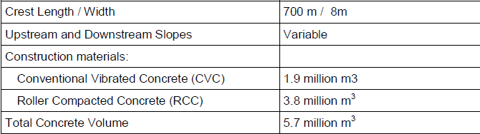
Salient Features of the Project (Contd.)

Slide 28
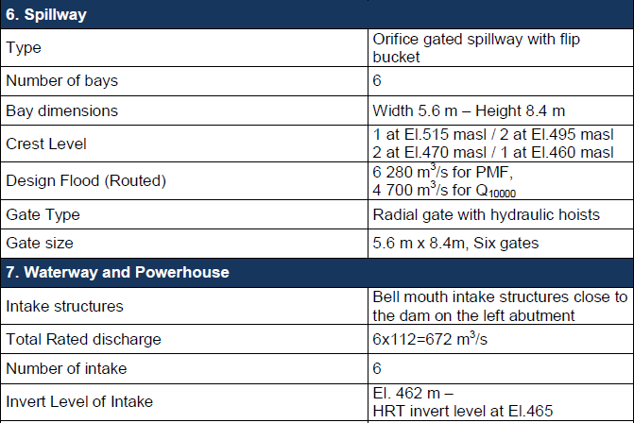
Salient Features of the Project (Contd.)

Slide 29
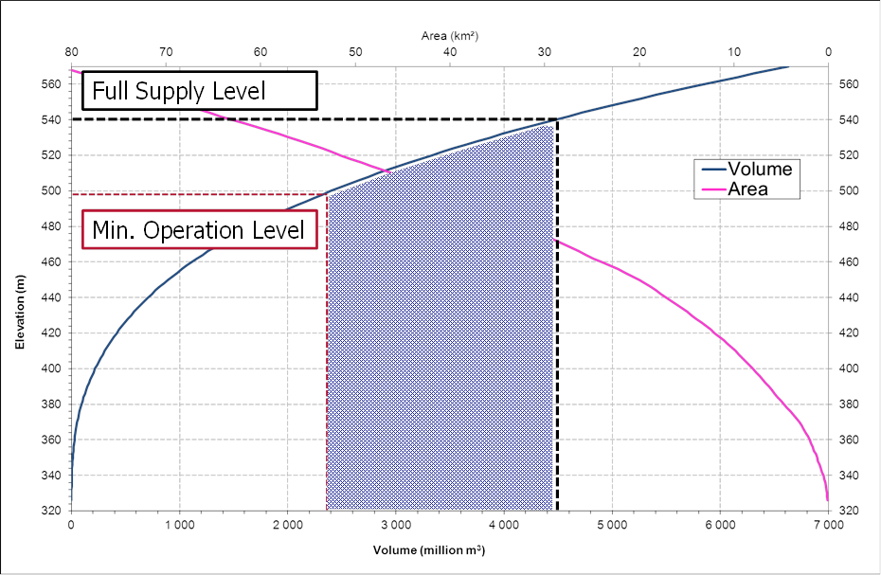
Reservoir
El. 540
El. 490
Live Storage
2.225 million m³
Dead Storage
2.242 million m³

Slide 30
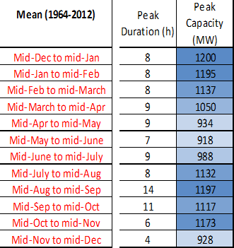
Generation Capacity
No. of Units
6
Capacity
200MW

Slide 31
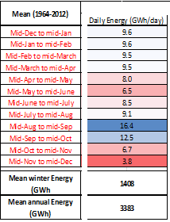
Energy Production

Slide 32
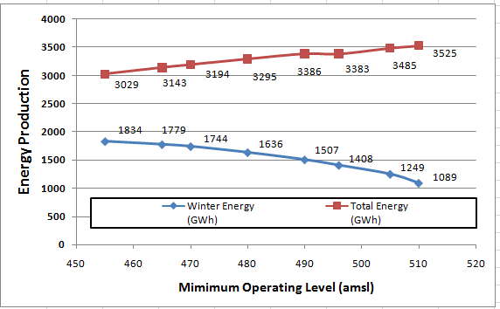
Total and Winter Energy vs MOL

Slide 33
Spillage and Installed Capacity
Increase Installed Capacity Impacts:
  Increase the mean annual generated energy
  Reduce spillage losses during the monsoon high flows period
  Increase the peak capacity for peak power generation throughout the year

Slide 34
Choice of Dam alternative
Four dam types were analyzed:
  Clay Core Rockfill Dam,
  Concrete Face Rockfill Dam,
  Arch-Gravity Dam,
  Double Curvature Arch Dam,
Arch concrete type was preferred:
  Arching action contributes to the resistance to the hydrostatic load
  Arching action strongly increases the ultimate resistance to seismic events

Slide 35
Choice of Dam alternative
Cost comparison:
  Clay Core Rockfill Dam,
  Concrete Face Rockfill Dam,
  Arch-Gravity Dam,
  Double Curvature Arch Dam,
Main quantities and cost of each project were estimated.

Slide 36
Double Curvature Arch Dam

Slide 37
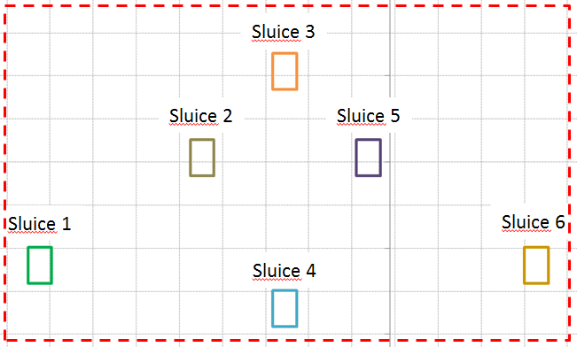
Spillway Features
  N=6
Gate in operation N0 | Flood combination | Flood entering in the reservoir m³/sec | Routed flood m³/sec | Max reservoir level masl
4 out of 6 | 10 000 year | 6 260 | 4 688 | 540.80
5 out of 6 | PMF | 9 809 | 6 278 | 542.00
6 out of 6 | PMF+GLOF | 12 809 | 7 838 | 541.30

Slide 38
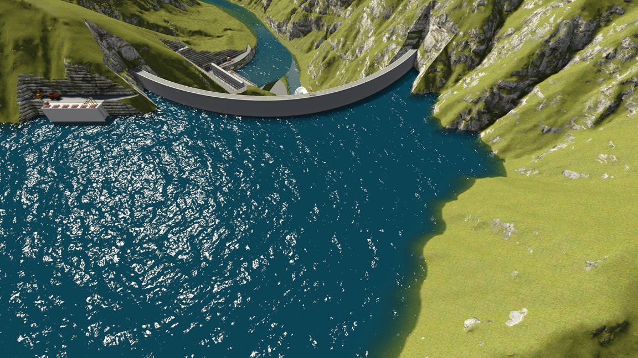
Dam

Slide 39
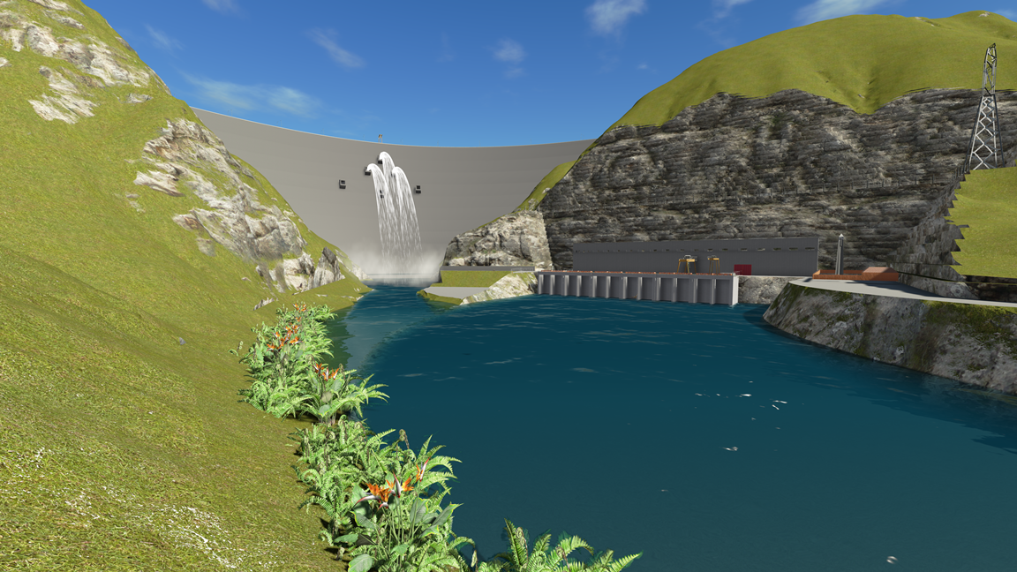
Dam

Slide 40
High Dam in the World (Existing)
SN | Name | Height | Type | Country | River
1 | Nurek Dam | 300 m | Earthen embankment | Tajikistan | Vakhsh
2 | Xiaowan Dam | 292 m | Concrete arch | China | Lancang
3 | Grande Dixence Dam | 285 m | Concrete gravity | Switzerland | Dixence
4 | Inguri Dam | 271.5 m | Concrete arch | Georgia | Inguri
5 | Vajont Dam (disused) | 261.6 m | Concrete arch | Italy | Vajont
6 | Manuel Moreno Torres (Chicoasén) Dam | 261 m | Earthen embankment | Mexico | Grijalva
7 | Tehri Dam | 261 m | Earthen embankment | India | Bhagirathi

Slide 41
High Dam in the World (under Construction)
SN | Name | Height | Type | Country | River
1 | Rogun Dam | 335 m | Embankment, earth and rock-fill | Tajikistan | Vakhsh
2 | Bakhtiari Dam | 315 m | Concrete arch | Iran | Bakhtiari River
3 | Shuangjiangkou Dam | 312 m | Embankment, rock-fill | China | Dadu
4 | Jinping-I Dam | 305 m | Concrete arch | China | Yalong Jiang
5 | Lianghekou Dam | 295 m | Embankment | China | Yalong
6 | Xiluodu Dam | 273 m | Concrete arch | China | Jinsha Jiang
7 | Diamer-Bhasha Dam | 272 m | Roller Compacted Concrete | Pakistan | River Indus
8 | Nuozhadu Dam | 261 m | Embankment | China | Lancang River
9 | BUDHIGANDAKI HEP | 263 M | Double Curvature Arch | NEPAL | Budhigandaki

Slide 42
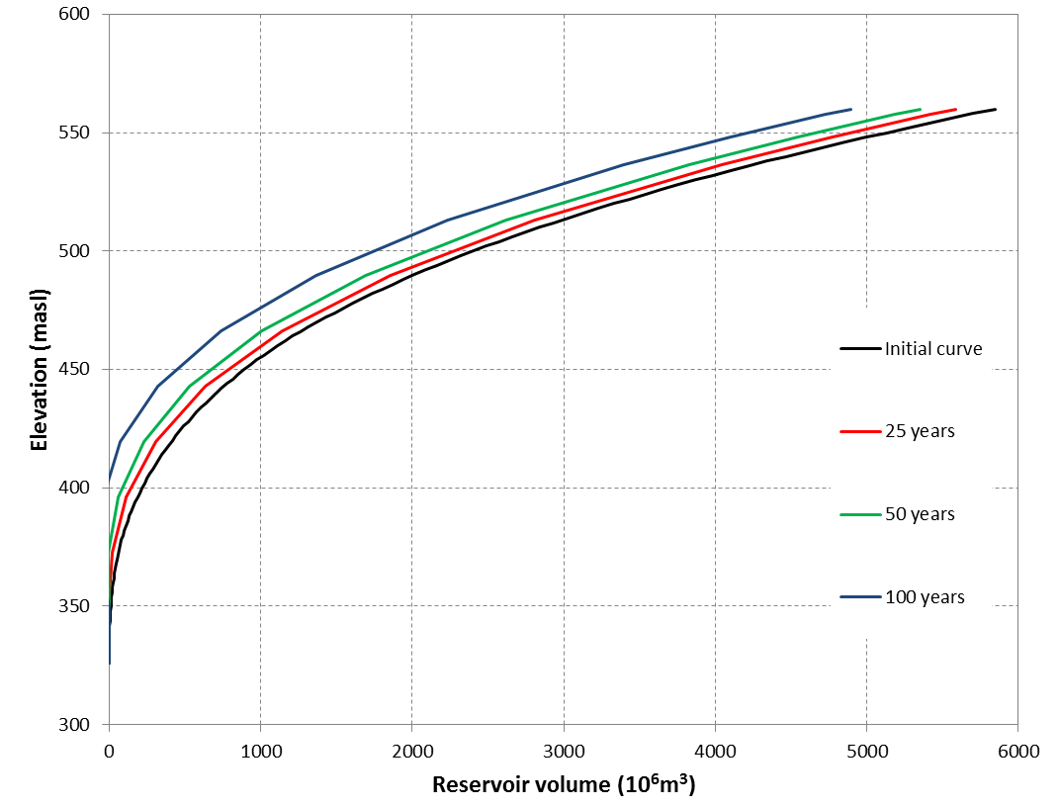
Volume 5: Sedimentation Study
Long term Sedimentation of the reservoir:
  Estimation of reservoir sedimentation using the Brune method (conservative method)
    97.5% of trap efficiency
  Empirical prediction of deposition patterns in the reservoir by the USBR method
    9.6 million m3/year
    458 million m³ and El 377 masl after 50 years
  Active storage of the reservoir
    6% of the active storage lost after 50 years
    10% of the active storage lost after 100 years
Reservoir level-volume curve changes for mean annual sediment inflow of 9.8 million m3 (USBR method)

Slide 43
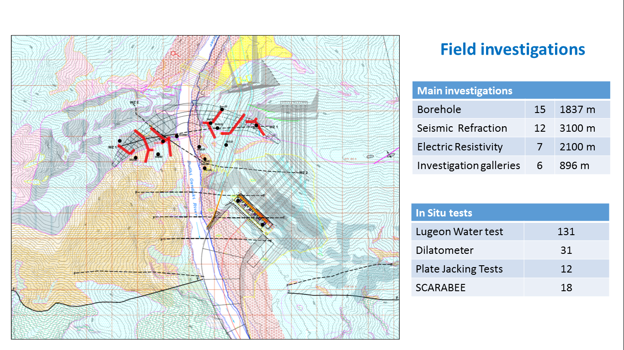
2. Natural Conditions
Volume 6: Geotechnical, Geological and Seismic Hazard Analysis

Slide 44
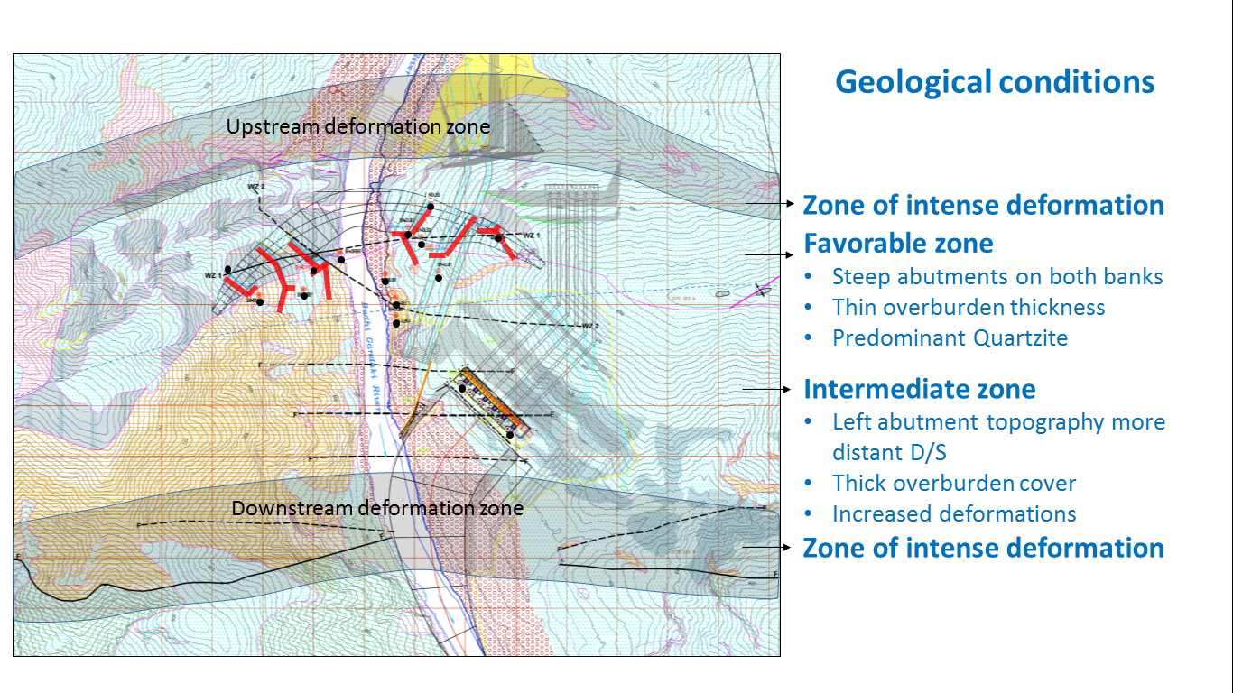
2. Natural Conditions
Volume 6: Geotechnical, Geological and Seismic Hazard Analysis

Slide 45
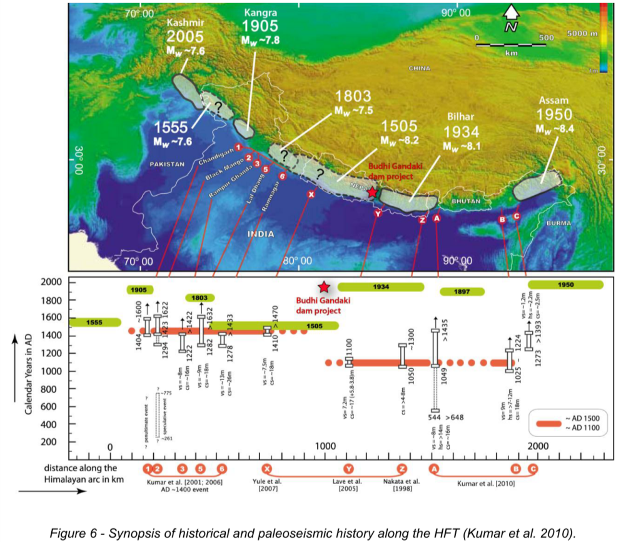
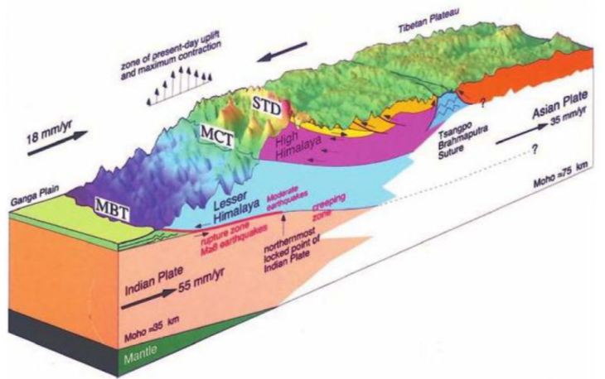
Seismic Hazard Analysis
Seismic Hazard:
For the project design OBE = 0.6g
    SEE = 1.2g

Slide 46
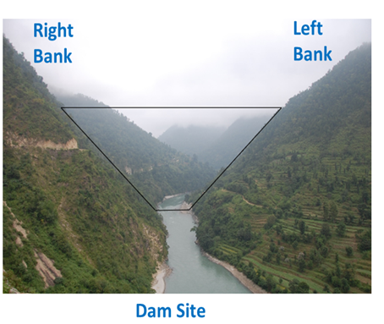
Dam Site

Slide 47
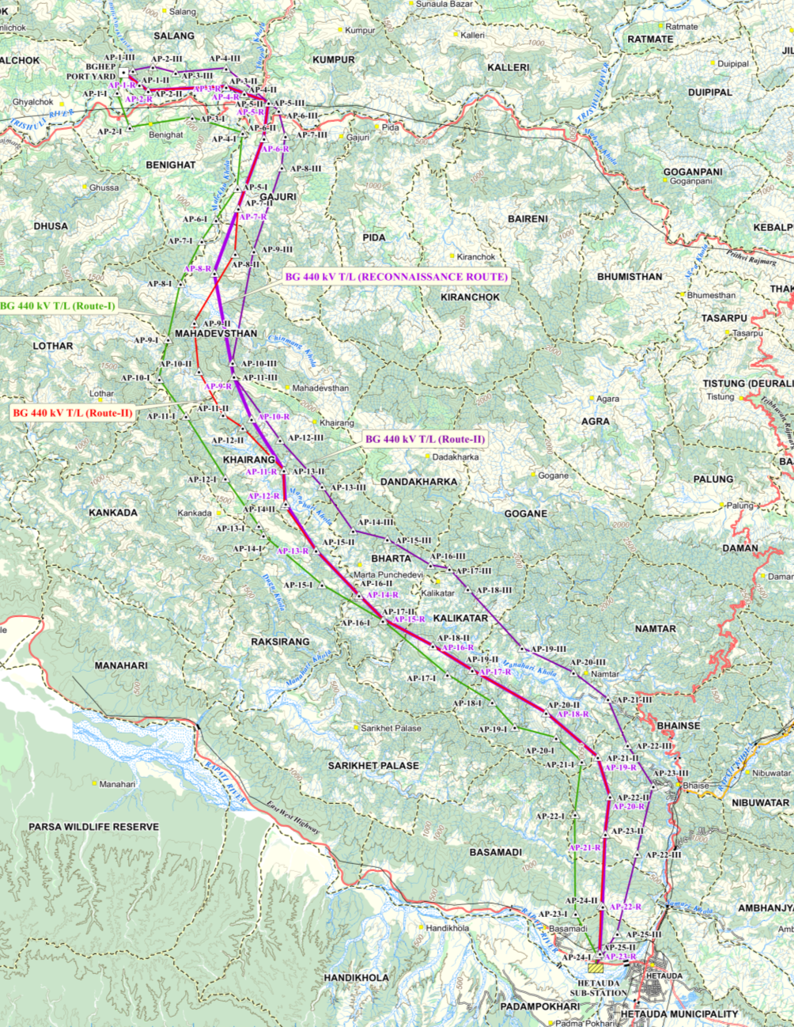
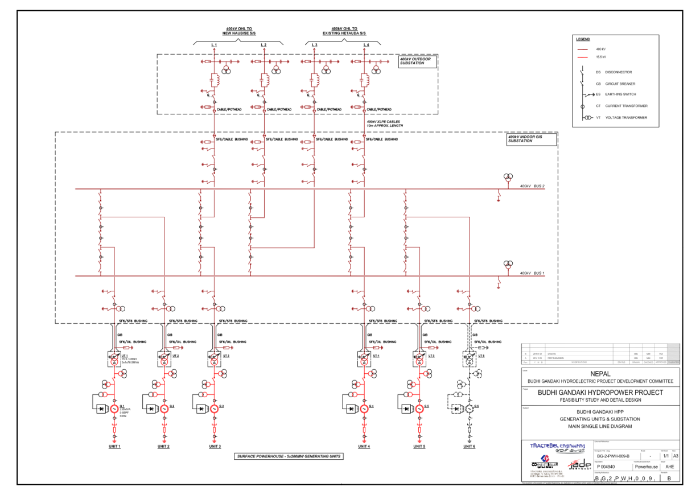
Power evacuation
TL 400kV BG HPP Hetauda substation - General layout plan
L=59km

Slide 48
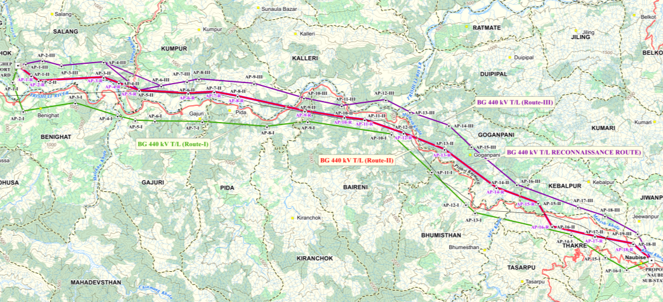
Power evacuation
TL 400 kV – BG HPP to Naubise substation - General layout plan
L= 40km

Slide 49
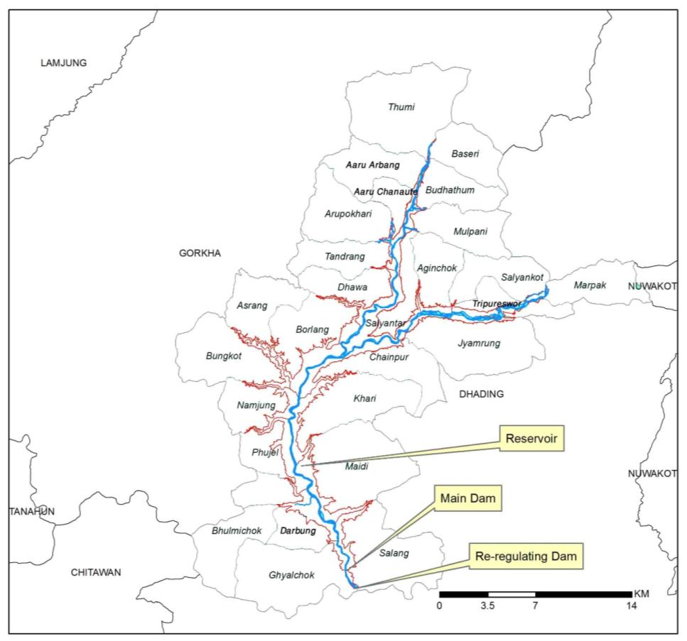
Environmental and Social Impact
District | VDCs
Gorkha (14) | Ghyalchok ( £ofnrf]s), Darbung (b/jfª ), Bhumlichok (e'NdLrf]s ), Phujel (km'h]n), Namjung (gfdh'ª ), Bungkot (j'ªsf]6), Asrang (cf;/fª ), Borlang (af]/nfª), Dhawa (wfjf ), Tandrang (tfgb|fª ), Aarupokhari (cf?kf]v/L ), Aaru Chanaute (cf?rgf}6]), Aaru Arbang (cf?cf{jfª ), and Thumi (y'dL)
Dhading (13) | Salang (;nfª), Maidi (d}bL ), Khari (v/L ), Chainpur (r}gk'/ ), Jyamrung (Hofd?ª), Marpak (df/kfs), Salyankot (;Nofgsf]6), Tripura orTripureswor (lqk'/f ), Aginchok (आगिञ्चोक), Salyantar (;Nofg6f/ ), Mulpani (d'nkfgL ), Budhathum (a'9fy'd ) and Baseri (j;]/L )

Slide 50
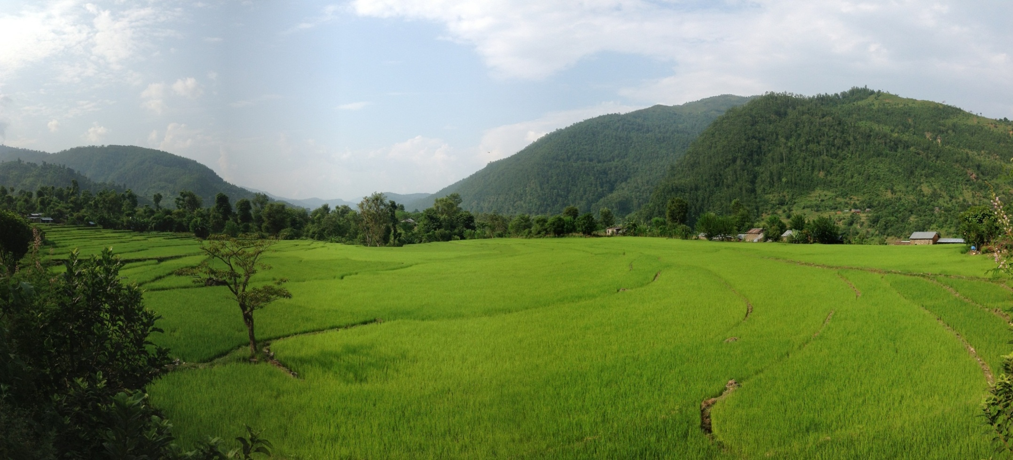
Environmental and Social Impact
Displacement Type | No of Households | Persons
Physical and economic displacement | 4750* | 20 568
Economic Displacement only | 5686** | 24 620
Total Physical and Economic Displacement | 10436 | 45 188
DARBUN VDC

Slide 51
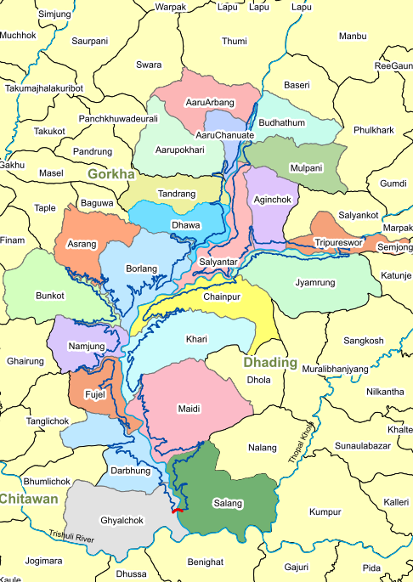
Environmental and Social Impact
Land use Type | Area (ha)
Bush | 664.76
Forest | 1843.58
Grass | 5.8
Barren Land | 11.2
Cultivation/ settlement | 3243
Dense Settlement | 0.75
Nursery | 1.27
Orchard | 15.19
Cliff | 4.33
Sand | 485.1
Water Body | 362.26
Total | 6637.24
Displaced Infrastructure | Nos/Length
Public Educational Institutions (Nos) | 23
Other service infrastructures (health posts, police post, post office, community halls etc) (Nos) | 64
Temples and Shrines (Nos) | 59
Motorable Road (km) | 131.95
Motorable Bridge (Nos/m) | 6 (453)
Suspension Bridges (Nos/m) | 30 (2288)
Cremation Sites (nos) | 44

Slide 52
Physical and Cultural Resources
Total Shrines affected by reservoir (Temples, Mosque, Church etc) is 76 comprising of 82 built structures
Of the total shrines affected 25 are older than 100 years
Total cremation sites affected is 44 with 23 built structures

Slide 53
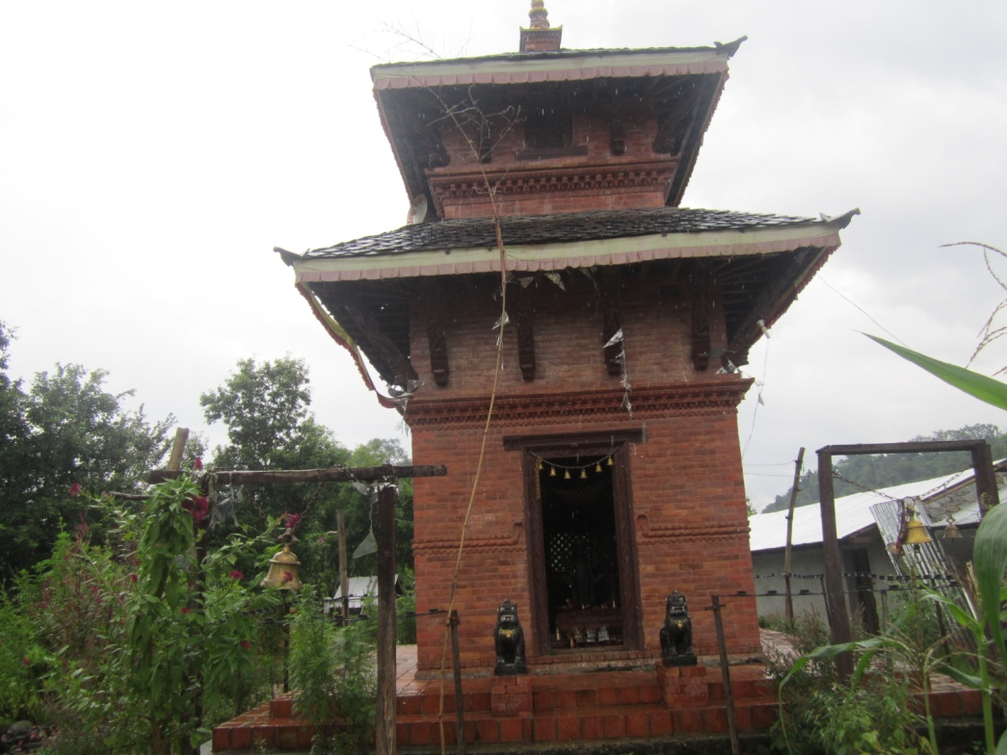
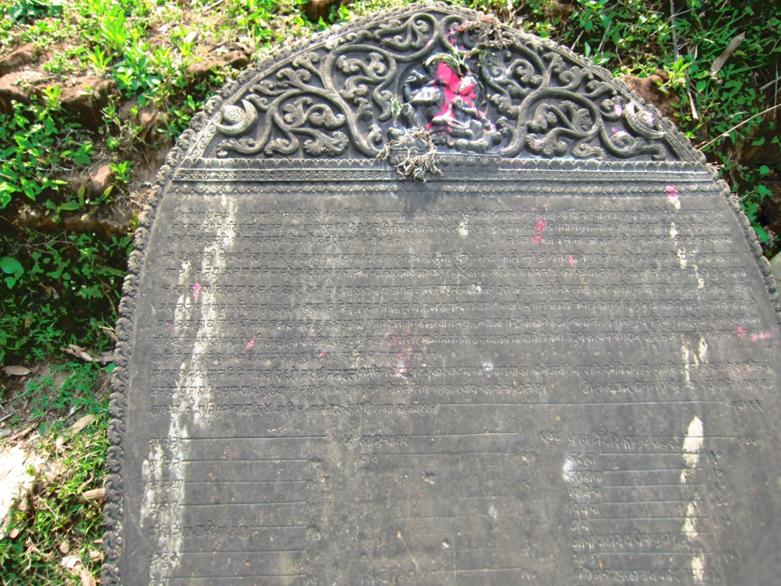
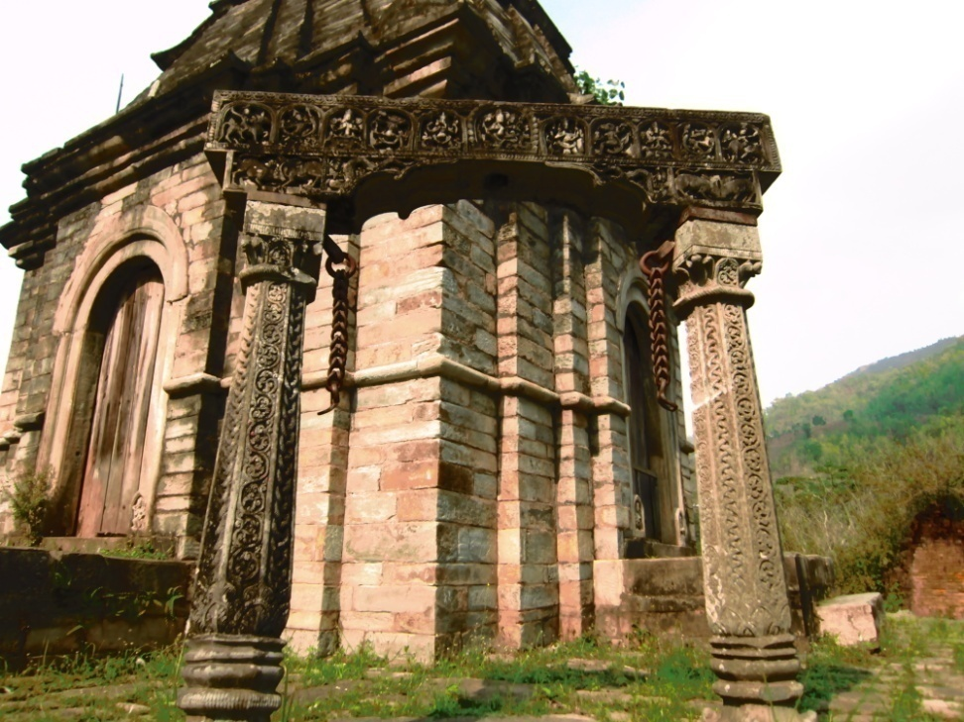
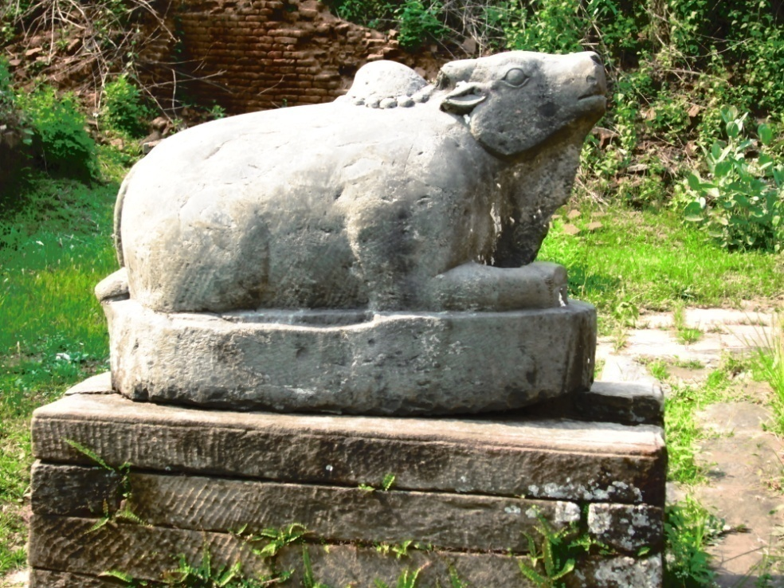

Slide 54
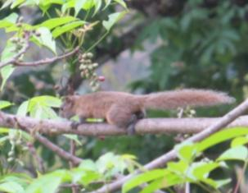


Wildlife (Mammals and Herpetofauna)
About 14 mammalian species have been accounted during the reconnaissance filed visits. Nine of them are of conservation significance.
About 6 herpetofauna species are reported of which three are of conservation significance

Slide 55
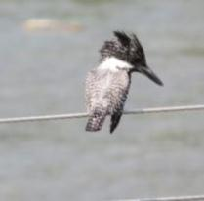
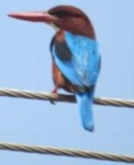
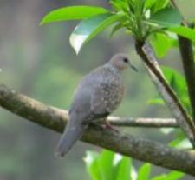
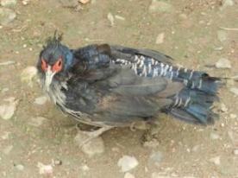
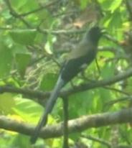
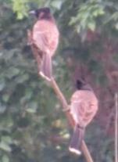

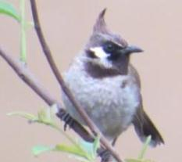


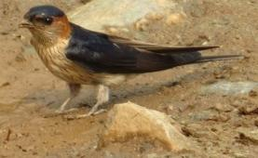








Wildlife (Avifauna )
A total of 46 bird species are reported by the local communities of the area. Only one species is of conservation significance

Slide 56






Fish
Total of 46 fish species are reported. Of the total 5 species are of conservation significance

Slide 57

Construction Schedule
Construction Planning:
  6 years and 6 months
  Volume of concrete of the Dam: 5.72 millions m3
  Date of commissioning : During 2022

Slide 58

Investment Cost
Project capital cost:
  Global consideration: TEF Data Base
  Local consideration: Current projects in Nepal

Slide 59
Economic and Financial Analysis
Index
Tanahun Hydro
Budhigandaki
Kaligandaki

Slide 60
Goal and Opportunites
Goal:
  To complete the project of 1200 MW capacity and contribute the socio-economic transformation of the country
Opportunities:
  To generate 3400 GWh energy per year
  To facilitate to development this project as a multipurpose water resources project
  To facilitate to link this project as a driver of development of other sectors: Tourism, Infrastructure Development Modern Settlement Development, Employment Generation
  To utilize this project to produce experts in this sector
  To link this project with Academic Researches

Slide 61
Challenges
Technical: Low
Financial: Medium
Socio-political: High
Contradiction between Need and Process
  Need: Fast Completion: Demands Parallel Works
  Process: Legal provision- Sequential Works

Slide 62

Perception on Preparation Level

Slide 63
Thank You !

